Slide 1
Untitled

Slide 2
R Markdown
This is an R Markdown presentation. Markdown is a simple formatting syntax for authoring HTML, PDF, and MS Word documents. For more details on using R Markdown see http://rmarkdown.rstudio.com.
When you click the Knit button a document will be generated that includes both content as well as the output of any embedded R code chunks within the document.

Slide 3
Slide with Bullets
Bullet 1
Bullet 2
Bullet 3

Slide 4
Slide with R Output
print(dir())
## [1] "all_data.RDS" ## [2] "e_comm_pres.pptx" ## [3] "e_comm_pres.Rmd" ## [4] "e_comm.R" ## [5] "Youth tracker 2026 full data set - Copy (1).xlsx"

Slide 5
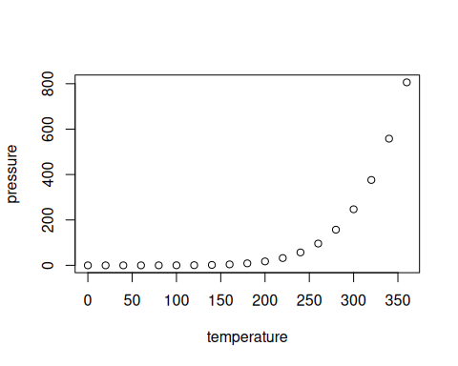
Slide with Plot

