Slide 1
Predicting MLB player batting average (BA): A comparison between Bayesian and frequentist approaches
EN.553.732 Bayesian Statistics
Dec 2nd, 2017
Kenneth Feder, Joseph High, Joseph Yu

Slide 2

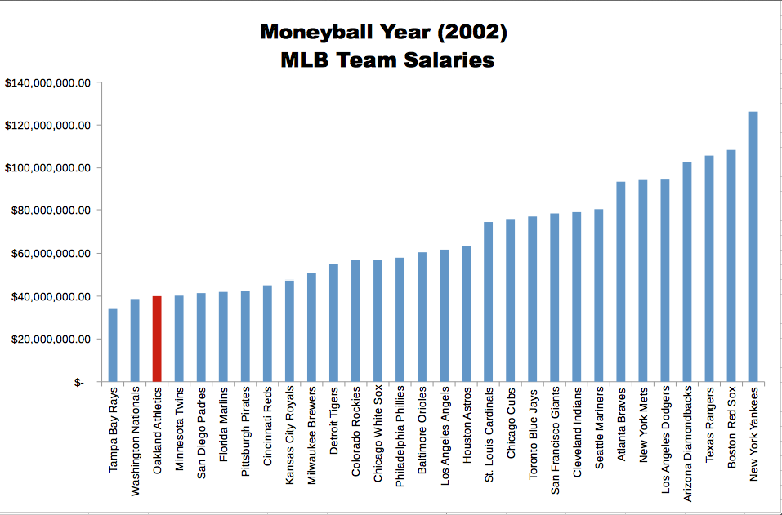
Oakland A’s successfully leveraged sabermetrics to field a competitive MLB team
Background
Methods
Results
Conclusion

Slide 3
Oakland A’s successfully leveraged sabermetrics to field a competitive MLB team
Background
Methods
Results
Conclusion
Can we build a statistical model to predict batting average (BA), a measure of player productivity?

Slide 4
MLB player statistics and inclusion criteria
Background
Methods
Results
Conclusion
Data acquired from Lahman Baseball archive
http://www.seanlahman.com/baseball-archive/statistics/
MLB player data inclusion criteria:
Played after 1901
Had at least 100 at bats per season
Played in either the National League or American League

Slide 5
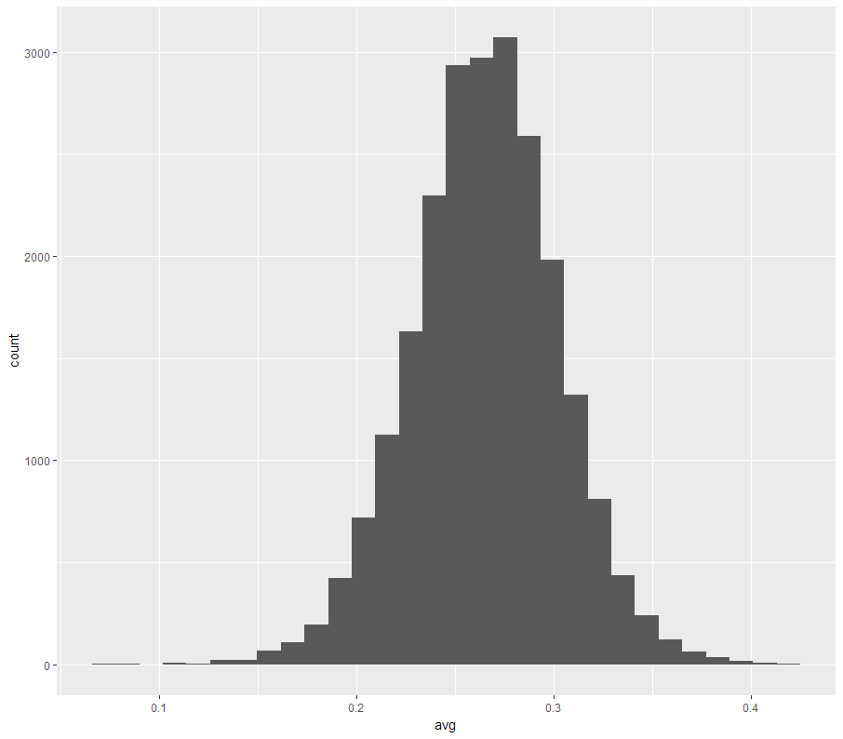
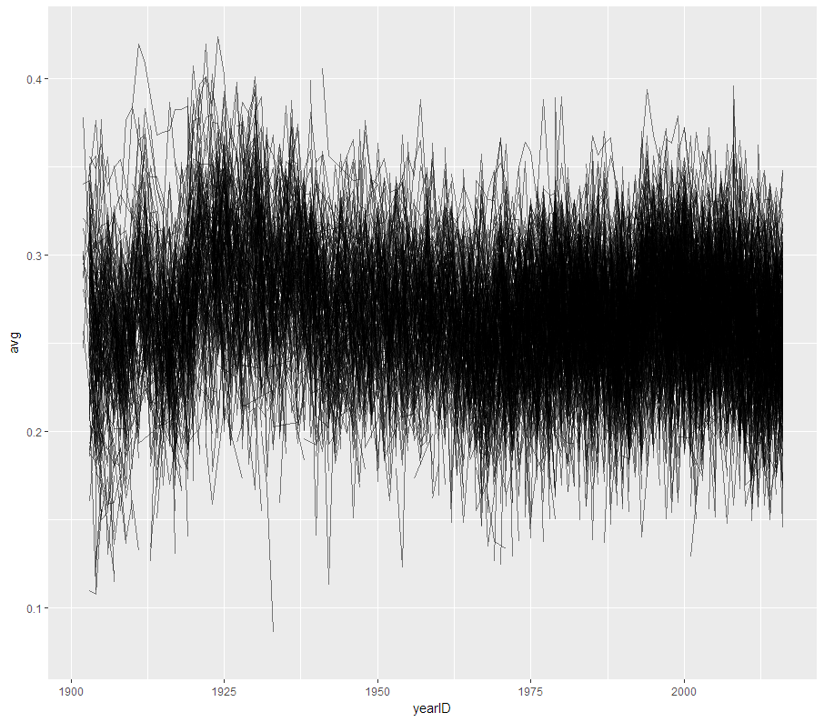
Batting average data visualized
Background
Methods
Results
Conclusion

Slide 6
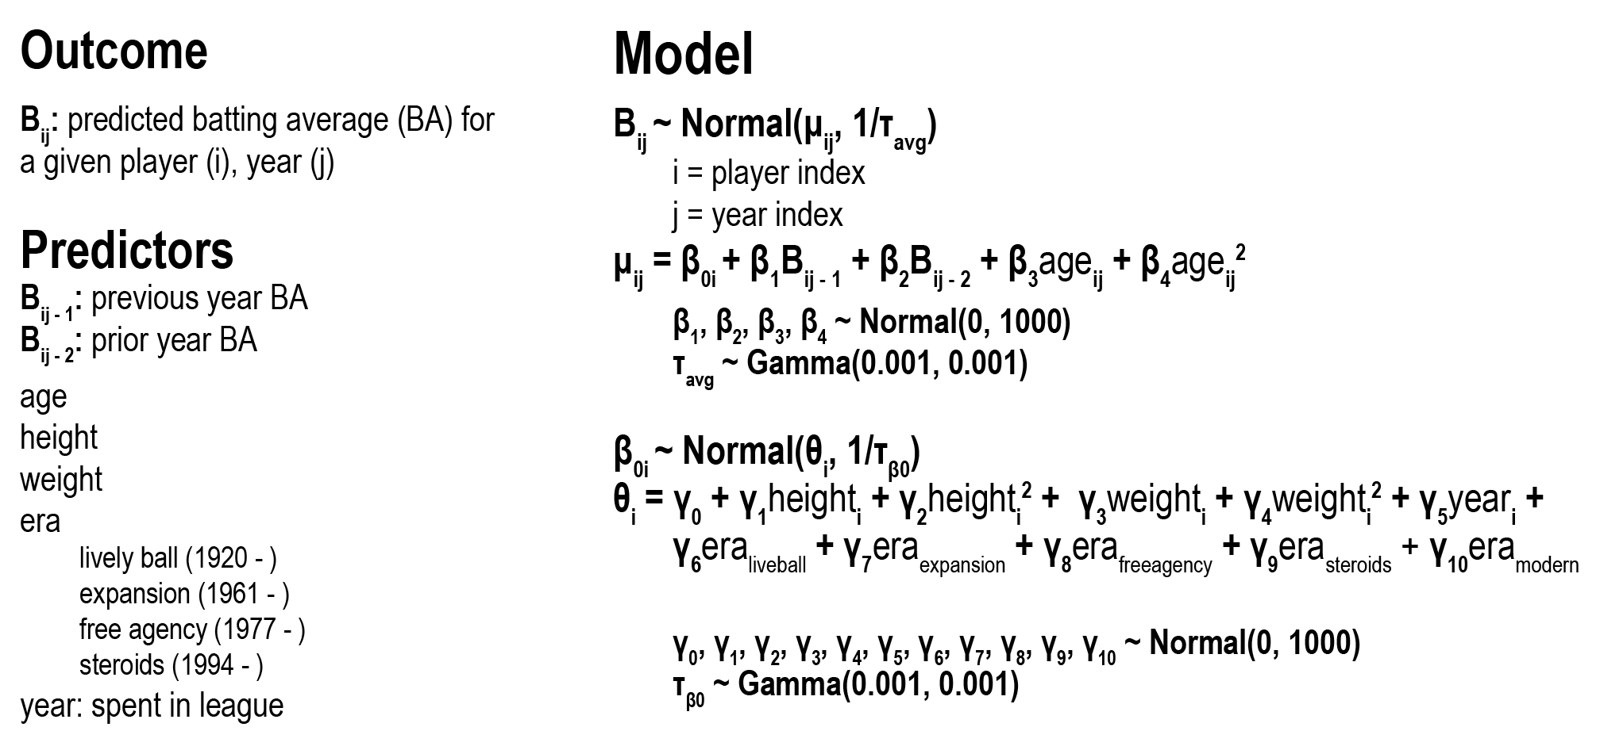
Multi-level Bayesian model was implemented
Background
Methods
Results
Conclusion

Slide 7
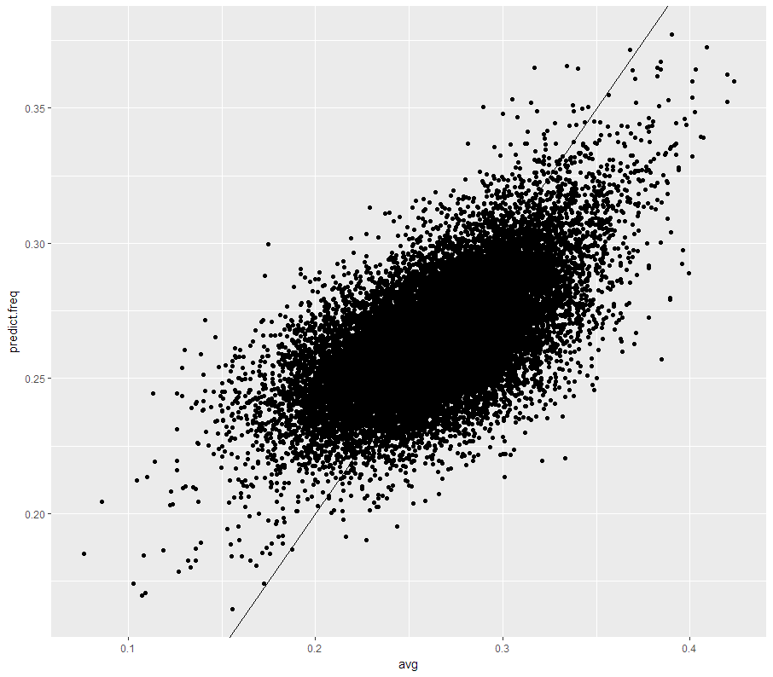
Predictive accuracy of fitted frequentist model
Background
Methods
Results
Conclusion

Slide 8
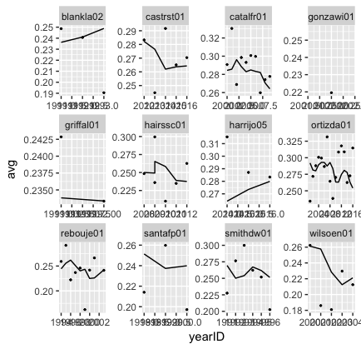
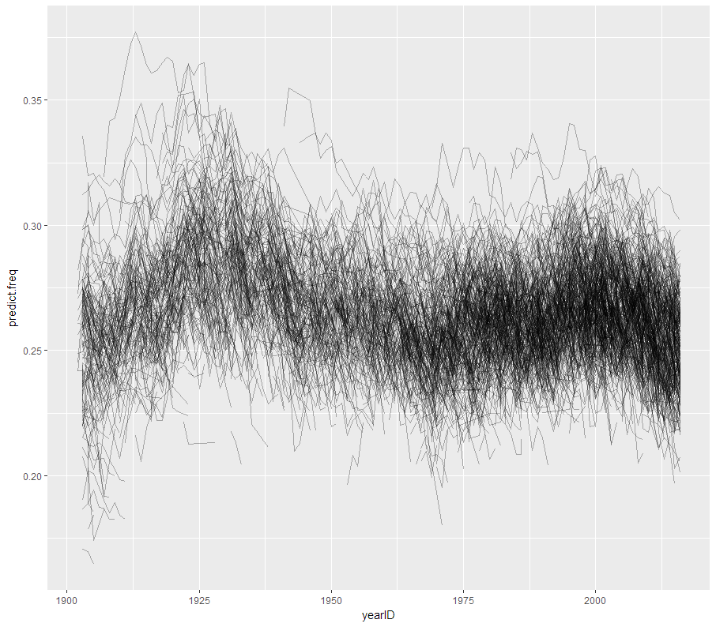
Fitted frequentist model predicted trajectories
Background
Methods
Results
Conclusion

Slide 9
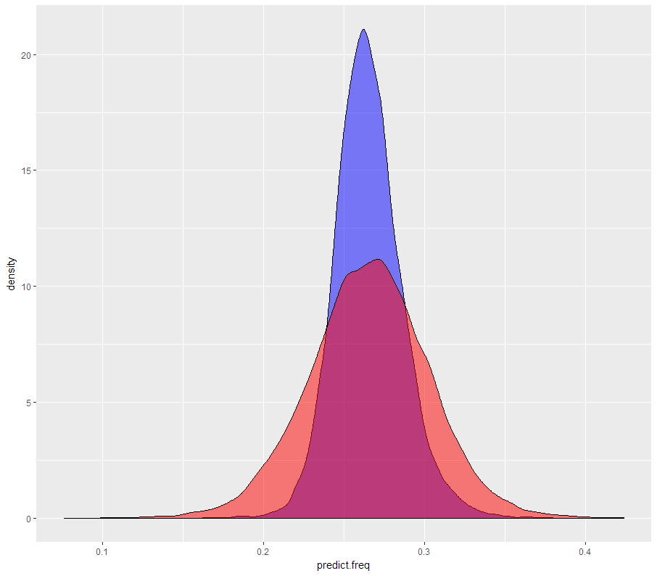
Frequentist – Accurate Mean, no Model for Variability
Background
Methods
Results
Conclusion
Notes:
Here we have the probability density plotted for the predicted batting average values derived from the frequentist model in blue, and the actual batting average data in red.
And while the frequentist approach does a good job capturing the mean batting average, it fails to capture the variability, especially at the tail ends of the distribution.

Slide 10
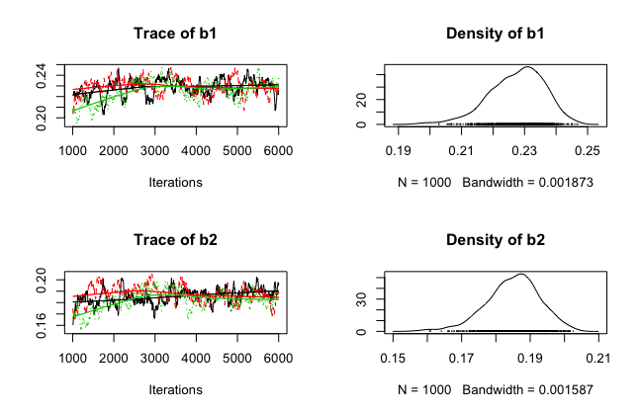
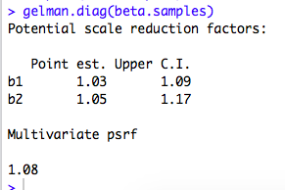
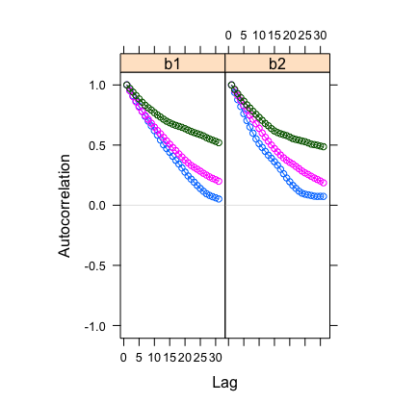
Bayesian model parameters demonstrate convergence (MCMC sampling implemented R package JAGS)
Background
Methods
Results
Conclusion
Notes:
Going to the Bayesian implementation, we used the JAGS R package to conduct our MCMC sampling for our model parameters.
Shown here are Gelman convergence diagnostics, autocorrelation, and trace plots of beta_1 and beta_2, two of our model parameters (1000 burn-in period, 5000 sampled, & thinned chain sampling [every 5])

Slide 11
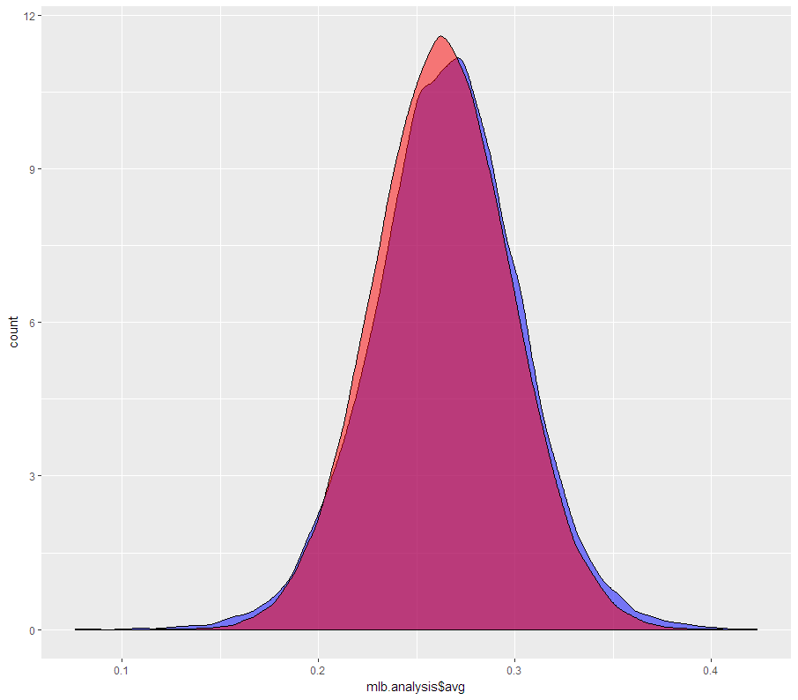
Bayesian posterior predictive reflects full variability in data
Background
Methods
Results
Conclusion

Slide 12
Developed a multi-level Bayesian model in predicting MLB player BA for a given season
Background
Methods
Results
Conclusion
Predictors included: BA in previous and prior years, age, height, weight, era, and years in league
Frequentist and Bayesian models are similar
Frequentist model provides less uncertainty in prediction
Bayesian posterior predictive distribution fits true BA well

Slide 13
Questions?

