Slide 1

Estimating the Temporal Radius of Influence using Scalar-on-Function Regression
Joe Janssen
Notes:
Today I will talk about estimating the temporal radius of influence using scalar-on-function regression

Slide 2
Outline
Problem Statement
Functional data analysis
Scalar-on-function regression
Objective functions
A simulation experiment
Discussion and conclusions
Notes:
First, I will talk about the problem we are trying to solve. Then I will introduce functional data analysis and in particular scalar-on-function regression. I will then discuss the objective functions we aim to compare and go through the results of a simulation experiment and end the talk with my conclusions.

Slide 3
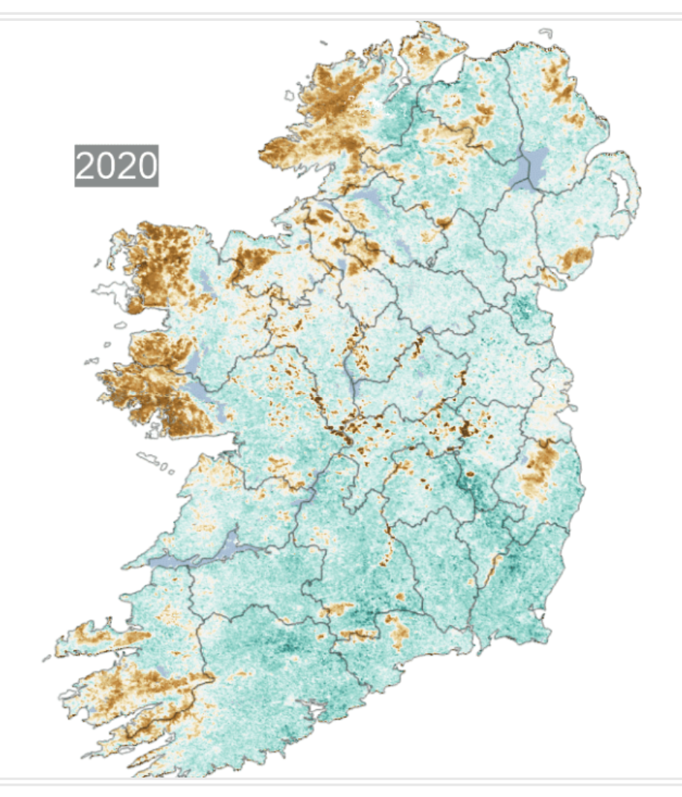
Normalized Difference Moisture Index (NDMI)
Background
NDMI is a measure of tree health/moisture
Is associated with destructive droughts and wildfire risk
Has historically been associated with climate only
Questions
Is NDMI also associated with local hydrologic characteristics
How far back in time does hydrology impact NDMI (temporal radius of influence)
How far out in space does hydrology impact NDMI (spatial radius of influence)
Notes:
NDMI is a measure of tree health/moisture. In previous literature, NDMI has been associated with destructive droughts and wildfire risk. Historically, NDMI has been modeled as a function of only climate, but we hypothesize that it is also a function of local hydrology. In our research project that will span the next 2-3 years, we have several questions that we would like to ask. First, we would like to test our hypothesis and find if local hydrologic characteristics influence NDMI. If they are related we would like to see how far back in time the relationship continues to exist and how far out in space does hydrology impact NDMI. In this project, I will focus on the first two questions and the spatial influence will be delt with later on in the project.

Slide 4
Functional Data Analysis (FDA)- Background and Motivations
Background
Roots in Fourier decomposition (1800s)
Expanded in stochastic processes (Karhunen–Loève theorem, 1940s)
Formalized by Ramsay and Silverman (1990s)
Motivations
Missing or irregularly spaced data
Discrete data may act continuously in real life
Relationships between variables may also be continuous in real life
Notes:
One way to answer these questions is through functional data analysis. The roots of functional data analysis dates back to the 1800s with Fourier decomposition. Exploration in this area continued within stochastic processes in the form of Karhunen-Loeve theorem from the 1940s which is similar to fourier decomposition, but the coefficients are random variables instead of fixed values. The field of functional data analysis was then named and formalized by Ramsay and Silverman in the 1990s. The main motivations for using FDA include having missing or irregularly spaced data, and the fact that the discrete input data or the relationships within your dataset may infact be continuous.

Slide 5
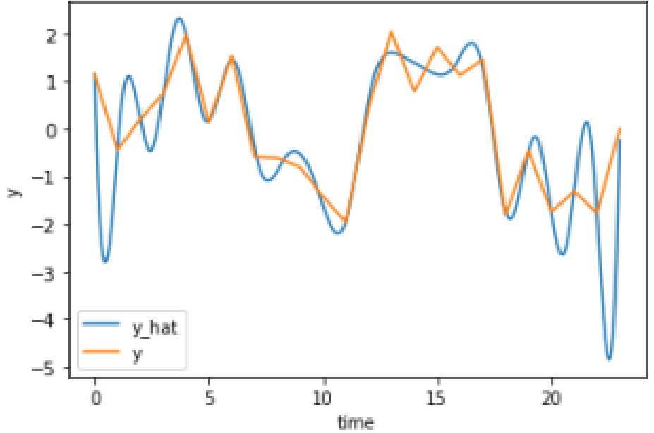

Scalar-on-Function Regression
Explanatory variables can be modeled as functions
$X_{i}^{k}\left(s\right)=\sum_{i=1}^{L}{h_{i,j,k}α_{j}(s)}$ for variable $k$ and observation $i$
$α_{j}\left(s\right)$ is a basis function
Coefficients connecting explanatory and response is a function
$β^{k}\left(s\right)=\sum_{i=1}^{M}{b_{j}^{k}B_{j}(s)}$
$B_{j}(s)$ is a basis function
$Y_{i}^{t}=\sum_{k=1}^{E}{\int_{0}^{t}{β^{k}\left(s\right)X_{i}^{k}\left(s\right) ds}}+ε_{i}^{t}$
Notes:
For the previously mentioned questions, scalar-on-function regression is well suited. As the first step, the explanatory variables are modeled as continuous functions. For each explanatory variable, L weighted basis functions are fitted to the data. An example of the fit is shown on the right side here, where the blue line shows the fitted function and the orange shows the observed data. Note that the plot seems to be showing some severe overfitting, we will talk about that later. The coefficients are also able to change with time and thus are also modeled as continuous functions with M basis functions. The response variable Y is a scalar and is modeled as the sum of E explanatory variables which are integrated from time 0 to t, with the weights modeled as the continuous function beta.

Slide 6
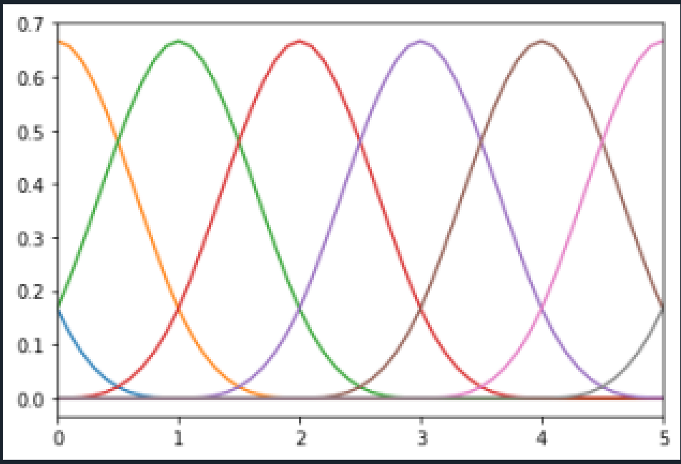

Fitting Functional Data- Basis Functions
Monomial
1, t, t²,… t^{n}…
B-spline
$N_{i,p}\left(u\right)=\frac{u−u_{i}}{u_{i+p}−u_{i}}N_{i,p−1}\left(u\right)+\frac{u_{i+p+1}−u}{u_{i+p+1}−u_{i+1}}N_{i+1,p−1}(u)$
$N_{i,0}\left(u\right)=\left\{\begin{aligned}1, u_{i}≤u<u_{i+1} \\ 0, else\end{aligned}\right.$
Fourier
$1,\sin\left(ωt\right),\cos\left(ωt\right),\sin\left(2ωt\right),\cos\left(2ωt\right)…sin\left(nωt\right),\cos\left(nωt\right)…$
Notes:
As I stated earlier, the first step is to fit functions to our discrete explanatory data. To do this, we must first consider which basis function to use throughout the analysis. The simplest one is the monomial basis which is 1, t, t-squared, etc. The next simplest basis function is Fourier which is composed of sine and cosine pairs at varying frequencies. The advantages of using Fourier basis functions is that it automatically induces periodicity. B-splines are another popular choice for basis functions. They are defined by the recursive function here. The advantage of using B-splines is they are non-zero on a compact domain which is useful for out purposes since we can force some parts of the function to 0 if needed. Thus, we will be using B-splines for the remainder of this project.

Slide 7

Fitting Functional Data- Basics
Fit data well, but avoid overfitting
Choose number of basis functions with cross validation
Such that we have low MSE and low “wigglyness”
Choose high # of basis functions, then choose smoothing parameter λ with cross validation
${PEN}_{2}\left(x\right)=\int{[D^{2}x\left(s\right)]^{2} ds}$
$\min_{x}{{\left(y−x\left(t\right)\right)}^{T}\left(y−x\left(t\right)\right)+λPEN_{2}(x)}$
Notes:
Given a set of discrete data that you want to turn continuous. As you may have noticed in one the previous slides, overfitting can be a huge issue and can be seen by the amount of quote un-quote wigglyness in the fitted function. One should choose the basis functions and coefficients such that the function fits the data well but does not overfit. There are a few ways to do this. One can either choose the number of basis functions or set a high number of basis functions and choose a smoothing parameter which reduces the squared second derivative over the entire function.

Slide 8
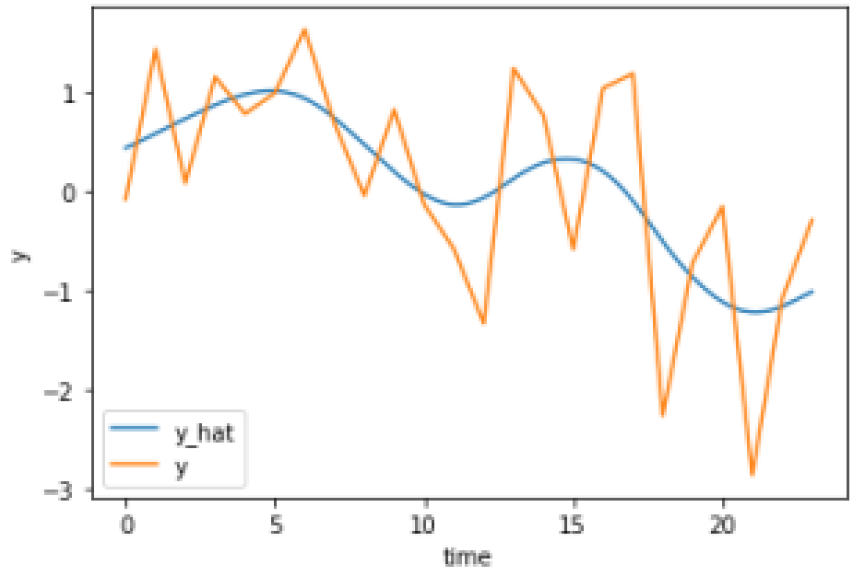
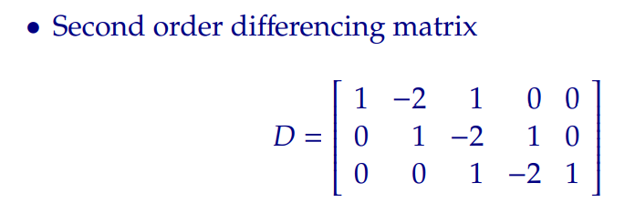

Fitting Functional Data- P Splines
Instead of evaluating integral of double derivative
Constrain second order derivative of coefficient sequence
$\min_{x}{{\left(y−φc\right)}^{T}\left(y−φc\right)+λc^{T}D_{2}^{T}D_{2}}c$
Set gradient to 0: $−2φ^{T}y+2φ^{T}φc+2λc^{T}D_{2}^{T}D_{2}c=0$
Solve for coefficients: $c=(φ^{T}φ+λD_{2}^{T}D_{2})^{−1}φ^{T}y$
Notes:
Instead of evaluating the integral of the double derivative, we can constrain the squared 2-norm of the second derivative of the coefficient sequence. We can then solve for the coefficients by minimizing the sum of squares plus some factor of the second derivative penalty. It remains to be seen how to choose the penalty parameter lambda.

Slide 9
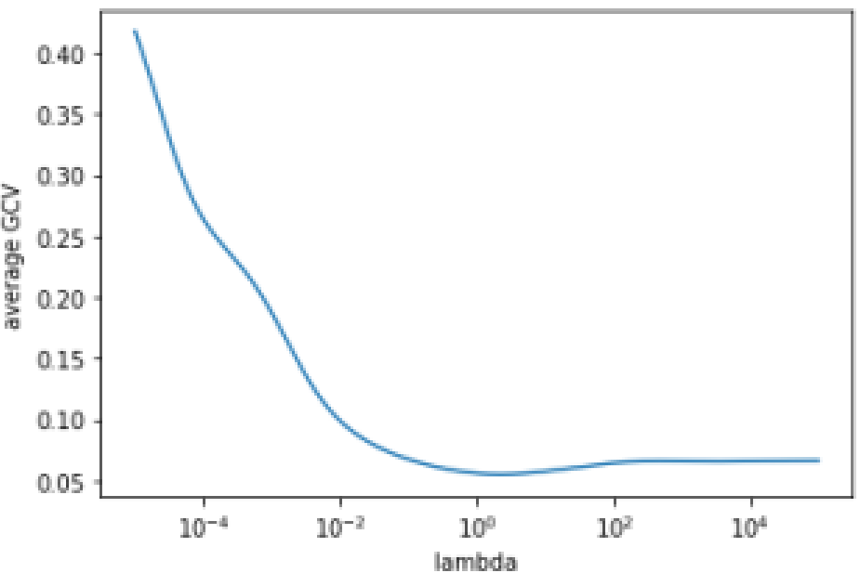

Fitting Functional Data- Optimization
Generalized Cross Validation (GCV)
GCV = SSE/(n-tr(H))^2
Sum of squared errors (SSE)
Tr is trace, sum of diagonal
H is hat matrix, $\hat{y}=Hy$
Average over all observations
Notes:
To choose the lambda parameter, we use generalized cross validation which is the sum of square errors divided by n minus the trace of the H matrix squared. We average the GCV across all observations. As shown in the plot on the right, the optimal lambda, which minimizes the average GCV, is around 1.

Slide 10

Finding Temporal Radius of Influence
Goals for estimated coefficient function
Make irrelevant parts 0
Should be continuous (Guan et al, 2020)
Good fit and smooth, minimize: $\frac{1}{2}|\left|y−\hat{y}\right||_{2}^{2}+ λ\sum_{j=1}^{p}{||D_{2}b_{j}||_{2}^{2}}$
Don’t want to solve lasso, should be fast, differentiable, convex
Notes:
Now that we have explained how to modify our explanatory variables into functional data, we can now focus on modeling our response along with the coefficient functions. Firstly, we would like to make the irrelevant parts of the coefficient function 0. This will reduce model variance and help us determine the temporal radius of influence. Further, we would like our coefficient function to be continuous and smooth and obviously fit the data well. Finally, since we may be modeling each area separately and each year separately we would like our modelling technique to be computationally efficient.

Slide 11

Finding Temporal Radius of Influence- Current State of the Art
Nested Group Bridge
Developed in 2020 by Guan, Lin, and Cao
Minimize: $\frac{1}{2}|\left|y−\hat{y}\right||_{2}^{2}+ λ||D_{2}b||_{2}^{2}+τ\sum_{j=1}^{M}{c_{j}||b_{A_{j}}||_{1}^{γ}}$
Initialize at optimal smooth solution and iterate with lasso problems at each step until convergence
Not convex, converges to local minimum
Only for a single explanatory variable
Notes:
The current state-of-the-art method for estimating functional linear models along with the temporal radius of influence is the nested group bridge approach developed in 2020 by Guan, Lin, and Cao. Here they try to minimize the sum of squared errors, the smoothness penalty term, and the nested group bridge penalty term. The coefficients, b, are grouped together and a power, gamma, of the L1 norm of these groups are added together such that the coefficients further in the past are punished more than coefficients that multiply the basis functions closer to the present. To solve this minimization problem, they initialize the coefficients at the optimal smooth solution then solve for the coefficients by iteratively solving a lasso problem until convergence. Unfortunately, the problem is not convex and only converges to a local minimum and it has only be tested and formulated on a single explanatory variable.

Slide 12
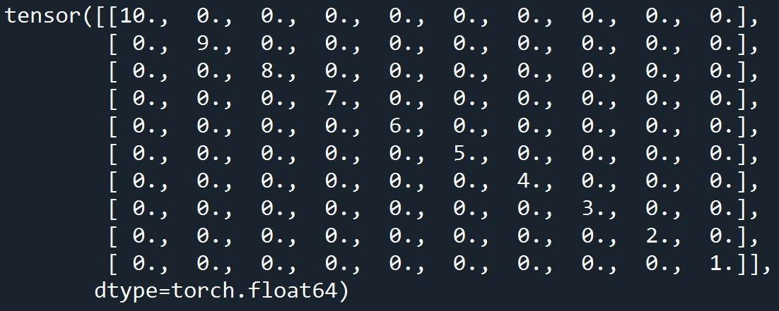

Finding Temporal Radius of Influence- Options
Ridge penalty with soft thresholding- solve exactly
Minimize: $\frac{1}{2}|\left|y−\hat{y}\right||_{2}^{2}+λ\sum_{j}{||D_{2}b_{j}||_{2}^{2}}+τ\sum_{j=1}^{p}{||Zb_{j}||_{2}^{2}}$
If ${|b}_{i,j}|<γ$, set $b_{i,j}=0$
Sequential thresholding- gradient decent
Minimize: $\frac{1}{2}|\left|y−\hat{y}\right||_{2}^{2}+ λ\sum_{j=1}^{p}{||D_{2}b_{j}||_{2}^{2}}$
If ${|b}_{i}|<{τZ}_{i,i}$, set $b_{i,j}=0$ at the end of each iteration
Normal functional linear regression- gradient decent
Minimize: $\frac{1}{2}|\left|y−\hat{y}\right||_{2}^{2}+λ\sum_{j}{||D_{2}b_{j}||_{2}^{2}}$, exact solution unstable
Notes:
We are left with several options for finding the temporal radius of influence that could out compete the current state of the art. The first one uses a ridge penalty with soft thresholding. In this method, the exact solution for the past and derivative penalized least squares problem is found, then if the coefficients are less than some threshold, gamma, the coefficients are set to 0. The matrix Z, used to penalize the coefficients further back in time is shown on the right. The second method, sequential thresholding minimizes the derivative penalized least squares problem with gradient decent. After each step, coefficients less than some threshold are set to 0. This is similar to the truncated gradient method discussed in Langford et al. The final method is the normal functional linear regression method which just solves the derivative penalized least squares problem. This is solved via gradient decent and not with the exact solution because the derivative matrix is singular and results become unstable.

Slide 13

Experiments
Use Scenario I and II from Hall and Hooker and Guan et al.
Generate 2*1000 timeseries of length 24 (2 explanatory vars)
Generalize scenarios such that radius can be between 2 and 24
Test
Ridge penalty with soft thresholding
Sequential thresholding
Normal functional linear regression
Notes:
Next, we will conduct a few simulation experiments to verify that the proposed methods can indeed do what we hypothesize. To do this, for each simulation experiment, we generate 1000 timeseries of length 24 which is a simple sine wave plus some noise for two explanatory variables. The simulations done for truncated linear models, such as the ones we are currently exploring have been consistent across previous papers starting with Hall and Hooker and Guan et al. who used and indicator function for scenario 1 and a sine wave times an indicator function for Scenario 2. They always set their indicator function to be 1 between 0 and .5 but in our case we generalize this to be a random number between 2 and 24. We test each of our proposed methods including ridge penalty with soft thresholding, sequential thresholding, and normal functional linear regression.

Slide 14
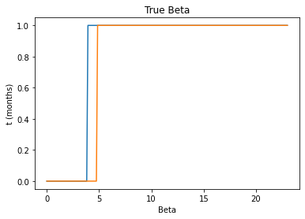
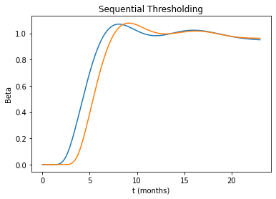
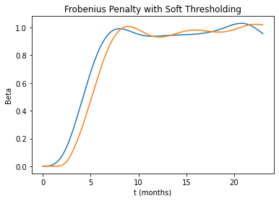
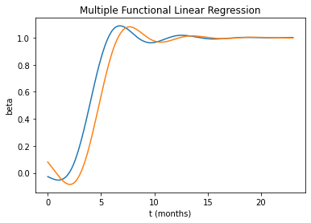
Experiment 1
Notes:
Each panel shows 2 lines. The blue line shows the first explanatory variable function and the orange line shows the second explanatory variable function. From experiment 1, we can see that sequential thresholding and the soft thresholding approach both produce an accurate and smooth representation of the true beta. Both of them correctly displace a coefficient of 0 towards the beginning of the timeseries as expected. On the other hand, the multiple functional linear regression method mistakenly shows that the beta is non-zero from t=0 to t=4.

Slide 15
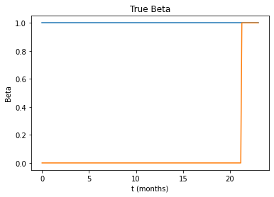
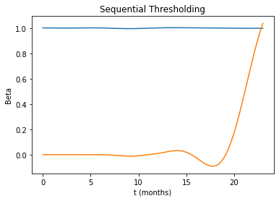
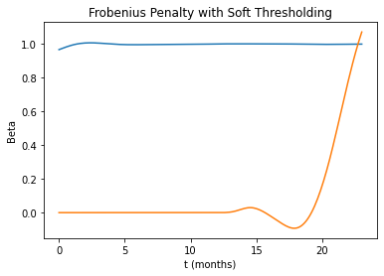
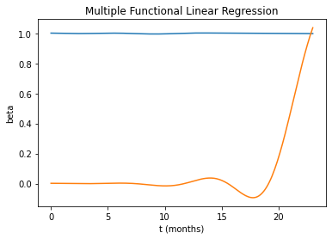
Experiment 2
Notes:
In experiment 2, all methods show a similar result and all are close to the true beta. Though it may seem that the multiple functional linear regression method produces 0 values for much of the second beta as it should, it in fact does not. Even though the beta values here should be exactly 0, they are in fact all non zero.

Slide 16
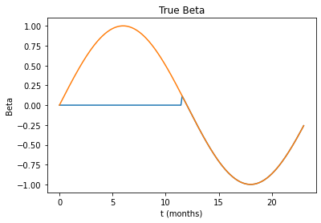
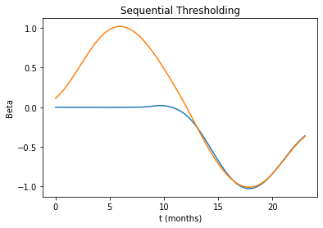
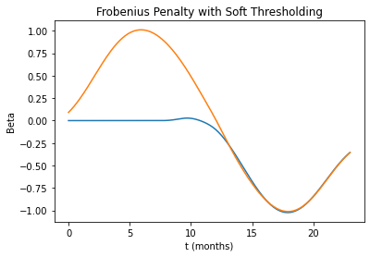
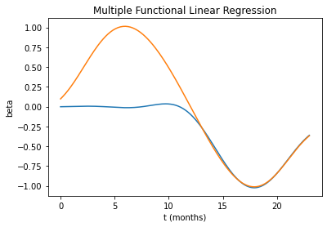
Experiment 3
Notes:
Likewise, in experiment 3, all methods show a similar result and all are close to the true beta. Again the multiple functional linear regression method produces betas that are non-zero when they should be exactly zero.

Slide 17
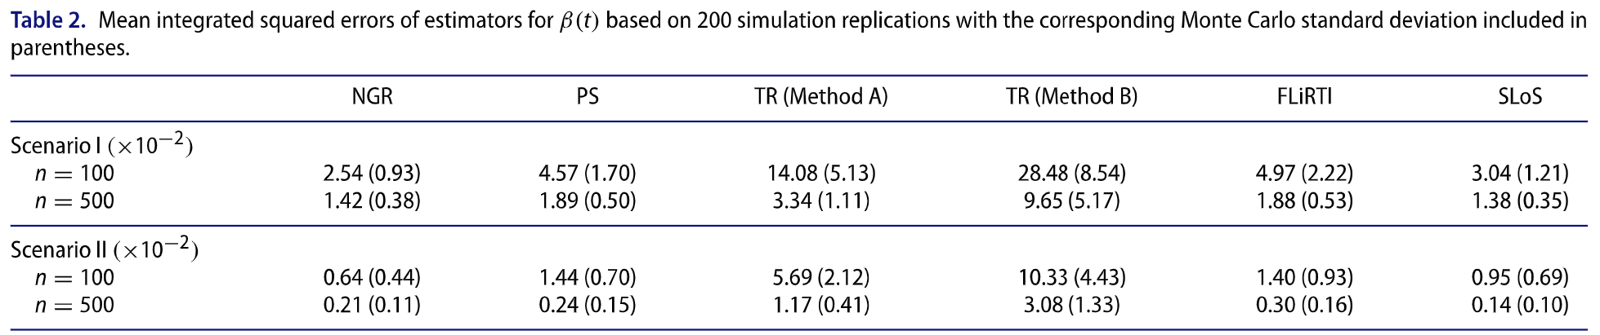
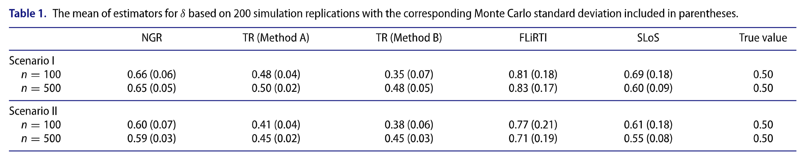
SOTA results
Notes:
The SOTA results shown in the paper by Guan et all are good, but nowhere near perfect. Their method NGR estimates a time radius of influence that is around 0.6 when there true value is 0.5, thus their estimates are off by 20%. Though their estimates of the radius of influence are considerably biased, their estimate of the true coefficient function are highly accurate as shown in the top table.

Slide 18
Discussions
Current SOTA: Nested Group Bridge Approach
Requires many iterations of lasso
Only works for single explanatory variable
Not convex, converges to local optimal solution
Provides good solutions, but is not perfectly accurate
Ridge Penalty with soft-thresholding
Can be solved analytically
Provides good solutions for multiple explanatory variables
Sequential thresholding
Converges quickly
Provides good solutions for multiple explanatory variables
Notes:
As we have seen, the current state-of-the-art method which is the nested group bridge approach requires many iterations of lasso, it only works for a single explanatory variable, it is not convex and thus converges to a local optimal solution. The ridge penalty method with soft-thresholding can be solved directly and provides good solutions for multiple explanatory variables. The sequential thresholding method converges quickly in a few thousand iterations. This method provides similarly good solutions for multiple explanatory variables.

Slide 19
Conclusions
Summary
Finding temporal radius of influence can be done without lasso iterations without loss of accuracy
Future work
Add the ability to have more basis functions than observations
Fast changes in the coefficient function is allowed
Apply methods on real NDMI and hydrology data
Notes:
In conclusion finding the temporal radius of influence can be done without lasso iterations without loss of accuracy. For future work, we will add the ability to have more basis functions than observations. This will enable less biased estimates of the radius of influence and allow for faster changes in the coefficient function. After that is done, we will apply the methods using real NDMI and hydrology data.

Slide 20
References
Eilers, P. H., Marx, B. D., & Durbán, M. (2015). Twenty years of P-splines. Sort, 39(2), 149-186.
Champion, K., Zheng, P., Aravkin, A. Y., Brunton, S. L., & Kutz, J. N. (2020). A unified sparse optimization framework to learn parsimonious physics-informed models from data. IEEE Access, 8, 169259-169271.
Guan, T., Lin, Z., & Cao, J. (2020). Estimating truncated functional linear models with a nested group bridge approach. Journal of Computational and Graphical Statistics, 29(3), 620-628.
Lin, Z., Cao, J., Wang, L., & Wang, H. (2017). Locally sparse estimator for functional linear regression models. Journal of Computational and Graphical Statistics, 26(2), 306-318.
Langford, J., Li, L., & Zhang, T. (2009). Sparse Online Learning via Truncated Gradient. Journal of Machine Learning Research, 10(3).
Hall, P., & Hooker, G. (2016). Truncated linear models for functional data. Journal of the Royal Statistical Society: Series B (Statistical Methodology), 78(3), 637-653.
Eilers, P., & Marx, B. (2015). A Crash Course on P-splines.
Hislop, S., Jones, S., Soto-Berelov, M., Skidmore, A., Haywood, A., & Nguyen, T. H. (2018). Using landsat spectral indices in time-series to assess wildfire disturbance and recovery. Remote sensing, 10(3), 460.
Van Le, H., Hoang, D. A., Tran, C. T., Nguyen, P. Q., Hoang, N. D., Amiri, M., ... & Bui, D. T. (2021). A new approach of deep neural computing for spatial prediction of wildfire danger at tropical climate areas. Ecological Informatics, 63, 101300.
Notes:
Thank you.

