Slide 1
Synthetic Speech Detection: A Courtroom Perspective
Joseph Janssen, Amit Ghimire, James Tang
Notes:
Today we will be presenting our project on synthetic speech detection with applications to a courtroom setting.

Slide 2
Outline
Introduction
Methods
Data
Results
Conclusion
Demo
Questions
Notes:
We will first introduce our problem and how it fits into previous research, then talk about the data we colected, our methods, results, and conclusions. We will then conclude our talk with a quick demo and hopefully have time for questions.

Slide 3
Outline
Introduction
Methods
Data
Results
Conclusion
Demo
Questions

Slide 4
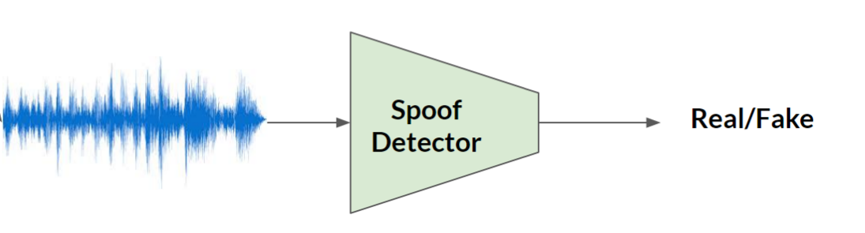
Motivation
Pakistani Tik-Toker caught up in extortion case
UFC fighter is accused of attempted murder
Georgia man confesses to murder
Notes:
A Pakistani Tik-Toker is caught up in an extortion case, a UFC fighter is accused of attempted murder, and a young Georgia man confesses to a murder. What do all these incidences have in common? Well, they all relied on recorded audio evidence. But, something significant separates the Georgia case from the others. The audio recording in the Georgia case was found to be fake and recorded instead by a malicious human impersonator. As advancements in machine learning and artificial intelligence continue, these dangerous but easily detectable human impersonators will be replaced by intelligent deepfake generators which can impersonate anyone after training on a few seconds of real audio. Thus, for those in a courtroom, we are left with a potentially life or death problem where we receive an audio clip and we must decide if the clip came from the proposed person or it is a fake.

Slide 5
Previous Research
Reimao, (2019) FoR
17,000+ observations, 6 synthetic speech generators
95%+ accuracy for known attacks (neural nets/ random forests)
85%+ accuracy for unknown attack (neural nets/ random forests)
Khalid et al., (2020) FakeAVCeleb
195,000+ observations, 1 synthetic speech generator
Audio-only: neural networks had 50-73% accuracy
Audio + Video: accuracy rises to 80%
Hua et al., (2021) ASVspoof2019
45,000+ observations, 17 speech generators
95%+ accuracy for known/unknown attacks (Res-TSSDNet)
Notes:
Many researchers have contributed to the field of synthetic audio detection. For example, Reimao in 2019 compared a bunch of different machine learning methods, but found that neural nets and random forests worked best. In 2020, Khalid et al showed that making predictions with only audio information is significantly more difficult compared to when audio and video is available for spoof detection. Most recently, Hua et al in 2021 produced a res-net model which was the best single model in the ASVspoof2019 challenge with 95%+ accuracy on a series of known and unknown attacks.

Slide 6
Gaps in Previous Research & Contributions
Differentiating between real and fake audio from a specific person
More realistic in courtroom setting
Differences in specific and general models
Only general models have been investigated previously
Notes:
We identified a few small gaps in previous research that we would like to address here. First, none of the papers have classified real and fake audio from a specific person. Receiving audio from a specific person is much more realistic in the courtroom setting, thus we would like to test to see if models focused on a spesific person can perform better compared to models more generalally trained to find spoofed audio.

Slide 7
Outline
Introduction
Methods
Data
Results
Conclusion
Demo
Questions
Notes:
Next we will summarize our methods.

Slide 8
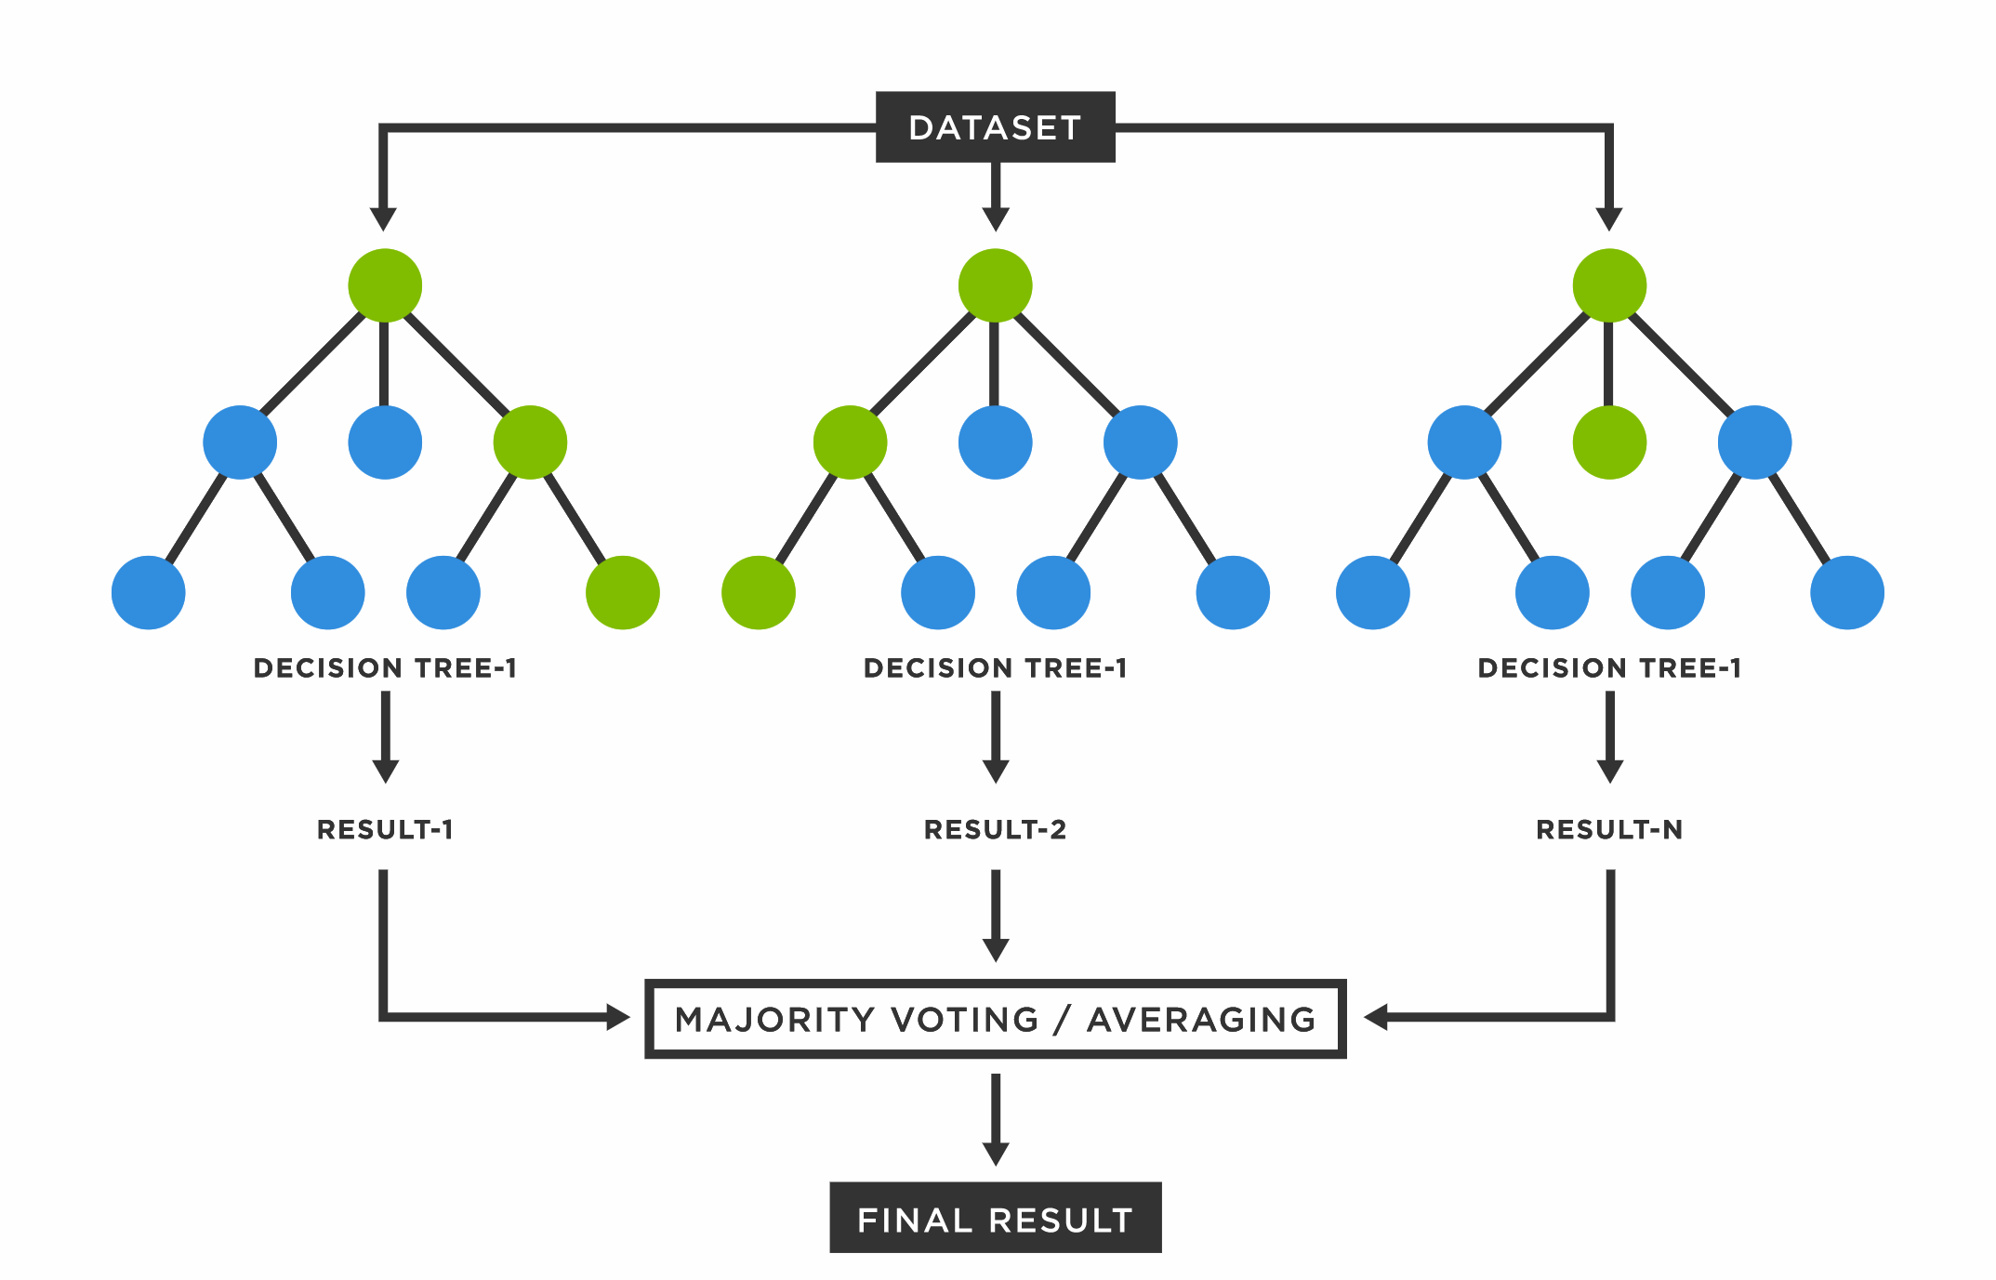
Methods- Random Forests
Default hyperparameters
Notes:
The first method we will use is random forests which is the tree ensemble method we discussed in class. For our experiements we use the default hyperparameters provided by the python package.

Slide 9
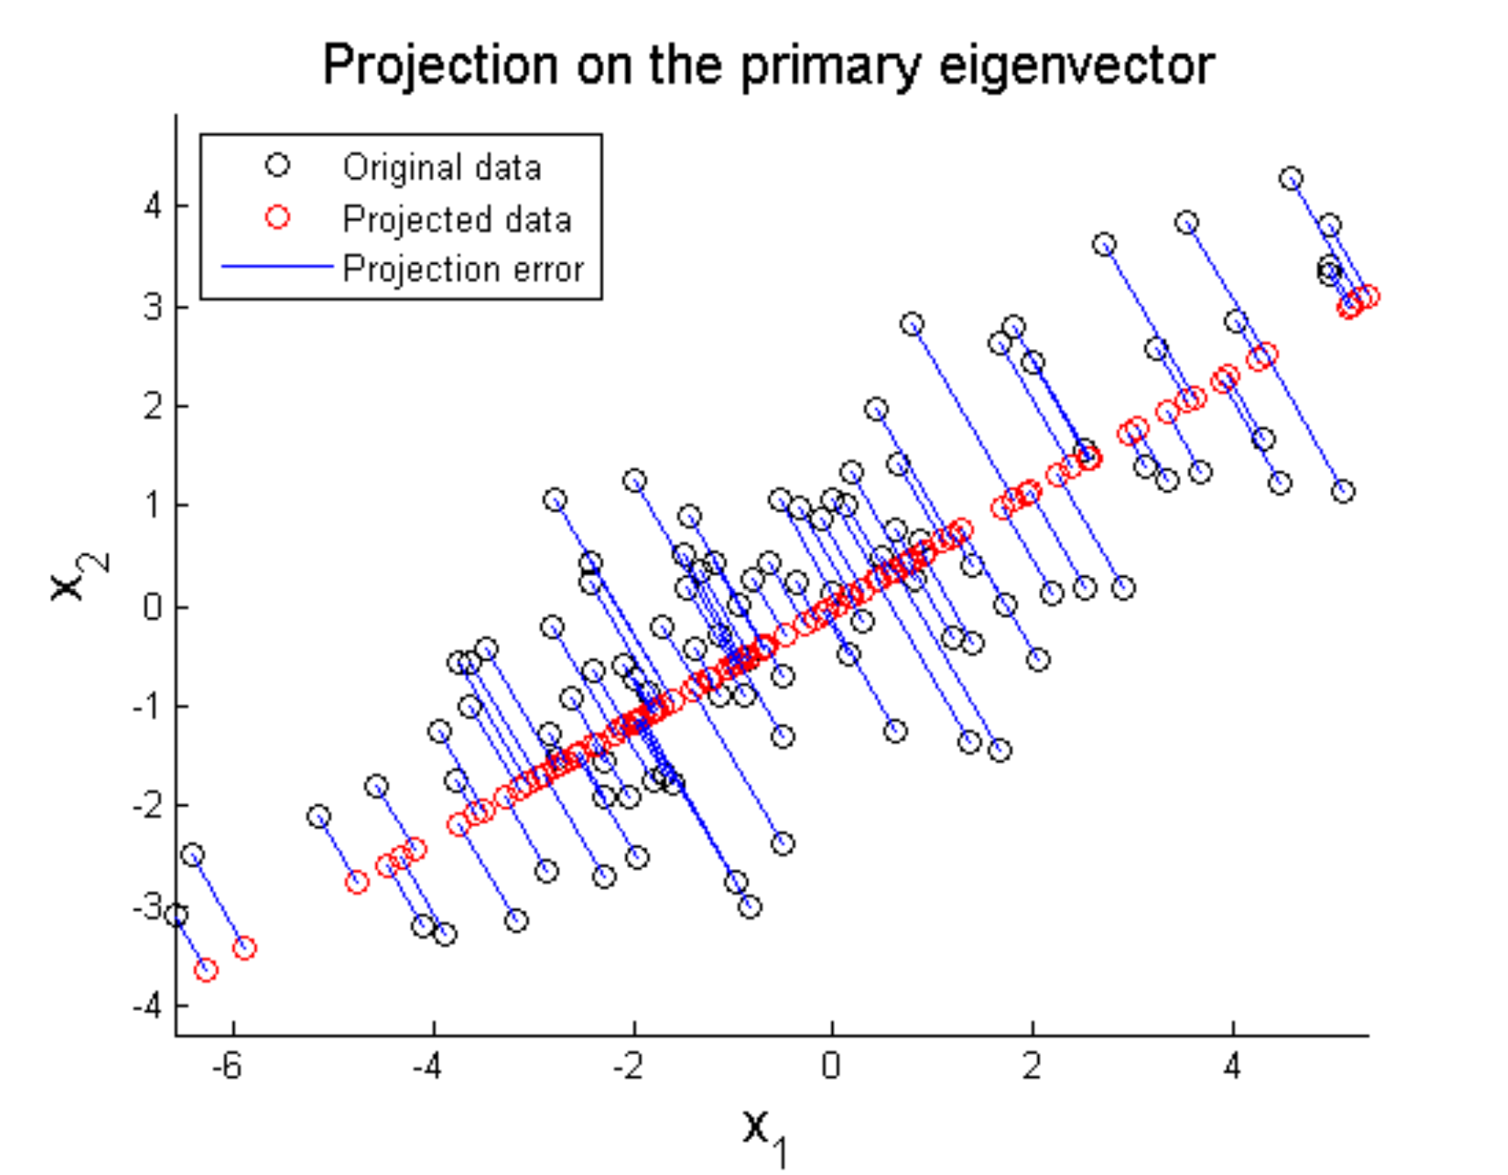
Methods- PCA
Notes:
In addition to random forests, we reduce the dimentionality of the feature space using PCA. We choose the number of principal componenets using the "elbow" method.

Slide 10
Methods- Features
Mel Frequency Cepstral Coefficients
Most commonly used feature set
Constant Q Transform
Good for generalization for unknown attacks
Group Delay Cepstral Coefficients
Good for phase information
Notes:
We combine three feature sets for our classifiers. The first is mel frequency cepstral coefficents which is the most commonly used feature for synthetic speech detection. The second features come from constant Q transorm which has been shown to generalize well for unknown attacks. Finally we use the group delay cepstral coefficients which includes more phase information.

Slide 11
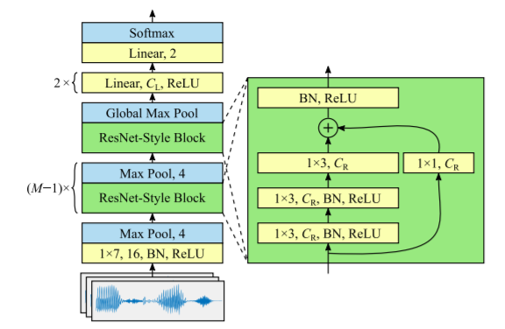
Methods- Neural Network (End to end)
Time-domain Synthetic Speech Detection Net
- End to End model, no need for featurization
- Input data is raw audio in the time domain
- Uses res-net architecture

Slide 12
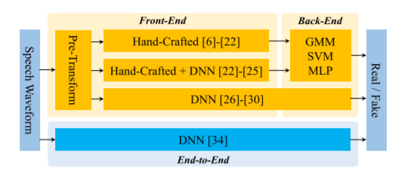
Methods- Neural Network (Features)
Also experiment with using different features with res-net instead raw audio
- end to end model can outperform and generalize better than models with hand crafted features
- We believe that limited data may limit the performance of the end to end models

Slide 13
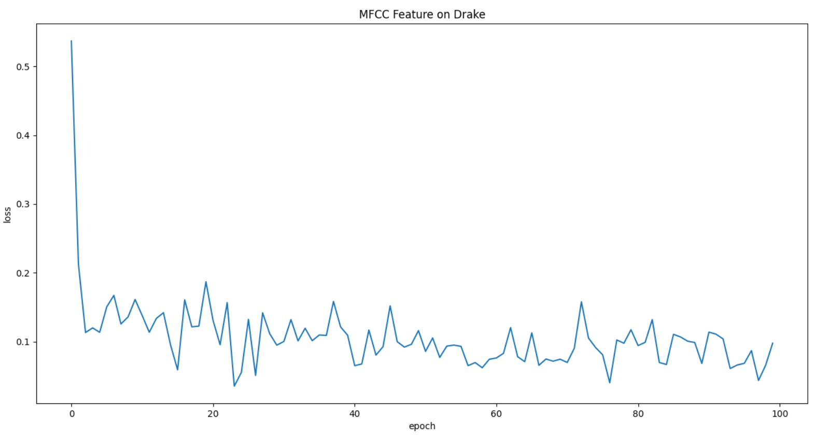

Training Details
Using Adam Optimizer
Learning rate = 0.01
Trained for 100 epochs
Batch size
16 for end to end
16 for MFCC
8 for constant Q transform
2 for MGDPS
Loss function
Mix-up regularization
Weighted Cross Entropy Loss

Slide 14
Methods- Evaluation
Confusion Matrix
[[TP,FP]
[FN,TN]]
Accuracy
Correct predictions/all predictions

Slide 15
Outline
Introduction
Methods
Data
Results
Conclusion
Demo
Questions

Slide 16
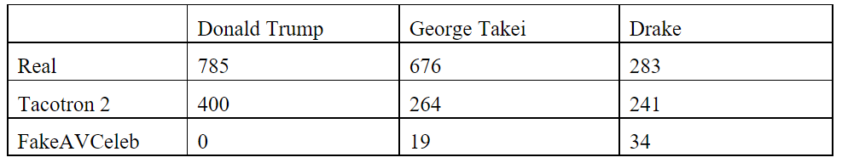
Data
Data consists of 2253 files
Real audio from YouTube clips
Fake audio is generated by Tacotron 2 and FakeAvCeleb (SVTTs)
80/20 Training/Testing split

Slide 17
Outline
Introduction
Methods
Data
Results
Conclusion
Demo
Questions

Slide 18
Results – Random Forest (I)
Known attacks
Trump- Accuracy 88%
[68 9]
[11 92]
Drake- Accuracy 87%
[41 4]
[8 45]
Takei- Accuracy 84%
[68 9]
[11 92]
Unknown attacks
Drake- Accuracy 33%
[0 89]
[6 47]
Takei- Accuracy 65%
[10 47]
[3 86]
All- Accuracy 70%
[60 86]
[31 214]
All- Accuracy 79%
[107 75]
[15 230]
Notes:
Random forest works well for models trained with single celebrity data
But fails to generalize to unseen audio synthesis algorithms

Slide 19
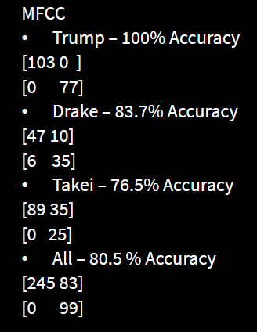
Results – Neural Nets (Known Attacks)
End To End
Trump – 42.8% Accuracy
[0 0 ]
[103 77]
Drake – 54.1% Accuracy
[53 45]
[0 0 ]
Takei – 59.7% Accuracy
[89 60]
[0 0 ]
All – 57.4 % Accuracy
[245 182]
[0 0 ]
Notes:
End – end model cannot learn because not enough data as mentioned earlier
But when trained with any feature, the accuracy increases significantly
As we can see with the MFCCs result here

Slide 20
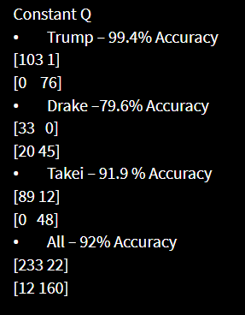
Results – Neural Nets (Known Attacks)
MGDCC
Trump – 98.9% Accuracy
[101 0]
[2 77]
Drake –100% Accuracy
[53 0 ]
[0 45]
Takei – 94% Accuracy
[81 1]
[9 59]
All – 98.6 % Accuracy
[242 3]
[3 179]
Notes:
Constant Q does decently well as well
but
Group Delay has the best performance with Neural Nets

Slide 21
Results – Neural Nets (Unknown Attacks)
MGDCC
Drake –42.3% Accuracy​
[53 82]
[0 7]
Takei – 94.5% Accuracy​
[84 3]
[5 54]
All – 79.8 % Accuracy​
[239 73]
[6 73 ]
Notes:
Neural Nets also perform better that RF for Unknown attacks
Shows better generalization potential than RF

Slide 22
Outline
Introduction
Methods
Data
Results
Conclusion
Demo
Questions

Slide 23
Conclusions
Random Forest
Works well for single person models for known attacks
Performance drops for unseen attacks
Neural Networks
Need more data for end-end models
MGDPS seems to have the best performance
Performs better than RF for unseen attacks
Limitations
Only male celebs, too little data, default hyperparameters
Future Work
Data Augmentation, transfer learning, hyperparameter tuning
Other applications – browser plugin to warn users of potential audio deepfakes in the content
Notes:
Inclusive sampling
Data Augmentaion eg : add noise

Slide 24
Outline
Introduction
Methods
Data
Results
Conclusion
Demo
Questions

Slide 25
Demo

