Slide 1
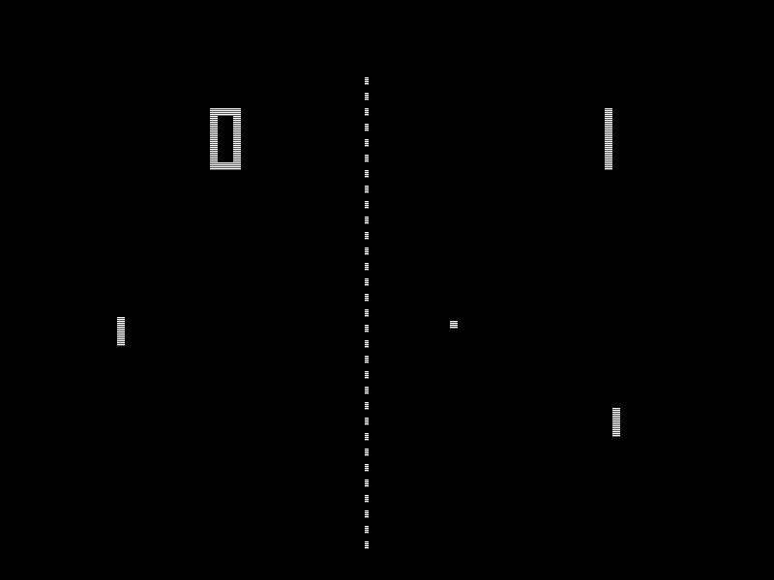
Python Pong
Kyle Phillips & Joe Jang
One of the earliest arcade video games. A table tennis sports game featuring simple two-dimensional graphics!

