Slide 2
Agenda
When and why map?
Rules vs Examples
  Exercise
Example Mapping
  Intro
  Let’s try it out

Slide 3
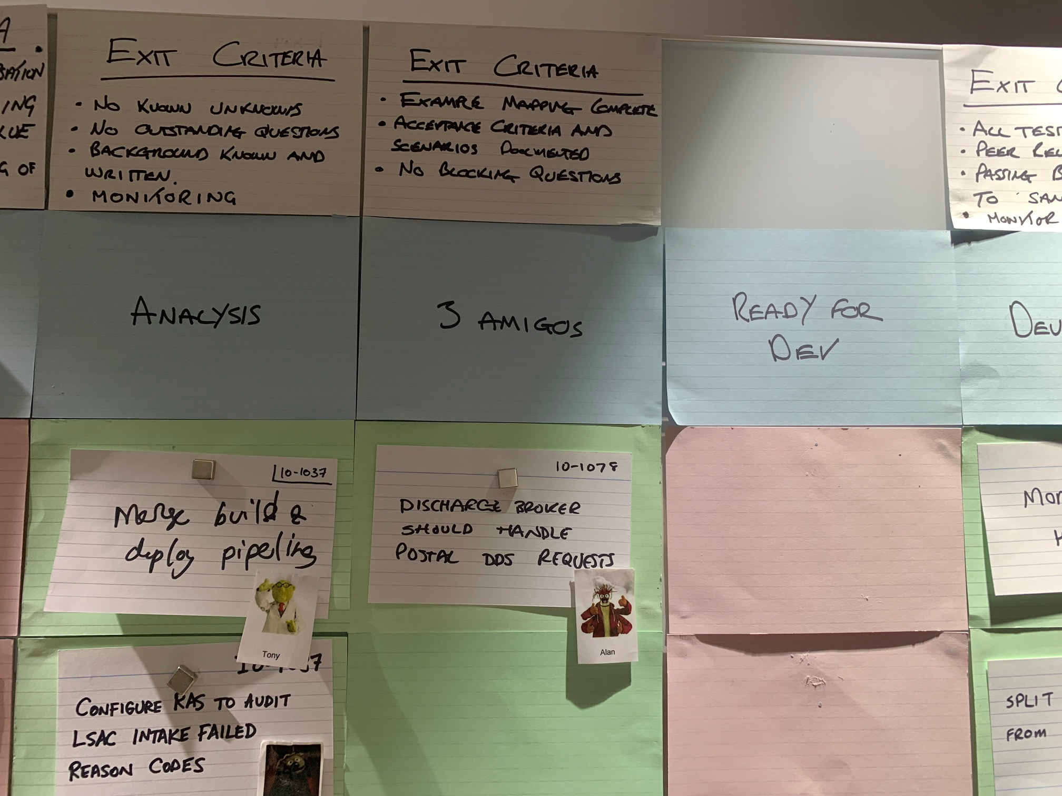

Slide 4
Examples vs Rules

Slide 5
Rules == Acceptance Criteria
Examples == Scenarios
https://lizkeogh.com/2011/06/20/acceptance-criteria-vs-scenarios/

Slide 6
Example or Rule?
Given a rabbit called Fluffy who is 1 1/2 months old
When we try to sell Fluffy
Then we should be told Fluffy is too young.

Slide 7
Example or Rule?
Given a rabbit called Fluffy who is 1 1/2 months old
When we try to sell Fluffy
Then we should be told Fluffy is too young.
EXAMPLE

Slide 8
Example or Rule?
Given a baby animal is younger than its recommended selling age
When we try to sell it
Then we should be told it's too young

Slide 9
Example or Rule?
Given a baby animal is younger than its recommended selling age
When we try to sell it
Then we should be told it's too young
RULE

Slide 10
You don’t have to use GWT
Given a baby animal is younger than its recommended selling age
When we try to sell it
Then we should be told it's too young
is the same as….
We should be prevented from selling animals younger than the recommended age.

Slide 11
Tease out examples
“Can you give me an example?”
“Can you give me a scenario where that happens?”
“What happens if …?”

Slide 12
We should be prevented from selling animals younger than the recommended age.

Slide 13
We should be prevented from selling animals younger than the recommended age.
Customers should be encouraged to return when the animal is old enough to sell.

Slide 14
Given rabbits can't be sold before they're 2 months old
Given Fluffy the rabbit is 1 1/2 months old
When we try to sell Fluffy
Then we should be prompted to tell the customer, "This pet is too young. Please come back in 15 days to collect your pet."

Slide 15
Passwords Game
https://speakerdeck.com/mattwynne/rules-vs-examples-bddx-london-2014?slide=3

Slide 16
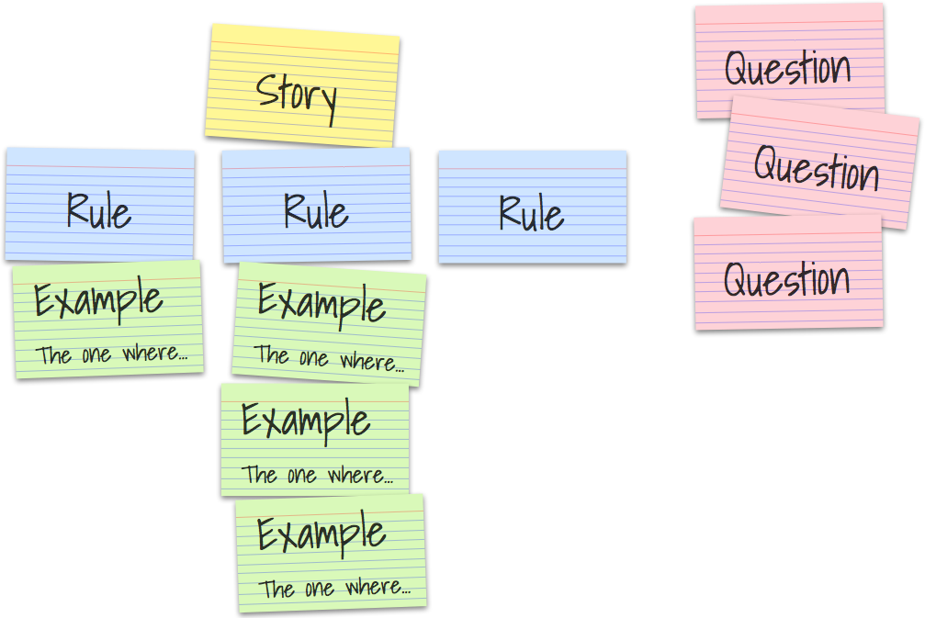

Slide 17
How it works

Slide 18
Roman Vote

Slide 19
What your map is telling you

Slide 20
Let’s try it!

Slide 21
Further Reading
Introducing Example Mapping:
https://cucumber.io/blog/2015/12/08/example-mapping-introduction
Acceptance Criteria vs Scenarios:
https://lizkeogh.com/2011/06/20/acceptance-criteria-vs-scenarios/
Book: Explore behaviour using examples by Seb Rose & Gasper Nagy

