Slide 1
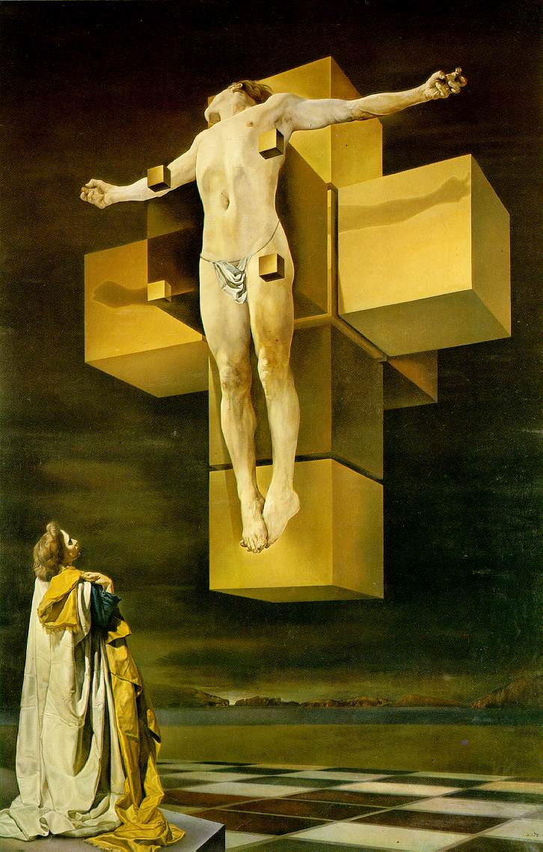
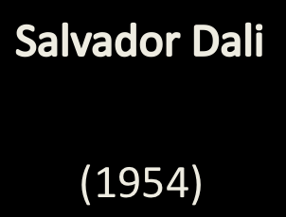
The Crucifixion:
Corpus Hypercubus

Slide 2
Segments, Squares, Cubes

Slide 3


Slide 4
0
1
2
3

Slide 5
-1
0
1
2
3

Slide 6
-1
0
1
2
3

Slide 7
Segment
0 ≤ x ≤ 1
-1
0
1
2
3

Slide 8
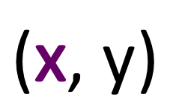
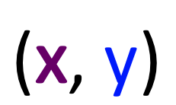
y
(x, y)
y
x
x

Slide 9
y
1
0 ≤ x ≤ 1
0 ≤ y ≤ 1
0
0
1
x

Slide 10
y
y = 1
0 ≤ x ≤ 1
1
x = 0
x = 1
0 ≤ y ≤ 1
0 ≤ y ≤ 1
0
0
y = 0
1
x
0 ≤ x ≤ 1

Slide 11
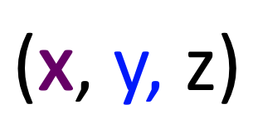
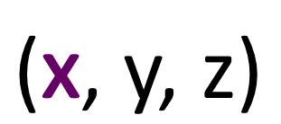
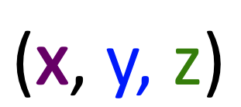
(x, y, z)
z
x
y

Slide 12
Cube
z
0 ≤ x ≤ 1
0 ≤ y ≤ 1
0 ≤ z ≤ 1
y
x

Slide 13
z
z = 1
0 ≤ x ≤ 1
0 ≤ y ≤ 1
y = 1
0 ≤ x ≤ 1
0 ≤ z ≤ 1
y
x

Slide 14
Four dimensions?
(x, y, z, w)

Slide 15
Hypercube
0 ≤ x ≤ 1
0 ≤ y ≤ 1
0 ≤ z ≤ 1
0 ≤ w ≤ 1

Slide 16
Faces?
0 ≤ x ≤ 1
0 ≤ y ≤ 1
0 ≤ z ≤ 1
w = 0
0 ≤ x ≤ 1
0 ≤ y ≤ 1
0 ≤ z ≤ 1
w = 1
How many?
8 faces

Slide 17
hypercube
4 faces
6 faces
8 faces

Slide 30
w = 0, z = 1
w = 0
w = 0, z = 0

Slide 31
w = 1, z = 1
z = 1
w = 0, z = 1
w = 0
w = 0, z = 0

Slide 32
w = 1, z = 1
z = 1
w = 0, z = 1
w = 0
w = 0, z = 0
z = 0
w = 1, z = 0

Slide 33
w = 1, z = 1
z = 1
w = 0, z = 1
w = 0
w = 0, z = 0
z = 0
w = 1, z = 0
w = 1
w = 1, z = 1

Slide 40
?
?

Slide 41
?

Slide 42
?

Slide 44
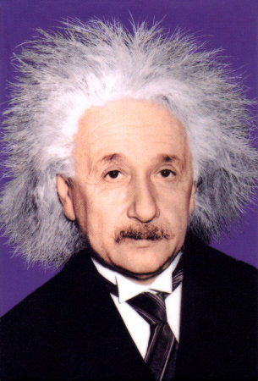

Slide 45
Space-time

