Slide 1

The Fall of Lytro

Slide 2

AGENDA
The Genesis
What is Light-Field Photography?
The Hype and the First Product
The Cracks begin to Show
The Second Attempt
The Pivot and the End

Slide 3

The Genesis

Slide 4


The Genesis
Founded in 2006 by Ren Ng, a Stanford PhD student
Ng's research focused on light-field photography, which captures information about the direction and intensity of light rays in a scene
The goal was to create a camera that could capture images with adjustable focus and depth of field after the photo was taken
The company aimed to revolutionize photography by allowing users to refocus images and create 3D effects
Lytro secured significant funding from venture capital firms, raising over $100 million in its early years

Slide 5
What is Light-Field Photography?

Slide 6

What is Light-Field Photography?
Conventional cameras capture a 2D representation of a 3D scene by recording the intensity and color of light rays that hit a flat sensor
Light-field cameras capture not only the color and intensity of light but also the direction of every single light ray in a scene
This is achieved by placing a grid of microscopic lenses (a microlens array) over the image sensor
The captured data allows for post-capture refocusing, enabling users to choose the focal point after the picture is taken
This technology was groundbreaking and won Ng the 2006 ACM Doctoral Dissertation Award

Slide 7
The Hype and the First Product

Slide 8
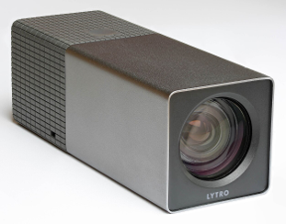
The Hype and the First Product
Lytro emerged from stealth mode in 2011 to immense media fanfare, promising "Shoot now, focus later"
In 2012, Lytro released its first product: the Lytro Light Field Camera
The camera had a unique tube-like design with a tiny 1.5-inch touchscreen
It produced "living pictures" that allowed users to click on different parts of the image to change the focus
The camera captured 11 Megarays but only produced a final 2D image of 1.2 megapixels, which was significantly lower than contemporary cameras
The product was priced between $399-$499, making it an expensive novelty item

Slide 9
The Cracks Begin to Show

Slide 10
The Cracks Begin to Show
Despite initial excitement, the first Lytro camera was a commercial disappointment due to several critical issues:
Abysmal Image Quality: The final exported image was only 1.2 megapixels, unsuitable for printing and lower quality than many smartphones
Awkward Ergonomics: The tube-like design was difficult to hold steady and lacked the familiar feel of a traditional camera
Proprietary Ecosystem: The "living pictures" were locked into Lytro's software, making sharing and editing cumbersome
A Gimmick, Not a Must-Have: The core feature of refocusing was seen as a cool party trick but did not address a pressing need for most photographers
High Price: At $399-$499, it was considered expensive for the quality and features offered

Slide 11
The Second Attempt

Slide 12
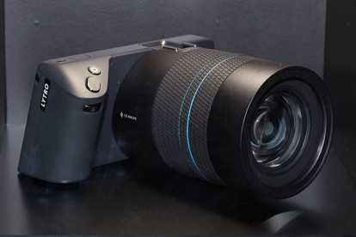
The Second Attempt
In 2014, Lytro released the Lytro Illum, a more advanced light-field camera aimed at professional photographers
The Illum featured a more conventional DSLR-like design with a larger sensor and better optics
It offered improved image quality with a 40 Megaray sensor, allowing for higher resolution images
The camera included advanced features such as manual controls, RAW image capture, and a larger touchscreen for editing
However, the Illum was priced at $1,599, making it significantly more expensive than other professional cameras
Despite the improvements, the Illum still struggled to gain traction in the market due to lingering issues with image quality and usability

Slide 13
The Pivot and the End

Slide 14
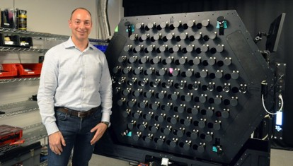
The Pivot and the End
In 2015, Lytro attempted to pivot towards the virtual reality (VR) market, leveraging its light-field technology for VR content creation
The company released the Lytro VR camera, designed to capture immersive 3D environments for VR applications
However, the VR market was still in its infancy, and Lytro faced stiff competition from established players in the camera and VR industries
Despite raising additional funding, Lytro struggled to achieve profitability and market adoption
In 2018, Lytro announced it was shutting down its operations and selling off its assets, marking the end of the company
The story of Lytro serves as a cautionary tale about the challenges of bringing innovative technology to market and the importance of addressing real consumer needs

Slide 15
The Pivot and the End
Innovation Alone is Not Enough: Groundbreaking technology must also deliver practical value and usability to succeed in the market
Market Timing Matters: Entering a market too early or without a clear demand can hinder adoption and growth
User Experience is Crucial: A product must be intuitive and enjoyable to use, or it risks being dismissed as a gimmick
Financial Sustainability is Key: Even with significant funding, a company must have a clear path to profitability to survive long-term
Lytro's legacy lives on in the continued exploration of light-field technology, which still holds promise for future applications in photography and beyond

Slide 16

Thank You

