Slide 1
Socket Programming Basics -- Using Python

Slide 2
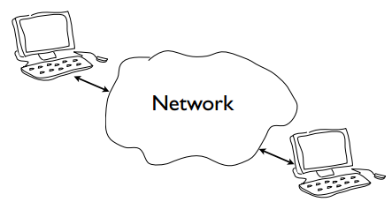
The Problem
Connection between computers
It is just send /receiving bits.

Slide 3
2 Main Issues
Addressing
Specifying a remote device and service
Data Transport
Moving bits back and forth

Slide 4
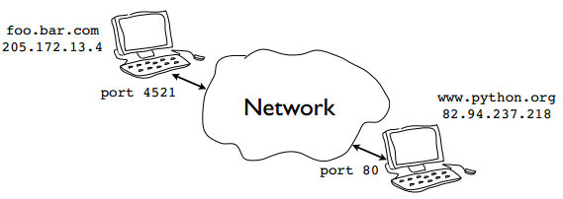
Network Addressing
Devices have a hostname and IP address.
Programs / services have port numbers.

Slide 5
Standard (Well-known) Ports
Ports for common services are preassigned
21: FTP
22: SSH
23: telnet
25: SMTP
80: HTTP
110: POP3
443: HTTPS
Other port numbers (usually greater than 1024) may be randomly assigned to programs.

Slide 6
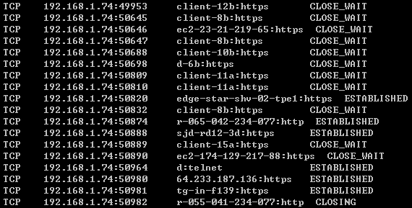
netstat
Use “netstat” to view network connections

Slide 7
Connections
Each endpoint of a network is always represented by a host and port number.
In Python you write it as a tuple (host, port)
(‘www.python.org’, 80)
(‘140.112.149.68’, 22)

Slide 8
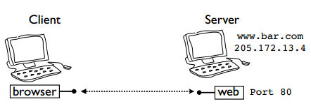
Server / Client Concept
Each endpoint is a running program.
Servers wait for incoming connections and provide a service, e.g. web, mail, etc.
Clients launch connections to servers.

Slide 9
Data Transport
There are two basic types of communication:
Streams (TCP): Devices establish a connection with each other and read / write data in a continuous stream of bytes -- like a file.
App
3
2
1
socket
Dest.

Slide 10
Data Transport
Datagams (UDP): Devices send discrete packets to each other. Each packet contains a collection of bytes, but is separated and self-oriented.
App
D1
3
2
D2
1
socket
D3

Slide 11
What Is A Socket?
An interface between application and network
The application creates a socket
The socket type dictates the style of communication
reliable vs. best effort
connection-oriented vs. connectionless
Once configured, the application can
pass data to the socket for network transmission
receive data from the socket (transmitted through the network by some other host)

Slide 12

What Is A Socket?
Programming abstraction for network code.
Socket: A communication endpoint.
Supported by socket library module
Allows connections to be made and data to be transmitted in either direction.

Slide 13
Socket Basics
To create a socket
import socket
s = socket.socket([addr_family], [type])
Address families
socket.AF_INET for IPv4
socket.AF_INET6 for IPv6
Socket types
socket.SOCK_STREAM for TCP
socket.SOCK_DGRAM for UDP

Slide 14
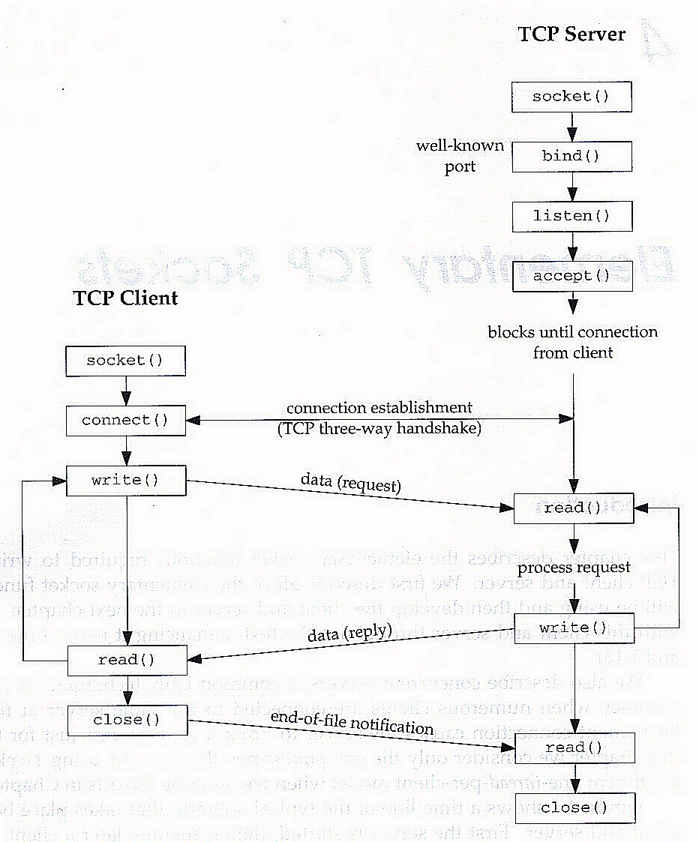
TCP Connection

Slide 15
Things To Do
Create a socket is the very first step.
Server
Host / Port / Process binding
Listen for incoming connections
Loop: Accept / Send / Connection Close
Client
Launch an outgoing connection
Send / Receive data
Connection Close

Slide 16
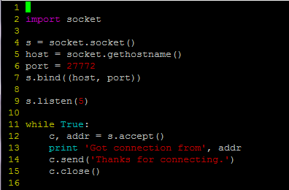


An Example -- TCP Server

Slide 17
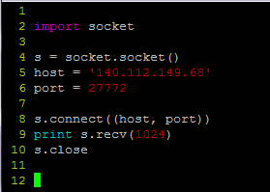
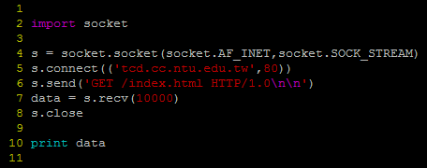
An Example -- TCP Client

