Slide 1


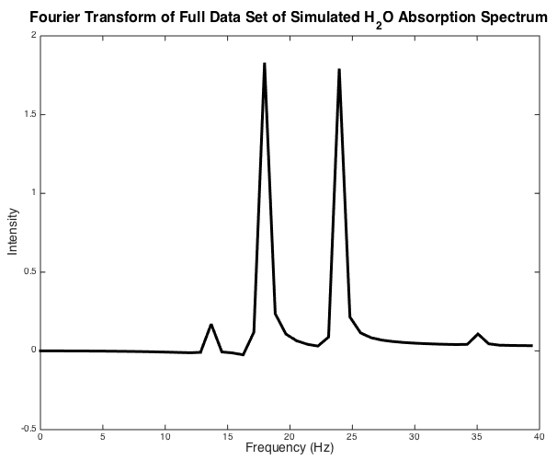
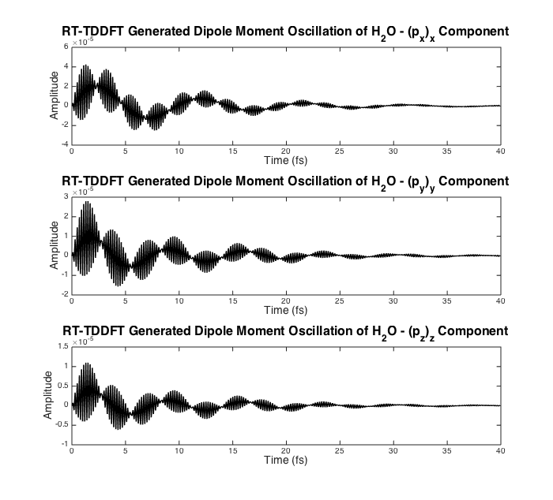
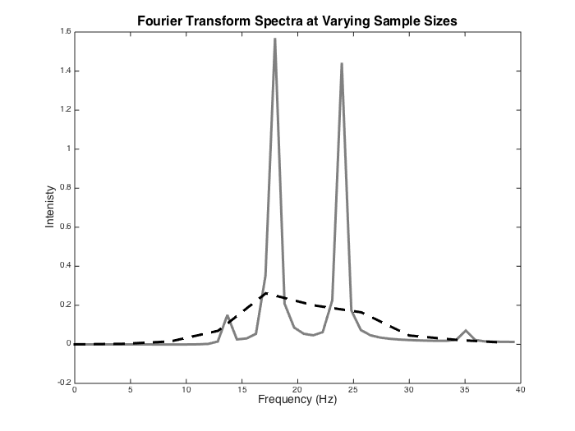
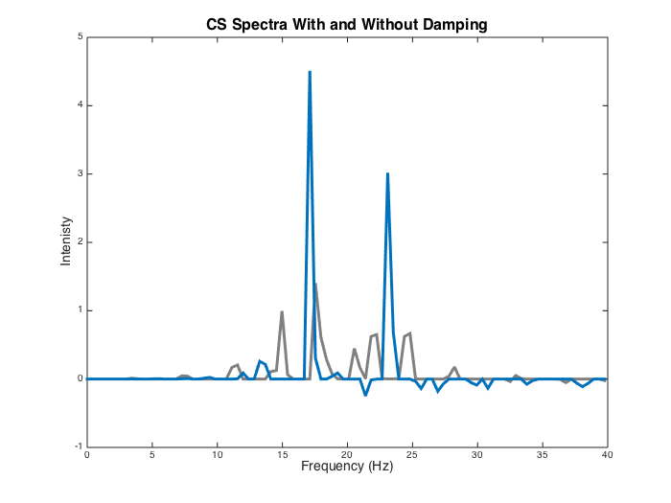
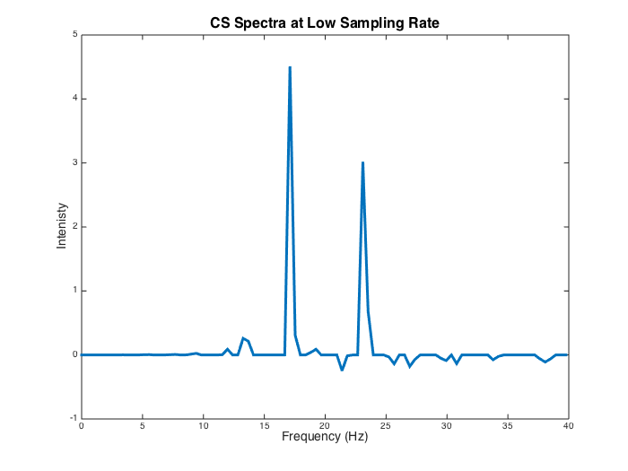
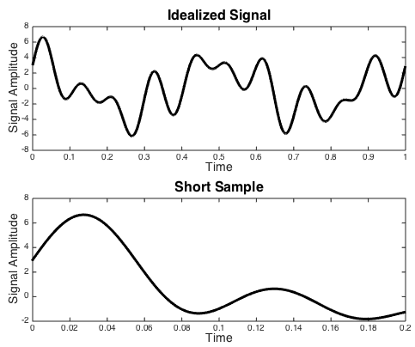
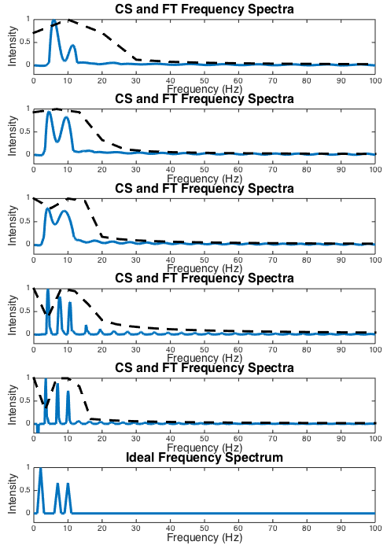
Applications of Compressive Sensing to
Simulated Chemical Spectra
C. Houferak, J. Kasper, J. J. Radler, S. Sun
Li Research Group, University of Washington Department of Chemistry
An Introduction to Compressive Sensing (CS)
Part Two: Simulated TDDFT Water Spectra
Computational chemistry seeks to construct models of chemical systems in
order to model experimentally observable quantities in support of experimental
research. A major implementation of computational modeling is simulating chemical
spectra, which are essentially the 'fingerprints' of a chemical species. Spectra are typically obtained experimentally, but may also be generated computationally from first principles.
Fine-grained computational models are often size-intensive with respect to simulation length and sampling rate. This study focuses on the Compressed Sensing (CS) technique for reducing the necessary sampling rate. CS assumes a high degree of sparsity in the frequency domain of a signal and makes use of the L¹ norm minimization technique to locate an optimally sparse vector of transformation coefficients. Here we apply it to modeled Optical Absorption spectra that traditionally use Fourier analysis for frequency resolution.
Absorption spectroscopy is an oft-utilized technique in chemistry that investigates how a molecule or material interacts with electromagnetic radiation in the ultraviolet and visible frequencies. When a particular frequency corresponds with the gap between energy levels of a molecule, electrons can be excited into higher molecular orbital. Thus, for a range of frequencies, spectra will show peaks at the frequencies corresponding to the energy level gaps. Absorbance features only occurring at molecular features of interest with characteristic frequencies implies sparsity in the frequency domain.
Consider a signal h(t) that is sampled n times with a spacing ∆t. The set of Fourier coefficients that we wish to find for a set of frequencies ω_{k} are given by g_{k}., where g_{k} is given by
Casting this in matrix form, a Fourier matrix F is given by
so that the problem we wish to solve is simply
In the case that we assume N > n, this system is underdetermined and will in general have multiple solutions. Yet since we know that we are looking for a sparse solution the task is to find the solution to Fg = h that has the most coefficients g_{k} that are zero. This can be done algorithmically by minimizing the L¹ norm of g. In order to allow for some level of noise in the signal the constraint can be loosened. This procedure, called basis pursuit denoising (BPDN), is
given by
where η is a threshold level.
Part One: Known Ideal Signal
Conclusions and Future Work
As shown above, the compressed sensing technique was able to capture the absorption spectrum to a least semi-quantitative accuracy. In practice this is good enough for most applications. This has profound implications for the computational chemistry community as it allows for highly accurate calculations to be run for a shorter period of time without sacrificing much in the quality of results.
Our tests above utilized the SPGL1 basis pursuit method due to its speed advantage over other L¹ minimization algorithms such as CVX. However, other possible methods for further reducing the time of calculation include running a coarse calculation first to determine key windows of interest, followed by a second fine-grained spectra (artificially setting some of the rows in the Fourier matrix to zero).
The plot above shows an ideal signal that was generated to use as a test case for our CS model with functional form:
The number of points to sample in the above plot was 400.
The plot on the right shows a variety of reconstructed samples (via CS and Fourier Transform) with number of sampled points from top to bottom being: 100,200,300,400, and 500. The total number of the signal was 2000 points so these sampling sizes correspond to reconstructions using 5, 10, 15,
20, and 25% of sampled points,
respectively.
X. Andrade, J. N. Sanders, and A. Aspuru-Guzik, Application of compressed sensing to the simulation of atomic systems, PNAS. Vol. 109 (2012) pp.12938—13933.
J. N. Kutz, Ch. 17 Basics of Compressed Sensing, AMATH 582 Course Notes. (2016). pp.395—418. http://courses.washington.edu/amath582/582.pdf.
E. van den Berg and M. P. Friedlander, Probing the Pareto frontier for basis pursuit solutions, SIAM J. on Scientific Computing, 31(2):890-912, November 2008

