Slide 1
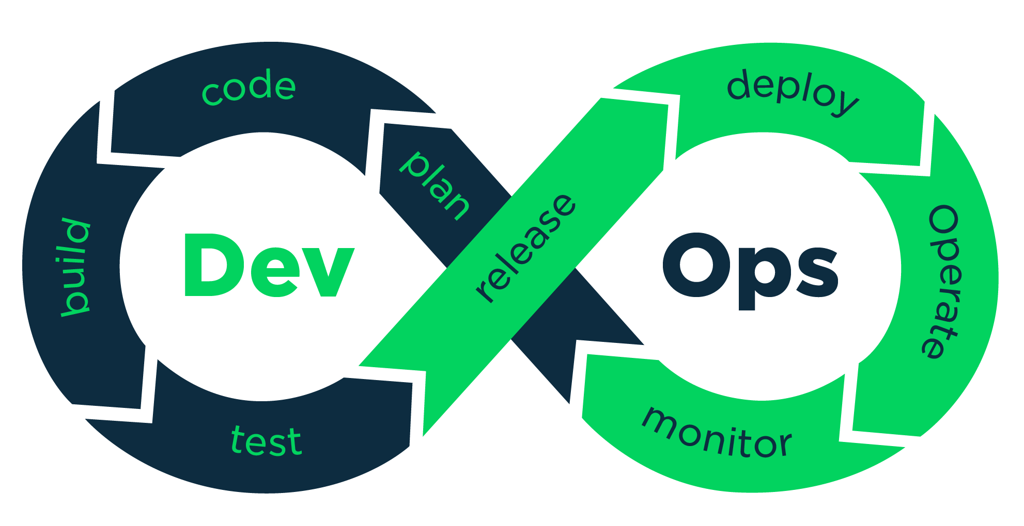

Jenkins: Pipeline as Code
Overview Jenkins Pipeline as Code

Slide 2
Jenkins : Pipeline as Code
Pipleline code uses a DSL.
DSL allows you to perform the Tests.

Slide 3
Jenkins : Benefits of code-based pipeline
Jenkins pipeline define in a txt file, calls a jenkinfile.
Version Control.
Less error-prone execution of Jobs.
Logic-based execution of steps.

Slide 4
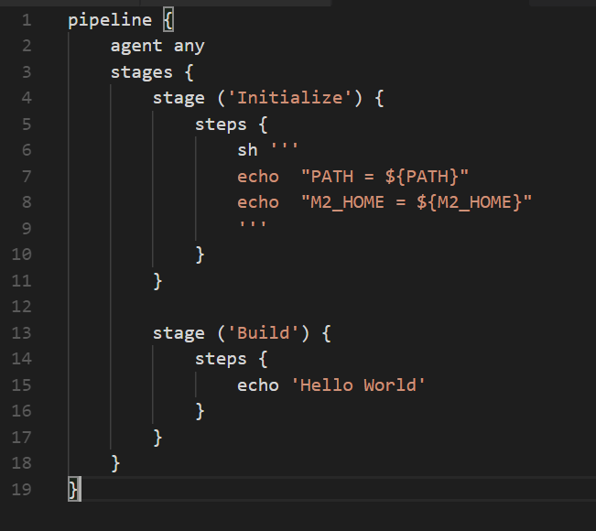
Jenkins : Benefits of code-based pipeline

Slide 5


