Slide 1
Additive Manufacturing for Femur Fracture Repairs
ME 566 – Spring 2022
Team A: Ben G., Divyaa V.G., James S., Joe K., Patrick D., Zach H.

Slide 2
Team Organization
Name | Main Role | Contact Info
Ben G. | Atlas 3D | bbg5259@psu.edu
Divyaa V.G. | CAD & nTopology | dfv5122@psu.edu
James S. | Magics | jrs6123@psu.edu
Joe K. | CAD & nTopology | jmk7677@psu.edu
Patrick D. | Technical Writing & Presentation | ped5159@psu.edu
Zach H. | FEA | zwh5154@psu.edu

Slide 3
Team Organization
Meeting Schedule
Date | 4/21 | 4/25 | 4/28 | 5/2 | 5/5
Time (EST) | 6pm | 6pm | 6pm | 6pm | 6pm
Meeting Details
Team meetings were held in Zoom
Meeting Discussion Leader: Joe/Divyaa
Meeting Minutes: Ben G.
Meeting minutes emailed to team after the meeting has ended
Planned Software
SolidWorks (for initial CAD Model and FEA)
Rhinoceros 6 (CAD, Parametric Design)
nTopology (Opportunistic DfAM, FEA)
Materialise Magics, Meshlab, Meshmixer (Fix mesh and populate build plate)
Atlas 3D (Optimal orientation for chosen application)

Slide 4
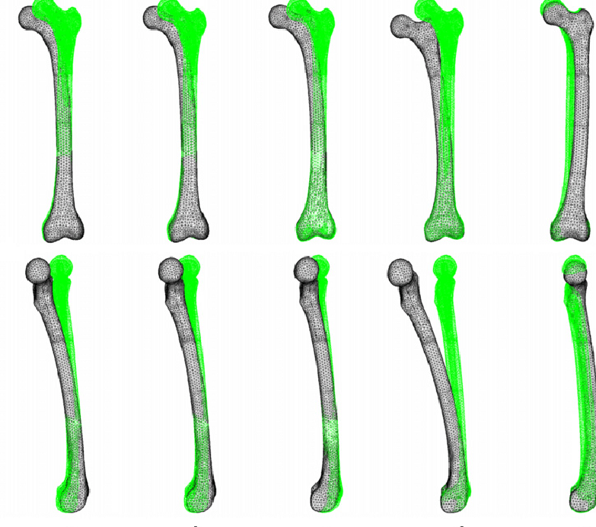
Project – Problem Statement
Project Objective: Utilize design for additive manufacturing techniques to redesign the plate and screw method of repairing a mid-shaft femoral fracture.
Goals: The new design should seek to improve the fit between the bone and plate, make the surgery easier, reduce the weight of the plate, and improve the performance of the repair along with taking into consideration the different loading condition.
Objective: To ideate viable plate designs, select a concept and verify it with FEA analysis. Followed by this, the chosen design can be setup in a build plate with multi-criteria build set-up optimization using the required softwares.
Assumptions: Isotropic material properties
Out of scope Items: Other types of femoral fracture will not be included, focus is only on the flat part of the bone, other methods of mid-shaft femoral fracture will not be considered. Anisotropic materials will not be analyzed.
Mesh Size: Mesh size will be dependent on final design although it is assumed our maximum size should be no more than 2mm.
Loading conditions:
Axial loads of 3.5 bodyweights (750N/BW) without failure (along shaft)
Sustain axial torsion of 0.1 Body Weight meters (BWm, 75 Nm)
Sustain frontal moment of 0.3 Body Weight meters (BWm, 225 Nm) (bending)
150 – 500 µm axial displacement during loading
Figure shows an example of deflection of a femur under normal walking conditions [1]
Notes:
[1] Speirs, Andrew & Heller, Markus & Duda, Georg & Taylor, William. (2007). Physiologically based boundary conditions in finite element modelling. Journal of biomechanics. 40. 2318-23. 10.1016/j.jbiomech.2006.10.038.

Slide 5
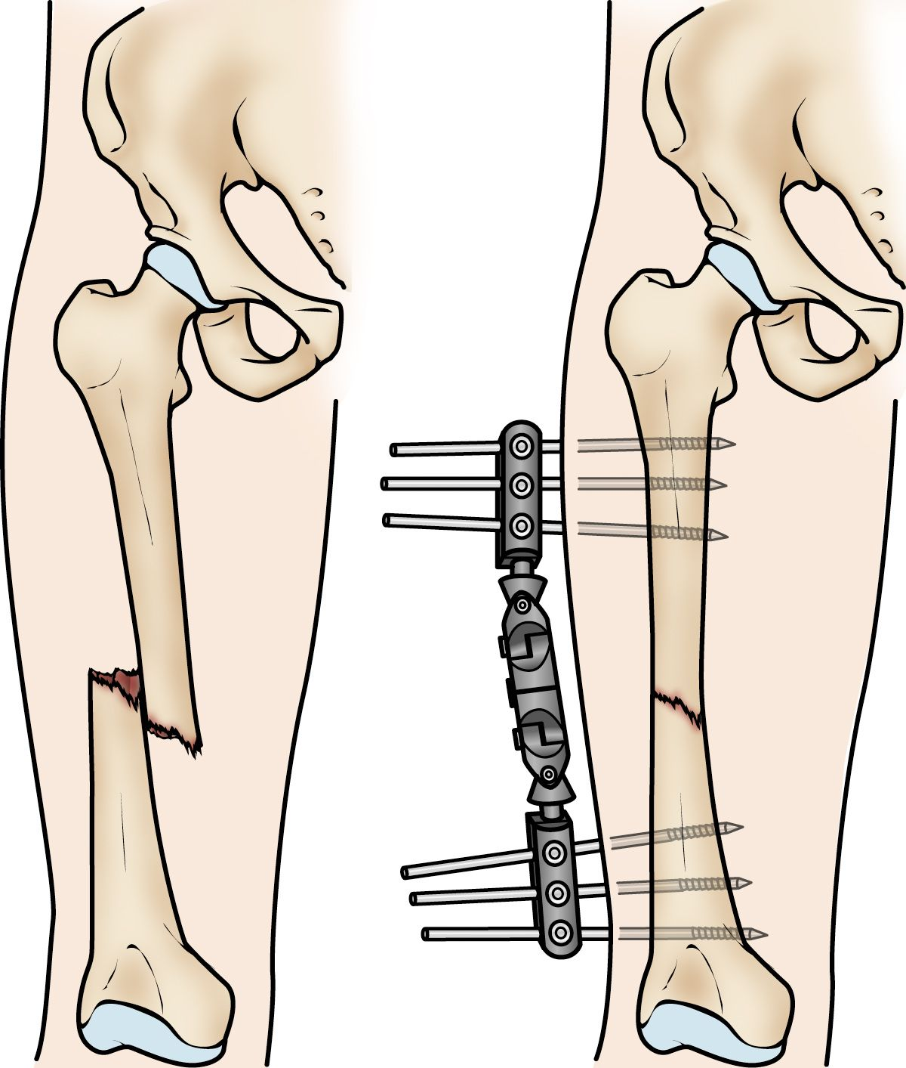
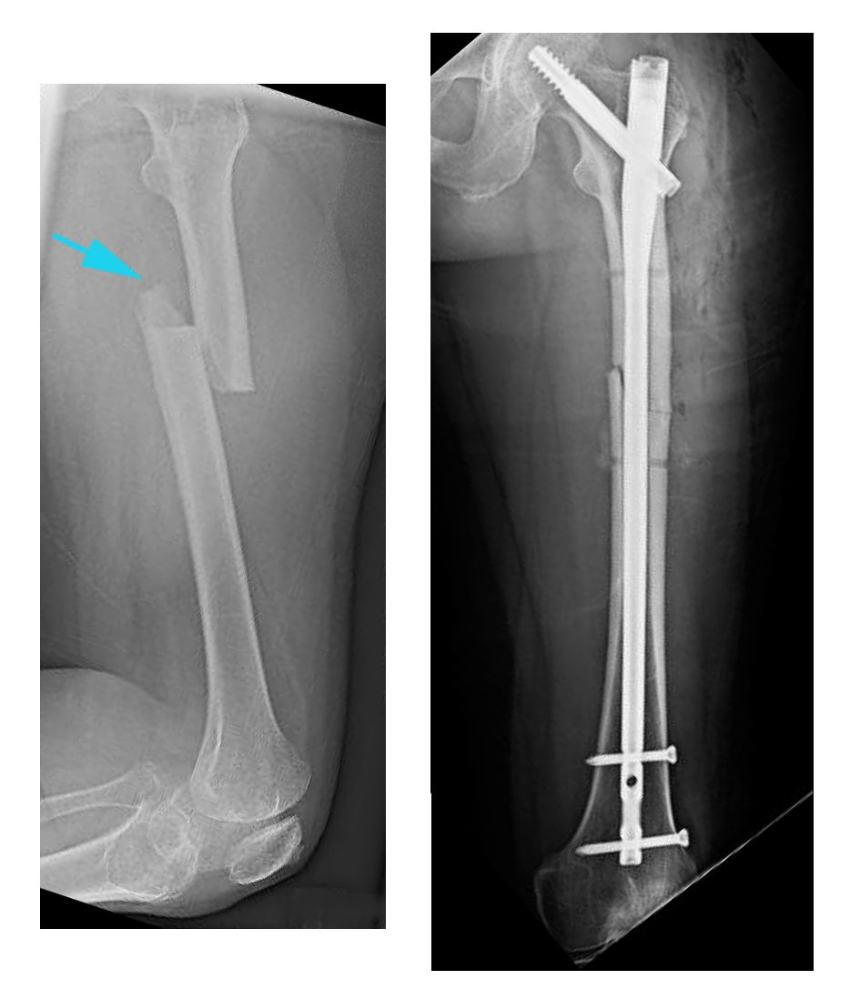
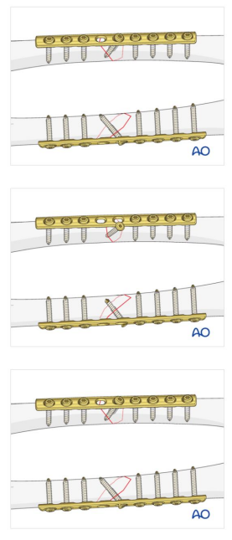
Common Repair Methods
External Fixation
Intramedullary Nail
Plate and Screws
General Information: Usually a temporary solution to fix a femoral fracture. Commonly used when a patient has many other injuries and isn't ready to have surgery to repair the femoral fracture. [1]
General Information: Primary method used by surgeons to repair femoral fractures. Usually made of titanium and can be made in different lengths to fit different size femur bones. [1]
General Information: Often used when intramedullary nailing is not possible such as for fractures that extend into the hip or knee joint. [1]
Notes:
[1] https://orthoinfo.aaos.org/en/diseases--conditions/femur-shaft-fractures-broken-thighbone/; images for the external fixation and intramedullary nail from this source as well

Slide 6
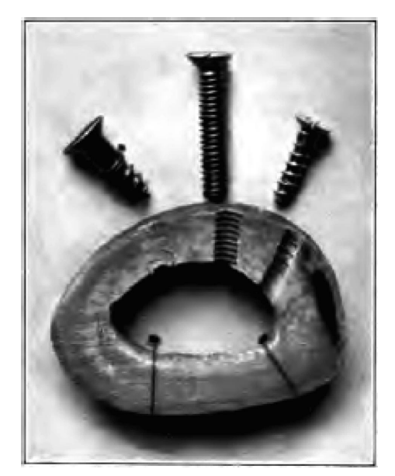
Project – Background
Study Topic
An Historical Perspective of the Development of Plate and Screw Fixation and Minimally Invasive Fracture Surgery With a Unified Biological Approach
Notes
First successful plate and screw bone repair was done using a flat plate made of nickel, copper, and tin alloy. Unicortical tapered screws that drilled into the bone and locked to the plate were used.
Ernest Hey Groves invented the first locked plate design
This design is still commonly used today
Notes:
https://journals.lww.com/techortho/Abstract/2007/09000/An_Historical_Perspective_of_the_Development_of.8.aspx

Slide 7
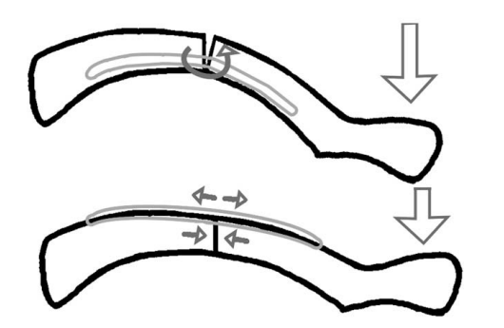
Project – Background
Study Topic
Reconstruction plates for stabilization of mid-shaft clavicle fractures
Screw Material: Stainless Steel
Plate Material: Unknown
Notes
Force is the same in the top and bottom image
Location of the plate on the bone can have a large effect on how the repair fails
Top image the bone fails due to bending
Bottom image the bone fails due to shearing of the bone itself
Placement of the plate in the bottom image allows for the repair to withstand a much greater force prior to failing
Notes:
https://www.sciencedirect.com/science/article/abs/pii/S1058274608006204

Slide 8
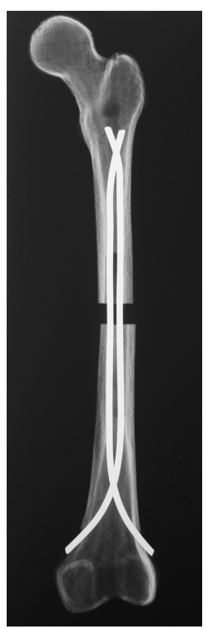
Project – Background
Study Topic
Biomechanical Comparison of Stainless Steel and Titanium Nails for Fixation of Simulated Femoral Fractures
Notes
Titanium nails are more flexible
Elastic nature of titanium nails reported to be key feature in successfully using the femoral fixation technique
Stainless Steel nails are much stiffer than titanium nails
Titanium nails proved to be more stable under compressive and torsional loading
Likely due to greater nail contact within the medullary canal
Femoral Fixation Technique
Notes:
https://pubmed.ncbi.nlm.nih.gov/15502562/

Slide 9
Material Selection
Plate material
Titanium due to its biocompatibility and corrosion resistance. [1,2]
Low modulus of elasticity might be beneficial for bone contact long term. [3]
Screw material
Ti64 which are selected for their improved ductility, biocompatibility, and corrosion resistance [1,2]
Screws will be bought and not printed due to resolution and cost considerations
Key considerations in these selections
Biocompatibility of materials
Due to interface with living tissue
Corrosion Resistance
Long history of proven success as implant materials [1,2,3]
Availability of powders for AM processing
Note: An item that will be discussed in detail in the post processing slide is the use of bio-active coatings to encourage healing. [4, 5]
Notes:
[1] https://www.jmst.org/article/2020/1005-0302/1005-0302-36-0-190.shtml
[2] https://www.ncbi.nlm.nih.gov/pmc/articles/PMC6650641/
[3] https://www.ncbi.nlm.nih.gov/pmc/articles/PMC1192810/
[4] https://onlinelibrary-wiley-com.ezaccess.libraries.psu.edu/doi/pdfdirect/10.1002/adfm.201808738
[5] https://www.sciencedirect.com/science/article/pii/S0169433212020326
[6] https://europepmc.org/article/med/2794696
Additional information considered.
[7] https://www.mdpi.com/1996-1944/13/23/5584/htm
ASTM F2924 Standard Specification for Additive Manufacturing Titanium-6 Aluminum-4 Vanadium with Powder Bed Fusion
ASTM F3001 Standard Specification for Additive Manufacturing Titanium-6 Aluminum-4 Vanadium ELI (Extra Low Interstitial) with Powder Bed Fusion

Slide 10
AM Process Selection - Options
Laser powder bed fusion
Electron beam powder bed fusion
Binder Jetting
Likely to not meet structural requirements
Directed energy deposition
Need higher resolution than DED can accommodate
(LB-PBF, option 1)
(EB-PBF, option 2)
Notes:
Salmi M. Additive Manufacturing Processes in Medical Applications. Materials. 2021; 14(1):191. https://doi.org/10.3390/ma14010191

Slide 11
AM Process Selection – Down Selecting
Criteria for Process down-select
Feature resolution and minute details
Design features
Surface finish
Structural loads
Support required
Powder waste
Speed of manufacturing
Materials that can be used
Cost of Manufacturing
Production volume
Notes:
(aa)https://www.sme.org/technologies/articles/2020/may/additive-manufacturing-in-orthopedics/

Slide 12
AM Process Selection
Finalist AM process: EB-PBF and LB-PBF
Chosen AM process: EB-PBF
Why?
One of the main reasons for this decision was the higher surface roughness experienced with EB-PBF. Even though LB-PBF gives better surface resolution, the high roughness can lead to better results within human body environment [1]
This leads to improved Osseointegration
High porosity similar to human bone
EB-PBF is cost effective and has efficient production [2]
Sandblasting used as post processing for LB-PBF leads to crack formation [2]
Additionally, one of EB-PBF’s most common fields is biomedical [3]
Notes:
[1]: Dryepondt, S. D., Kirka, M. K., & Ryan, D. R. (2019, June 28). Comparison of Electron Beam and Laser Beam Powder Bed Fusion Additive Manufacturing Process for High Temperature Turbine Component Materials, Phase II. OAK RIDGE NATIONAL LABORATORY. Retrieved April 21, 2022, from https://www.ornl.gov/sites/default/files/2019-08/ORNL-Solar%20CRADA%20HX%20Phase%202%20Report_Approved.pdf
[2]: Fatma Nur Depboylu, Evren Yasa, Özgür Poyraz, Joaquim Minguella-Canela, Feza Korkusuz, M Antonia De los Santos López (2022). Titanium based bone implants production using laser powder bed fusion technology, Journal of Materials Research and Technology, Volume 17, Pages 1408-1426, ISSN 2238-7854,
https://doi.org/10.1016/j.jmrt.2022.01.087.(https://www.sciencedirect.com/science/article/pii/S2238785422000874)
[3]: 3D printing - Additive. (2018). Dassault Systemes. Retrieved April 21, 2022, from https://make.3dexperience.3ds.com/processes/powder-bed-fusion
Ossification is the natural growth of bone
Osseointegration is the growth of bone creating a continuous ceramic implant with the implant as more bone permeates the implant
[4] https://www.sciencedirect.com/science/article/pii/S174270611830672X

Slide 13
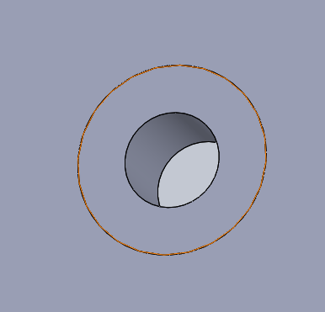
Design - Dimensions
Initial dimensions were given for the “Plate and Screws” project as seen below
Plate Dimensions:
30cm length
20cm width (chosen not given)
5mm MAX thickness
Screw hole 4mm in diameter
8mm outer diameter that should remain untouched at every hole location
“The minimum edge distance surrounding all bolt holes shall be 2 times the diameter of the bolt hole” [1]
Notes:
[1]: 3-2-1 Liftoff! ULA Rocket Hardware Challenge | Engineering & Design Challenges | GrabCAD. (2016, September). Grab CAD. https://grabcad.com/challenges/3-2-1-liftoff-ula-rocket-hardware-challenge

Slide 14
Design Concepts – Hand Sketches
One of the initial steps of a successful design is referred to as “Hand-sketching”. This phase is always found in early stages of design thinking [1]
Design-sketching skills tremendously help in communicating an idea in a quick and efficient way. It has also been proven that there is a robust link between “a designer’s ability to sketch and their ability to visualize in their heads or through prototypes [2]
For the reasons stated above, we decided to sketch our four initial design concepts before going into 3D modeling. They will be presented in the following slide
Notes:
[1]: Murtell, J. (2021, July 14). The Best Times to Post on Social Media in 2022. American Marketing Association. https://www.ama.org/marketing-news/the-5-phases-of-design-thinking/
[2]: Yang, M. C., & Cham, J. G. (2006). An Analysis of Sketching Skill and Its Role in Early Stage Engineering Design. Journal of Mechanical Design, 129(5), 476–482. https://doi.org/10.1115/1.2712214

Slide 15
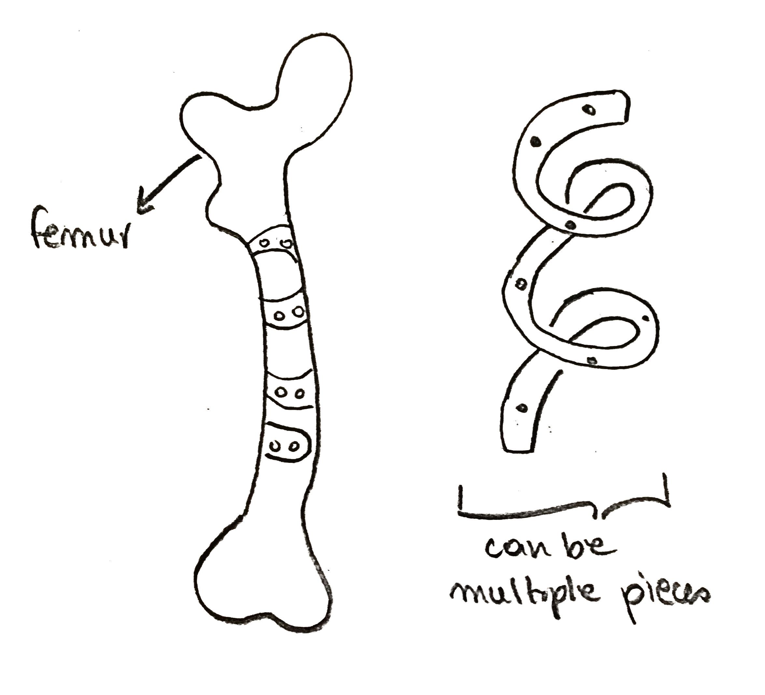
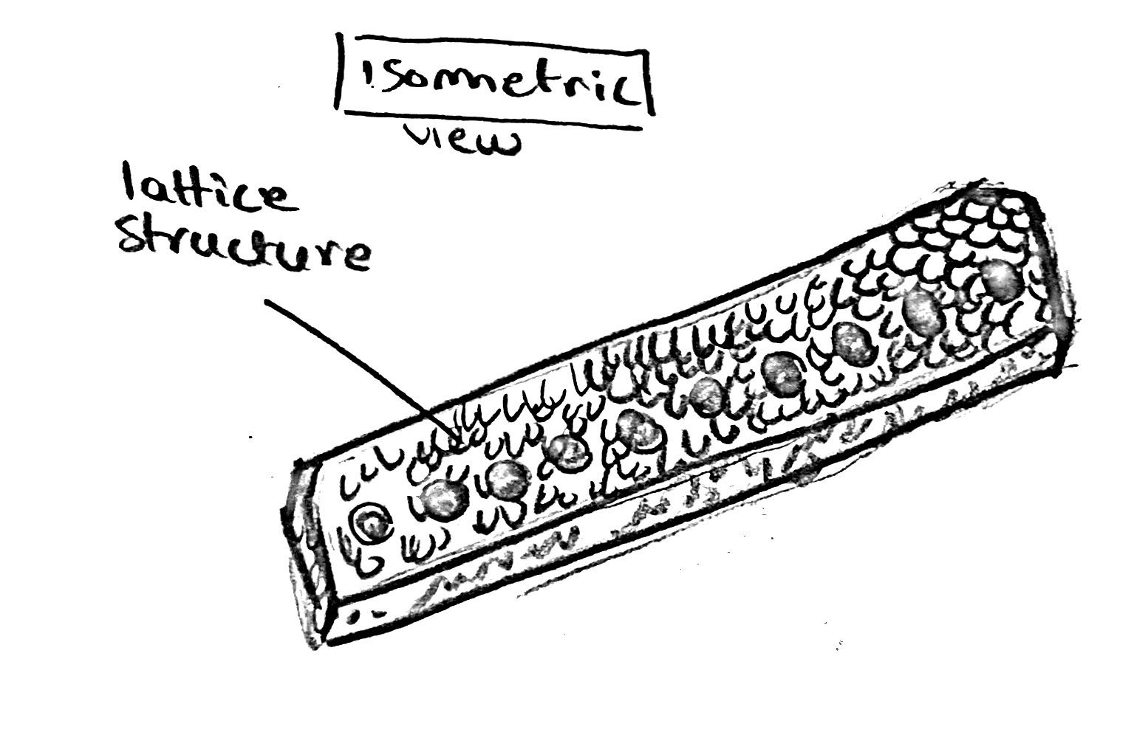
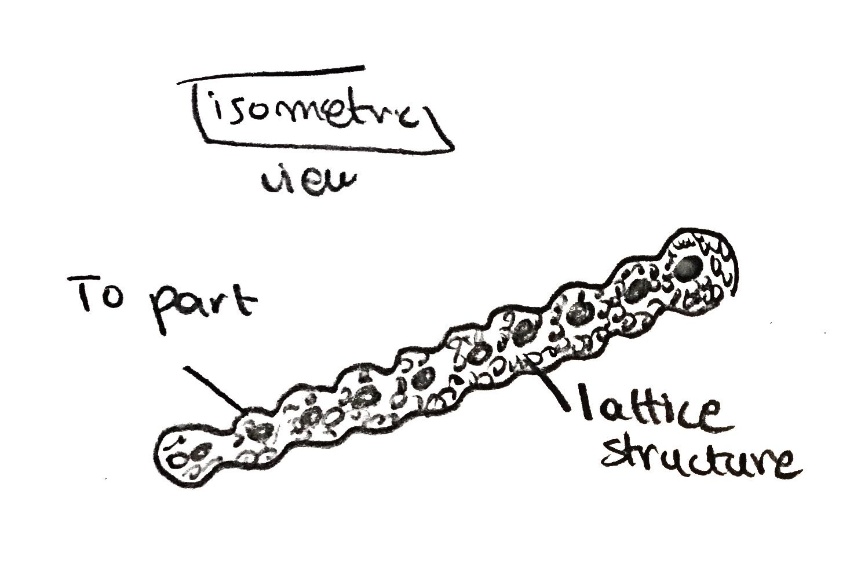
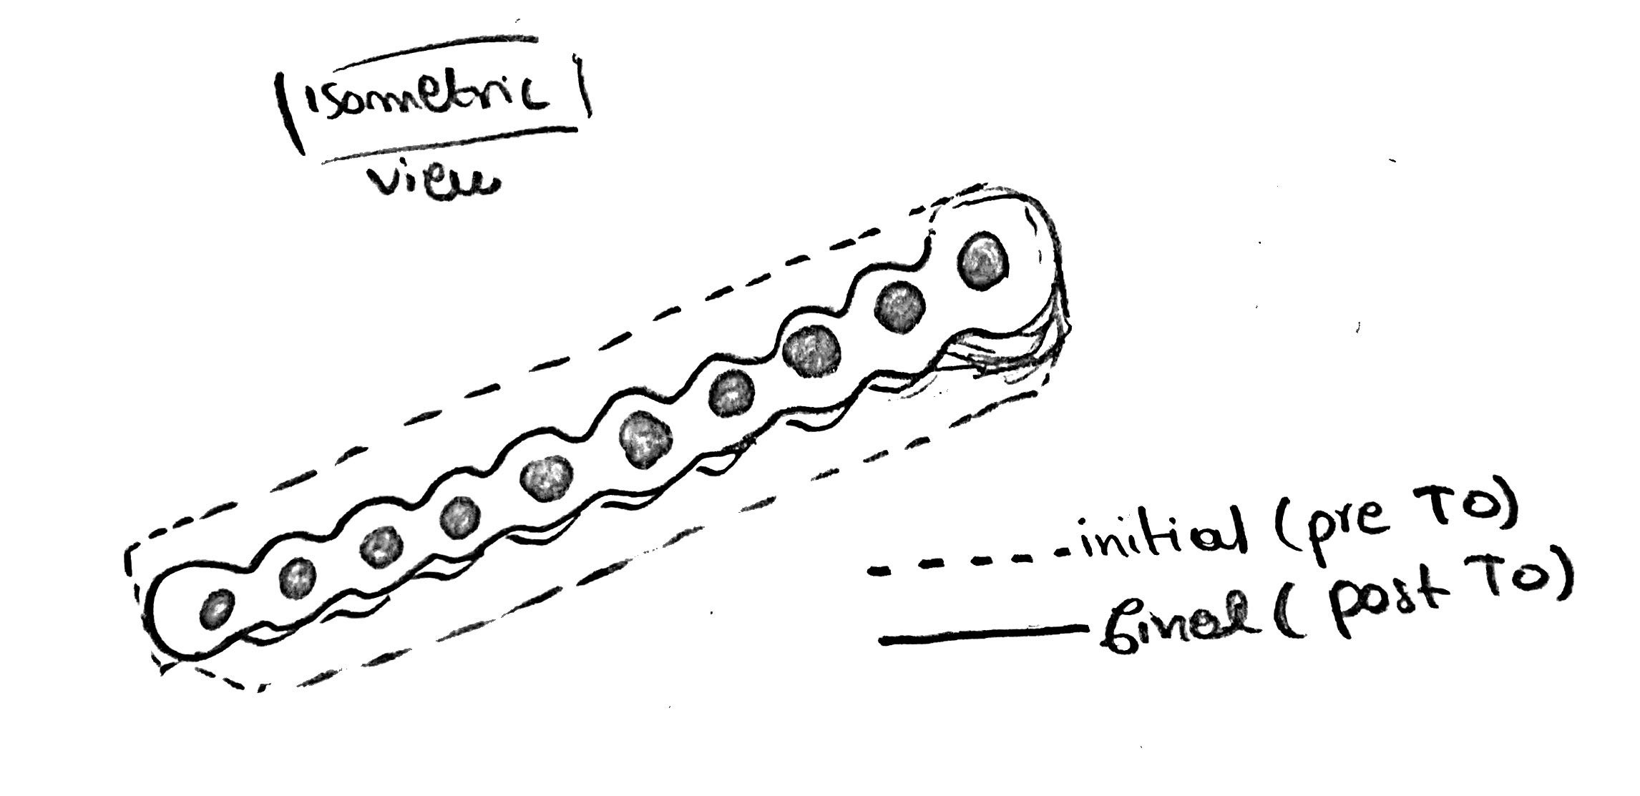
Design Concepts – Hand Sketches
1
2
4
3

Slide 16
Design Concepts – Making a Decision
Lattice Structures can help in weight reduction. Less material will be used, and the strength will be distributed accordingly. This could lead “to enormous energy and cost savings” [1]
A recent study proved that the Gyroid unit cell performs well in energy absorption applications (non-extreme ones). The gyroid structure has good mechanical properties [2]
Topology Optimization is a freeform material distribution technique. It gives the part better structural performance and material removal can be controlled as needed [3]
Going lightweight is essential for such applications. These Opportunistic Design for Additive Manufacturing methods (Topology Optimization and lattices) have been done in nTopology
Notes:
[1]: Beyer, C., & Figueroa, D. (2016). Design and Analysis of Lattice Structures for Additive Manufacturing. Journal of Manufacturing Science and Engineering, 138(12). https://doi.org/10.1115/1.4033957
[2]: Ramos, H., Santiago, R., Soe, S., Theobald, P., & Alves, M. (2022). Response of gyroid lattice structures to impact loads. International Journal of Impact Engineering, 164, 104202. https://doi.org/10.1016/j.ijimpeng.2022.104202
[3]: Liu, J., Gaynor, A.T., Chen, S. et al. Current and future trends in topology optimization for additive manufacturing. Struct Multidisc Optim 57, 2457–2483 (2018). https://doi.org/10.1007/s00158-018-1994-3

Slide 17
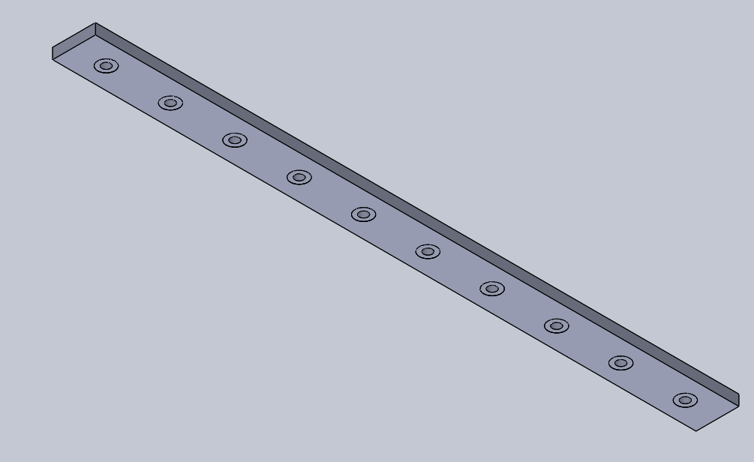
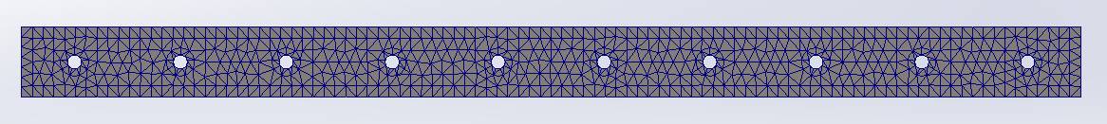
Design - Initial
This model is not considered a design concept. It is the initial geometry that will help produce future iterations
It will also be compared to the other designs for lighter weight and higher strength
For the extra material around the holes, we used the “do not merge result” icon in the Solid Works extrude feature
With that being said, we will be able to have the surrounding material as separate parts in nTopology, which will help us in later applications such as Topology Optimization and Lattice Structure
Notes:
As we can see in the bottom images, our initial design, which was designed in Solidworks consists of a solid plate and 10 holes with the exact dimensions we mentioned before. The image on the left shows the details of the mesh used for the initial Finite Element Analysis which was then verified in ntopology for our topology optimization

Slide 18
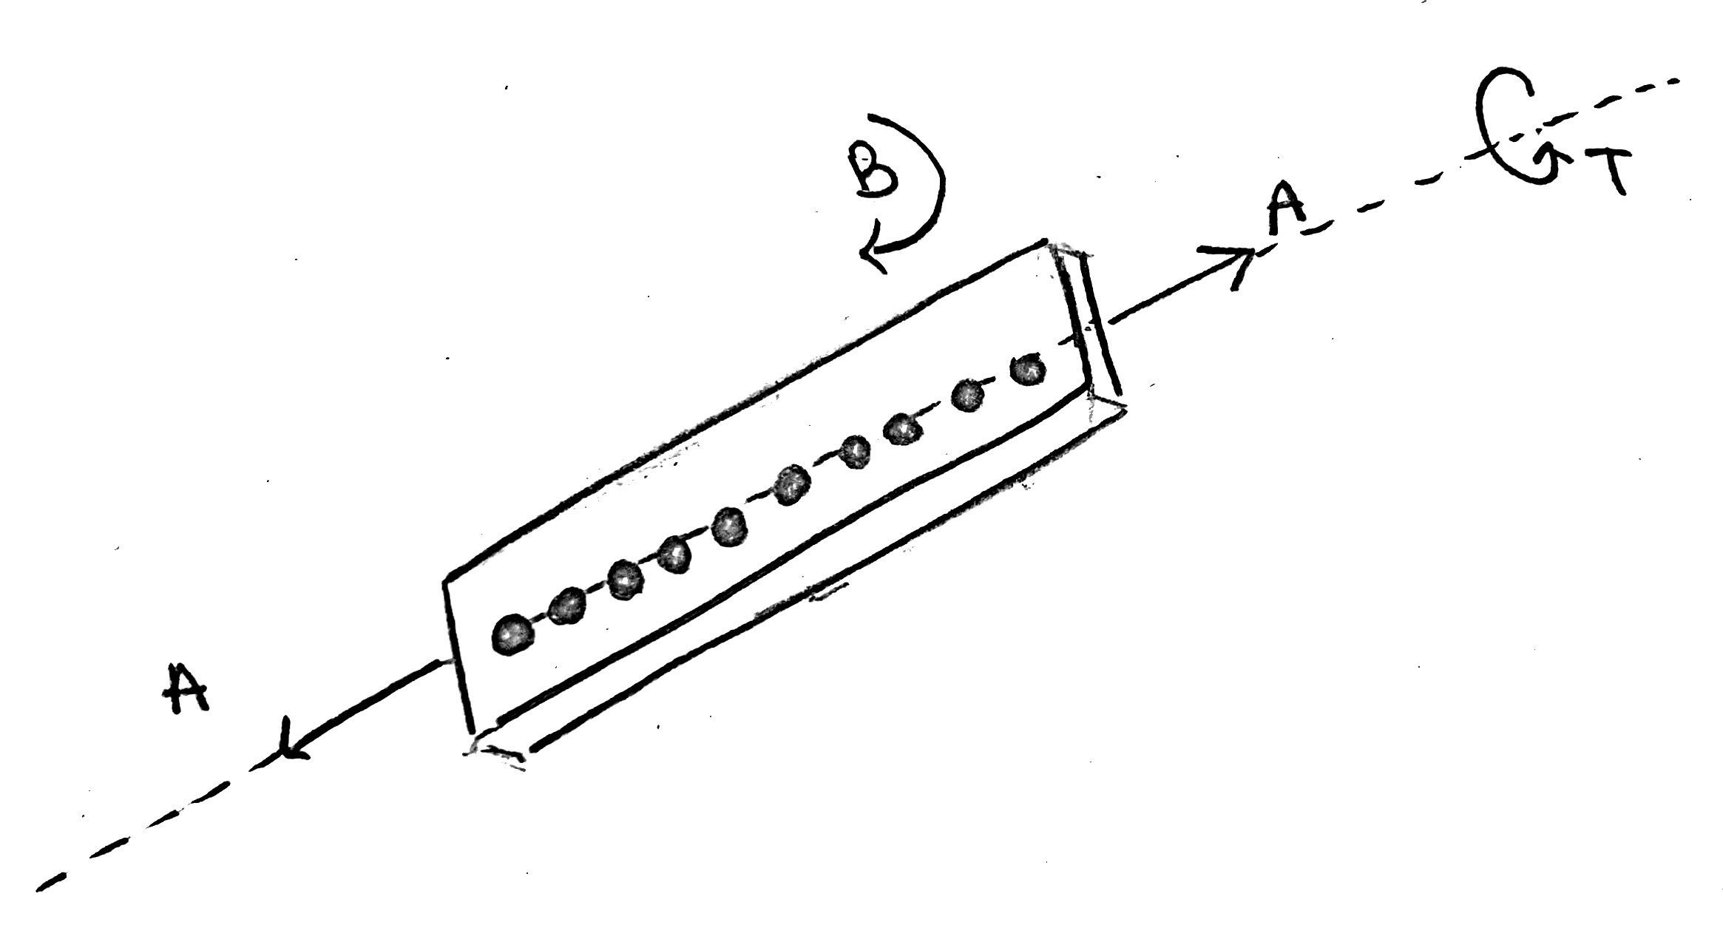
Design – Loading and Boundary Conditions
The design failure criteria will be followed to determine whether the model passes or fails
The image below shows the three criteria to test for:
A = Axial loads of 2625 N (3.5 BW)
T = Axial torsion of 75 Nm (0.1 BW.m)
B = Bending moment of 225 Nm (0.3 BW.m)
Additionally, the black holes are considered to be fixtures (assuming rigid connection between screws and plate)
150-500µm axial displacement during loading
Notes:
Loading conditions were provided at the beginning of the project by the professor.

Slide 19
Initial Finite Element Analysis
Concurrent loading conditions from before
Initial Axial displacement of ~300um before topology optimization
Initial mass 130.08 grams
Notes:
Our initial finite element analysis was performed in solidworks using the concurrent loading conditions as mentioned before. The initial CAD model exhibited an axial displacement of roughly 300um which fits within our defined range of 150 to 500um. Its initial mass was 130.8 grams before optimizations were performed.

Slide 20
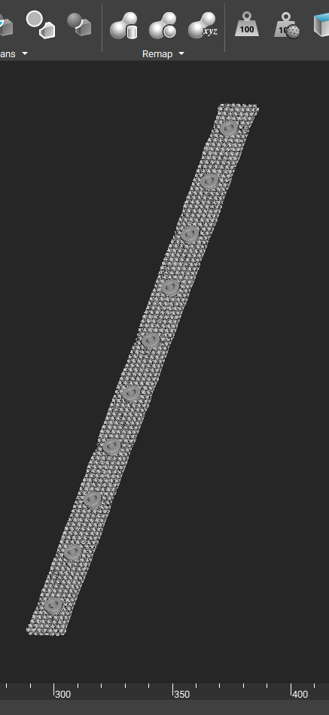
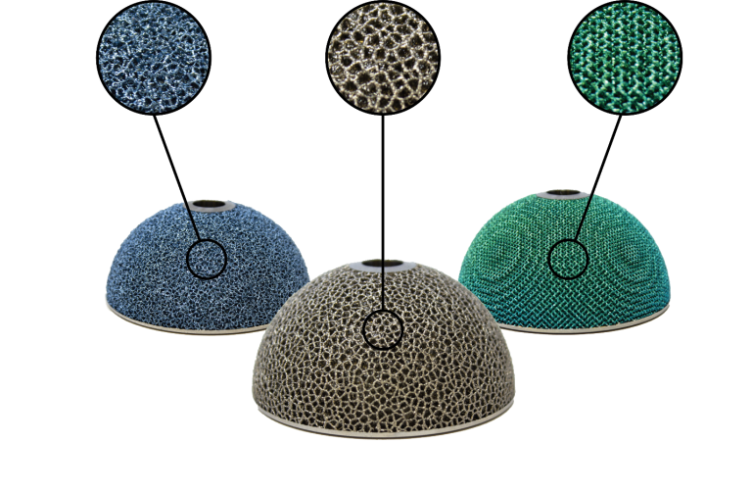
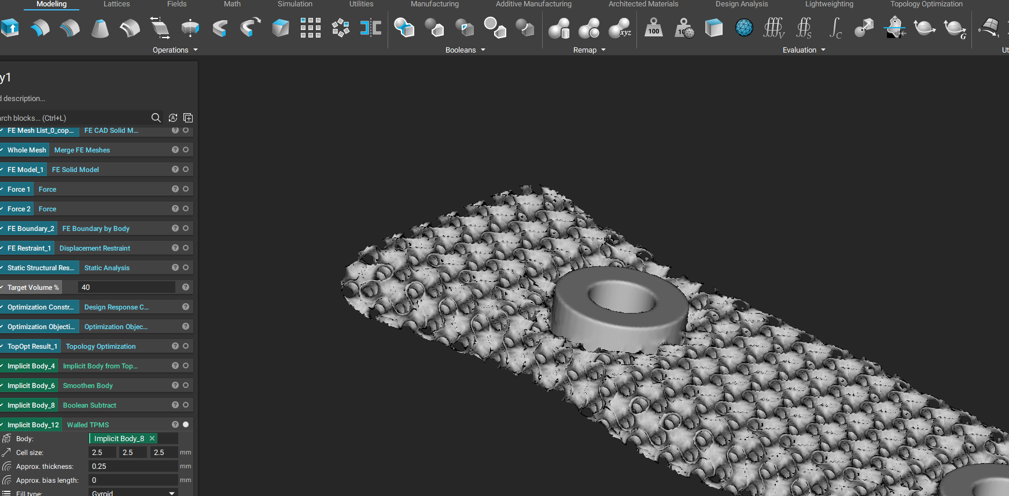
Design for AM plans
DfAM Considerations
Screw Spacing and Location
Screw location and spacing can be adjusted to suit specific patient
10 screw locations for fixation to bone fragments were utilized.
Machining allowances
Excess material at screw locations was added to allow for machining (reaming, chamfering, etc.)
Lattice Structure
Minimum lattice thickness: 0.25 mm
Optimization for lattice geometry was based on maximum axial displacement.
A self-supporting TPMS structure was used
Powder removal/part cleaning/post-processing
A TPMS Gyroid structure limits supports and allows for ease of powder removal.
Notes:
https://www.ge.com/additive/sites/default/files/2021-09/GE_CS_Amplify_8.5x11_R3.pdf
http://balticimplants.eu/patient-specific-medical-devices/femoral-osteosynthesis-plates/
https://ntopology.com/blog/2020/08/05/additive-manufacturing-in-orthopedics-lattice-structures/

Slide 21
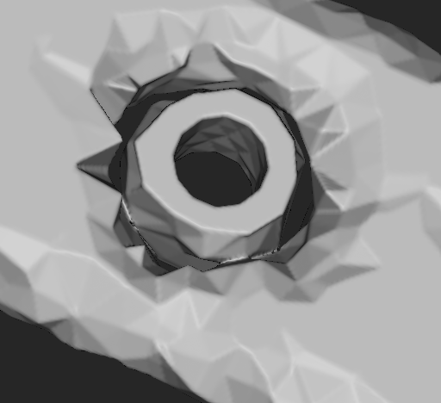
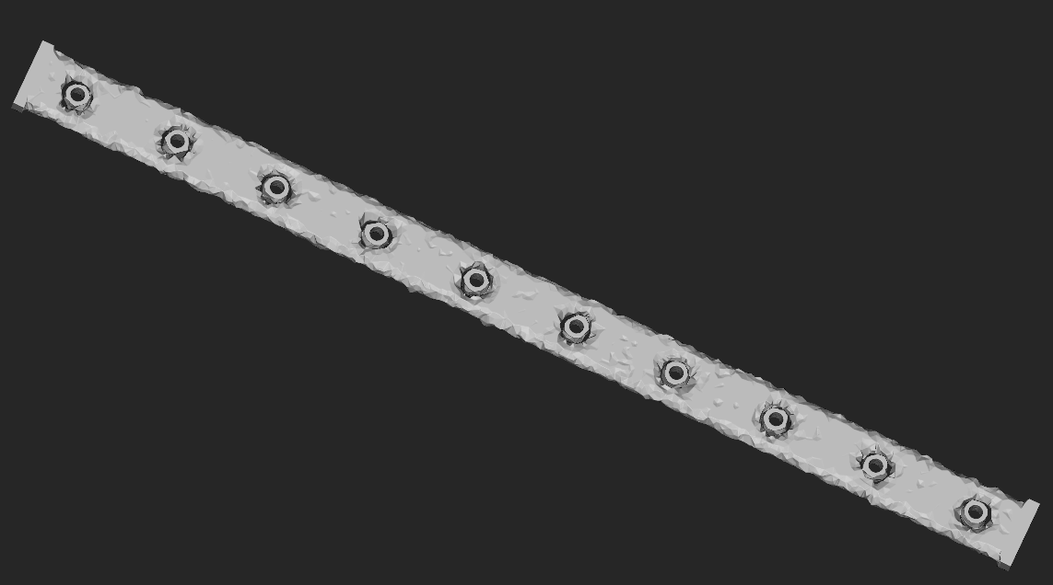

Design Concepts – Final Decision
Topology Optimized Part Smoothened Part
Notes:
In the first image (left), we can see the results from the Topology Optimization
In the second image (right), we can see the results of smoothening the rough structure, along with subtracting the 8mm outer diameter (in order to add it later)
Note that all values used will be shown in later slides

Slide 22
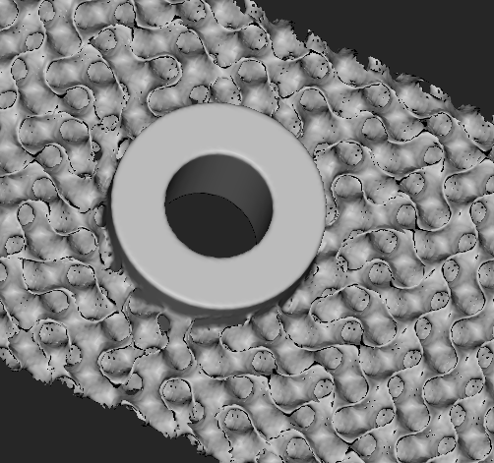
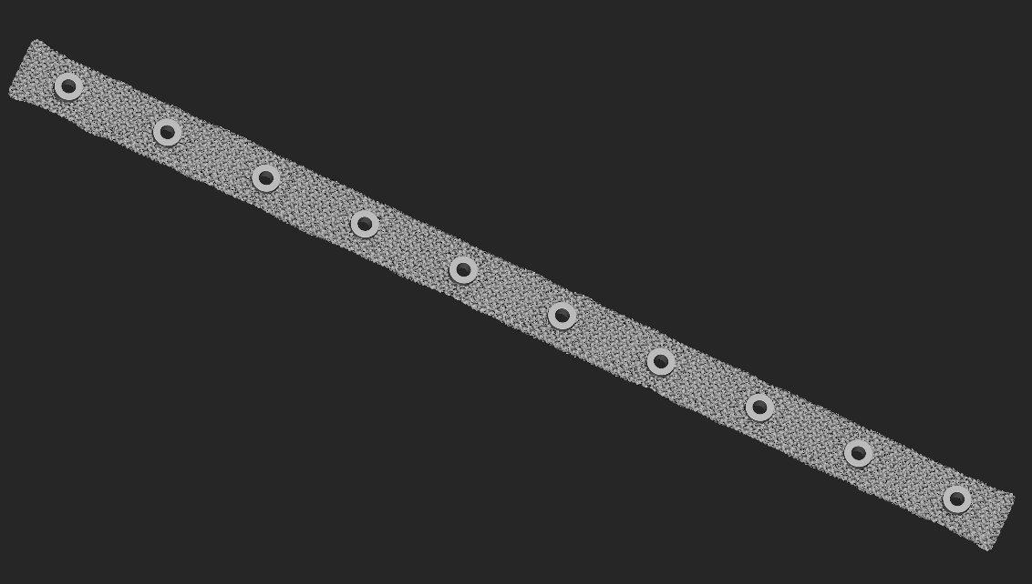

Design Concepts – Final Decision
Lattice Structure Part Mesh part
Notes:
In the first image (left), we now have the part with both Topology Optimization and Lattice Structures (in Gyroid form).
We also added the screw holes with their appropriate surroundings.
In the last image (right), we turned the part into a mesh to be exported in .stl format for further analysis (Atlas, Magics)

Slide 23
Design Concepts – Parameters
The parameters used for the previously seen design are the following:
Target volume: 70%
Topology Optimization threshold: 0.235
For smoothening:
Grid Size: 1mm
Smooth Operations: 3
Unit cell (Gyroid) size for lattice structure: 2.5mm in x, y, and z
Lattice Structure approximate thickness: 0.25mm
Mesh Tolerance: 1mm
All units are in: mm
Notes:
Most of these parameters were initially used from ME566 Homework 6 (with some alterations according to this case study)

Slide 24
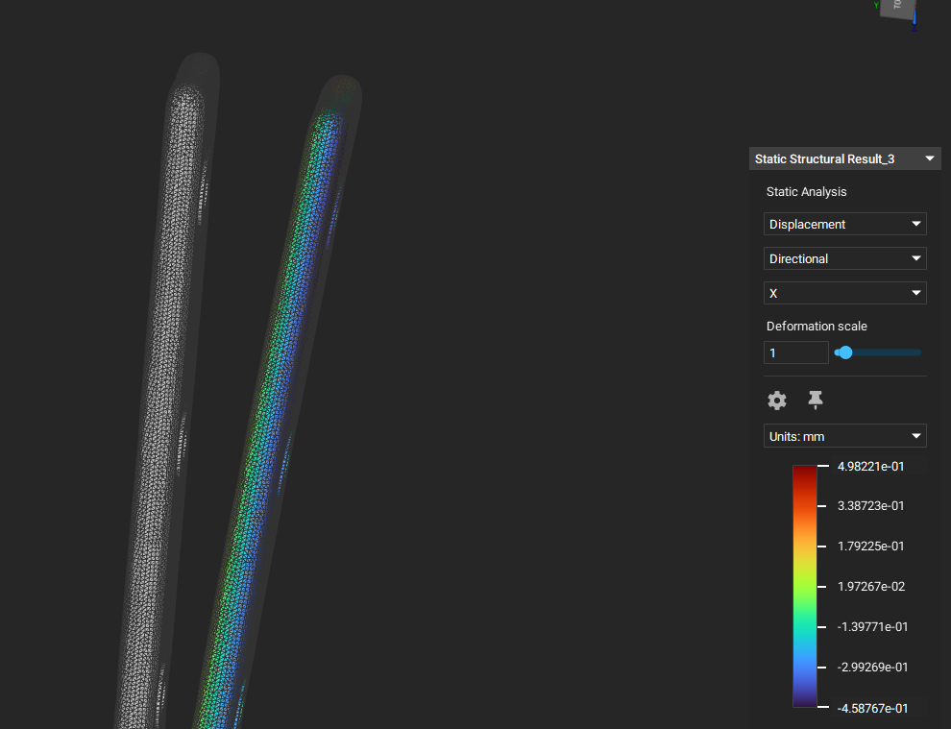
Finite Element Analysis- Final Desicion
Used concurrent loading parameters from our Loading/Boundary Conditions
Maximum displacement is estimated to be 498um
Achieved 70% of original mass (30% weight reduction)
Simulation run in ntopology on the topology optimized model for verification
Notes:
After performing the topology optimization, our model was then reevaluated using Finite Element Analysis and the same loading conditions as before. Our design exhibited a 30% mass reduction and a maximum axial displacement of 498um after the optimizations were run.

Slide 25
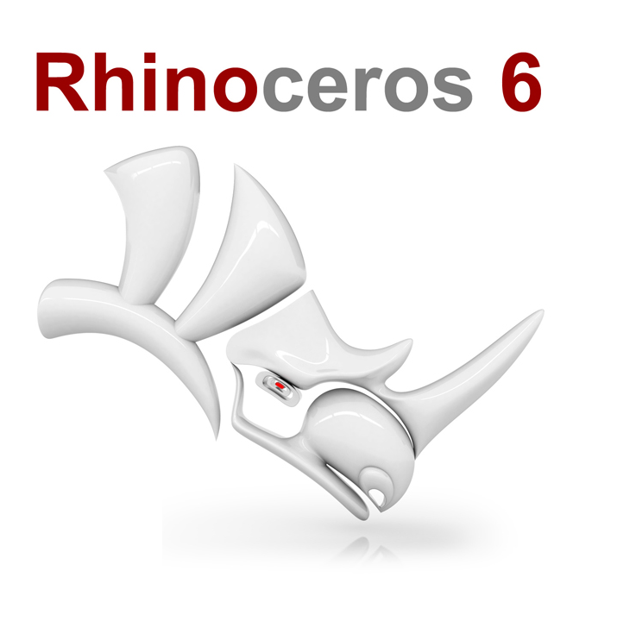

Design Concepts – Parametric Design
Design Generation is prone to iterations
Parametric design can be of great help!
It is unlikely for a structure to be perfect forever. Newer versions/iterations are extremely common [1]
With this program (Rhino + Grasshopper), changing dimensions is made easy. A grasshopper script has been generated with number sliders that change the design variables accordingly
Notes:
[1]: Barrios Hernandez, Carlos Roberto. “Thinking Parametric Design: Introducing Parametric Gaudi.” Design Studies 27, no. 3 (2006): 309–24. https://doi.org/10.1016/j.destud.2005.11.006.

Slide 26
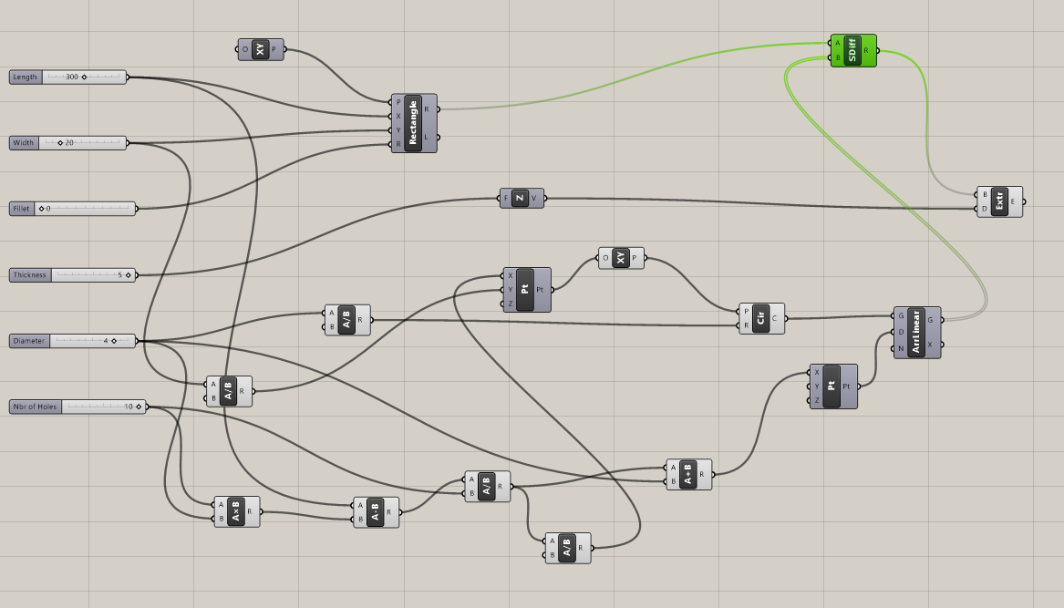
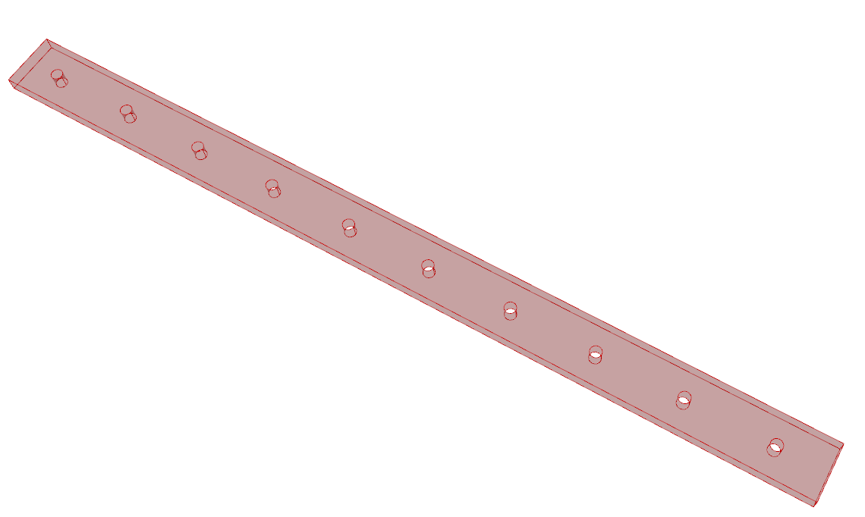
Design Concepts – Parametric Design
Grasshopper Side Rhino Side
Notes:
Parameters that could be changed:
Length
Width
Fillet
Thickness
Diameter
Number of holes

Slide 27
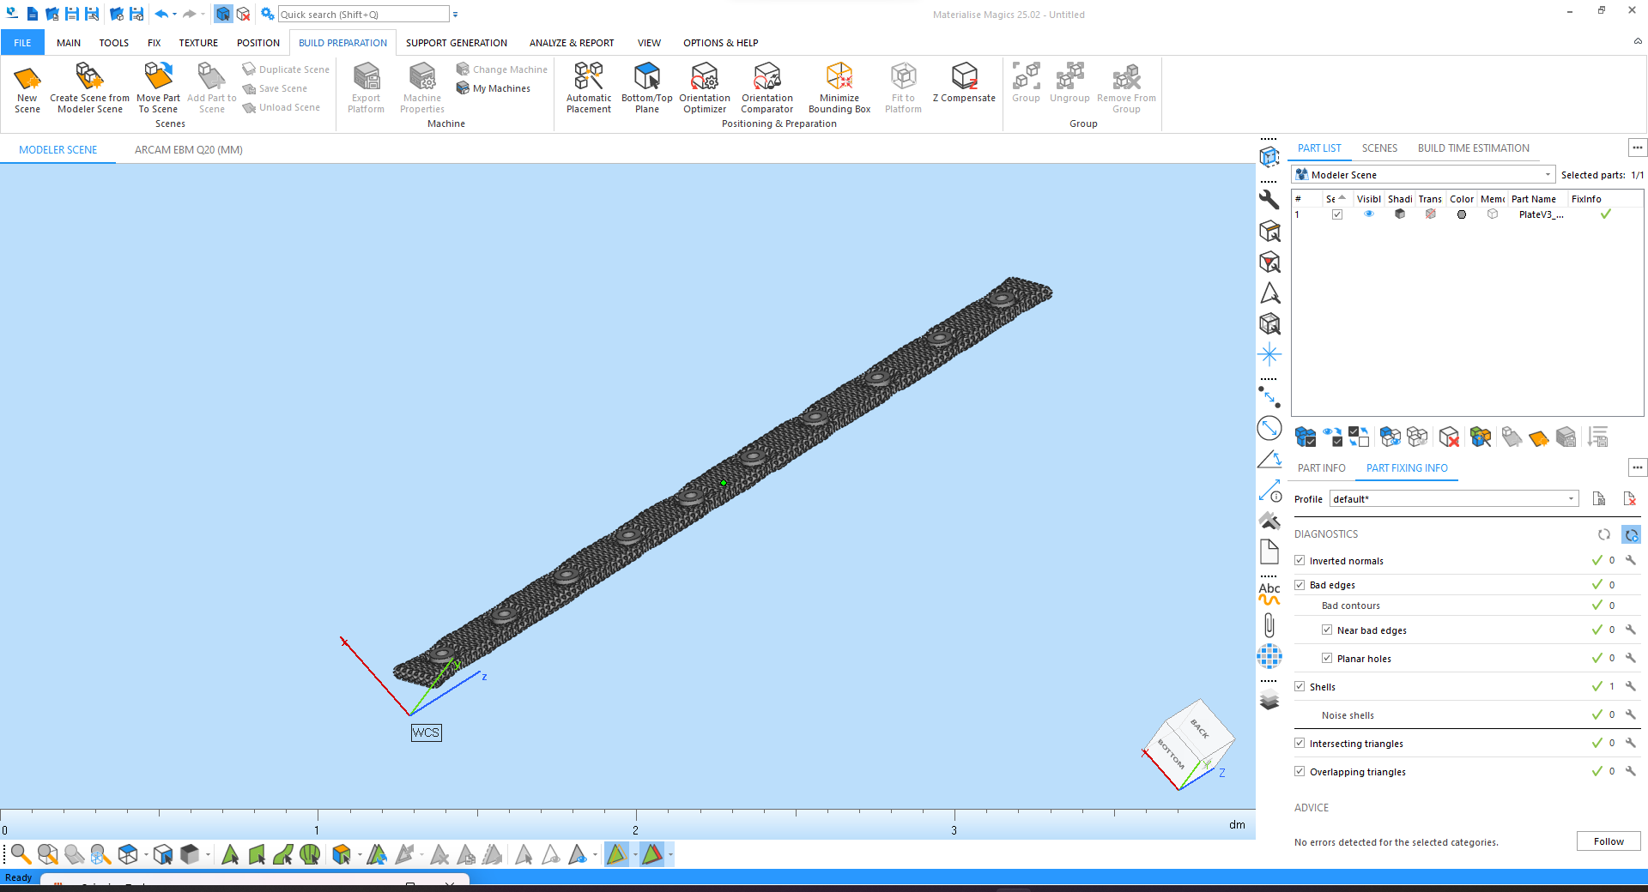
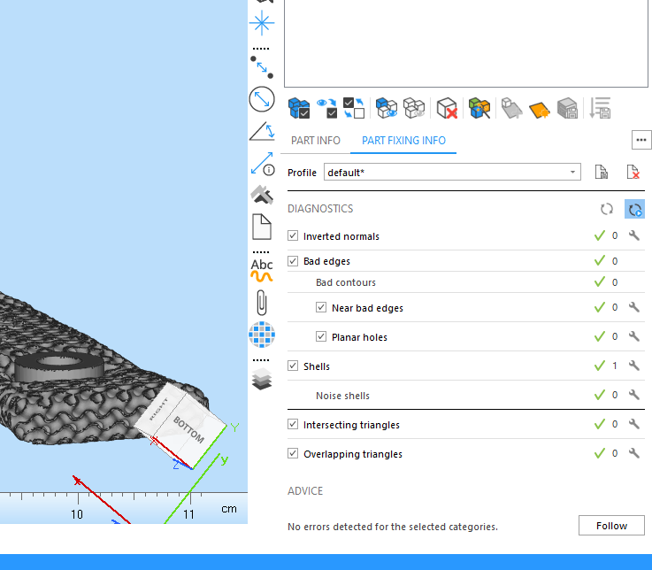
AM Part File Preparation plans
STL file modification via Magics
STL File Generation
STL file generated from nTop software
STL Issues
Magics contains mesh fixing algorithms to automatically and manually fix and modify STL files. STL issues listed below:
Inverted Normals
Triangle issues (IE Bad edges, intersecting triangles, overlapping triangles)
Hole(s) in shell
Noise shells and/or multiple shells
Notes:
https://www.materialise.com/en/blog/5-basic-3d-model-repair-functions-every-data-prepper-should-know
https://www.stratasysdirect.com/resources/tutorials/how-to-prepare-stl-files

Slide 28
AM Build Preparation Plans
Build simulation conditions (Proprietary/recommended settings) [1,2]
Arcam Q20
Preheating: 600 °C - 800 °C
E-Beam spot size: 80 µm
Beam power/energy density: 1250 W
Layer thickness: 75 µm
Scanning Speed: 4530 mm/s
Hatch Spacing: 100 µm
Hard Recoater
Multi-criteria build set-up optimization
Minimum distortion is the most critical factor
Minimum distortion will be critical to ensure a proper fit between the bone and the plate. A better fit will create a more ideal load transfer from bone to plate also.
Number of build failures
A small amount of distortion should lead to a low amount of build failures
Max part strength
The plate will be sized to withstand loading conditions and have a healthy safety factor. Therefore, it is not critical for the part to have its max strength possible, but care should be taken to ensure that the part does not become weaker than the material properties used during the FEA analysis.
Build time
The plate section that will be printed likely won't be very big so long print time probably will not be an issue. The plates will also be custom designed to meet each patient's bone so the part will not need to be mass produced.
Support considerations
Support removal
Support placement (where we can and can't have supports)
Support styles (stronger supports, perforated supports, removal style (by hand or machining))
Support scarring/smoothness
Notes:
[1] Ginestra, Paola, et al. "Selective laser melting and electron beam melting of Ti6Al4V for orthopedic applications: a comparative study on the applied building direction." Materials 13.23 (2020): 5584.
[2] Murr, Lawrence E., et al. "Next generation orthopaedic implants by additive manufacturing using electron beam melting." International journal of biomaterials 2012 (2012).

Slide 29
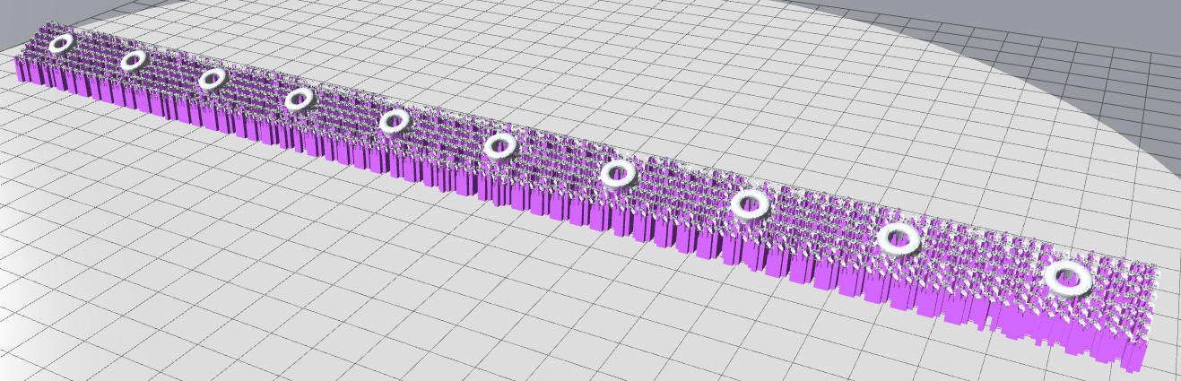
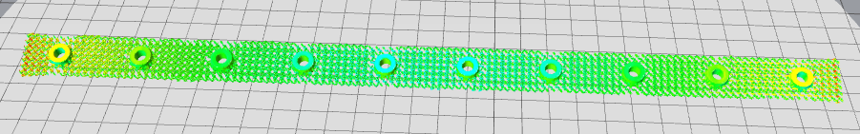
AM Build Simulation
Atlas 3D simulation software
Processing parameters were entered and then the software's minimum distortion option was chosen as it is the most critical build factor for the plate
Build simulation showed that a greater amount of distortion exists at either end of the part
The software chose to orient the part at a ~25 deg angle in order to achieve a minimal amount of distortion

Slide 30
AM Build Simulation Difficulties
Atlas 3d software struggled to properly render the lattice structure and showed some distortion between the CAD shape and atlas 3d rendering
Support material could not be added to the lattice structure geometry because it would not be able to be removed
Atlas 3d build optimization is not able to recognize this and therefore added supports inside the lattice
Atlas 3d does have a feature where you can indicate where supports are not allowed. However, the lattice structure is so thin and has so many facets that it is practically impossible to use the feature
Increasing the critical angle was also tried as a method of preventing Atlas 3d from adding supports to the lattice structure but it was unsuccessful
Manual removal of the unwanted supports is the only viable option

Slide 31
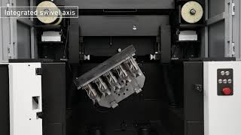
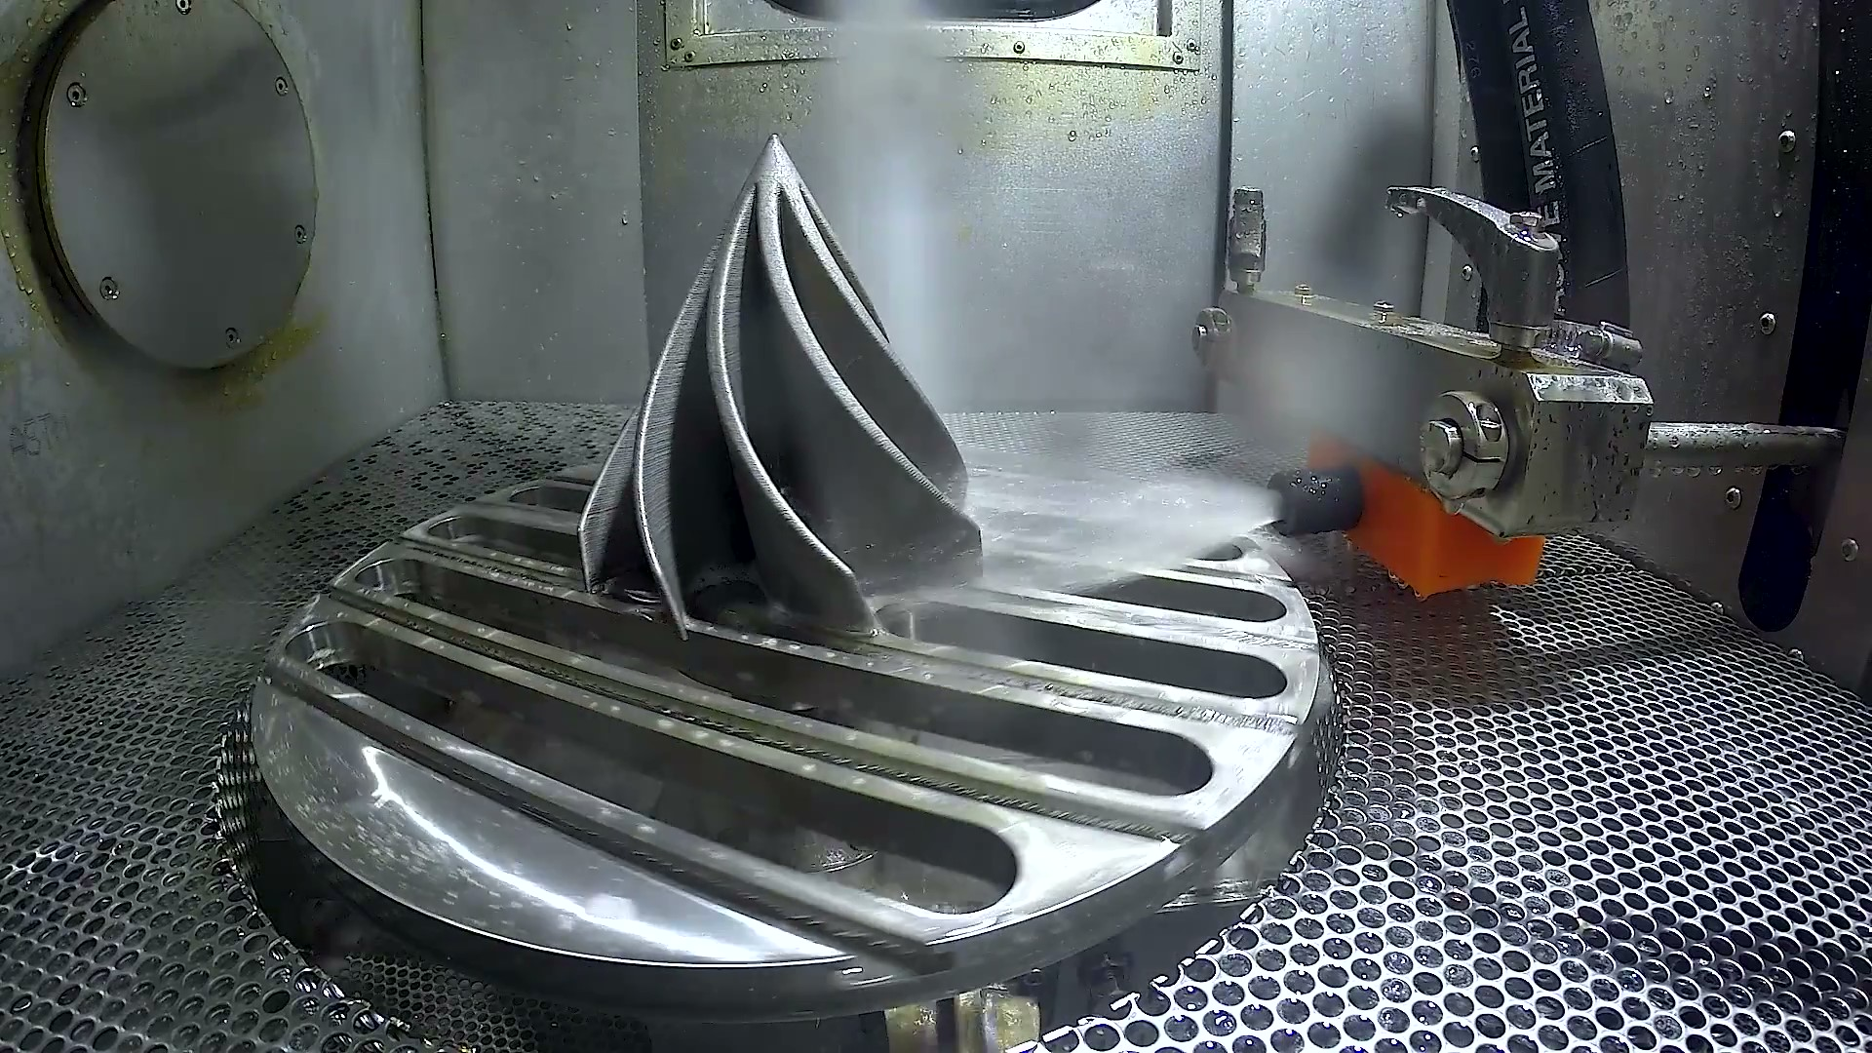
Post-AM Plans
Stress relieving
Detailed in ASTM F3001 Section 12 and 13
Alternative stress relief regime may be necessary/beneficial
Part Removal via EDM [1]
Reduced offset distance needed: 5mm used
High precision removal
Straighter cuts than bandsaw
Better for fragile or intricate parts
Powder Removal [2, 3]
Secondary powder removal steps to ensure no intrusion of material in-vivo
NDI
CT Scan to check for lack of fusion areas
Optical Microscopy to check for powder adhesion to structures and/or part defects
Part surface in contact with the bone will be coated with hydroxyapatite
Via Micro-Arc Oxidation or Vacuum Plasma Spraying [4, 5]
This will encourage bone regrowth and enhance healing
Lattice structure in contact with the skin/muscle tissue may be infiltrated/covered in a bioactive (silica-based) glass to allow a smooth surface/interface during healing, this coating will dissolve within the body as it's bio-compatible but will not impact the structure of the implant
After which the parts will be treated with a steam based hydrothermal heat treatment [4]
Cleaning of the parts is imperative to avoid infection and steam is an effective means to accomplish this
Notes:
[1] https://www.mmsonline.com/articles/cutting-am-parts-from-build-plate-turns-wire-edm-upside-down
[2] https://www.tctmagazine.com/additive-manufacturing-3d-printing-news/guyson-orbit-600-rpf-cleaning-3d-printed-medical-implants/
[3] https://scholarworks.utep.edu/cgi/viewcontent.cgi?article=4189&context=open_etd
[4] https://www.frontiersin.org/article/10.3389/fbioe.2021.625877
[5] https://pubmed.ncbi.nlm.nih.gov/12889006/
[6] https://3dheals.com/3d-printed-trabecular-implants/

Slide 32
Future Work
Gradient Lattice Structures: A gradient design can achieve various functionalities, while optimizing strength-to-weight ratio characteristics [1]. This could help design the plate with more than one type/size of unit cell to act accordingly with the loads
Make the plate smoother on the edges: With a lattice structure all around the plate, surgeons can have a hard time maneuvering the part. In real-time operations conditions, this should be avoided
Blender renders: Blender is a software that can provide high quality renders , while also including realistic materials and textures [2]
Notes:
[1]: Seharing, A., Azman, A. H., & Abdullah, S. (2020). A review on integration of lightweight gradient lattice structures in additive manufacturing parts. Advances in Mechanical Engineering, 12(6), 168781402091695. https://doi.org/10.1177/1687814020916951
[2]: Nguyen, L. (2021, October 14). Blender for Architecture. Is it as great as 3D rendering software? iRender Cloud Rendering Service. https://irendering.net/blender-for-architecture-is-it-as-great-as-3d-rendering-software/

Slide 33
Appendix:
Additional slides show the Proposed Project Schedule and Risks with anticipated Mitigation strategies
Notes:
Thank you for coming to our presentation

Slide 34
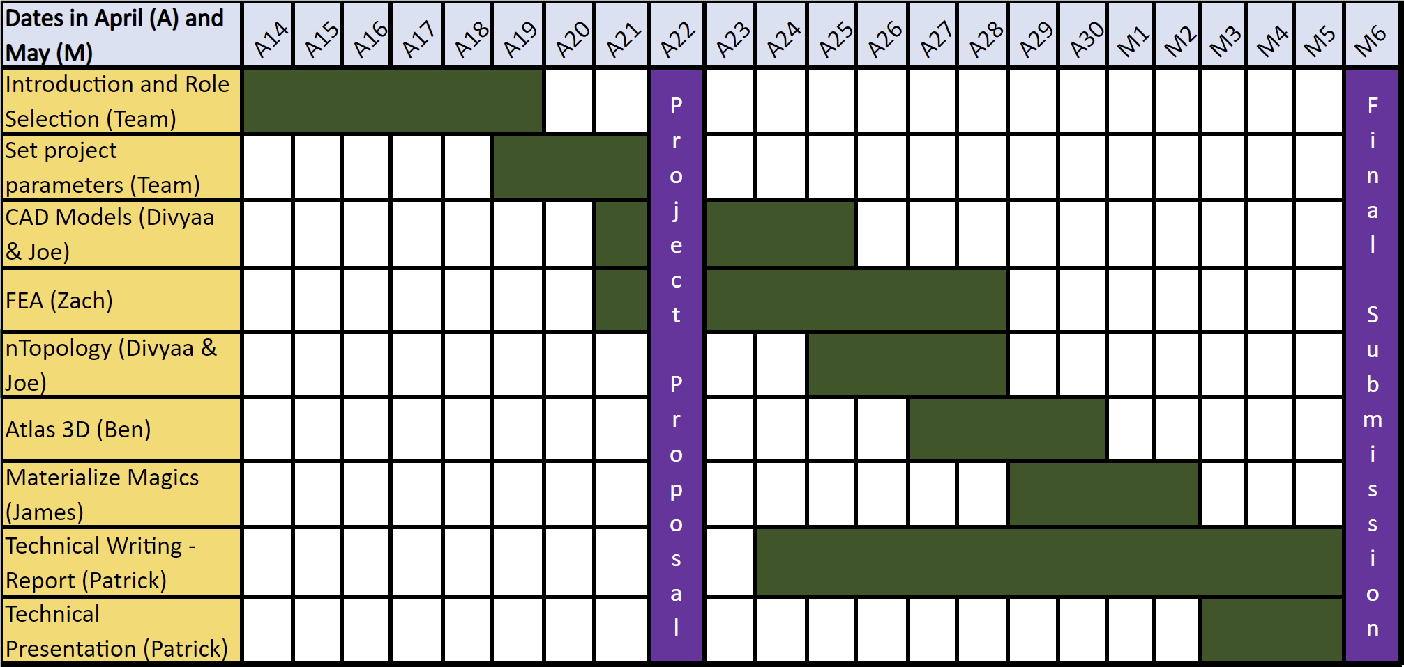
Gantt Chart
Notes:
A Gantt chart that was developed at the beginning of the project to help keep team members on track and define roles

Slide 35
Risks – Mitigation
Ranking | Major Risks | Mitigation Strategies
1 | Time and communication coordination between WC and UP students. | Utilizing when2meet app to schedule times for availability/meetings. Utilizing MS Teams for real time file editing and file sharing. Distributing meeting minutes and key takeaways to keep all members informed of major updates and roles. Maintaining a running group chat for constant communication
2 | Issue with transferring stl files between the different sofwares | Do a trial run with a sample part to ensure file type and versions are compatible Have backup options in case there are issues
High Priority
High Priority
Low Priority
Notes:
Risks and mitigation strategies that we, as a team, predicted would impact the course of our project.

