Slide 1
CALCULATOR
SUBMITTED TO:
Mr. Tushar Tkhitoliya
.
SUBMITTED BY :
Joel Matthew
2210990465
G-10

Slide 2
TABLE OF CONTENTS:
INTRODUCTION
PROBLEM STATEMENT
TECHNICAL DETAILS
KEY FEATURES
PROJECT HIGHLIGHTS
CONCLUSIONS
REFERENCES

Slide 3
INTRODUCTION:
The Simple Calculator Application is a Python-based program designed to provide users with a straightforward tool for performing basic arithmetic calculations.
Developed using the Tkinter library, this application offers a user-friendly interface that allows users to input numbers and perform various arithmetic operations with ease.
In today's digital age, individuals often require access to simple yet effective tools for performing arithmetic calculations.
The aim of this project is to address this gap by creating a simple calculator application that offers essential functional

Slide 4
OVERVIEW:
Many existing calculator applications may be overly complex or lack the intuitive interface desired by users.
Users often require access to a simple yet effective tool for performing basic arithmetic calculations.
There is a need for a user-friendly calculator application that offers essential functionality without unnecessary complexity.
The lack of such a tool may lead to inconvenience and frustration for users seeking a straightforward solution for arithmetic calculations on their computers.

Slide 5
PROBLEM STATEMENT:
Many existing calculator applications may be overly complex or lack the intuitive interface desired by users.
Users often require access to a simple yet effective tool for performing basic arithmetic calculations.
There is a need for a user-friendly calculator application that offers essential functionality without unnecessary complexity.
The lack of such a tool may lead to inconvenience and frustration for users seeking a straightforward solution for arithmetic calculations on their computers.

Slide 6
TECHNICAL DETAILS:
Developed using the Python programming language.
Utilizes the Tkinter library for creating the graphical user interface (GUI).
Features an Entry widget for displaying input and results.
Incorporates Button widgets for numeric input and arithmetic operations.
Implements event handling mechanisms to capture user input and perform calculations.
Leverages Python's versatility and Tkinter's capabilities to create a responsive and intuitive calculator application.

Slide 7
KEY FEATURES:
User-Friendly Interface: The application boasts a clean and intuitive interface, allowing users to input numbers and perform calculations effortlessly.
Numeric Input: Users can input numeric values using the on-screen buttons provided for digits 0 through 9.
Arithmetic Operations: The calculator supports basic arithmetic operations, including addition, subtraction, multiplication, and division.
Clear Functionality: A 'C' button is included to allow users to clear the input and start a new calculation.

Slide 8
PROJECT HIGHLIGHTS:
The Simple Calculator Application offers a simple yet effective solution for performing arithmetic calculations, catering to the needs of users across various domains.
Its intuitive interface and essential features make it suitable for both casual users and professionals seeking a reliable calculator tool.
The project demonstrates the power and versatility of Python programming language, particularly in GUI application development.

Slide 9
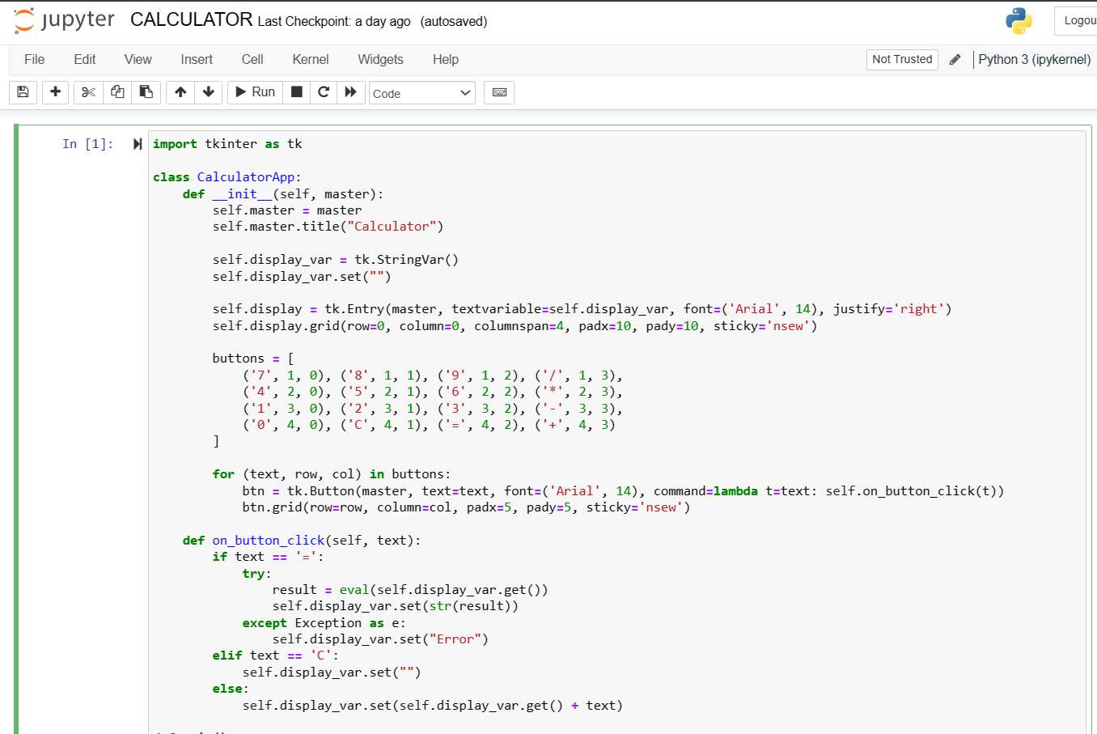
CODE:

Slide 10
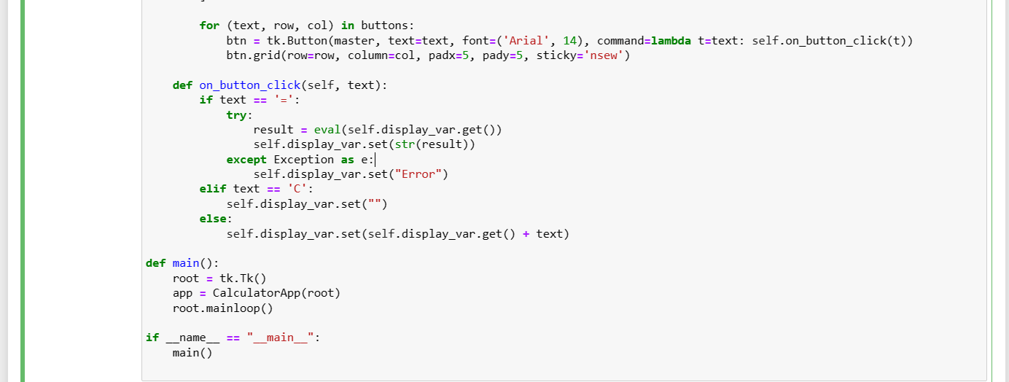

Slide 11
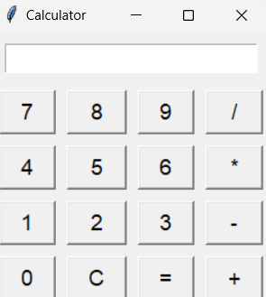
OUTPUT OF OUR CODE:

Slide 12
CONCLUSION:
The Simple Calculator Application represents a successful endeavor in creating a user-friendly tool for performing basic arithmetic calculations.
Leveraging Python and Tkinter, the application provides a straightforward and efficient solution for users across various domains.
Its intuitive interface and essential features make it suitable for both casual users and professionals seeking a reliable calculator tool.
This project demonstrates the power and versatility of Python programming language, particularly in GUI application development.

Slide 13
REFERENCES:
Python Documentation: https://www.python.org/doc/
Tkinter Documentation: https://docs.python.org/3/library/tkinter.html
Stack Overflow: https://stackoverflow.com/
Tutorialspoint: https://www.tutorialspoint.com/python/index.htm

Slide 14


