Slide 1


Airline safety - Final
Joel McMillin

Slide 2
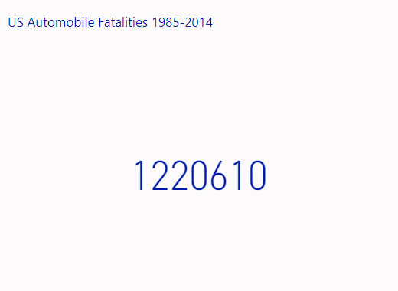
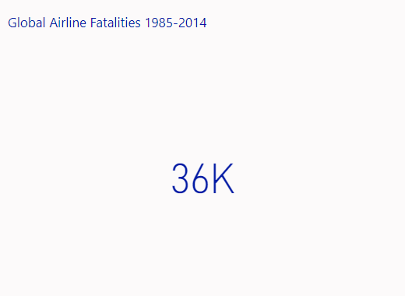
The Reality of Auto vs Airline Safety – the Numbers
Airline Fatalities = 3% of Auto Fatalities over a 30-Year period

Slide 3
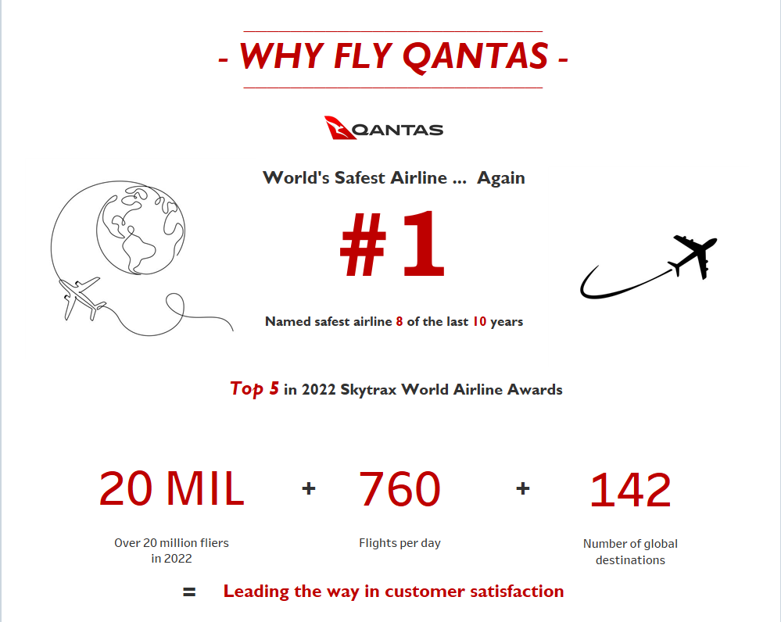

Slide 4
references
“Accidents and Fatalities per Year.” Google Sheets, Google, https://docs.google.com/spreadsheets/d/1SDp7p1y6m7N5xD5_fpOkYOrJvd68V7iy6etXy2cetb8/edit#gid=661081734.
Barida, Vitalii. “Airplane Fly Icon. Plane Flying with Line. Travel Transportation...” IStock, https://www.istockphoto.com/vector/airplane-fly-icon-plane-flying-with-line-gm1314724689-402876132.
Green, Eli. “Qantas Regains Top Spot for Safest Airline in 2023.” Escape, 3 Jan. 2023, https://www.escape.com.au/news/qantas-regains-top-spot-for-safest-airline-in-2023/news- story/469c74cdf2b14eda3eab0c7f19cd8e8d.
“Investor.qantas.com.” Qantas Annual Report 2022, https://investor.qantas.com/FormBuilder/_Resource/_module/doLLG5ufYkCyEPjF1tpgyw/file/annual-reports/2022-Annual-Report.pdf.
“Motor Vehicle Fatality Rate in U.S. by Year.” Wikipedia, Wikimedia Foundation, 17 Jan. 2023, https://en.wikipedia.org/wiki/Motor_vehicle_fatality_rate_in_U.S._by_year.
“Qantas Logo.” 1000 Logos The Famous Brands and Company Logos in the World Qantas Logo Comments, https://1000logos.net/qantas-logo/.
“Qantas Logo Color Palette Image Format.” Qantas Logo Color Scheme " Brand and Logo " SchemeColor.com, https://www.schemecolor.com/qantas-logo-colors.php.
“Qantas Remains Number One in Airline Satisfaction for Both Domestic and Domestic Business Travel.” Home - Roy Morgan Research, 29 Jan. 2020, https://www.roymorgan.com/findings/qantas- remains-number-one-in-airline-satisfaction-for-both-domestic-and-domestic-business-travel.
“Qantas Shock Ranking in Airline Awards.” Yahoo! Finance, Yahoo!, 26 Sept. 2022, https://au.finance.yahoo.com/news/qantas-achieves-shock-ranking-in-world-airline-awards-014415438.html.
Staff, 9News. “Qantas Reclaims World's Safest Airline Title.” 9News, 9News, 3 Jan. 2023, https://www.9news.com.au/national/qantas-named-worlds-safest-airline-2023-reclaim-top- spot/4275a9bf-c3c1-453e-9860-59ee3211f904#:~:text=In%20picking%20Qantas%20for%20the,the%20industry's%20most%20experienced%20airline%22.

