Slide 1
Dyslexia

Slide 2
Dyslexia
http://www.dyslexia.ie
A specific learning difficulty which makes it harder for some people to learn, to read, write and spell.

Slide 3
Dyslexia
What’s it like?

Slide 4
Dyslexia
What’s it like?
It’s different for different people.
U
A
B

Slide 5
Dyslexia
What’s it like?

Slide 8
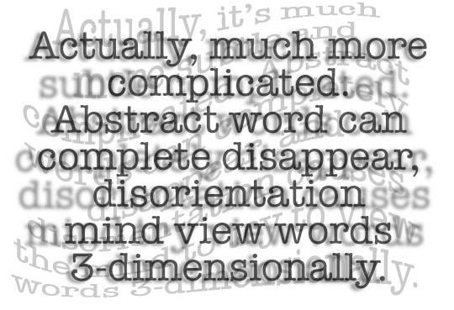

Slide 9
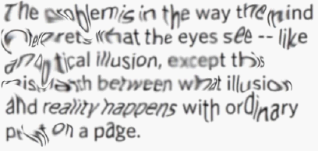

Slide 10
Dyslexia
The Dyslexia Association of Ireland (DAI) recommends the use of san serif fonts such as Arial, Comic Sans, Verdana or Sassoon.
Arial
Comic Sans
Verdana
Sassoon

Slide 11
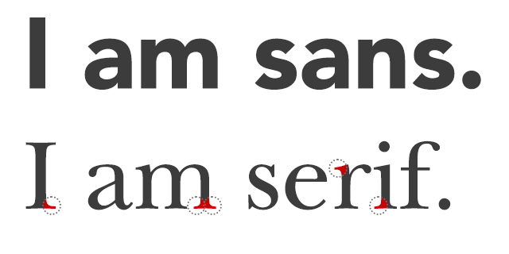
Dyslexia
The Dyslexia Association of Ireland (DAI) recommends the use of san serif fonts such as Arial, Comic Sans, Verdana or Sassoon.
Arial
Comic Sans
Verdana
Sassoon

Slide 12
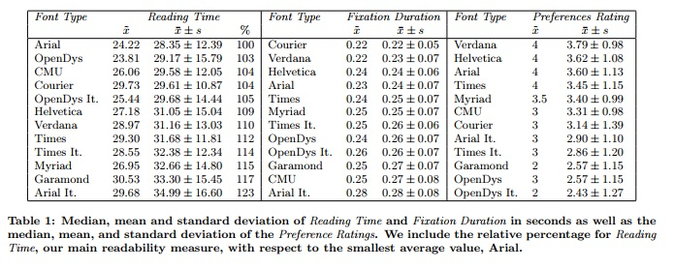
Dyslexia
Rello, L., Baeza-Yates, R. (2013) “Good Fonts for Dyslexia”, In Proceedings of the 15th International ACM SIGACCESS Conference on Computers and Accessibility (p. 14). ACM.

Slide 13
Help the Student to Prepare for Class by:
Giving them your notes a few days before class.
Giving them labs a few days before the lab (if possible).
Explaining the key words first before they are used when discussing that topic in class.

Slide 14
Help the Student in the Class by:
Using images and diagrams where possible (and help learners devise their own pictures and diagrams).
Breaking a longer sentence into a few shorter ones (sometimes students are so focused on understanding each word, they can miss the meaning of the sentence).
Providing model answers where possible.
Providing sentence starters to show how to begin a written response.

Slide 15
Help the Student in Tests and Assignments by:
Arranging tests and assignments to work from easiest to hardest problems.
Not penalizing them for spelling errors.
Breaking down tests and assignments into small parts (using new paragraphs and bullet points to break things up).
Providing them with extended time for testing.

Slide 16
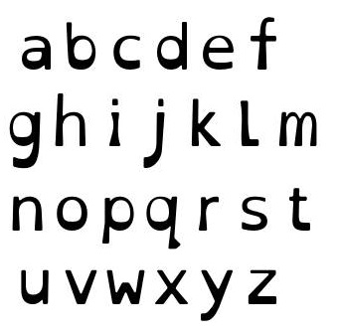
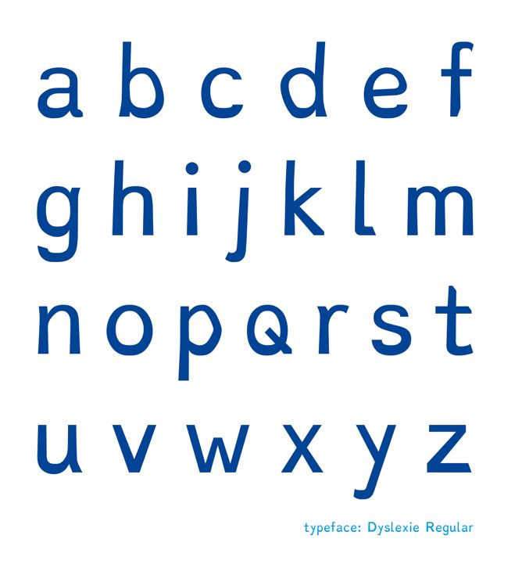
Dyslexia
Open Dyslexic Font:
https://opendyslexic.org
Dyslexie Font:
https://www.dyslexiefont.com/en/typeface/

Slide 17
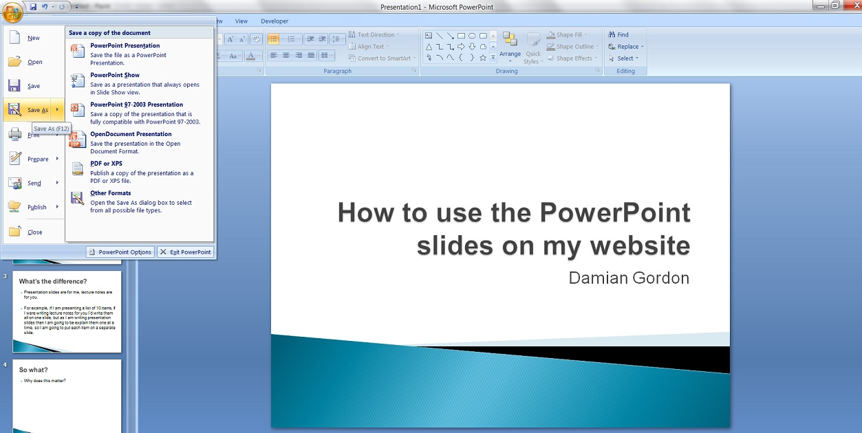
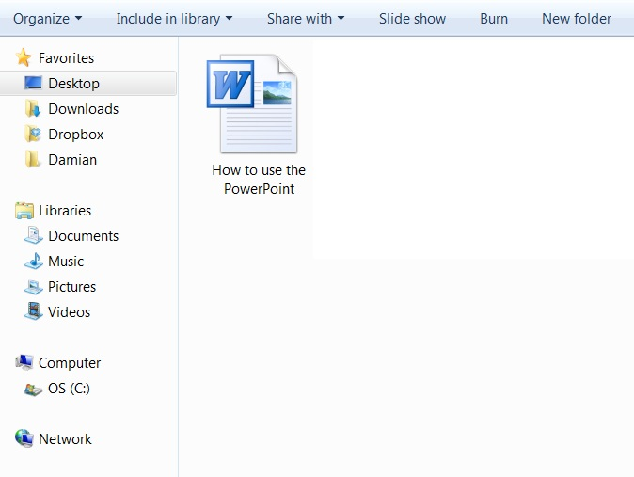
An aside…
Save my slides as file type “Outline/RTF” under “Other Formats”:
And you’ll find a Word document that you can manipulate:

Slide 18
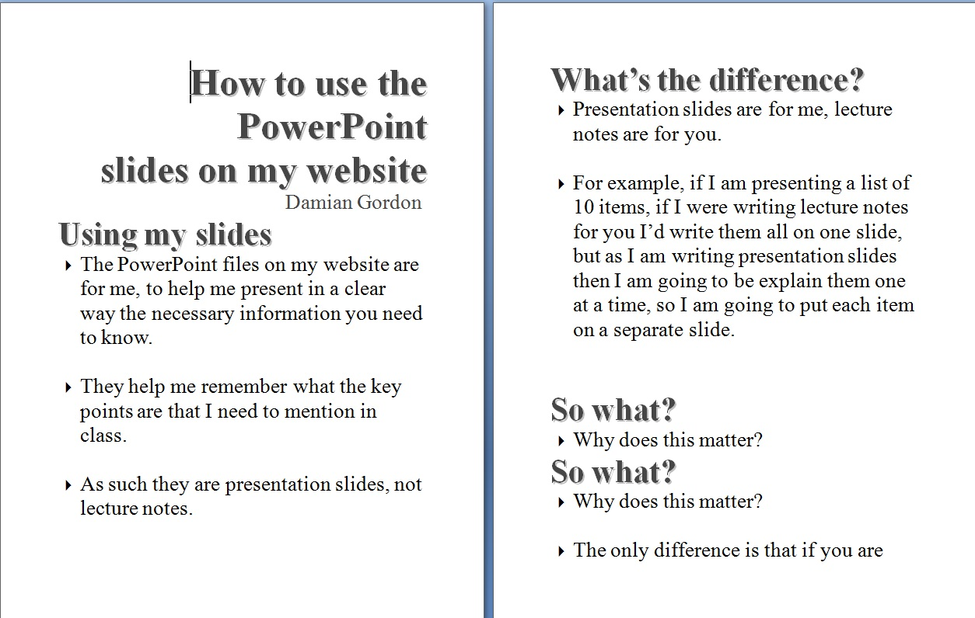
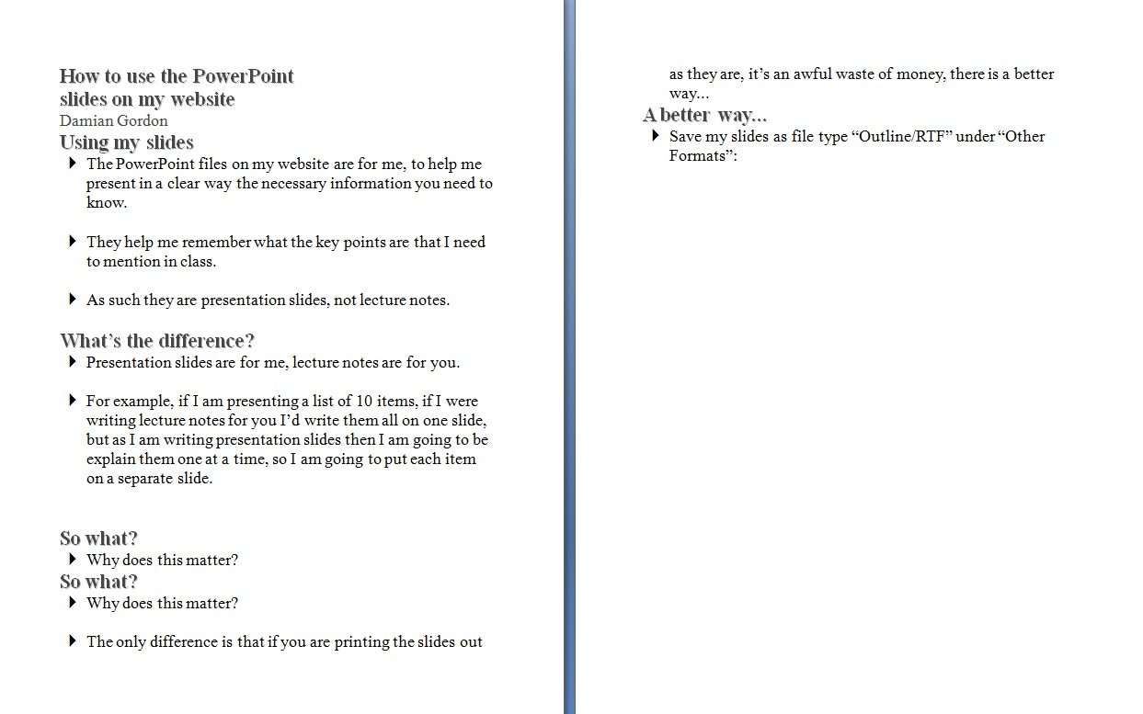
An aside…
You’ll find the text is too big:
So you should reduce the text size and CHANGE THE FONT:

Slide 19
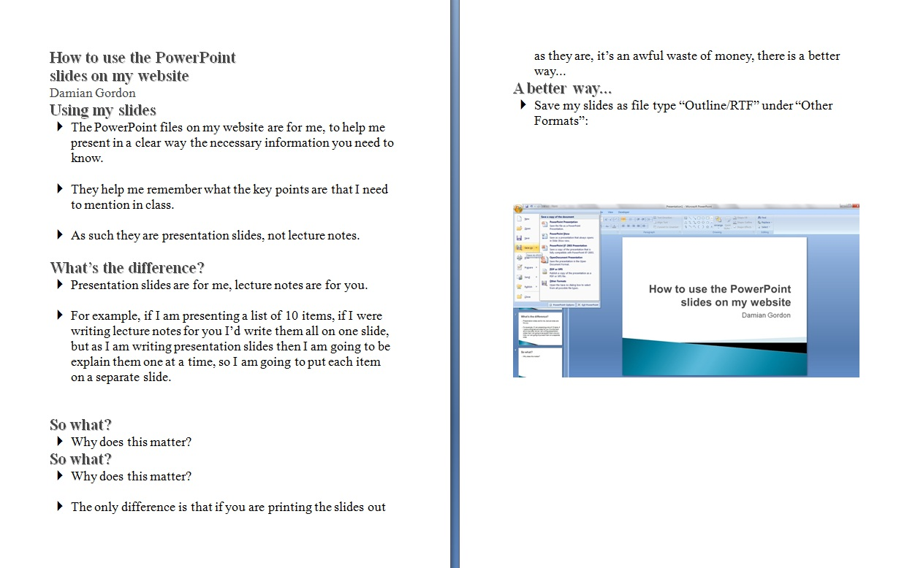
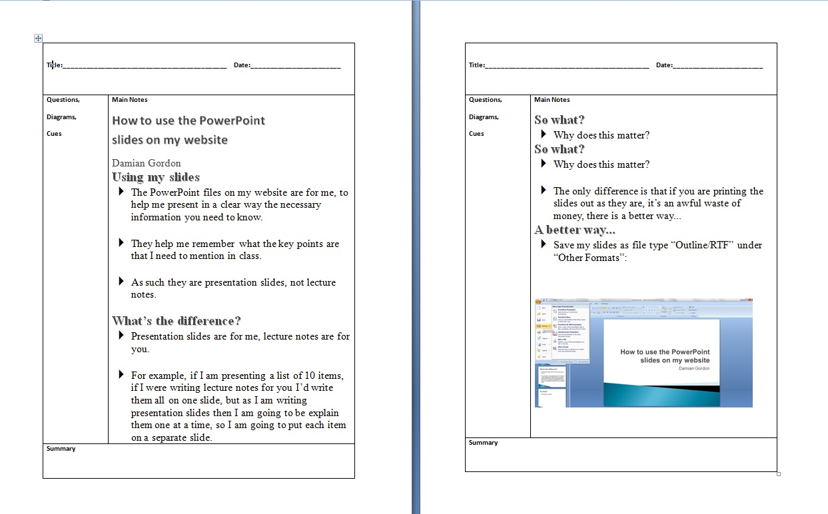
An aside…
Add in any diagrams from the PowerPoint (a lot of the images in my slides are just for “setting the mood” so there’s no need to include them):
And put the notes in the Cornell Note format (you’ll find a template on the same page as this presentation):

Slide 20
An aside…
DARTs: Directed Activities for Reading Texts, activities involving highlighting, cutting-and-pasting and moving around enlarged text.
So it’s better if your documents are available are DOC or PPT, and not PDF.

Slide 21
An aside…
And it’s best to avoid examples that use single letter pairs, such as:
p,q
p,d
b,d
b,q

Slide 22
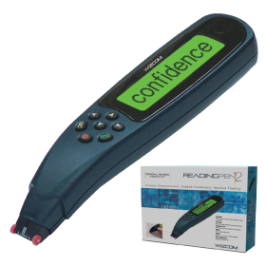
Dyslexia

Slide 23
Thanks !!! Please contact me if you have any comments or suggestions: Damian.Gordon@dit.ie

