Slide 1


TrustChain Presentation
Building Trust Through Transparent Supply Chains
Author : Joel Sundarsingh A
Co -Author : B Kailaash
Faculty : Dr. N Duraimurugan

Slide 2
Introduction & Motivation
Key statistics on MSME challenges
Delayed Payments
Outstanding Dues
₹ 48,000 crore worth of delayed-payment applications filed by MSMEs
The Financial Express, Jan 2025
46,000 + companies disclosed dues totaling ₹ 61,770 crore within 45 days and ₹ 22,730 crore beyond 45 days
TaxGuru, 2025
Visibility Gap
Export Dependence
77 % of logistics decision-makers rate real-time visibility as a must-have capability
Maersk Insights, 2024
MSMEs contribute ≈ 45.8 % of India’s exports yet lag in digital adoption and transparency tools
SIDBI & NITI Aayog Report, 2025
SOURCE REFERENCES
2

Slide 3
Problem Statement
Challenges in Current Supply Chains
Fragmented Systems
Existing supply chains are often fragmented, leading to communication gaps and inefficiencies that hinder effective collaboration among stakeholders, ultimately affecting overall trust and performance in the MSME sector.
Unverifiable Data
The reliance on traditional data sources creates unverifiable information, making it difficult for MSMEs to establish credibility and trust with partners, thus compromising transparency in their operations.
KEY TAKEAWAYS
3

Slide 4
Objectives of TrustChain
Immutable Ledger
The blockchain ensures data integrity with an unchangeable record.
Traceability & Accountability
Each supply chain event — from order to payment — is cryptographically linked.
Analytics Insights
Big Data analytics provide valuable insights for decision-making.
Predictive Risk Analysis
Predictive analytics detects anomalies early using clustering and pattern recognition.
Predictive TrustScore
TrustScore measures the reliability of supply chain partners.
ADDITIONAL INFORMATION
4

Slide 5


Existing Systems
Challenges of Fragmented Supply Chain Models
Current supply chains suffer from data silos, lack of verification, and centralized vulnerabilities. These issues hinder trust and transparency, creating risks for MSMEs and their stakeholders.
NOTES
5

Slide 6
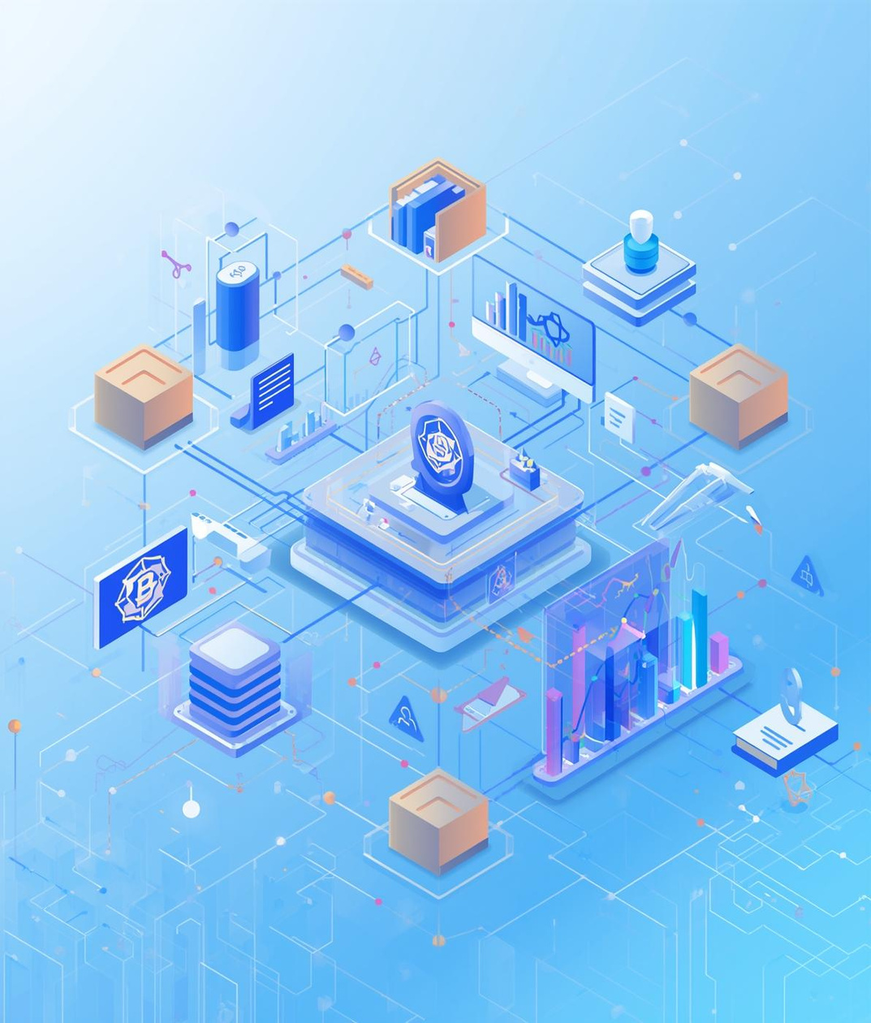
Proposed System
Integrating Blockchain and Analytics
This proposed system combines hybrid blockchain technology with advanced analytics. Utilizing the MERN stack and Ethereum/IPFS, it enhances supply chain transparency and predictive trust computation for MSMEs.
NOTES ON IMPLEMENTATION
6

Slide 7
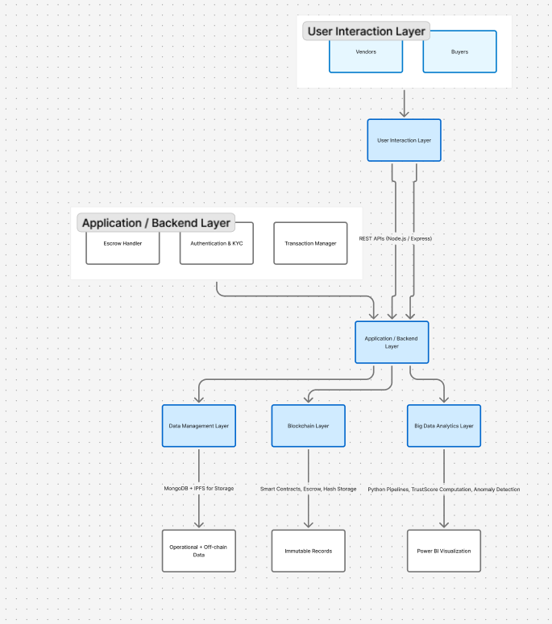
System Architecture
Layers of the System Design
This architecture illustrates the interconnected layers crucial for ensuring transparency and accountability in supply chains, emphasizing the roles of users, applications, blockchain, analytics, and data management.
NOTES ON ARCHITECTURE
7

Slide 8
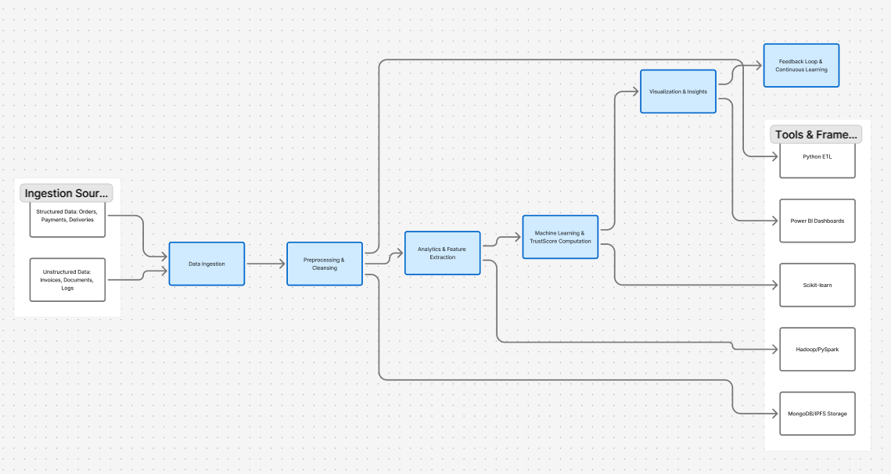
Data Flow and Analytics
Data Flow and Analytical Intelligence Framework
This data flow illustrates how transactional information moves through TrustChain, from ingestion to insight generation.
It highlights the integration of ETL pipelines, Big Data frameworks, and machine learning models that transform raw events into predictive trust intelligence.
NOTES ON ARCHITECTURE
8

Slide 9
Key Modules
User Management
Transaction & Escrow
Blockchain Ledger
Centralized control for user authentication and roles.
Secure processing of transactions with escrow features.
Immutable records for all transactions and data entries.
NOTES
DETAILED MODULE DESCRIPTIONS ARE AVAILABLE.
9

Slide 10
Key Modules
TrustScore
Analytics
Dashboard
This module quantifies trust levels through data analysis.
Provides insights for decision-making and performance improvement.
Visualizes key metrics for user-friendly monitoring and control.
ADDITIONAL INSIGHTS
FURTHER DETAILS CAN ENHANCE UNDERSTANDING AND USABILITY.
10

Slide 11
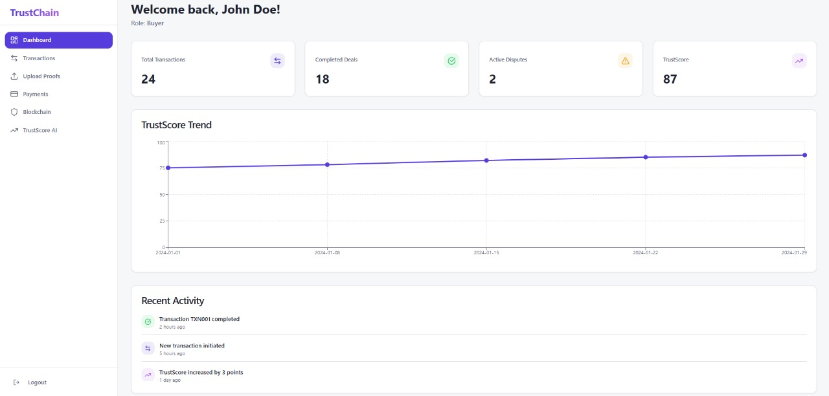
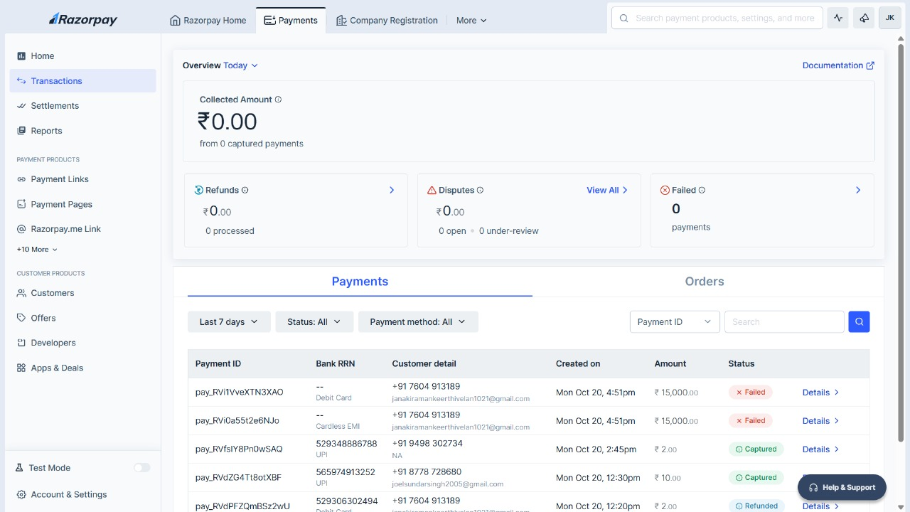
User Dashboard and Payment Interface
IMPLEMENTATION INSIGHTS
11

Slide 12
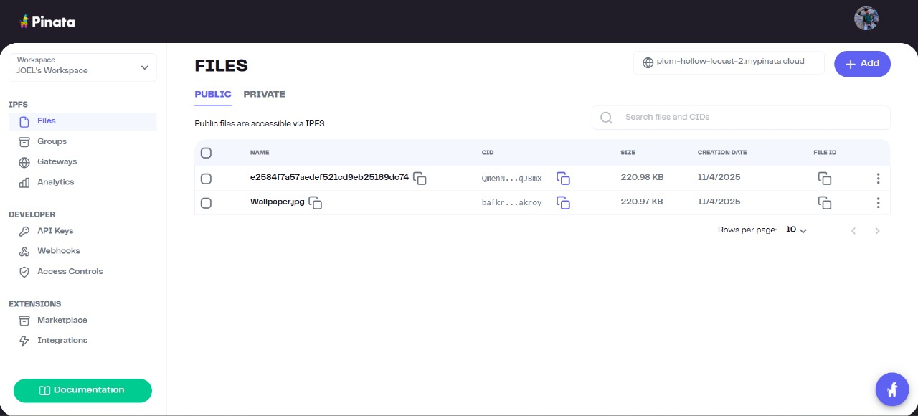
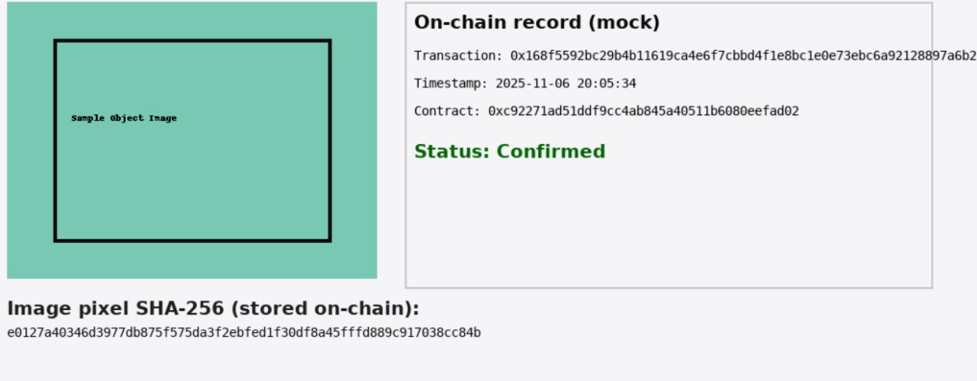
Data Storage (IPFS & Blockchain)
VISUAL REPRESENTATIONS
12

Slide 13
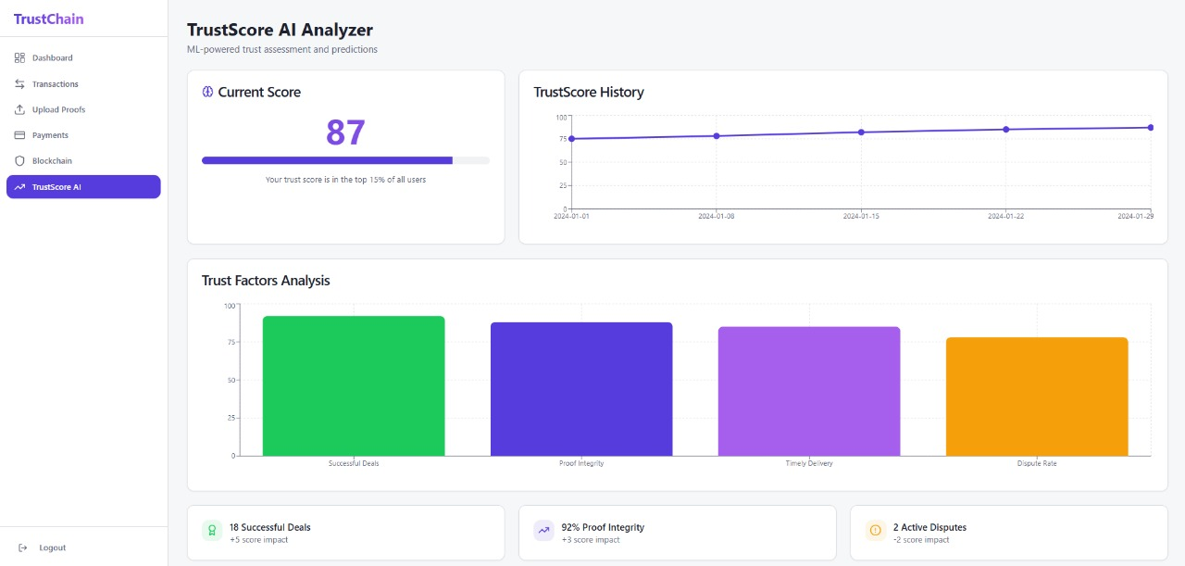
TrustChain Data Analytics
VISUAL REPRESENTATIONS
12

Slide 14
Conclusion & Future Work
Synergy
Next Steps
The integration of blockchain and big data enhances trust and transparency, creating a robust framework that empowers MSMEs to confidently engage in supply chain activities and decision-making.
Future efforts will focus on implementing federated machine learning and conducting pilot rollouts in MSMEs, enabling scalable insights while safeguarding sensitive data across diverse systems.
FINAL THOUGHTS
13

Slide 15
Contact Information
We’re here to answer you
Phone
8778728680
Email
joelsundarsingh2005@gmail.com

