Slide 1





Introduction to Robotic Process Automation
Scholar Shelf Bot
Your Register No : 220701110
Name : Joel Sundarsingh A
Guide Name : Mrs.J.Jinu Sophia
Designation and Department : Assistant Professor(SG) ,Department of Computer Science and Engineering

Slide 2
Abstract
The Scholar Shelf Bot is an innovative robotic process automation (RPA) solution designed to automate the management and reconciliation of penalties within academic institutions. The bot streamlines the retrieval and validation of penalty data from institutional records, ensuring accuracy and compliance. By automating tasks such as matching penalties to payments, generating structured reports, and sending automated notifications, the system reduces manual effort and improves efficiency. Users can customize reconciliation rules and filters, enabling tailored workflows. With robust error handling and real-time updates, the bot ensures reliability, minimizes human error, and provides a scalable solution to simplify administrative processes in educational environments.

Slide 3
Need for the Proposed System
The manual process of managing library penalties and records is time-consuming and error-prone.
Staff must manually review borrowing records, calculate fines, and update databases, leading to inefficiencies.
Notifications regarding overdue penalties are often delayed, causing miscommunication.
The system struggles to handle increasing user traffic and complex library operations.
Automation with the Scholar Shelf Bot addresses these challenges, ensuring accuracy, efficiency, and real-time updates.

Slide 4
Advantages of the Proposed System
Reduces manual effort and saves time.
Ensures accurate penalty calculation and reconciliation.
Provides real-time updates and structured reports.
Improves communication with automated notifications.
Enhances efficiency and reliability of library operations.

Slide 5
Literature Survey
Paper 1: Automation in Library Management (Johnson & Patel, 2017)
Advantages
Streamlined overdue notifications improved user communication.
Reduced administrative workload by automating repetitive tasks.
Disadvantages
Lacked real-time updates and error handling for penalties.
Limited customization options for fine calculation.
Paper 2: Inventory Automation (Kumar et al., 2019)
Advantages
Enhanced accuracy in tracking inventory records.
Reduced delays in library resource availability updates.
Disadvantages
Did not integrate penalty management workflows.
No support for user-specific reconciliation processes or reports.

Slide 6
Main Objective
Automate the reconciliation of library penalties to reduce manual effort and errors.
Provide real-time updates and structured reports for accurate record management.
Customize fine calculation rules and workflows to suit institutional needs.
Enhance communication through automated notifications to users and administrators.
Deliver a scalable, user-friendly, and efficient solution for library management.

Slide 7
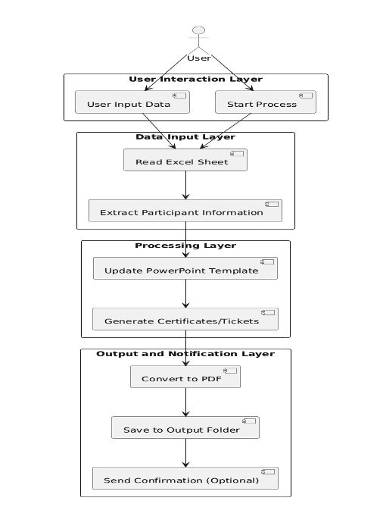
Architecture
User Input Layer: Captures essential data such as user IDs, book details, return dates, and penalty rules. This layer ensures accurate input collection for further processing.
Data Processing Layer: Automates the calculation and reconciliation of overdue penalties. It applies predefined rules and organizes data into structured formats for efficient management.
Notification and Storage Layers: Stores processed data in databases or Excel sheets and sends real-time notifications to users and administrators, ensuring transparency and prompt updates.
User Input Layer: Captures essential data such as user IDs, book details, return dates, and penalty rules. This layer ensures accurate input collection for further processing.
Data Processing Layer: Automates the calculation and reconciliation of overdue penalties. It applies predefined rules and organizes data into structured formats for efficient management.
Notification and Storage Layers: Stores processed data in databases or Excel sheets and sends real-time notifications to users and administrators, ensuring transparency and prompt updates.
Fig1.1 Architecture Diagram

Slide 8
System Requirements
Hardware
PC/Laptop with a minimum of 4GB RAM.
Processor: 2.5GHz or higher.
Storage: At least 20GB of free space.
Internet connection for email and updates.
Software
UiPath Studio (latest version recommended).
Microsoft Excel for data management.
Email client with SMTP configuration.
Windows 10 or above operating system.

Slide 9
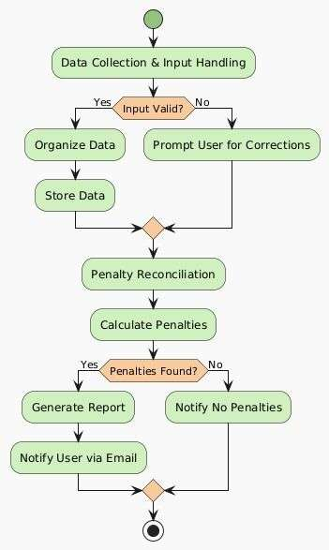
Functional Description
Module 1: Data Collection and Input Handling
Captures user inputs such as book details, return dates, and user IDs.
Validates input data for accuracy and completeness.
Provides a foundation for penalty calculation by organizing collected data

Slide 10
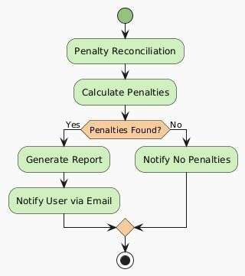
Functional Description
Module 2: Penalty Reconciliation and Reporting
Processes input data to calculate penalties based on predefined rules.
Generates structured reports in Excel and sends notifications via email.
Ensures accurate reconciliation and real-time updates.

Slide 11
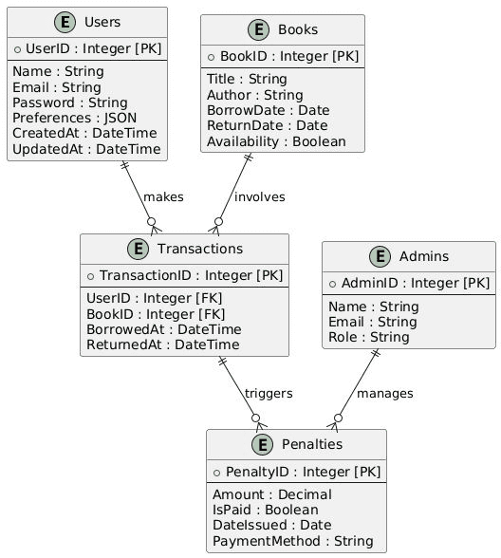
Table Design

Slide 12
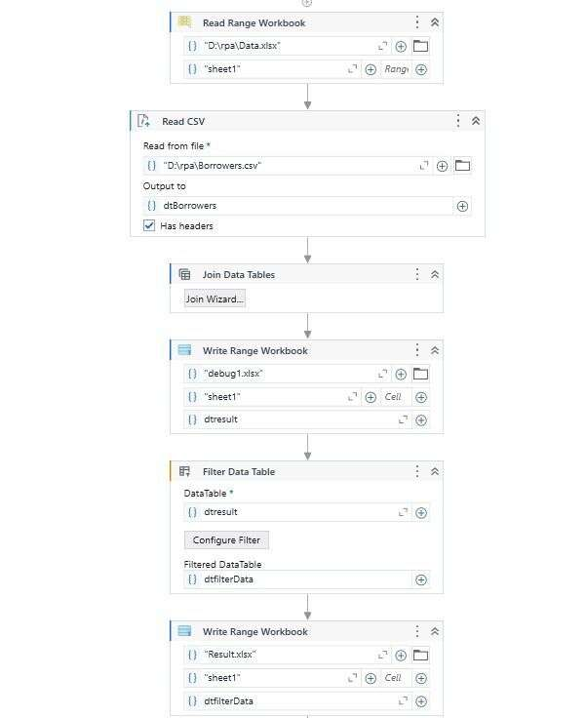
Process Design
Main Process
The primary process focuses on automating the reconciliation of overdue penalties in library management.
The bot retrieves borrowing records from the database or Excel files, calculates penalties based on predefined rules, and reconciles them into structured formats.
It ensures real-time updates of records, minimizing delays and inconsistencies in penalty management.

Slide 13
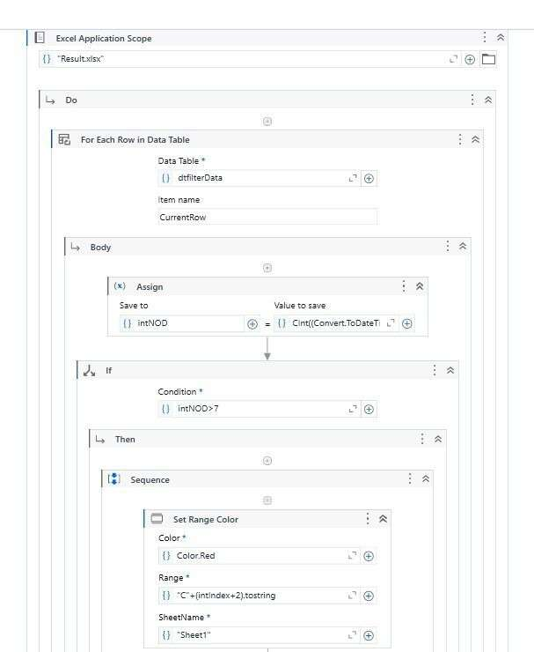
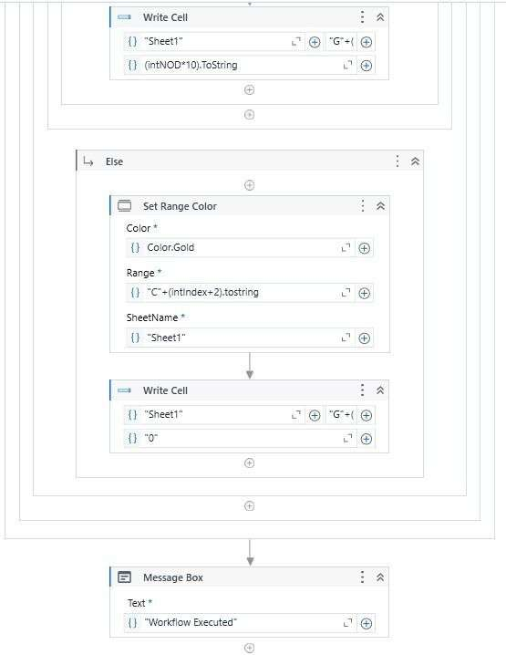
Process Design
Sub Process
A secondary process handles the automation of email notifications to users and administrators.
Notifications include details about overdue penalties, successful reconciliation, and any adjustments made during the process.
The bot attaches the reconciled reports in email communication, ensuring transparency and simplifying follow-ups.

Slide 14
Implementation
Module 1: Data Collection and Input Handling
The bot begins by capturing user inputs such as user IDs, book return dates, and penalty rules through an input dialog interface.
This module ensures that all essential data required for penalty reconciliation is collected accurately before processing.
Module 2: Penalty Reconciliation and Reporting
Using the collected data, the bot calculates overdue penalties based on predefined rules.
Customizable options allow adjustments, such as waivers or modified penalty rates, during reconciliation.
The module organizes the reconciled data into structured Excel sheets, ready for storage or reporting.

Slide 15
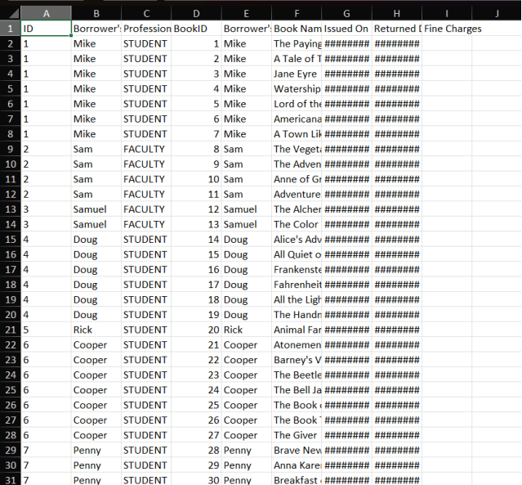
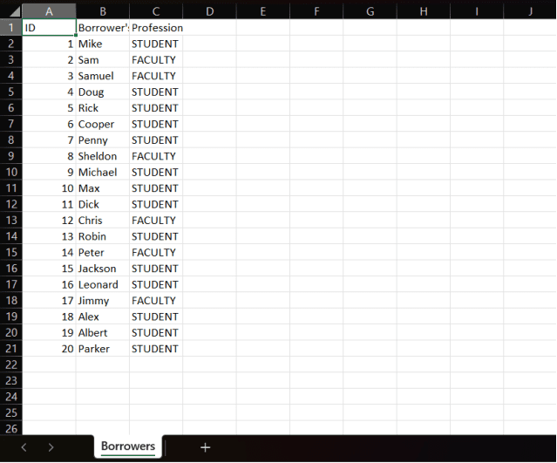
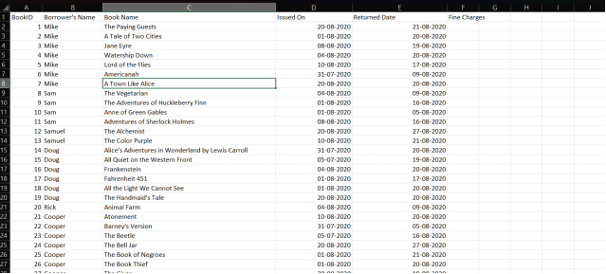
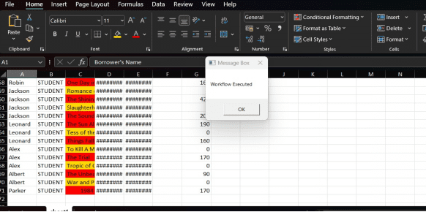
Implementation

Slide 16
Testing
Description:
Testing was performed to ensure the Scholar Shelf Bot operates reliably and meets the functional requirements.
The testing process included unit tests for individual workflows and integration tests for overall functionality.
Test cases covered scenarios such as input collection, penalty calculation, report generation, and email delivery

Slide 17
Conclusions
The Scholar Shelf Bot successfully automates library penalty management processes, reducing manual effort and enhancing operational efficiency.
By leveraging RPA tools like UiPath, the bot ensures accurate penalty reconciliation, structured data management, and timely notifications.
Robust error-handling mechanisms and real-time updates guarantee reliable and seamless operation.
The bot improves library resource management, making it scalable, user-friendly, and beneficial for academic institutions.

Slide 18
Future Enhancement
Implement advanced AI algorithms to predict overdue patterns and recommend actions.
Expand system capabilities to integrate with cloud-based library management platforms.
Enable multilingual support for notifications, catering to diverse user bases.
Introduce a mobile app interface for users to track fines and manage accounts seamlessly.
Incorporate machine learning for dynamic penalty adjustment based on user history and behavior.
Develop real-time analytics dashboards for better decision-making by administrators.
Integrate biometric authentication for enhanced security in library resource management.

Slide 19
IEEE Paper
John Doe
Department of Information Technology, Stanford University, California, USA
This paper explores how Robotic Process Automation (RPA) optimizes penalty reconciliation in libraries, reducing manual errors and increasing process efficiency.
Customizable Library Automation for Penalty Notifications and Reporting:
Jane Smith
School of Engineering and Technology, University College London, London, UK
The study focuses on automating fine notifications and reporting mechanisms with customizable rules, improving accuracy and scalability in library systems.
Enhancing Library Efficiency with RPA-Based Workflow Management:
Michael Brown
Department of Computer Science, Massachusetts Institute of Technology, USA
This paper highlights the implementation of RPA in automating workflows, such as fine calculations and user notifications, ensuring real-time updates and transparency.

Slide 20
References
UiPath Documentation: https://docs.uipath.com
UiPath Forum: https://forum.uipath.com
Johnson & Patel (2017), "Automation in Library Management," International Journal of Automation Systems.
Kumar et al. (2019), "Advancements in Library Inventory Automation," Journal of Technological Innovations.
Chen and Wang (2020), "Real-Time Notification Systems for Library Management," IEEE Transactions on Education.
Lee et al. (2021), "Integrating Customizable Rules in Library Automation," Journal of Computer Applications.

Slide 21
Queries

Slide 22
Demonstration

Slide 23
Thank You

