Slide 1
Debugging
Amit Amritkar

Slide 2
Overview
Understanding debugging
Naïve debugging
Introduction of debuggers
IDB
GDB debugger
Serial code debugging
Programs that crash
Programs that hang/give incorrect results

Slide 3
Debugging
Debugging is the process of finding and resolving bugs or defects that prevent correct operation of computer software or a system.
Finding a bug is a process of confirming the many things that you believe are true until you find the one which is not true.
The Binary Search Principle:
First try to confirm that everything is OK at the “approximate“ halfway point in the program. If so, then check at the approximate 3/4-way point; if not, check at the 1/4-way point. Each time, narrow down the big's location to one half of the previous portion.

Slide 4
Debugging
Parallel programs offer yet more opportunities for errors and non-optimal behavior, making the usage of special tools not only matter of taste but essential for successful development.
There are tools for
debugging (including memory debugging, debugging of parallel applications),
correctness checking of parallel programs,
performance explorations,
comfort of development (IDE's),
... and of course tools with more than one skill.

Slide 5
Naïve debugging
Include printf() or cout statements in the code to get values of variables.
Allows us to identify the approximate location of the bug
Why avoid the use printf() or cout statements, because they
make you lose precious time/concentration
make you do lots of time-consuming editing and recompiling
to add/remove them
are less informative

Slide 6
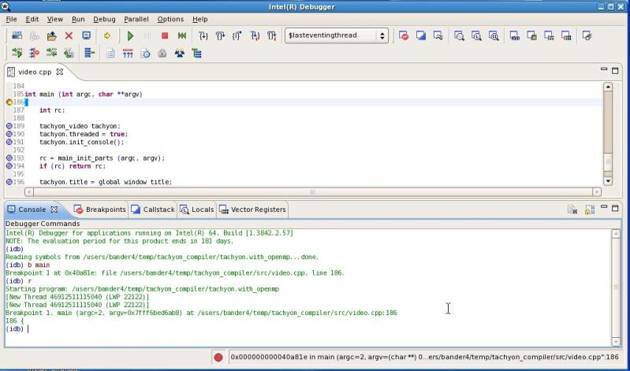
Intel debugger - idb

Slide 7
Debugging with Gdb
Gdb – GNU DeBugger
The purpose of a debugger is to allow you to see what is going on "inside" another program while it executes--or what another program was doing at the moment it crashed.
GDB can do four main kinds of things (plus other things in support of these) to help you catch bugs in the act:
Start your program, specifying anything that might affect its behavior.
Make your program stop on specified conditions.
Examine what has happened, when your program has stopped.
Change things in your program, so you can experiment with correcting the effects of one bug and go on to learn about another.

Slide 8
Supported languages
You can use GDB to debug programs written in C or C++.
GDB can be used to debug programs written in Fortran, although it does not yet support entering expressions, printing values, or similar features using Fortran syntax. It may be necessary to refer to some variables with a trailing underscore.
Debugging Pascal programs which use sets, subranges, file variables, or nested functions does not currently work. GDB does not support entering expressions, printing values, or similar features using Pascal syntax.

Slide 9
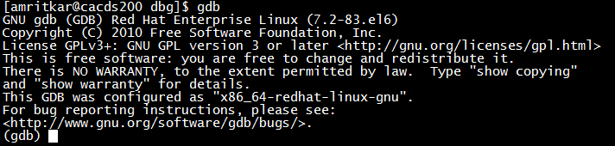
GBD – command line
To invoke and run
$ gdb myapp.x
(gdb) run
(gdb) quit

Slide 10
Example 1a
Let’s try a Fortran program that fills an array
Compile
gfortran -o g2 -g g2.f90
When I run this, I get a “Bus error”
program g2
real A(10)
integer i
do i = 1,100
A(i) = 1.0
end do
end program

Slide 11
Gdb session
amritkar@cacds200(~) gdb ./g2
GNU gdb (GDB) Red Hat Enterprise Linux (7.2-83.el6)
…
Reading symbols from /home/amritkar/dbg/g2...done.
(gdb) r
Starting program: /home/amritkar/dbg/g2
Program received signal SIGBUS, Bus error.
0x000000000040063f in MAIN__ () at g2.f90:6
6 A(i) = 1.0
(gdb) backtrace
#0 0x000000000040063f in MAIN__ () at g2.f90:6
#1 0x000000000040066e in main ()
(gdb) whatis A
type = real4 (10)
(gdb) p A
$1 = (1, 1, 1, 1, 1, 1, 1, 1, 1, 1)
(gdb) whatis i
type = int4
(gdb) p i
$2 = 1065353217
(gdb)
Wait, A is size 10!
What happened to “i”?

Slide 12
Compiler - checking options
Some compilers also have runtime bounds checking
gfortran: -fbounds-check
Sun Studio: -C
amritkar@cacds200(~) gfortran -g -o g2 -fbounds-check g2.f90
amritkar@cacds200(~) ./g2
Fortran runtime error: Array reference out of bounds for array 'a', \
upper bound of dimension 1 exceeded (in file 'g2.f90', at line 6)
amritkar@coil(~) sunf90 -g -o g2 -C g2.f90
amritkar@coil(~) ./g2
****** FORTRAN RUN-TIME SYSTEM ******
Subscript out of range. Location: line 6 column 7 of 'g2.f90'
Subscript number 1 has value 11 in array 'A'
Aborted

Slide 13
Example 1b
Compile and execute sample problem crash.cc
$g++ -g crash.cc -o crash
Identify the issue with gdb
gdb crash
In this example, it is fairly obvious that the crash occurs because of the attempt to divide an integer by 0.

Slide 14
Gdb session
$gdb crash
# Gdb prints summary information and then the (gdb) prompt
(gdb) r
Program received signal SIGFPE, Arithmetic exception.
0x08048681 in divint(int, int) (a=3, b=0) at crash.cc:21
21 return a / b;
# 'r' runs the program inside the debugger
# In this case the program crashed and gdb prints out some
# relevant information. In particular, it crashed trying
# to execute line 21 of crash.cc. The function parameters
# 'a' and 'b' had values 3 and 0 respectively.
(gdb) l
# l is short for 'list'. Useful for seeing the context of
# the crash, lists code lines near around 21 of crash.cc
(gdb) where
#0 0x08048681 in divint(int, int) (a=3, b=0) at crash.cc:21
#1 0x08048654 in main () at crash.cc:13
# Equivalent to 'bt' or backtrace. Produces what is known
# as a 'stack trace'. Read this as follows: The crash occurred
# in the function divint at line 21 of crash.cc. This, in turn,
# was called from the function main at line 13 of crash.cc
(gdb) up
# Move from the default level '0' of the stack trace up one level
# to level 1.
(gdb) list
# list now lists the code lines near line 13 of crash.cc
(gdb) p x
# print the value of the local (to main) variable x

Slide 15
Example 2 – logical errors using GUI
NumInputs numbers to be placed in array Y, ascending order.
Pseudocode:
set Y array to empty
get NumInputs numbers from command line
for I = 1 to NumInputs
get new element NewY
find first Y[J] for which NewY < Y[J]
shift Y[J], Y[J+1], ... to right,
to make room for NewY
set Y[J] = NewY
Call tree:
main() -> GetArgs()
-> ProcessData() -> Insert() -> ScootOver()
-> PrintResults()

Slide 16
Example 2
Let's try compiling (note -g option) and running the program:
% gcc -o ins -g Ins.c
% ins 12 5 9 3 2 25 8 19 200 10
(no output, no return to OS prompt)
Program just hangs!
OK, let's apply DDD:
% ddd ins
Or:
% ddd --separate ins

Slide 17
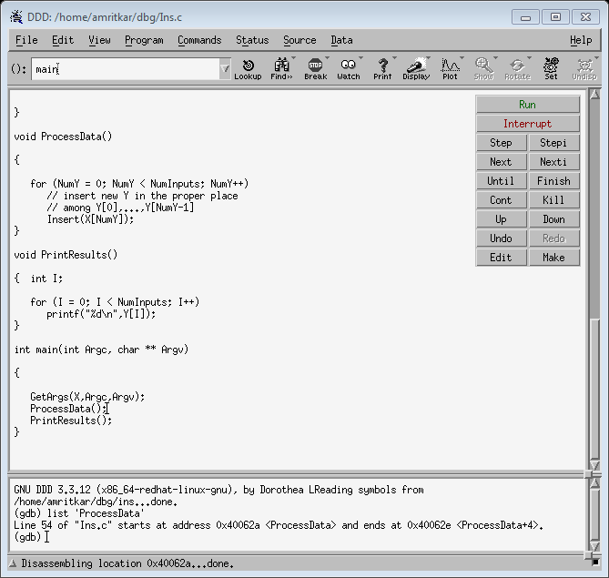
DDD – GUI to gdb
Command tool window
Source file window
Debugger console window

Slide 18
Where is our “approximate halfway point" here in Ins.c?
A look at main(),
GetArgs(Argc,Argv);
ProcessData();
PrintResults();
suggests we take as our first confirmation point the beginning of ProcessData().
So, we will set a breakpoint - a place where DDD will make execution of the program pause - at the call to ProcessData():

Slide 19
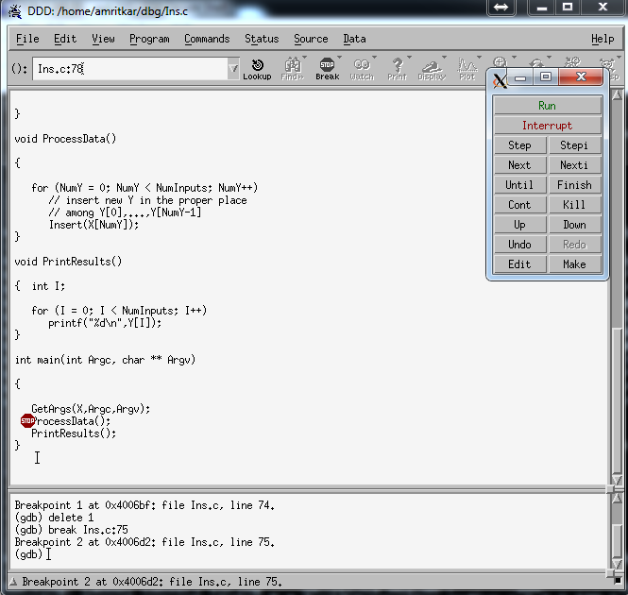
Move the mouse cursor to the line where ProcessData() is called.
Click on the left end of the line.
Click on Break (stop-sign icon).
A red stop sign will then appear on the line, showing that DDD will stop there:

Slide 20
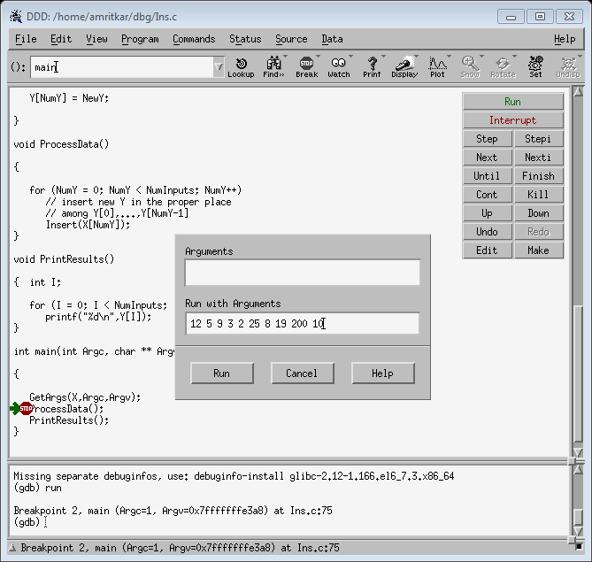
Now, let's run the program via DDD:
Click on Program, then on Run to get the Run Program window.
Fill in the command line arguments (12, 5, ...) in that window.
Click on Run in that window.

Slide 21
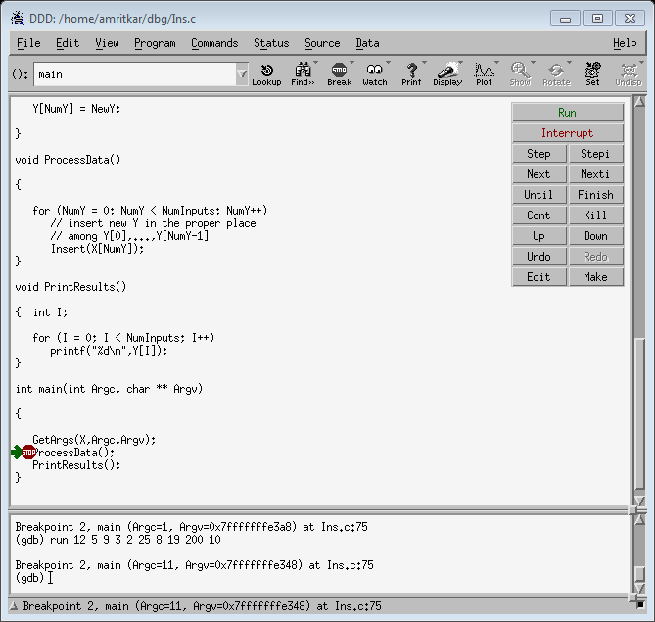
DDD runs our program, stopping at the breakpoint. The green arrow shows our current line, i.e. the one about to be executed:

Slide 22
Now, let's confirm that the program is running correctly so far. All it's done is set NumInputs and the array X, so let's check them:
So, let's verify that NumInputs = 10, and that X has the correct values (12, 5, ...):
Move the mouse cursor to any place where NumInputs appears in the Source Code window.
Rest there for a half second or so.
The value of NumInputs will appear in a yellow box near the mouse cursor (the cursor doesn't appear here), and at the edge below the Debugger Console.
Do the same for X.

Slide 23
OK, both NumInputs and X are all right. But if there had been a bug within GetArgs(), say
X[I] = atoi(AV[I]);
we would have found it here, by checking the values of the AV strings, etc.
By the way, if we had just wanted to check the value of X[I] here, not all of X (what if X had had 10,000 elements instead of just 10?), we could have used the mouse to highlight the whole expression "X[I]", then right-clicked on it and selected "Print X[I]". The value would be printed to the Debugger Console. Or we could select "Display X[I]", which would create a subwindow in which X[I] would be continuously displayed.

Slide 24
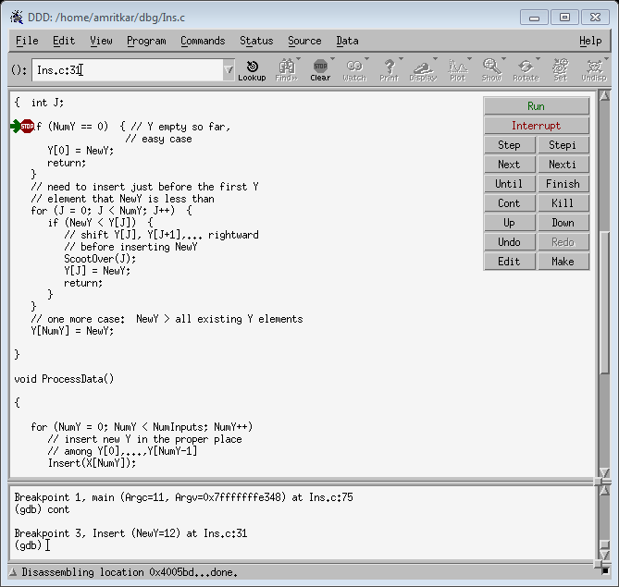
Let's browse some more, say in Insert().
Place a breakpoint in the definition of Insert().
Hit Cont to continue to the next breakpoint, which will be the one we just placed in Insert().
Once we get into Insert(), the green arrow points to the line
if (NumY = 0) { // Y empty so far, easy case

Slide 25
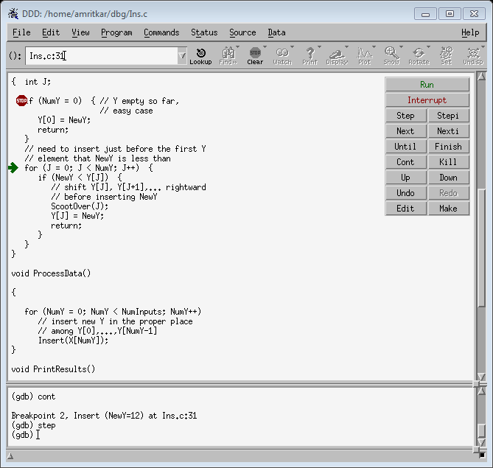
This is the first time we've hit Insert(), so NumY should be 0. But we need to confirm it, by moving the mouse cursor to NumY. (it's 0.)
Hitting Step (or Next) that \should" take us to the line
Y[0] = NewY;
but once again, we must confirm it.
What do you get?

Slide 26
It skipped right over the if, going straight to the for loop!
So (NumY = 0) must have been false. But we confirmed that NumY was 0!
The old classic C learner's error { we used = instead of == The if line should have been
if (NumY == 0) {
That's what made the program hang: It kept assigning 0 to NumY, so the Y array never grew.

Slide 27
Open another terminal
Fix the error, recompile and run again.
A seg fault in Unix means an execution error due to the program's accessing memory which is not allocated to it.
Fundamental Principle for Execution Errors:
The first step to take after an execution error is to run the program through DDD (if the error occurred when run without DDD), to determine where the execution error occurred.

Slide 28
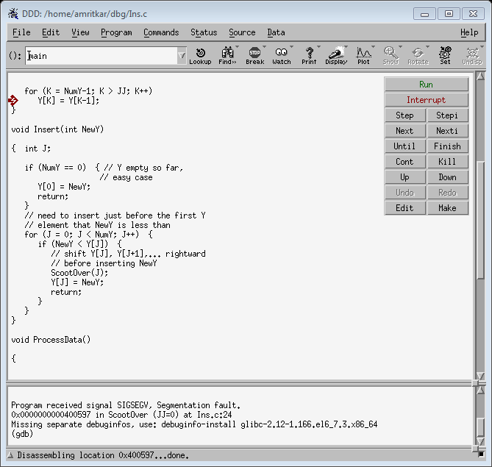
re-rerun the program within DDD.

Slide 29
Remember, a seg fault occurs when the program is accessing a portion of memory to which it is not permitted access. So, we suspect that K has a value outside the range of Y, which has only 10 elements.
Let's check, once again by moving the mouse cursor to any place K appears:
K=280 (out of range)

Slide 30
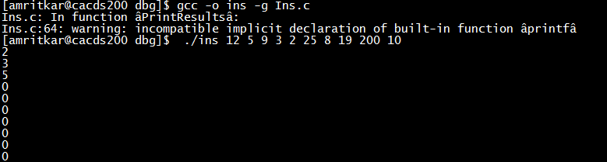
K = 10 or 11 did not cause a seg fault, as we were still in the same page of virtual memory.
Let's look at the code which is setting K:
for (K = NumY-1; K > JJ; K++)
Y[K] = Y[K-1];
Recall that this code was supposed to shift the Ys over to the right, first moving the rightmost Y, then shifting the next-to-rightmost Y, etc.
In other words, this was supposed to be a "down" loop; K++ should be K--.

Slide 31
Let's go to ProcessData() and do some spot checks for various values of NumY in the loop there:
for (NumY = 0; NumY < NumInputs; NumY++)
// insert new Y in the proper place
// among Y[0],...,Y[NumY-1]
Insert(X[NumY]);
Trying the Binary Search Principle, let's rst do a check for the NumY value which is halfway through, i.e. NumInputs/2 = 5:

Slide 32
Put a breakpoint on the line which calls Insert().
Right-click on this breakpoint's stop-sign icon.
Select Properties.
Specify Condition as NumY == 5 (not NumY = 5!).
Hit the Run button.
DDD will stop at the call to Insert() when NumY is 5, skipping the previous calls to Insert().
This is a small convenience for this case in which X is only 10 elements, but would be crucial of X had 10,000 elements.

Slide 33
We then check Y (by moving mouse cursor to Y). It turns out that
Y = {2,3,5,0,0,0,0,0,0,0}
just as after the end of full execution.
So, the problem occurred during the "first half." Well, let's start at the beginning, since the rst X, 12, doesn't appear in Y:
Remove the Condition NumY == 5 from the breakpoint at the call to Insert(): Right-click on its stop sign icon, choose Properties, erase the Condition.
Hit the Run button to restart.
Each time DDD stops at the call to Insert(), do:
Check Y (as usual, by moving the mouse to an instance of Y anywhere in the code) to confirm it is what it should be at this stage.
Hit the Cont button to have DDD continue until the next breakpoint (which will be this one again).

Slide 34
We find that the case NumY = 0 works ne, i.e. Y[0] = 12. But the next case, NumY = 1, fails: Y[0] becomes 5, and the 12 disappears.
So, we've narrowed the problem down to the events within Insert() when NumY = 1.
Here's the main part of Insert():
for (J = 0; J < NumY; J++) {
if (NewY < Y[J]) {
// shift Y[J], Y[J+1],... rightward
// before inserting NewY
ScootOver(J);
Y[J] = NewY;
return;
}
}
We need to step through these lines for this case NumY = 1:

Slide 35
Re-run by hitting Run.
The first time we hit the breakpoint at the call to Insert(), NumY is 0, so hit Cont.
Hit Step (not Next) to enter Insert().
Hit Step or Next twice to get to the if within the for loop.
Take a look around: Confirm our expected values for NumY (should be 1), NewY (should be 5), and Y (should be 12, 0, 0, ...). Yes, all OK.
Now (NewY < Y[J]) should be true; confirm it: Hit Step or Next. Yes, we do go to the call to ScootOver().
Let's skip over ScootOver(), i.e. execute it but not enter it: Hit Next (not Step).
Let's confirm that the Y array was shifted rightward: Move the mouse cursor to display the values in Y. Aha! The 12 is still in Y[0], instead of in Y[1].

Slide 36
So, we need to go into ScootOver().
Disable existing breakpoints, and add a new one at the call to ScootOver().
Re-run the program.
The first time the breakpoint is hit, this should be the case NumY = 1, but confirm it. Yes, OK.
Hit Step (not Next) to enter ScootOver().
Remember, at this time Y consists of just one element, 12, which we must shift to the right to make room for NewY, 5, which is to be inserted. We will try to confirm this.
Hit Step or Next to execute the first line.

Slide 37
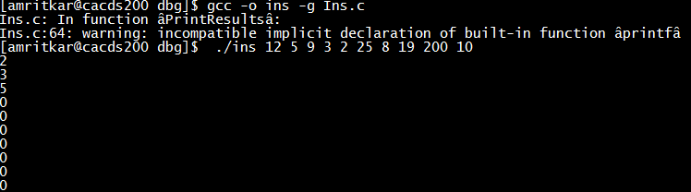
The loop to shift Y rightward wasn't executed at all.
A closer look shows why: Since NumY was 1 and JJ was 0, the loop amounted to
for (K = 0; K > 0; K--)
so the loop wasn't executed.
A bit more thought reveals that the expression NumY-1 in the loop should have been NumY.
So, recompile and re-run:

Slide 38
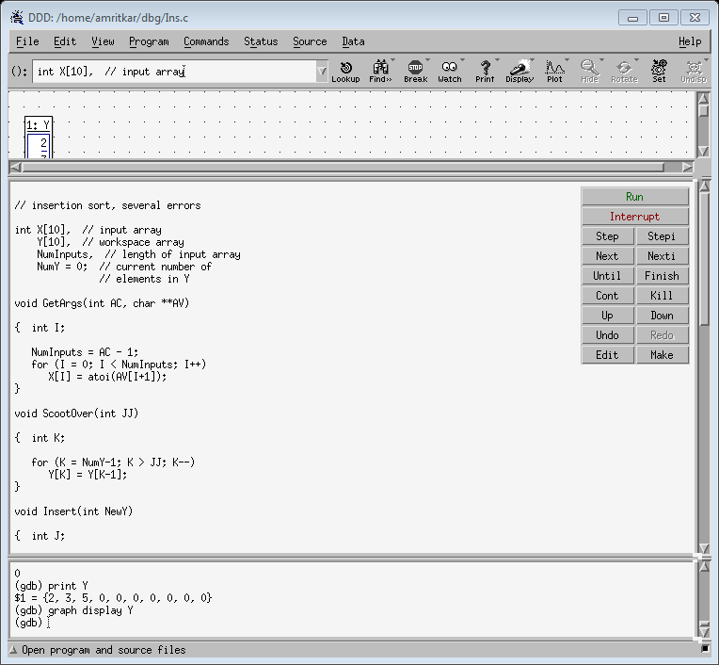
The first element missing in the output above is 8, so let's see what happened when it was inserted into Y.
Re-enable the breakpoint at the call to Insert().
Add the condition X[NumY] == 8.
Hit the Run button, then Step to enter Insert().
We anticipate that we may be checking Y a lot, so it's easier to continuously display it:
Go to any instance of Y in the Source File window.
Right-click on it.
Select "Display Y".
A Data window will open above the Source File window.
You may wish to resize the DDD window, and the Data and Source File windows.
Keep hitting Next until we see a change in Y.

Slide 39
Y never changed! The 8 was ignored.
After some thought, we realize that the for loop only handles the case in which NewY is inserted within Y. We need separate code for the case in which NewY is added at the right end of Y.
After the for loop, add the code:
// one more case: NewY > all existing Y elements
Y[NumY] = NewY;

Slide 40
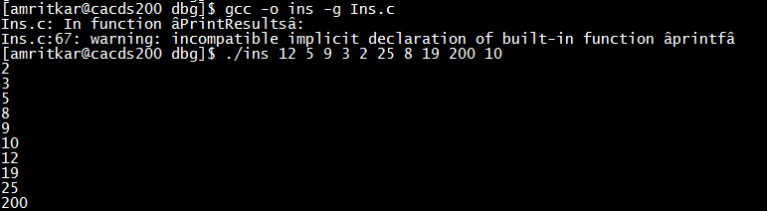
Examining arrays passed as function arguments:
Many people avoid using global variables. Suppose for example the arrays X and Y in our insert-sort example had been declared local to main(). The call to GetArgs(), for instance, would now be GetArgs(X,Argc,Argv);
and GetArgs() itself would look like this:
void GetArgs(int XX[], int AC, char **AV)
{ int I;
NumInputs = AC - 1;
for (I = 0; I < NumInputs; I++)
XX[I] = atoi(AV[I+1]);
}

Slide 41
attaching gdb to running processes
GDB can attach to already running processes using the attach [process-id] command. After attaching to a process GDB will stop it from running. This allows you to prepare the debug session using GDB commands, e.g. setting breakpoints or watchpoints. Then use the continue command to let the process continue running. Although GDB is a serial debugger you can examine parallel programs by attaching to individual processes of the program. For instance, when running batch jobs you can log into one of the compute nodes of the job and attach to one of the running processes.
The listing below displays a sample debug session attaching to one of the processes of a running job for examining data (lines starting with # are comments):

Slide 42
$ gdb (gdb) # List the processes of the MPI program (gdb) shell ps -eo pid,comm | grep mpi_prog 14957 mpi_prog 14961 mpi_prog 14962 mpi_prog ...etc. (gdb) # Attach to one of the MPI processes (gdb) attach 14961 Attaching to process 14961 Reading symbols from /path/to/executable/mpi_prog...done. ...etc (gdb) # Set a watchpoint to stop execution when the variable Uc is updated (gdb) watch Uc Hardware watchpoint 1: Uc (gdb) # Continue the execution of the program (gdb) continue Continuing. Hardware watchpoint 1: Uc Old value = -3.33545399 New value = -2.11184907 POTTEMP::ptemp (ldiad=...etc) at ptemp1.f90:298 298 Vc= dsdx(2,1,ie2)*u0 + dsdx(2,2,ie2)*v0 + dsdx(2,3,ie2)*w0

Slide 43
(gdb) # Set the list command to display 16 lines... (gdb) set listsize 16 (gdb) # ...and display the source backwards starting 2 lines below the current one (gdb) list +2 284 do k= 1, 8 285 kp= lnode2(k,ie2) 286 u0= u0 + u12(kp) 287 v0= v0 + u22(kp) 288 w0= w0 + u32(kp) 289 vt= vt + vtef2(kp) 290 enddo 291 292 u0= 0.125*u0; v0= 0.125*v0; w0= 0.125*w0; vt= 0.125*vt 293 294 ! 295 !---- Contravariant velocity 296 ! 297 Uc= dsdx(1,1,ie2)*u0 + dsdx(1,2,ie2)*v0 + dsdx(1,3,ie2)*w0 298 Vc= dsdx(2,1,ie2)*u0 + dsdx(2,2,ie2)*v0 + dsdx(2,3,ie2)*w0 299 Wc= dsdx(3,1,ie2)*u0 + dsdx(3,2,ie2)*v0 + dsdx(3,3,ie2)*w0 (gdb) # Print a 5 element slice of the variable u12 (gdb) print u12(3006:3010) $1 = (0.0186802763, 0.0188683271, 0.0145201795, 0.00553302653, -0.00918145757) (gdb) # Release the process from GDB control (gdb) detach Detaching from program: /path/to/executable/mpi_prog, process 14961 (gdb) quit

Slide 44
GDB quick guide
Command | Explanation
run | Start running the code
n (next) | Advance execution to the next line of the current function
s (step) | Step into a subroutine or function call
bt (back trace) | Stack frame for each active subroutine
l (list) | Ten lines of source code surrounding the current line
p (print) <variable> | Print <variable> in a format appropriate to its data type
c (continue) | Continue execution
b (break point) <file>:<line number> | Insert break point in <file> on <line number>
watch <expr> | Insert watch point
info <> | Information about <> variable, memory, threads, etc
help | Help
quit | Exit the program

Slide 45
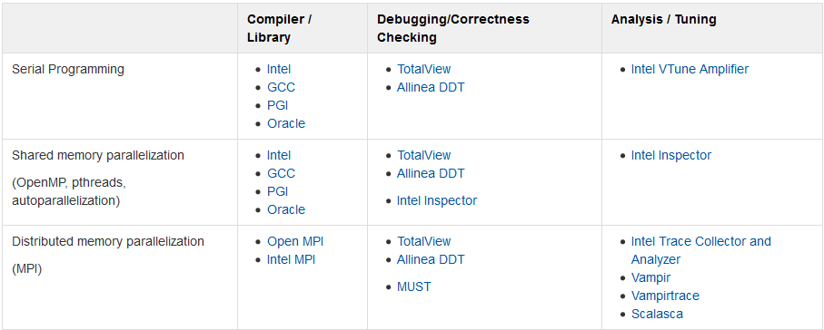
Copyright (C) 1988, 1989, 1990, 1991, 1992, 1993, 1994, 1995 Free Software Foundation, Inc.
Published by the Free Software Foundation 675 Massachusetts Avenue, Cambridge, MA 02139 USA Printed copies are available for $20 each. ISBN 1-882114-11-6

Slide 46
References
http://www.clustermonkey.net/MPI/debugging-in-parallel-in-parallel.html
https://www.cacds.uh.edu/researchresources/hpc/opuntia/opuntia-user-guide/debugging/
http://web.mit.edu/gnu/doc/html/gdb_1.html
http://sourceware.org/gdb/current/onlinedocs/gdb/
http://www.unknownroad.com/rtfm/gdbtut/gdbtoc.html
http://heather.cs.ucdavis.edu/~matloff/Debug/Debug.pdf
https://doc.itc.rwth-aachen.de/display/CCP/Tools+for+Debugging%2C+Correctness+Checking+and+Optimization

Slide 47
Questions?
My office – MREB 205N
Email – aramritkar@uh.edu

