Slide 1
Numbers and computers

Slide 2
Agenda
Chapters 3 and 4 from book
“Scientific computing for engineers”
By Chapra and Canale
Bits/Bytes
Integers
Significant digits, precision
Errors
Normalized representation
Floating‐point
Precision 32‐bit, 64‐bit, IEEE standard 754
Overflow, underflow, hole‐at‐zero, machine epsilon
Loss of precision
Complex numbers

Slide 3
Everything is bits
Each bit is 0 or 1
By encoding/interpreting sets of bits in various ways
Computers determine what to do (instructions)
… and represent and manipulate numbers, sets, strings, etc…
Why bits? Electronic Implementation
Easy to store with bistable elements
Reliably transmitted on noisy and inaccurate wires
0
1
0
1.1V
0.9V
0.2V
0.0V
Bryant and O’Hallaron, Lecture notes - Introduction to Computer Systems, Fall 2015

Slide 4
For example, can count in binary
Base 2 Number Representation
Represent 15213₁₀ as 11101101101101₂
Represent 1.20₁₀ as 1.0011001100110011[0011]…₂
Represent 1.5213 X 10⁴ as 1.1101101101101₂ X 2¹³
Bryant and O’Hallaron, Lecture notes - Introduction to Computer Systems, Fall 2015

Slide 5
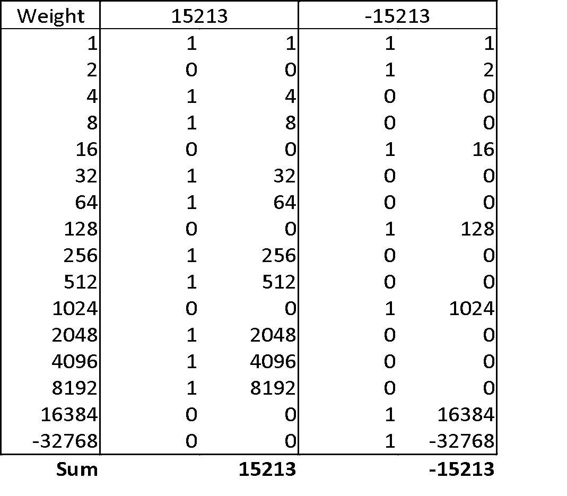
Binary conversion Example
x = 15213: 00111011 01101101
y = -15213: 11000100 10010011
Bryant and O’Hallaron, Lecture notes - Introduction to Computer Systems, Fall 2015

Slide 6
Encoding Byte Values
Decimal
Hex
Binary
Byte = 8 bits
Binary 00000000₂ to 11111111₂
Decimal: 0₁₀ to 255₁₀
Hexadecimal 00₁₆ to FF₁₆
Base 16 number representation
Use characters ‘0’ to ‘9’ and ‘A’ to ‘F’
Used to represent memory addresses
0
0
0000
1
1
0001
2
2
0010
3
3
0011
4
4
0100
5
5
0101
6
6
0110
7
7
0111
8
8
1000
9
9
1001
A
10
1010
B
11
1011
C
12
1100
D
13
1101
E
14
1110
F
15
1111
Bryant and O’Hallaron, Lecture notes - Introduction to Computer Systems, Fall 2015

Slide 7
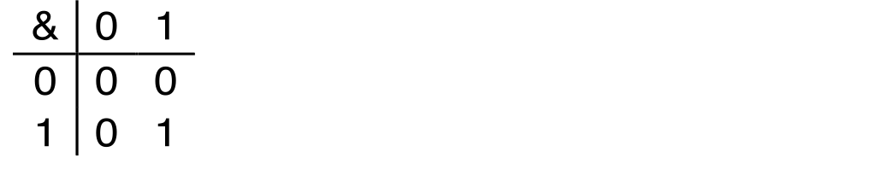
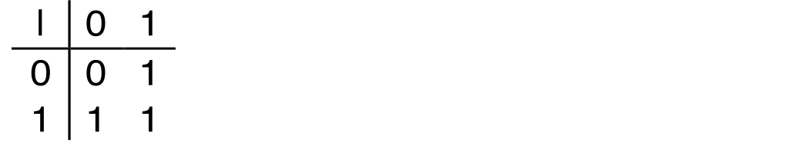
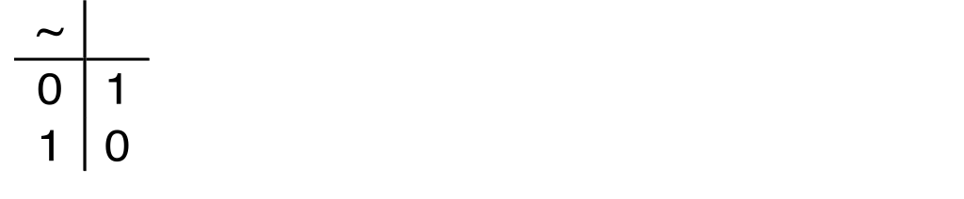
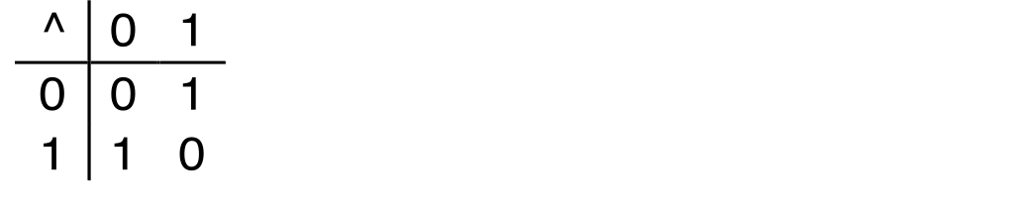
Boolean Algebra
Developed by George Boole in 19th Century
Algebraic representation of logic
Encode “True” as 1 and “False” as 0
And
A&B = 1 when both A=1 and B=1
Or
A|B = 1 when either A=1 or B=1
Not
~A = 1 when A=0
Exclusive-Or (Xor)
A^B = 1 when either A=1 or B=1, but not both
Bryant and O’Hallaron, Lecture notes - Introduction to Computer Systems, Fall 2015

Slide 8
General Boolean Algebras
Operate on Bit Vectors
Operations applied bitwise
All of the Properties of Boolean Algebra Apply
Operations
& Intersection (and)
| Union (or)
^ Symmetric difference (xor)
~ Complement (not)
01101001
& 01010101
01000001
01101001
| 01010101
01111101
01101001
^ 01010101
00111100
~ 01010101
10101010
01000001
01111101
00111100
10101010
Bryant and O’Hallaron, Lecture notes - Introduction to Computer Systems, Fall 2015

Slide 9
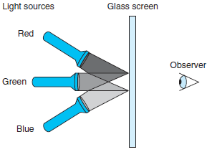
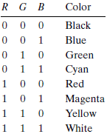
Boolean algebra example
Computers generate color pictures on a video screen or liquid crystal display by mixing three different colors of light: red, green, and blue
Computer Systems: A Programmer's Perspective, 3/E (CS:APP3e) Randal E. Bryant and David R. O'Hallaron

Slide 10
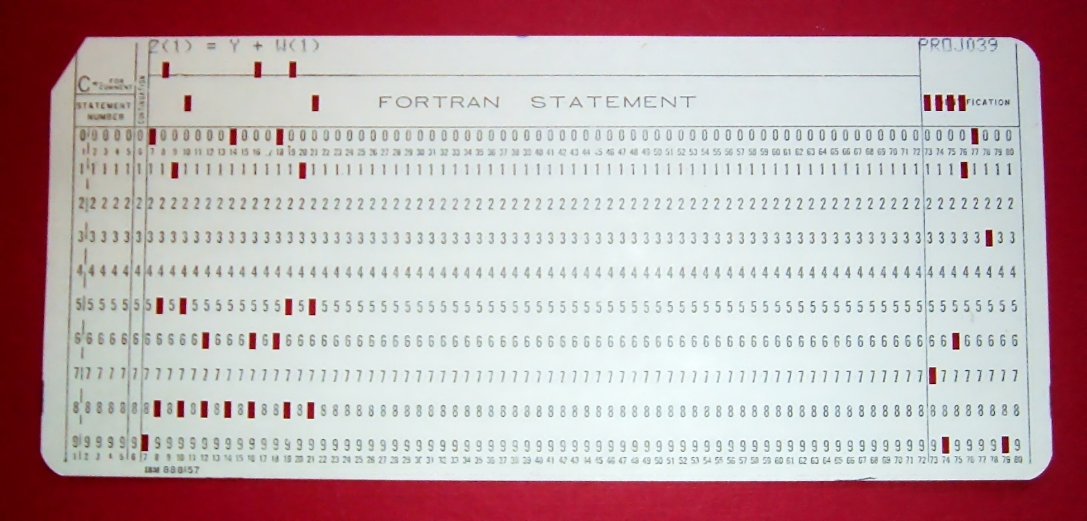
FORTRAN punch card for Z(1) = Y + W(1)
https://en.wikipedia.org/wiki/Punched_card

Slide 11
Byte-Oriented Memory Organization
00•••0
FF•••F
• • •
Programs refer to data by address
Conceptually, envision it as a very large array of bytes
In reality, it’s not, but can think of it that way
An address is like an index into that array
and, a pointer variable stores an address
Note: system provides private address spaces to each “process”
Think of a process as a program being executed
So, a program can clobber its own data, but not that of others
Bryant and O’Hallaron, Lecture notes - Introduction to Computer Systems, Fall 2015

Slide 12
Machine Words
Any given computer has a “Word Size”
Nominal size of integer-valued data
and of addresses
Until recently, most machines used 32 bits (4 bytes) as word size
Limits addresses to 4GB (2³² bytes)
Increasingly, machines have 64-bit word size
Potentially, could have 18 EB (exabytes) of addressable memory
That’s 18.4 X 10¹⁸
Machines still support multiple data formats
Fractions or multiples of word size
Always integral number of bytes
Bryant and O’Hallaron, Lecture notes - Introduction to Computer Systems, Fall 2015

Slide 13
Word-Oriented Memory Organization
32-bit
Words
64-bit
Words
Bytes
Addr.
Addresses Specify Byte Locations
Address of first byte in word
Addresses of successive words differ by 4 (32-bit) or 8 (64-bit)
0000
Addr
=
??
0001
0000
0002
Addr
=
??
0003
0000
0004
Addr
=
??
0005
0004
0006
0007
0008
Addr
=
??
0009
0008
0010
Addr
=
??
0011
0008
0012
Addr
=
??
0013
0012
0014
0015
Bryant and O’Hallaron, Lecture notes - Introduction to Computer Systems, Fall 2015

Slide 14
Example Data Representations
MATLAB | C Data Type | Typical 32-bit | Typical 64-bit | x86-64
char | Char | 1 | 1 | 1
 | Short | 2 | 2 | 2
int32 | int | 4 | 4 | 4
 | long | 4 | 8 | 8
Single | float | 4 | 4 | 4
double | double | 8 | 8 | 8
 | long double | − | − | 10/16
 | pointer | 4 | 8 | 8
All values are in Bytes (1 byte = 8 bits)
Bryant and O’Hallaron, Lecture notes - Introduction to Computer Systems, Fall 2015

Slide 15
Byte Ordering
So, how are the bytes within a multi-byte word ordered in memory?
Conventions
Big Endian: Sun, PPC Mac, Internet
Least significant byte has highest address
Little Endian: x86, ARM processors running Android, iOS, and Windows
Least significant byte has lowest address
Bryant and O’Hallaron, Lecture notes - Introduction to Computer Systems, Fall 2015

Slide 16
Byte Ordering Example
Example
Variable x has 4-byte value of 0x01234567
Address given by &x is 0x100
Big Endian
0x100
0x101
0x102
0x103
01
23
45
67
01
23
45
67
Little Endian
0x100
0x101
0x102
0x103
67
45
23
01
67
45
23
01
Bryant and O’Hallaron, Lecture notes - Introduction to Computer Systems, Fall 2015

Slide 17
Reality of Numbers
What is the largest named number you know?
What is the closest number to zero you can name?
Now what is that number plus the largest number?

Slide 18
Reality of Numbers
Integers: …, −2, −1, 0, 1, 2, …
Rational: ½, ⅔, ⅗, …
Irrational: π, e, √2, …
Real: 1.234, 0.000056, …
Complex: 1 + 2i
Quaternion: 1 + i + 2j – k
Vector
Tensor
Etc

Slide 19
Reality of Numbers
As humans we have a symbolic number system that given any amount of time we can give a precise definition, for example:
Define pi
Construct sqrt(2)

Slide 20
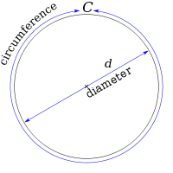
Reality of Numbers
As humans we have a symbolic number system that given any amount of time we can give a precise definition, for example:
Define pi
3.14 (Incorrect for most practical purposes)
22/7 (Better but still wrong)
C / d (Correct but not so useful)
Notes:
Image: Public Domain - http://en.wikipedia.org/wiki/File:Pi_eq_C_over_d.svg

Slide 21
Reality of Numbers
Computers have a limited amount of space for numbers. How does this change how we compute?
We use standards so numbers on one machine are similar to another

Slide 22
Reality of Numbers
Computers have a limited amount of space for numbers. How does this change how we compute?
Use standards
numbers on one machine should be similar to others
IEEE 754 Standard for Binary Floating-Point Arithmetic

Slide 23
Reality of Numbers
Computers have a limited amount of space for numbers. How does this change how we compute?
Use correct algorithms
Errors can accumulate via round off
Errors can also accumulate due to truncation or interpolation
See Nicholas Higham’s Accuracy and Stability of Numerical Algorithms aka BIBLE of numerical stability

Slide 24
Numbers in Science and Engineering
• Integers: signed and unsigned
• Floating point numbers: The IEEE-754 specification
• Floating point math
• Overflow and Underflow
• Examples and Counterexamples

Slide 25
Digital Machine Representation
COSC4364
Lennart Johnsson 2016-01-19
Every digital computer can only represent a finite number of digits
Irrational numbers cannot be represented (e.g. 1/3)
Only rational numbers that fit the machine representation can be represented exactly. The set depends on number system used and the number of machine digits in that representation
Numbers may be too large, or too small resulting in overflow or underflow
The finite number of digits limits the precision with the machine epsilon defining the smallest interval between numbers that can be represented
Johnsson L., Lecture notes spring 2016

Slide 26
Integers
Scientific computation mostly uses real numbers. Integers are mostly used for array indexing.
16/32/64 bit: short,int,long,long long in C, size not standardized, use sizeof(long) et cetera. (Also unsigned int et cetera)

Slide 27
Integers
In C, commonly:
char (one byte)
short (two bytes)
int (four bytes)
long (eight bytes)
NOTE: This is not standardized and may vary between compilers and installations. A careful programmer will use sizeof() when in doubt.
We will focus on the canonical 32-bit int type

Slide 28
Integers: Representation
2⁷ | 2⁶ | 2⁵ | 2⁴ | 2³ | 2² | 2¹ | 2⁰
0 | 0 | 1 | 0 | 1 | 0 | 1 | 0
2¹ | 2
2³ | 8
2⁵ | 32
Sum: | 42
42

Slide 29
Machine Integer Arithmetic
2³¹ | 2³⁰ | 2²⁹ | 2²⁸
1 | 1 | 1 | 1
2³ | 2² | 2¹ | 2⁰
1 | 1 | 1 | 1
4294967295
2³¹ | 2³⁰ | 2²⁹ | 2²⁸
0 | 0 | 0 | 0
2³ | 2² | 2¹ | 2⁰
0 | 0 | 0 | 1
+ 1
2³¹ | 2³⁰ | 2²⁹ | 2²⁸
0 | 0 | 0 | 0
2³ | 2² | 2¹ | 2⁰
0 | 0 | 0 | 0
= 0

Slide 30
Signed Integers: Two's Complement
2³¹ | 2³⁰ | 2²⁹ | 2²⁸
0 | 0 | 0 | 0
2³ | 2² | 2¹ | 2⁰
0 | 0 | 0 | 0
0
2³¹ | 2³⁰ | 2²⁹ | 2²⁸
0 | 0 | 0 | 0
2³ | 2² | 2¹ | 2⁰
0 | 0 | 0 | 1
- 1
2³¹ | 2³⁰ | 2²⁹ | 2²⁸
1 | 1 | 1 | 1
2³ | 2² | 2¹ | 2⁰
1 | 1 | 1 | 1
= -1

Slide 31
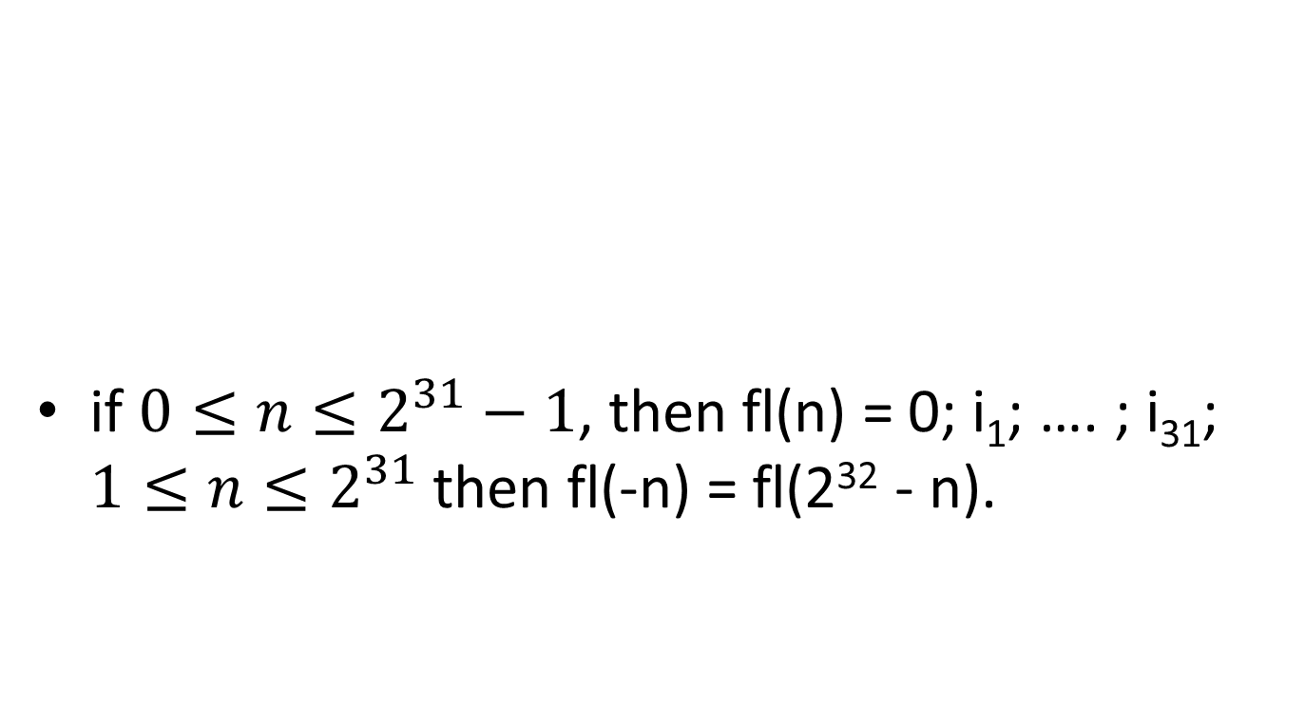
Encoding Integers
Unsigned
n is the number of bits
2^{(n)}
Signed (Two’s Complement)
-2^{(n-1)} to 2^{(n-1)}
Bryant and O’Hallaron, Lecture notes - Introduction to Computer Systems, Fall 2015

Slide 32
Integers
Questions to consider
How do you create numbers larger than 2^32?
How do you detect that your numbers have overflowed?
If I'm using big numbers should I just switch to floating point?

Slide 33
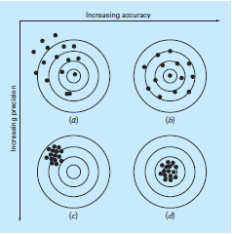
Accuracy and Precision
Accuracy refers to how closely a computed or measured value agrees with the true value.
Precision refers to how closely individual computed or measured values agree with each other.

Slide 34
COSC4364
Accuracy
Lennart Johnsson 2016-01-19
Accurate to n decimal places means that you can trust n digits to the right of the decimal place.
Accurate to n significant digits means that you can trust a total of n digits as being meaningful beginning with the leftmost nonzero digit.
Johnsson L., Lecture notes spring 2016

Slide 35
COSC4364
Lennart Johnsson 2016-01-19
Significant Digits of Precision
Traditional Place‐value notation:
Leftmost non‐zero digit most significant
Example: 123 = one hundred twenty three in the traditional place‐value decimal notation. (formally d₂d₁d₀ with value d₂10²+d₁10¹+d₃10⁰)
Significant digits of precision are the correct digits starting with the most significant digit and ending with the rightmost correct digit
Johnsson L., Lecture notes spring 2016

Slide 36
COSC4364
Significance of Precision
Example:
0.1036x+0.2122y=0.7381
0.2081x+0.4247y=0.9327
Lennart Johnsson 2016-01-19
Solving with Gaussian elimination using 3 digits of precision using rounding
0.104x+0.212y=0.738
0.208x+0.425y=0.933
Multiply 1st
eq. by 2 and subtract from 2nd eq.
0.001y = 0.933‐1.48 = ‐0.547
y = ‐547
Johnsson L., Lecture notes spring 2016

Slide 37
COSC4364
Significance of Precision
Example cont’d
0.1036x+0.2122y=0.7381
0.2081x+0.4247y=0.9327
Solving with Gaussian elimination using 4 digits of precision using rounding
Lennart Johnsson 2016-01-19
Multiply 1st
eq. by (0.2081/0.1036) ≈ 2.009
and subtract from 2nd eq.
(0.2081 – 0.1036*2.009)x+(0.4247‐2.009*0.2122)y = 0.9327‐2.009*0.7381
0.2081 0.4263
1.483
‐0.0016 y = ‐ 0.5503
y = 343.9
Johnsson L., Lecture notes spring 2016

Slide 38
COSC4364
Significance of Precision
Example cont’d
0.1036x+0.2122y=0.7381
0.2081x+0.4247y=0.9327
Lennart Johnsson 2016-01-19
Solving with Gaussian elimination using 10 digits of precision using rounding
Multiply 1st
eq. by (0.2081/0.1036) ≈ 2.008687259 = m
and subtract from 2nd eq.
(0.2081 – 0.1036*m)x+(0.4247‐m*0.2122)y = 0.9327‐m*0.7381
` 0.2081 0.4262434363 1.482612066
‐0.0015434363 y = ‐ 0.5499120656
y = 356.2907427
Johnsson L., Lecture notes spring 2016

Slide 39
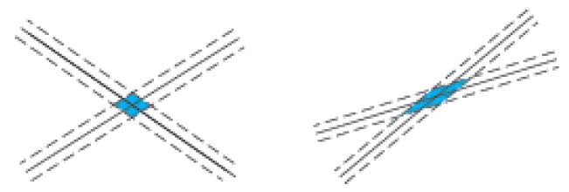
COSC4364
Significance of Precision
Problems for which the variation in the
Lennart Johnsson 2016-01-19
solution due to small changes in the input data also are small are said to be well‐posed.
Problems for which the variation in the solution due to small changes in the input data may be large are said to be ill‐posed.
Johnsson L., Lecture notes spring 2016

Slide 40
COSC4364
Errors
Lennart Johnsson 2016-01-19
Absolute
|True value – Approximate value|
Relative
(|True value – Approximate value|)/|True value|
True value is not always known. If not then the best known value is used as a substitute.
Johnsson L., Lecture notes spring 2016

Slide 41
COSC4364
Lennart Johnsson 2016-01-19
Absolute and Relative Errors
Example 1. | True value | = 1.333,
 | Approx. value | = 1.334
– Absolute error: 0.001
– Relative error:
0.00075
Example 2: True value
Approx. value
– Absolute error: 0.001
= 0.001,
= 0.002
– Relative error: 1
In most cases the relative error is the more relevant error information of the two measures
Johnsson L., Lecture notes spring 2016

Slide 42
COSC4364
Lennart Johnsson 2016-01-19
Absolute and Relative Errors
• Example 3. x = 0.00347. Rounded x_{r} = 0.0035
– Absolute error: 0.00003
– Relative error:
0.00003/0.00347 = 0.00865
Example 4: x = 30.158. Rounded x_{r} = 30.16
– Absolute error: 0.002
– Relative error:
0.002/30.158=0.000066
Example 3 has 2 significant digits, Example 4 has 4
In most cases the relative error is the more relevant error information of the two measures
Johnsson L., Lecture notes spring 2016

