Slide 1
ChurchManagement
Software that I developed in 2014 for the accounting management of NGOs

Slide 2
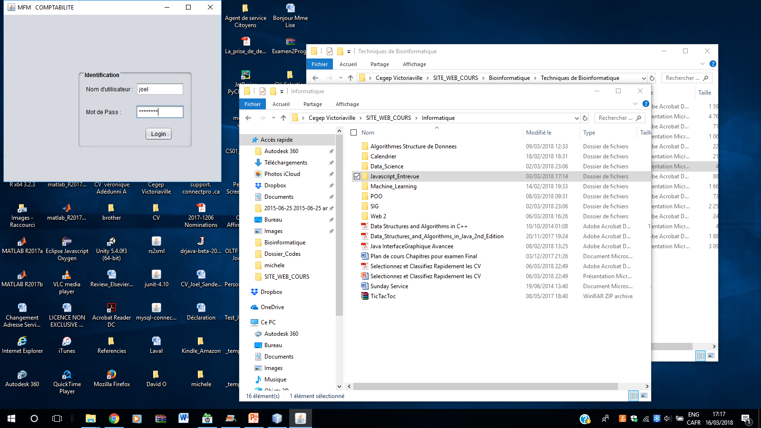
I will not go into detail for reasons of confidentiality. I will show you the outline.
Obviously, for questions of traceability, we must enter his name and password to know what agent was in office that day.

Slide 3
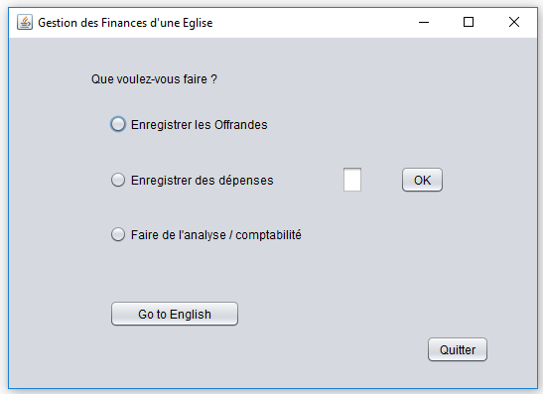
There are 3 main accounting activities in an NGO:
The interface is also available in English. I do not want to scann the whole demonstration once again

Slide 4
Registration of Offerings

Slide 5
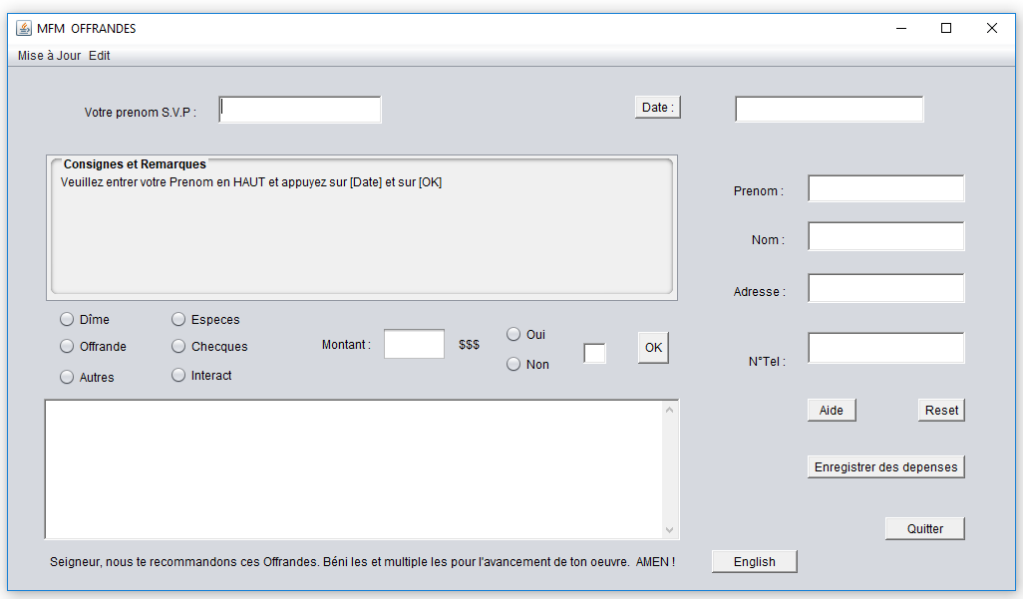
I produced the interface so that the user does not need to read the help topic. I designed him an intelligent system, which interacts directly with him in each of these actions. Awesome ! right !!

Slide 6
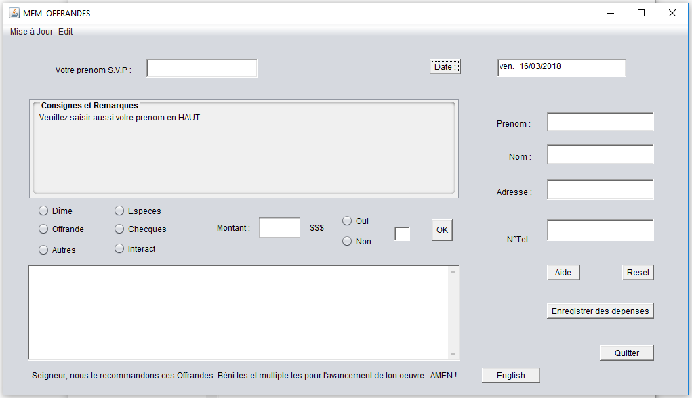

Slide 7
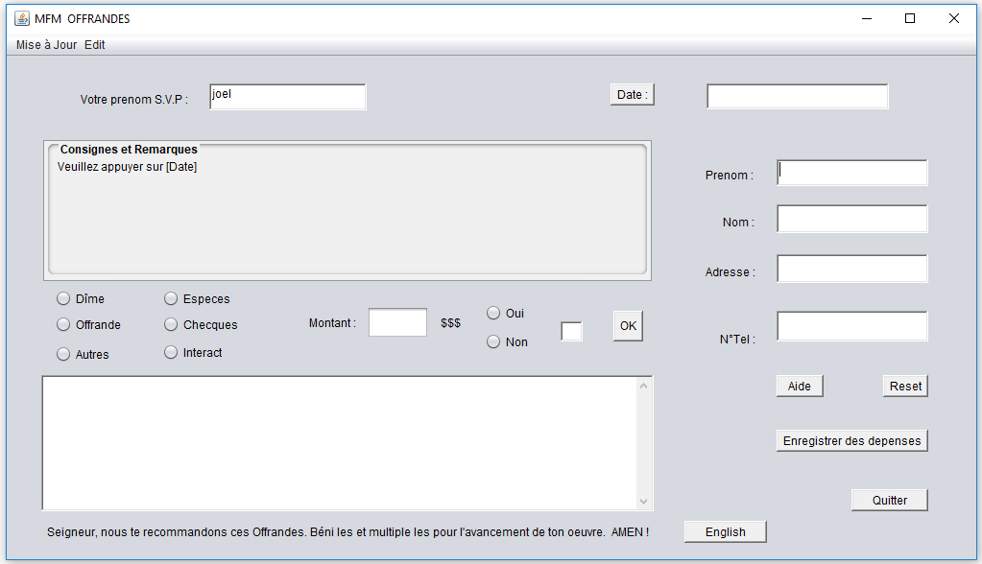

Slide 8
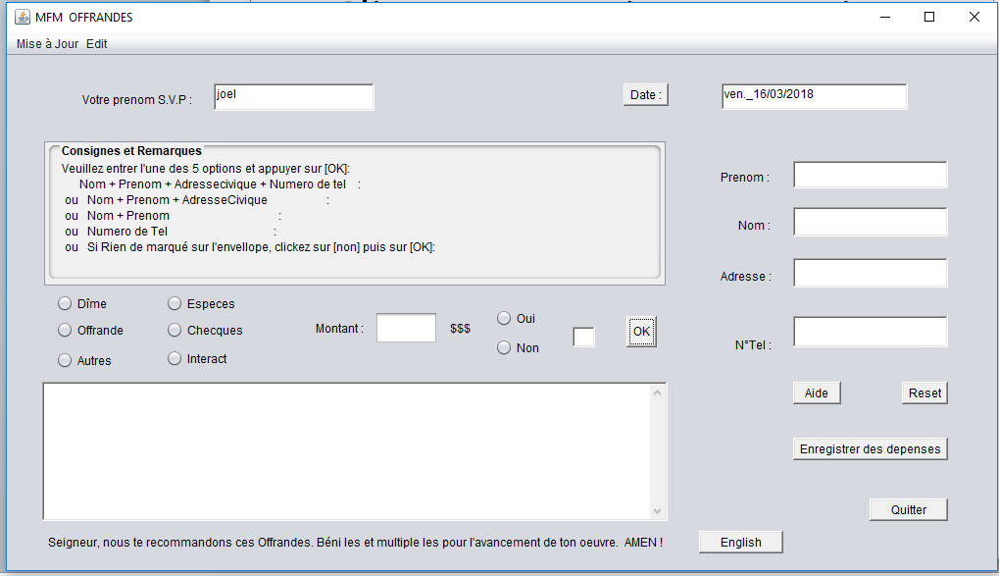

Slide 9
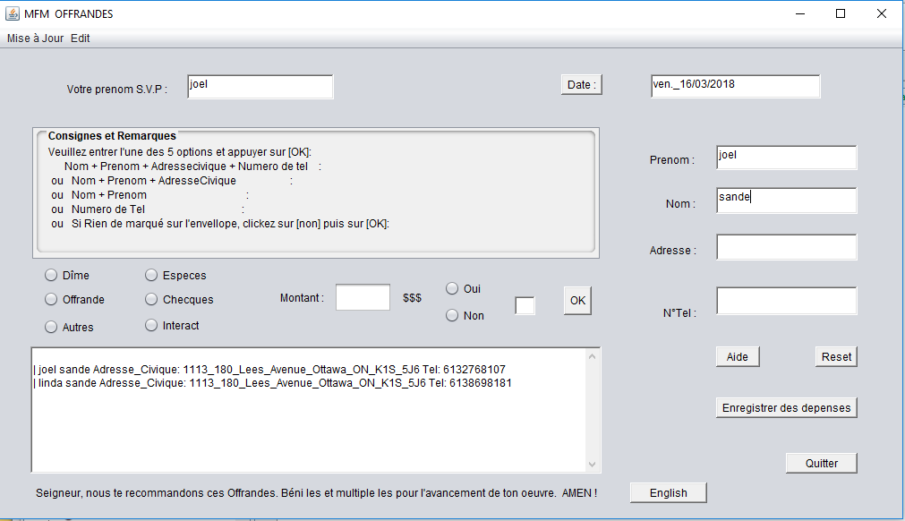
The system searches by selected fields. At this moment, he displays to me all the registered persons whose names contain the expression / sande / the / _ / were not necessary; sorry for the presentation.

Slide 10
I do not want to roll all the code. I prefer to keep some things confidential

Slide 11
Recording of expenditures

Slide 12
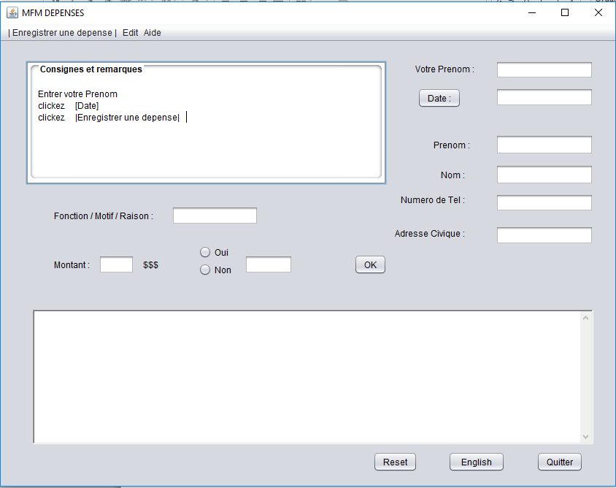
Same principle: the accountant must enter his first name before starting

Slide 13
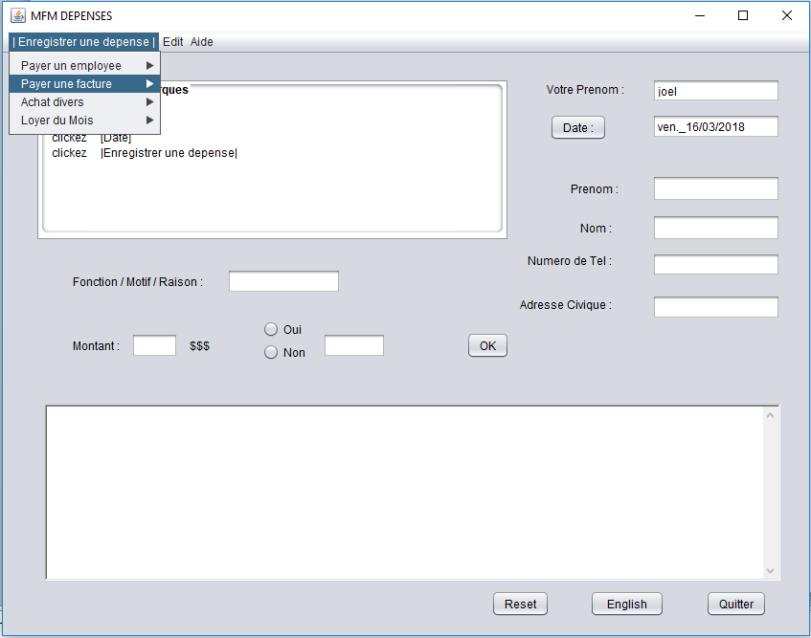

Slide 14
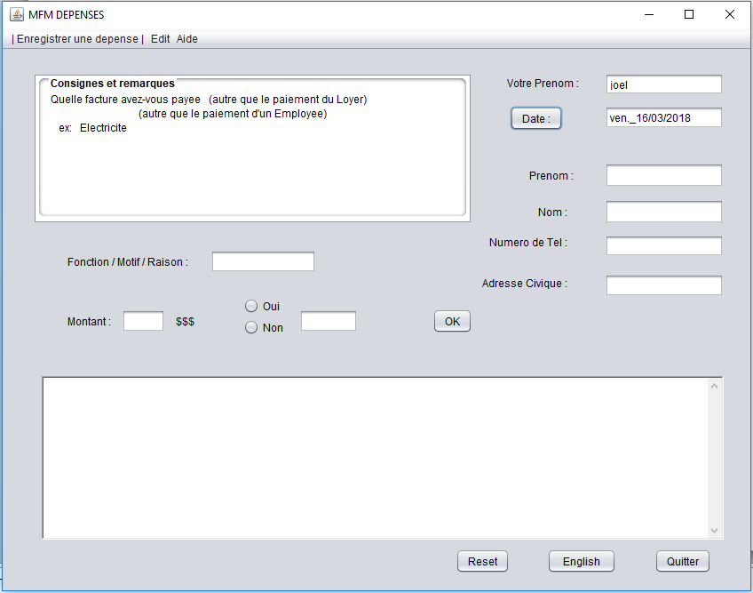

Slide 15
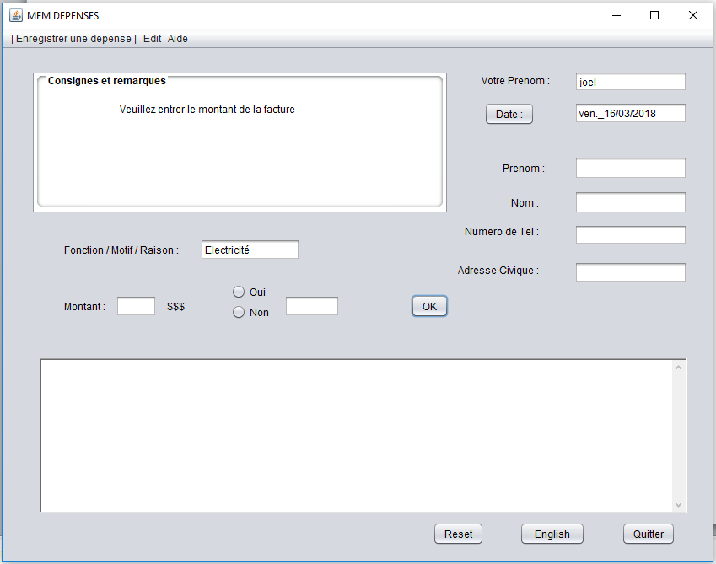

Slide 16
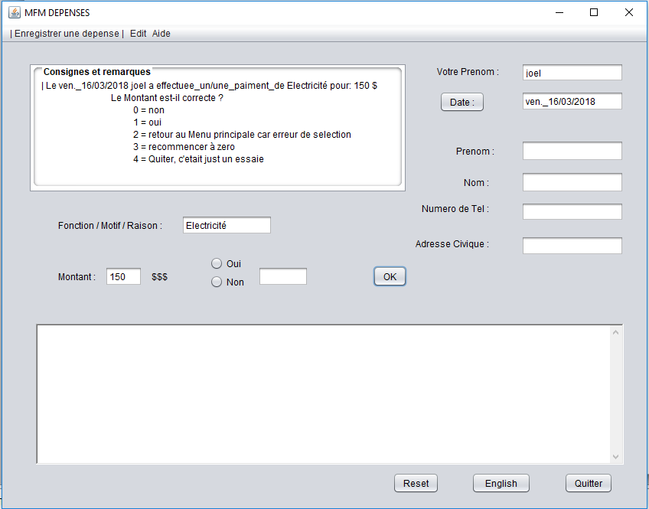

Slide 17
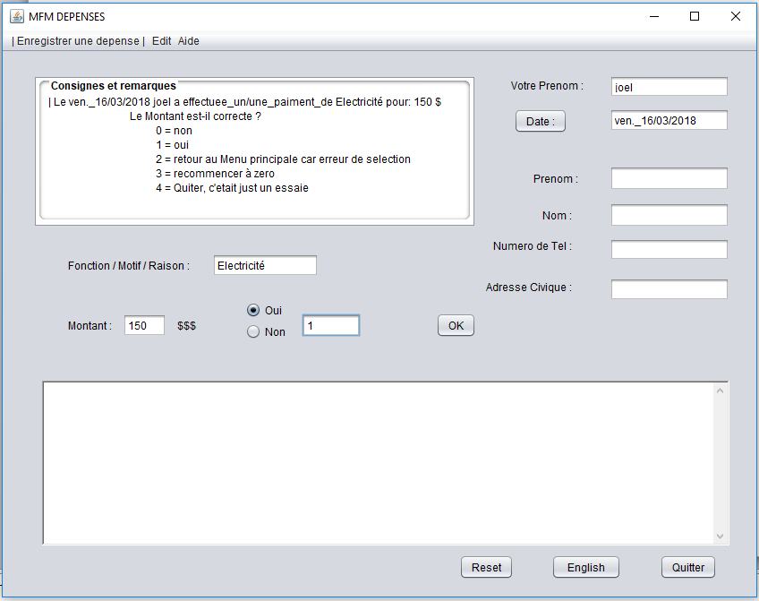

Slide 18
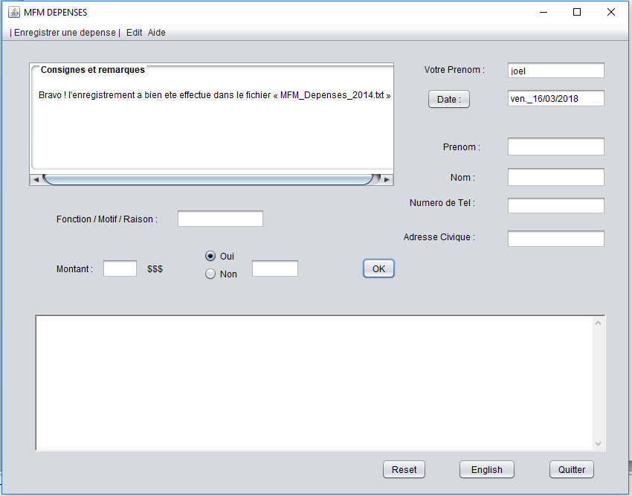

Slide 19
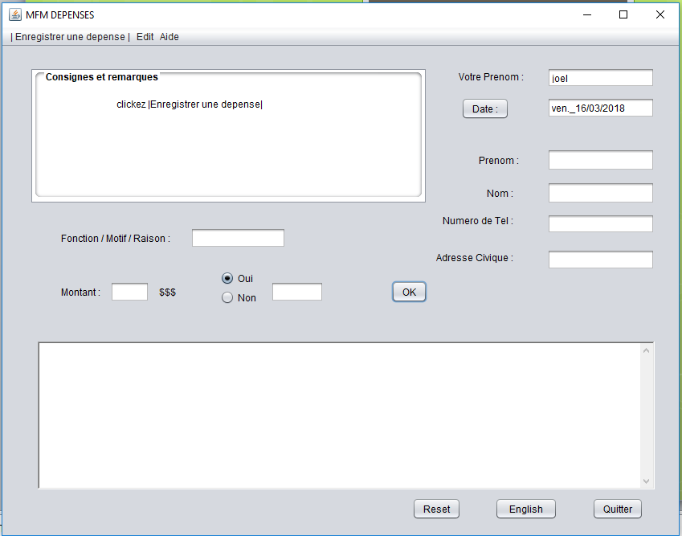

Slide 20
Accounting queries

Slide 21
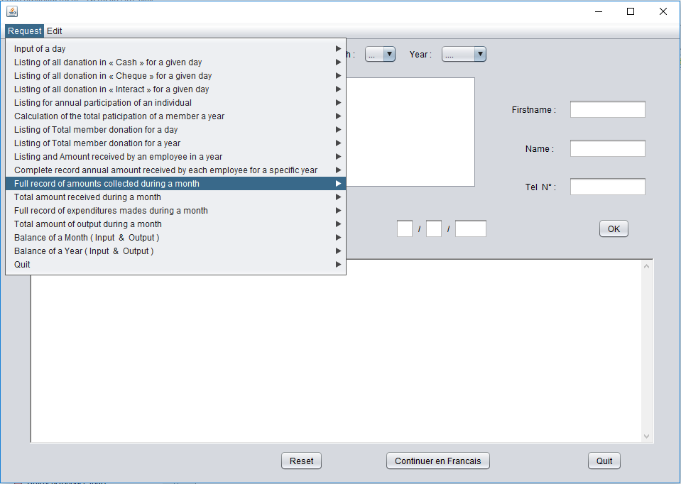

Slide 22
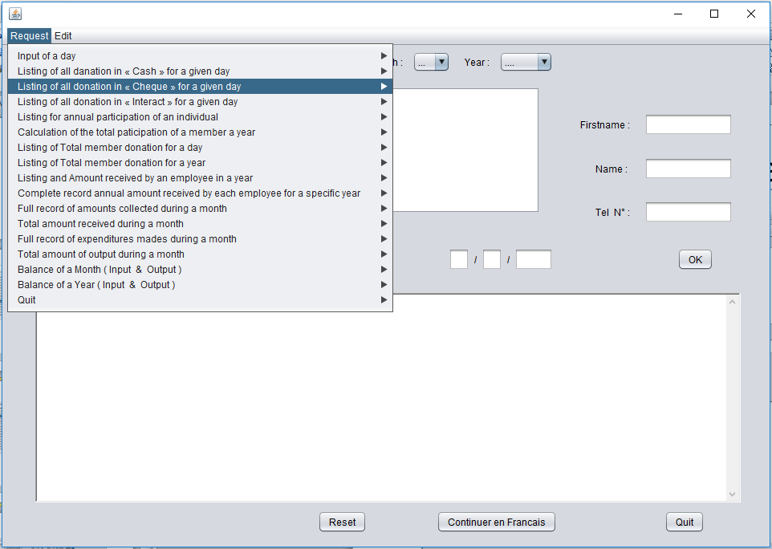

Slide 23
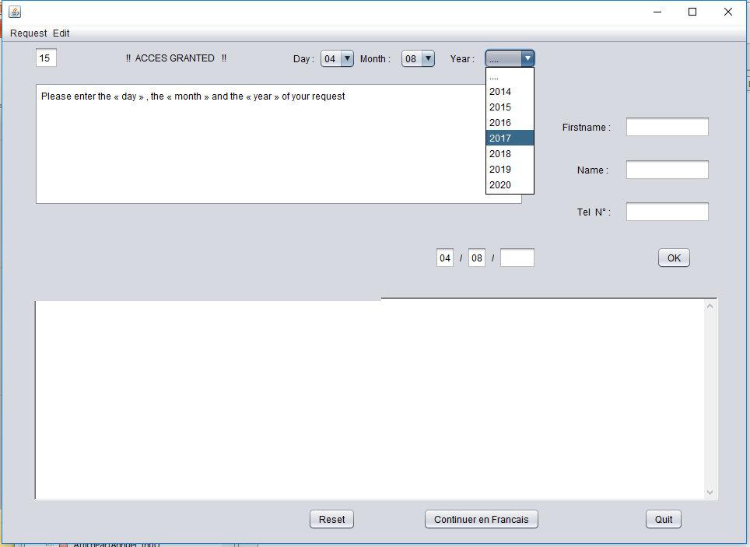

Slide 24
For reasons of confidentiality, I will stop there for this section.

Slide 25
