Slide 1
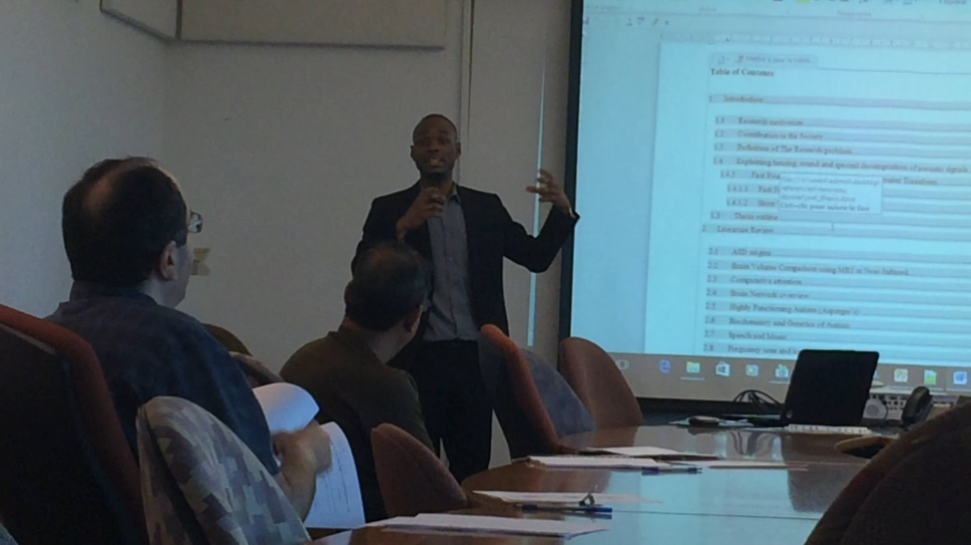
Website in progress
Who am I ?
By Joel Sandé

Slide 2
Joel Sandé
I am a multidisciplinary person devoted to science and technology.
I have knowledge in:
Biochemistry (a mix between biology and chemistry).
Bioinformatics (a mix between biology and informatics).
Biomedical Engineering (the use of engineering to solve health problems).

Slide 3
Joel Sandé
Over time, I understood that we can NOT know everything, although I am convinced that the best way to solve a health problem is to approach it from different angles that complement each other, reason why I did these multidisciplinary courses where I learned a lot of things that I would not have discovered otherwise.
Now I'm on a journey of acquiring technical computer skills.

Slide 4
Joel Sandé
My goal therefore in the long term is to work in HighTech related to the field of health, in close collaboration with doctors, pharmacists, the pharmaceutical industry, biotechnologists.
To do research and development to improve the conditions of patients and health workers.

Slide 5
Purpose of the Site
I designed this site with the objective of:
Showing a portfolio of some achievements.
Inform, educate my readers on different areas of Science and Technology that I know from my education.
Obviously .. if partners are added, the site will be much bigger. The future will tell.

Slide 6
Purpose of the Site
Also and above all :
Group together in one place, the set of activities conducive to development. I touched Biochemistry, Bioinformatics, Biomedical Engineering, because I was (and still am) convinced that the most effective solution for solving health problems is to attack them from different perspectives. Look at my link on Biomimicry and you will understand.

Slide 7
Multifield involvement
Problems of Big data in Biology have been solved by Bioinformatics from which we have a better idea on the functioning of Genomics and Genetics in human being. This has many applications both in the food industry and Pharmaceuticals industry.

Slide 8
Multifield involvement
Doctors obviously rely already on the Biomedical engineer on whom they completely depend in the exercise of their functions (radio, observation equipment, regulation and implantation, calibration... and so on (go have a look on my thesis topic)).
Artificial Intelligence, .. As well as all great advances in computer science will simply try to mislead the biological processes. For having done everything except medicine (because one cannot do everything) I found that this synergy is broken at many levels. The only business, universities trying to reconcile all these are the most successful ones today.

Slide 9
End of demonstration
I will stop there for now. The goal is to give you a brief overview of the purpose of the site.

