Slide 1
Python Editors & IDEs
Sublime Text 3
&
PyCharm
757Python Meetup
12 May 2016
Joel Kirch

Slide 2
Editors
Many to choose from:
  IDLE (Default with Python)
  Operating System Defaults
    Windows: Notepad, Wordpad
    Mac:TextEdit, VI
    Linux: VI, nano, pluma (graphical), and many more
  3rd Party
    Too many to choose from: https://wiki.python.org/moin/PythonEditors

Slide 3
Sublime Text 3
Download: https://www.sublimetext.com/3
Cross Platform
Demo
  Colors / Fonts
  Tabs
  Split Editing
  Multiple Selections
  Batch Edits
  Command Palette (Ctrl-Shift-P) setsp
  Goto Anything (Ctrl-P)
  Easy to enhance with plugins: https://packagecontrol.io/

Slide 4
Package Control
Install
  https://packagecontrol.io/installation#st3
  Ctrl+` (yes, that's a backtick, it's above the Tab key)
    Sublime Text console
  You will need to close and restart the ST3 a couple of times to install the dependencies.
Install a plugin (Ctrl-Shift-P) PCI
  Compare Side-By-Side
Demo

Slide 5
Integrated Development Environments (IDE)
Many to choose from:
  No default from Python
  No default from Operating Systems
  Again, too many to choose from:
    https://wiki.python.org/moin/IntegratedDevelopmentEnvironments

Slide 6
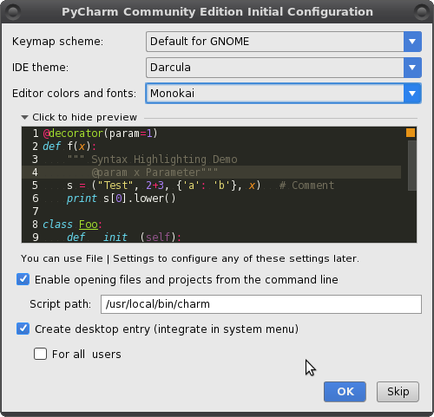
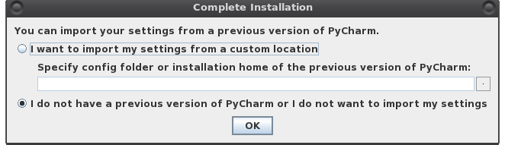
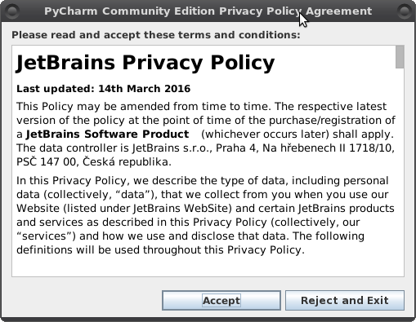
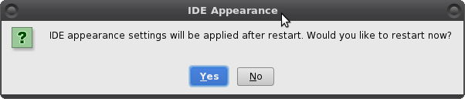
PyCharm
Download: https://www.jetbrains.com/pycharm/
Cross Platform
Install
  Accept User Agreement
  Edit Settings
  Restart application

Slide 7
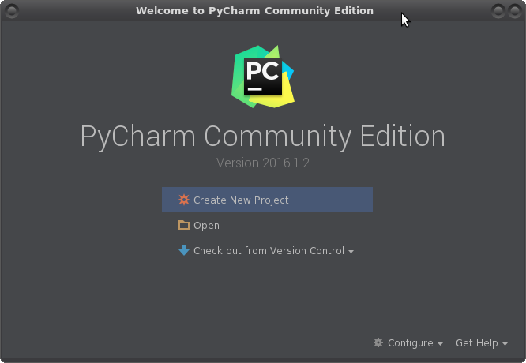
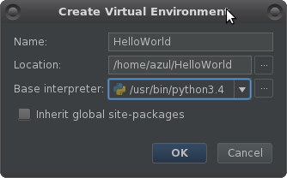
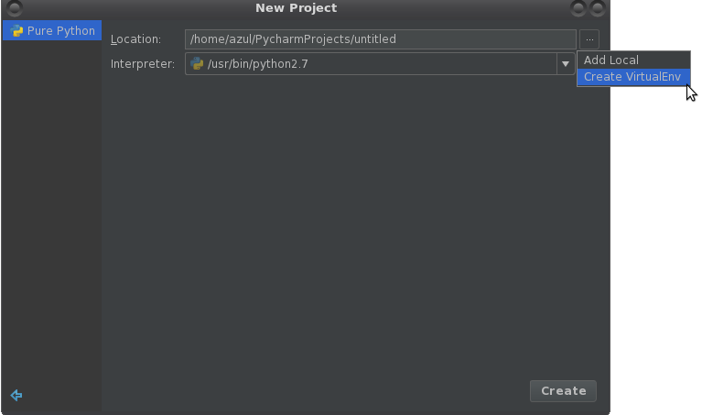
PyCharm Demo

Slide 8
PyCharm Keyboard Shortcuts
Mac
  https://resources.jetbrains.com/assets/products/pycharm/PyCharm_ReferenceCard_mac.pdf
Linux / Windows
  https://resources.jetbrains.com/assets/products/pycharm/PyCharm_ReferenceCard.pdf

