Slide 1
Beating the World Record with AI: A Mario PPO Experiment
Reinforcement Learning Meets Super Mario Bros
Presented by: Joel

Slide 2
Project Goal
Use reinforcement learning (PPO) to train an AI agent
Goal: Beat the world record time from World 1-1 to 1-4 in Super Mario Bros

Slide 3
Approach Overview
Two Main Strategies:
1. Train separate models for each level (W1-1 to W1-4)
2. Train a single general model for all 4 levels

Slide 4
Tools & Setup
RL Algorithm: Proximal Policy Optimization (PPO)
Library: Stable-Baselines3 (with gym-super-mario-bros & nes-py)
Custom reward shaping: progress, flagpole, time left
Training on GPU, logging via TensorBoard

Slide 5
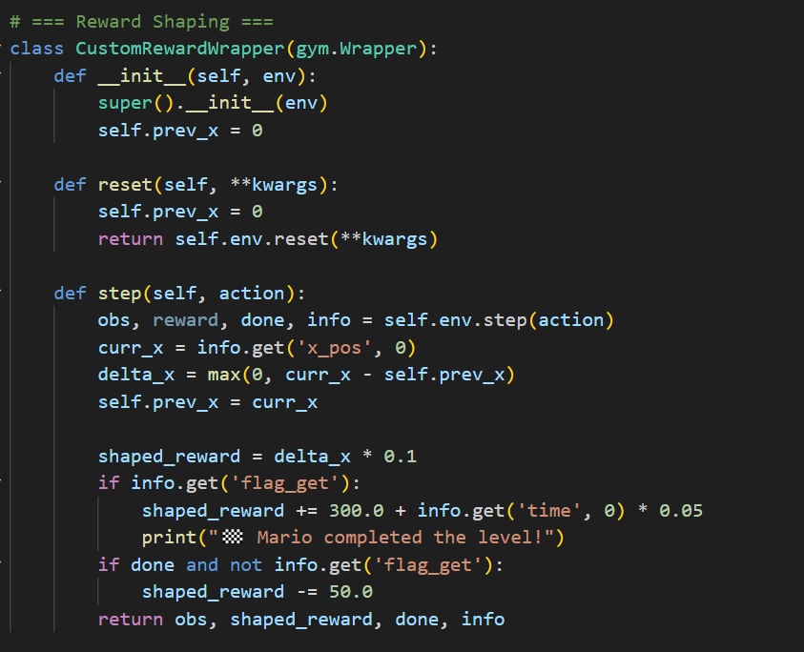
Reward Function

Slide 6
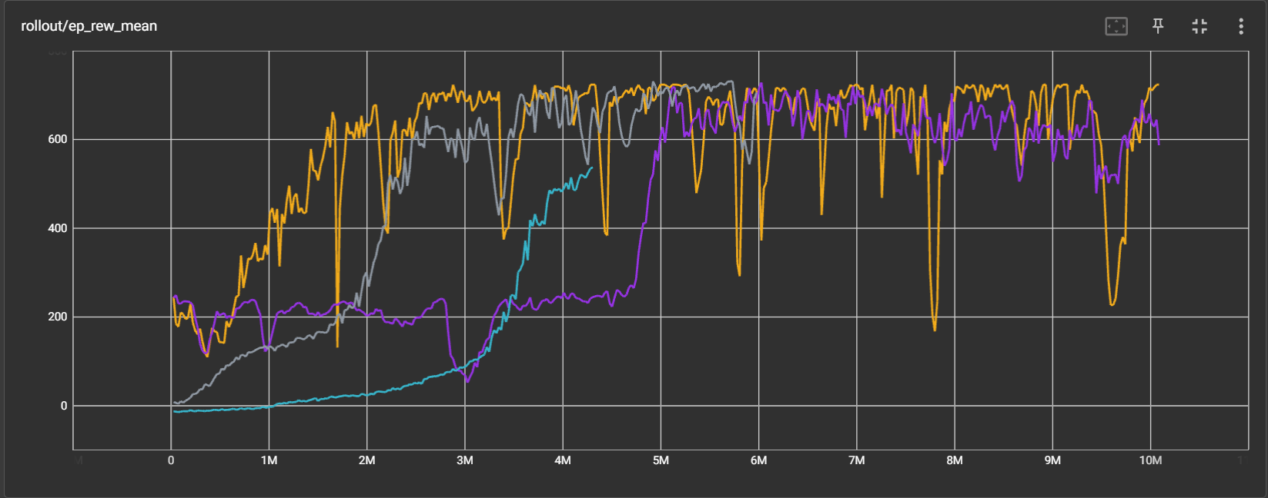
Training Separate Models
Each level trained independently using PPO
Custom reward shaping and early stopping
Reached near-optimal performance on each level
Consistently completed 1-1, 1-2, 1-3, 1-4 after training each level for approximately 5 million steps each

Slide 7
Result
WORLD- LEVEL | WORLD RECORD | MODELS RESULT | TIME DIFFERENCE
1-1 | 370 | 357 | 13s
1-2 | 350 | 333 | 17s
1-3 | 260 | 247 | 13s
1-4 | 263 | 259 | 04s

Slide 8
Attempting a General Model
One PPO agent trained across all 4 levels
Used Multi-Learning and Dynamic Level Sampling
Overfitted to easier levels like 1-1
Failed to generalize well to 1-3

Slide 9
Key Challenges
Generalizing across different enemies/layouts
Catastrophic Forgetting

Slide 10

Multi-Task Learning Design
Assigned 12 workers to parallelly run on different levels
Reduce training on mastered levels.
Logged worker-to-level mapping every 1M steps

Slide 11
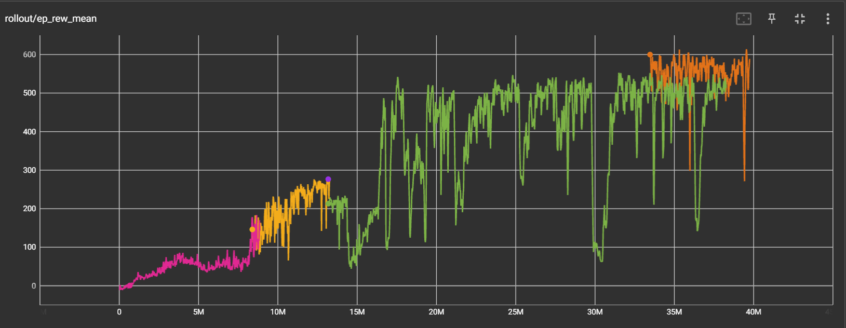
Dynamic Level Sampling
Sampled harder levels more frequently
Ensured at least one worker on each level
Pros: Reduced forgetting, encouraged generalization
Cons: Still overfitted to simpler levels

Slide 12
Result
WORLD- LEVEL | WORLD RECORD | MODELS RESULT | TIME DIFFERENCE
1-1 | 370 | 366 | 04s
1-2 | 350 | 338 | 12s
1-3 | 260 | - | -
1-4 | 263 | 261 | 02s

Slide 13
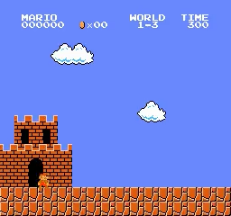
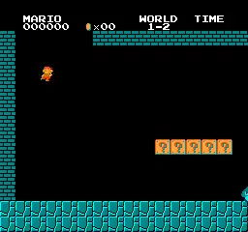
Demo / Videos
Video clips of per-level success (W1-1 to W1-4)
Video of general model struggles

Slide 14
Thank You!
Any questions?

