Slide 1
Clustering in Python
k-means clustering
Dr. Chun-Hao Chen

Slide 2
Outline
1、Import Library
2、Generate Clustering Instances
3、Call KMeans() for Clustering
4、Show Clustering Result

Slide 3
1. Import Library
import matplotlib.pyplot as plt
from sklearn.datasets import make_blobs
from sklearn.cluster import KMeans
# Draw figures
# make_blobs: generate clustering instances
# Kmeans: k-means clustering algorithm

Slide 4
2. Generate Clustering Instances
Example:
# create instances
# X: attribute values
# y: group label
X, y = make_blobs(
n_samples=150, n_features=2,
centers=3, cluster_std=0.5,
shuffle=True, random_state=0
)
print(X)
print(X[:, 0])
print(X[:, 1])
#n_sample = 5, list X is shown as follows:
[
[-1.3049724 3.08471943] [ 0.92466065 4.50908658] [ 1.45131429 4.22810872] [ 2.43578638 0.95850117] [ 2.12728931 1.62480041]
]
#centers = 3, list y is shown as follows:
[2 0 0 1 1]
# X[:, 0]
[-1.3049724 0.92466065 1.45131429 2.43578638 2.12728931]
# X[:, 1]
[ 3.08471943 4.50908658 4.22810872 0.95850117 1.62480041]

Slide 5
3、Call KMeans() for Clustering
km = KMeans(
n_clusters=3, init='random', n_init=10, max_iter=300, tol=1e-04, random_state=0
)
y_km = km.fit_predict(X) # Compute cluster centers and predict cluster index for each sample.
print(y_km) # Continue previous example: y_km = [1 2 2 0 0]
Randomly generate initial centroids
Number of iterations
n_clusters=3, init='random', n_init=10, max_iter=300, tol=1e-04, random_state=0
number of clusters
Number of time the k-means algorithm will be run with different centroid seeds.
Difference in the cluster centers of two consecutive iterations to declare convergence

Slide 6
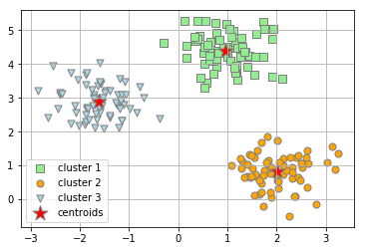
4、Show Clustering Result
# Draw the 3 clusters
plt.scatter( X[y_km == 0, 0], X[y_km == 0, 1], s=50, c='lightgreen', marker='s', edgecolor='gray', label='cluster 1')
plt.scatter( X[y_km == 1, 0], X[y_km == 1, 1], s=50, c='orange', marker='o', edgecolor='gray', label='cluster 2')
plt.scatter( X[y_km == 2, 0], X[y_km == 2, 1], s=50, c='lightblue', marker='v', edgecolor='gray', label='cluster 3')
# Draw the centroids
plt.scatter(
km.cluster_centers_[:, 0], km.cluster_centers_[:, 1], s=250, marker='*', c='red', edgecolor='gray', label='centroids'
)
plt.legend(scatterpoints=1)
plt.grid()
plt.show()

