Slide 1
Financial machine learning
JOEL ALCEDO

Slide 2
BEFORE ANYTHING…
Artificial Intelligence
Techniques for computers to mimic human decision making
Machine learning
Techniques for computers to learn without being told to do so (e.g. k-means)
Deep learning
Subset of ML making computation of multilayer NNs possible

Slide 3
AI: THEN AND NOW
Logical
if(rains){
function(umbrella);
function(go_to_work);
} else{
function(go_to_work);
}
Computer learned

Slide 4
Section 1
Building up capabilities

Slide 5
THE ML MINDSET FINANCE VS. TECH COMPANY
Financial machine learning is its own discipline
No silver bullet; alpha discovery is still a process, but the tools to extract alpha have become more sophisticated and widely democratized.
The signals and strategies that work are generally not published in financial journals.
The “right” way to build up ML capabilities = industrializing the process...

Slide 6
Digging for gold
“Mining for gold and silver was a relatively straightforward endeavor during the 16th and 17th centuries. In less than a hundred years, the Spanish treasure fleet quadrupled the amount of precious metals in circulation throughout Europe. Those times are long gone, and today prospectors must deploy complex industrial methods to extract microscopic bullion particles out of tons of earth. That does not mean production is at historical lows. On the contrary, nowadays miners extract 2,500 metric tons of microscopic gold every year, compared to the average annual 1.54 metric tons taken by the Spanish conquistadors throughout the entire 16th century! Visible gold is an infinitesimal portion of the overall amount of gold on Earth. El Dorado was always there…if only Pizarro could have exchanged the sword for a microscope…”

Slide 7
Digging for gold
“…the discovery of investment strategies has undergone a similar evolution. If a decade ago it was relatively common for an individual to discover macroscopic alpha (i.e. using simple econometric tools like econometrics), currently the chances of that happening are quickly converging to zero. Individuals searching nowadays for macroscopic alpha, regardless of their experience or knowledge, are fighting overwhelming odds. The only true alpha left is microscopic, and finding it requires capital-intensive industrial methods. Microscopic alpha today is more abundant than macroscopic alpha has ever been in history…”
Advances in Financial Machine Learning
-Dr. Marco Lopez De Prado

Slide 8
THE ML PRODUCTION CHAIN: A TEAM EFFORT
Data Curator
Also known as the data engineer.
Feature Analyst
Takes the processed data and develops signals.
Software engineers, mathematical programmers, algorithm specialists take the helm here.
Backtester
Deployment team
Cleans, collects, stores, delivers data.
Good understanding of context in which data arises (e.g. stock splits, rolling futures, etc.)
Strategist
Experts in information theory, signal extraction, visualization, labeling, weighting, etc.
The “signal librarian” – not developing strategies – looking for things that could be useful…e.g. can easily discover probability of sell-off is greater when limit orders are cancel/replaced with market orders.
Takes the signals and transforms them into investment algorithms. Takes library of features to formulate hypothesis.
Team members are data scientists with deep knowledge of markets and economy.
Theory should identify economic mechanism that causes agent to lose money to the strategy.
Features developed in black box, strategy in a white box.
Examines the profitability of the strategy.
Evaluates probability of backtest overfitting, performance, risk, viability of strategy under various scenarios among others.
Ensures the thing they deployed is identical to the prototype they received.
Expert in empirical / experimental techniques.
Should also cross-examine meta information about how strategy came about in the first place.
Important to minimize production latency.
Need to have a good tech stack (automation servers, Hadoop, HPC, etc.)
Only management gets to see backtest results.

Slide 9
COMMON MISTAKES
Category | Pitfall | Description | Solution
Epistemological | The Sisyphus Paradigm | Discretionary PMs work in silos. Asking them to work together would lead to converging ideas. Hiring quants to work in silos is not sustainable for the firm. | Developing a robust meta-strategy. In other words, a production chain where roles are defined and everyone is aware of the holistic view (next slide).
Epistemological | Research through backtesting | Harvey et al. [2015] show that “most claimed research findings are likely false.” | Understand your feature importances. Identify which variables matter more so you can form an opinion on how.
Data processing | Chronological sampling | Market data and information does not arrive at a constant entropy rate. | Sample data as a function of the amount of information exchanged (price, volume, etc.)
Data processing | Integer differentiation | Differencing (good) will create a stationary series , but will also eliminate memory of series (bad) | Determine the appropriate / minimum amount of differentiation required to preserve memory while also preserving stationarity.
Classification | Learning side (buy/sell) and size (amount) simultaneously. | If you have a model that says buy, sell, or do nothing, you still need to know how much you should risk. | Meta-labeling: build a secondary model that does not learn the side, but learns the size. Utilize outcome of primary model as 1 (gain), 0 (loss).
Source: Advances in Financial Machine Learning

Slide 10
COMMON MISTAKES
Category | Pitfall | Description | Solution
Classification | Weighting non-IID samples | Independent and identically distributed data: when each variable has the same probability distribution and are mutually independent. Not usually in finance! | Determine the common features.
Evaluation | Cross validation leakage | Observations cannot be assumed IID processes. If serial correlation exists, and your model predicts Y_{t} based on X_{t}, the likelihood Y_{t+1} draws a reasonable outcome based on observed X_{t+1} could be high, even if X is not relevant. Could result in misleading CV. | Of course, use features that are relevant. Beyond this, utilize “purging” and “embargoing” to prevent leakage in k-fold cross validation.
Evaluation | Backtest overfitting | When selection bias leads somebody to select the best result under multiple testing, the backtest is likelier to be a false discovery. | Deflated Sharpe: what is the probability the Sharpe is significant? You can compute expected Sharpe ratio using multiple trials of the same strategy. Backtesting is very nuanced subject and should be handled by an expert.
Source: Advances in Financial Machine Learning

Slide 11
Portfolio governance
EMBARGO
Run the strategy on unseen data
Do the results align with expectation?
PAPER TRADING
Run the strategy on a live system without any real money.
REAL MONEY
Gradually increase capital allocation.
DECOMMISSION
ALLOCATION
This way you can test latency, delays, etc.
Deploy using capital
Does the system behave the same way as in the paper trading?
As performance decays over time, reduce allocation.
All good things must come to an end.
When algo performs below expectations for a sufficient period of time, pull the plug.

Slide 12
TYPES OF DATA
Fundamental data
Assets & Liabilities
Sales
Costs
Cash flow
Macroeconomic
Market data
Price / yield
Implied volatilities
Volume
Dividend / coupons
Open interest
Quotes / cancellations
Analytics
Credit ratings
Analyst recommendations
Earnings expectations
Alternative data
Sensor-based (e.g. satellites)
Google trends
Twitter
Metadata

Slide 13
COGNITIVE BIAS CODEX
https://upload.wikimedia.org/wikipedia/commons/thumb/6/65/Cognitive_bias_codex_en.svg/1900px-Cognitive_bias_codex_en.svg.png

Slide 14
Section 2
Algorithms

Slide 15
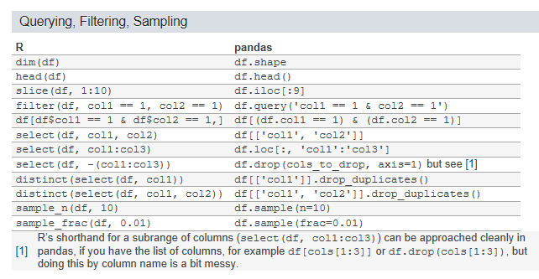
DOES IT MATTER WHAT PROGRAMMING LANGUAGE TO USE?
Machine learning and data science in general is highly democratized
Python is where most of the new development in the space happens
R has transformed from a clunky language to a grammatically fluid paradigm
Both are more-or-less equivalent
R > Python with visualization
Python > R with production code
Best way to learn how an AI algorithm works? Build it from scratch…completely. Then it will be less of a black box.
Depending on the role would predicate what programming language to use (e.g. deployment team should have some expertise with C++, Java, etc.)
Strategists, Feature Analysts, etc., typically come with R, Python, Matlab

Slide 16
AI: MORE HELPFUL IN OPERATIONAL WORK VS. TRADING DECISIONS?
No. Both areas focus on different things and implementation looks different as well.
For example, more operational-related work can be formed in pure black box systems.
Within the context of market investing, various elements can be developed in black box systems, but the strategy should be implemented in a white box.
In the financial ML space, setting up the production line as we covered is important.
Funds utilizing ML/AI in investment process
Man / AHL: long only 100% systematic
AQR
Bridgewater
Rentec
Many more…!
“The non-linear interactions when you’ve got five or six different types of signals become much harder to explain. That’s where you start relying on machine learning”
Matthew Sargaison, Man AHL

Slide 17
AI: MORE HELPFUL IN OPERATIONAL WORK VS. TRADING DECISIONS?
BUT…
Most hedge funds who are interested in utilizing AI strategies will do it wrong.
Common pitfalls we discussed earlier.
Making sure the right infrastructure is set up, industrialized and robust enough (from the data to the hardware) is mission critical.
SPX Index
Eurekahedge AI Hedge Fund Index

Slide 18
AI: When should we use vs. when should we not use?
100% systematic is possible.
But there is a gradient of supervision involved…
Machine learning is not a panacea, proceed with caution
If we go back to the meta strategy…
Data Curator
Uses computer programming to deliver data.
Feature Analyst
Uses data science and analytics to form signals
Quality of deployment predicated on quality of deployment team ☺
Backtester
Deployment team
Strategist
Uses data science and analytics to form strategy.
Uses applied mathematics, knowledge of finance to model risk, returns, run simulations, etc.
Machine learning could be involved to understand data
All flavors of AI possible.
Quality of feature predicated on quality of data.
Strategy generally in white box.
Quality of strategy is predicated on quality of feature library.
Quality of backtest predicated on quality of strategy.
Uses low-abstracted computer programming to implement in most efficient way possible.

Slide 19
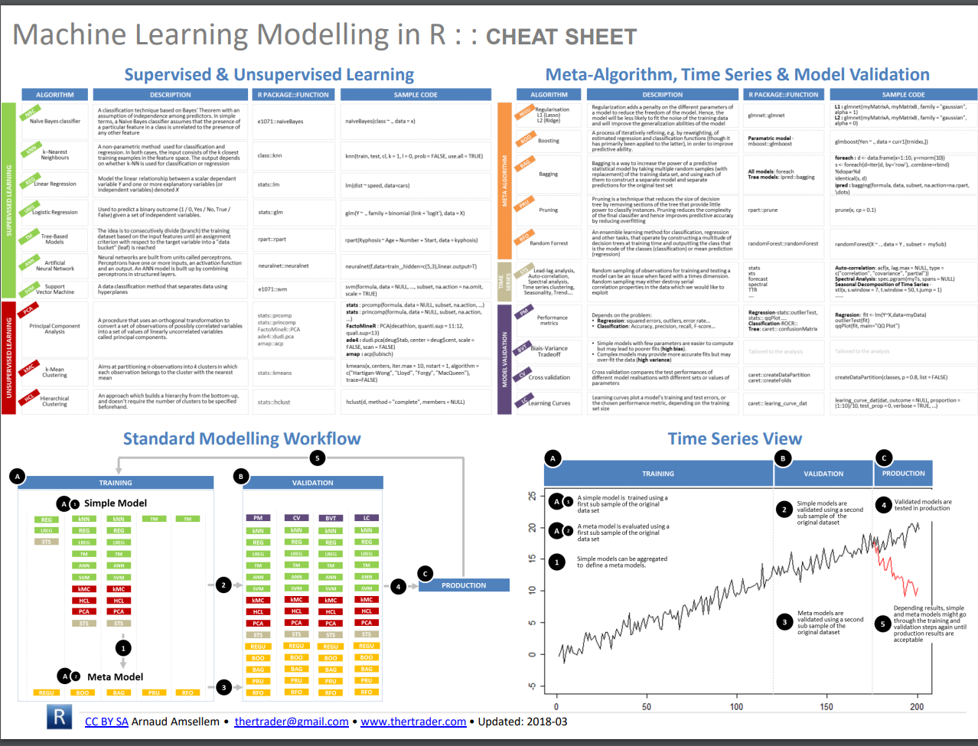

Slide 20


Slide 21
MACHINE LEARNING + CREDIT RISK MODELING
ML is commonly used for determining risk of default by Moody’s, S&P, et al.
With sufficient data, random forest + boosting* algorithms are common
*boosting: basically a tree-based algo where the trees are weight based on their importance
DEFAULT RISK H_{d} = 39%
H_{nd} = 61%
DEFAULT H_{d} = 100% H_{nd} = 0%
NONDEFAULT H_{d} = 9%
H_{nd} = 91%
NONDEFAULT H_{d} = 17%
H_{nd} = 83%
NONDEFAULT H_{d} = 0%
H_{nd} = 100%
NONDEFAULT H_{d} = 12%
H_{nd} = 88%
DEFAULT H_{d} = 25%
H_{nd} = 75%
EBITDA/Interest Expense < 2
Liabilities/Sales <= 0.35
Total assets < 25bn
EBITDA/Interest Expense > 2
Liabilities/Sales > 0.35
Total assets > 25bn

Slide 22
LSTM NETWORKS HOW THEY WORK 1/7
Before understanding what an LSTM is, we need to understand what a feedforward NN is and a RNN is. Let’s do a quick refresh.
Feedforward networks: Input * Weight + Add Bias → Activate → Feed forward
Neural nets = universal function approximators.
Hidden layer 1
Hidden layer 2
Hidden layer 3
Output layer
w
w
w
w
Input
+
+
+
+
Output
b
b
b
b

Slide 23
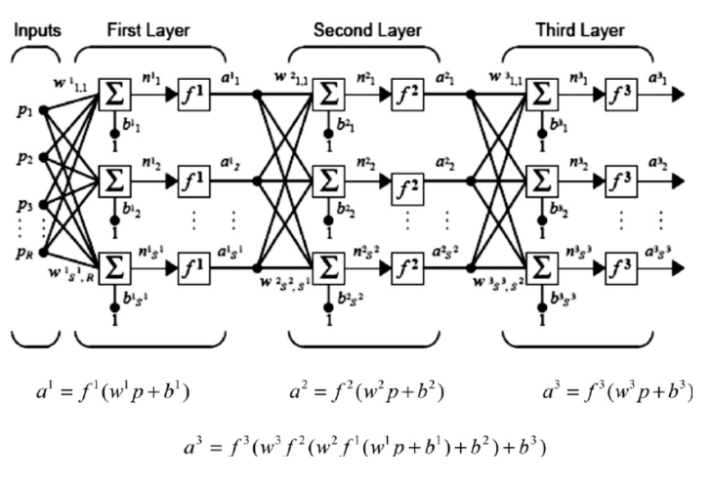
LSTM NETWORKS HOW THEY WORK 2/7
Simple feed-forward architecture
Input: variables
Weight: derived through backwards propagation and gradient descent
Bias: intercept offset
Activate: take output, feed into nonlinear function, so network can learn both linear and nonlinear functions

Slide 24
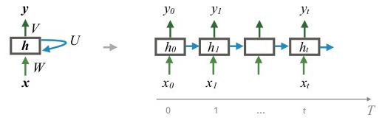
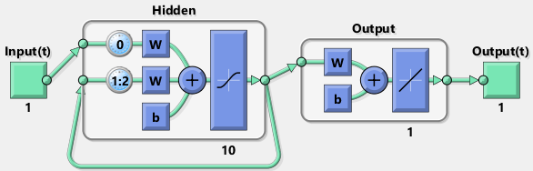
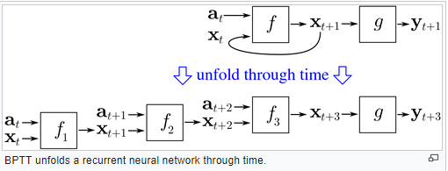
LSTM NETWORKS HOW THEY WORK 3/7
What makes an RNN different from a simple feed forward network?
They help us compute conditional memory…the next value in a sequence of values
RNNs were developed in the 1980s
We add a third weight matrix to connect current hidden state to hidden state at previous time step, referred to as the recurrent hidden state.
Backpropagation is slightly different; through time: BPTT

Slide 25
LSTM NETWORKS HOW THEY WORK 4/7
RNN: two elephants in the room…
Long term dependencies might not be captured well because we are feeding in the previous hidden layer.
When we feed forward networks, we derive a prediction value, derive the error value, which is then used to backpropagate.
As we propagate the error value after every layer recursively in RNNs, the gradient value gets smaller and smaller and smaller (we’re looking at the partial derivative of the error term). The implication is that the magnitude of change in the first layer of our network is going to be smaller vs. in the tail end of the network.
Sensitivity decays exponentially over time – and this could create an instance in which the gradient vanishes (or explodes) – this is called the vanishing gradient problem.

Slide 26
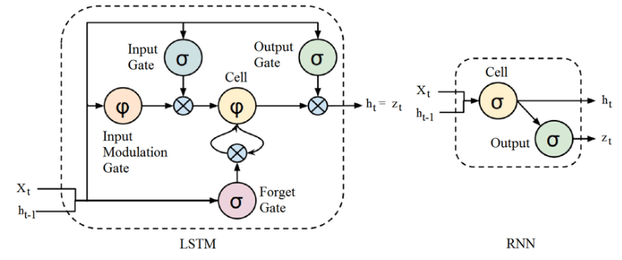
LSTM NETWORKS HOW THEY WORK 5/7
So the solution is LSTM!
Seeks to preserve fidelity of the updating process.
It replaces the RNN cell. Instead of: Input * Weight + Bias → Activate which we see in RNN…
…we have various “gates” (input, output, forget), which all perform their own series of matrix operations – they are perceptrons – or single layer neural networks.

Slide 27
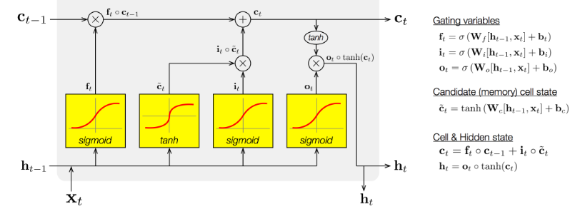
LSTM NETWORKS HOW THEY WORK 6/7
These gates each have their own set of weight values. The whole thing is differentiable (meaning we compute gradients and update the weights using them) so we can backprop through it
We want our model to be able to know what to forget, what to remember. So when new a input comes in, the model first forgets any long-term information it decides it no longer needs. Then it learns which parts of the new input are worth using, and saves them into its long-term memory.
And instead of using the full long-term memory all the time, it learns which parts to focus on instead.
Basically, we need mechanisms for forgetting, remembering, and attention. That's what the LSTM cell provides us.

Slide 28

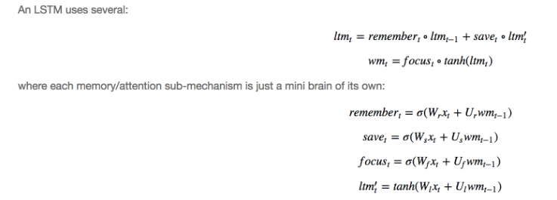
LSTM NETWORKS HOW THEY WORK 7/7
A key to remember is that RNNs will use ONE equation to update its hidden state/memory.
An LSTM uses several
Which piece of long term memory to remember and forget? We'll use new input and working memory to learn remember gate. Which part of new data should we use and save? Update working memory using attention vector.
The long-term memory, is usually called the cell state,
The working memory, is usually called the hidden state. This is analogous to the hidden state in vanilla RNNs.
The remember vector, is usually called the forget gate (despite the fact that a 1 in the forget gate still means to keep the memory and a 0 still means to forget it),
The save vector, is usually called the input gate (as it determines how much of the input to let into the cell state),
The focus vector, is usually called the output gate )

Slide 29
NATURAL LANGUAGE PROCESSING
Syntax
Word order
Word endings
Speech
NLP is an evolving area in academic research, staying on top of what is new is never a bad thing
BERT is a relatively new framework open sourced by Google researchers which has been used to outperform a number of (varied) NLP benchmark tests with state of the art results. White paper.
NLP usually requires two steps:
Train a language model on text data
Use learned representations for a task-specific model
NLFF: natural language based finance forecasting is the study area worth focusing on.
Semantics
Word meanings
The way in which word meanings link together
Sequencing
Pragmatics
Conversation
Social rules
Matching language to situation

Slide 30
NATURAL LANGUAGE PROCESSING
Easy
Medium
Hard
Chunking
Part of speech tagging
Named entity recognition
Spam detection
Thesaurus
Syntactic parsing
Word sense disambiguation
Sentiment analysis
Topic modeling
Information retrieval
Machine translation
Text generation
Automatic summarization
Question answering
Conversational interfaces

Slide 31
HYPERPARAMETER SELECTION
Hyperparameters: higher level properties the model can’t directly learned
Number of layers in NN
Number of trees in random forest
Learning rate for logistic regression
There are a number of approaches to hyperparameter selection. Grid search is a methodology to brute force iterate through your hyperparameters and find whichever model has the lowest error term. Works wonderfully, but not scalable (imagine if you had 20 hyperparameters!)…
Random search has been shown to be more efficient than grid search and capable of finding close-to-optimal grid surface. Source 1, Source 2 .
More sophisticated approaches are possible as well (Bayesian optimization)
You may also hear about rules of thumb too, (e.g. the “elbow rule” for k-means also exist).

Slide 32
How Bayesian optimization works
and applies Bayesian inference to compute a posterior distribution over f given
the previous observations fi; yigti
=1. This posterior distribution is in turn used to construct an
acquisition function to decide the next query point t+1. The acquisition function trades-off exploitation
and exploration
There is an entire field dedicated to Bayesian optimization
Utilize information learned through the training process
Falls into category of algorithm called sequential model-based optimization
Use previous observation of the loss function f to determine next optimal point to sample f for. We assume the loss function is a Gaussian process, e.g.: y=f(x)+ϵ
Just like training your primary model, learning the right hyperparameter space is not plug-and-play.
Example of how Bayesian optimization works SVM hyperparameters…
https://thuijskens.github.io/images/2016_12_29/bo_2d_new_data.gif
AlphaGo was trained using Bayesian optimization sequentially
Specifies probabilistic prior model over unknown function
Apply Bayesian inference to compute posterior distribution over f given the previous obserbations
Use posterior function to construct an acquisition function to decide next query point.

Slide 33
Risk jump / Event jump

Slide 34
K-MEANS VS. Self organizing maps
Pretty similar, but SOM’s preserve the topology
You can replicate k-means using a SOM if your surface

Slide 35
Rules of thumb in selecting similar models
k-means vs. self organizing map as an example
What is the topology of the data?
Error term of model – which performs best?
Does an meta-model perform better than a single model?

Slide 36
REFERENCES / RESOURCES
https://developers.google.com/machine-learning/glossary/
https://paperswithcode.com/greatest
https://www.youtube.com/channel/UCWN3xxRkmTPmbKwht9FuE5A
https://www.amazon.com/d/1119482089
https://www.amazon.com/d/1491962291/
https://www.amazon.com/d/1617294438/
https://www.amazon.com/d/1491952962/
https://karpathy.github.io/2019/04/25/recipe/
https://course.spacy.io/
https://blog.aidangomez.ca/2016/04/17/Backpropogating-an-LSTM-A-Numerical-Example/
https://github.com/grananqvist/Awesome-Quant-Machine-Learning-Trading
http://datagrid.lbl.gov/backtest/

Slide 37
SECTION 3
What’s new in ML

Slide 38
ANNs can be used to stimulate brain activity
MIT neuroscientists, using their current best model of the brain’s visual neural network, in an animal study, showed they could create images that strongly activate brain neurons of their choosing.
http://news.mit.edu/2019/computer-model-brain-visual-cortex-0502
https://www.biorxiv.org/content/biorxiv/early/2018/11/04/461525.full.pdf

Slide 39
TENSORFLOW.JS
Not new per se…
https://www.tensorflow.org/js/demos

