Slide 1

A/B Test Analysis: Ad vs. PSA Campaign (Synthetic Dataset)
Conversion Analysis with Statistical Testing & Business Insight
Joe Lam
🔗 https://github.com/joelam21/marketing-ab-test-ad-vs-psa

Slide 2
Objective & Business Context
Test Goal: Which marketing approach drives more conversions — an ad or a PSA?
Outcome Metric: Binary (converted or not)
Dataset: Synthetic data from Kaggle (for demonstration purposes)

Slide 3
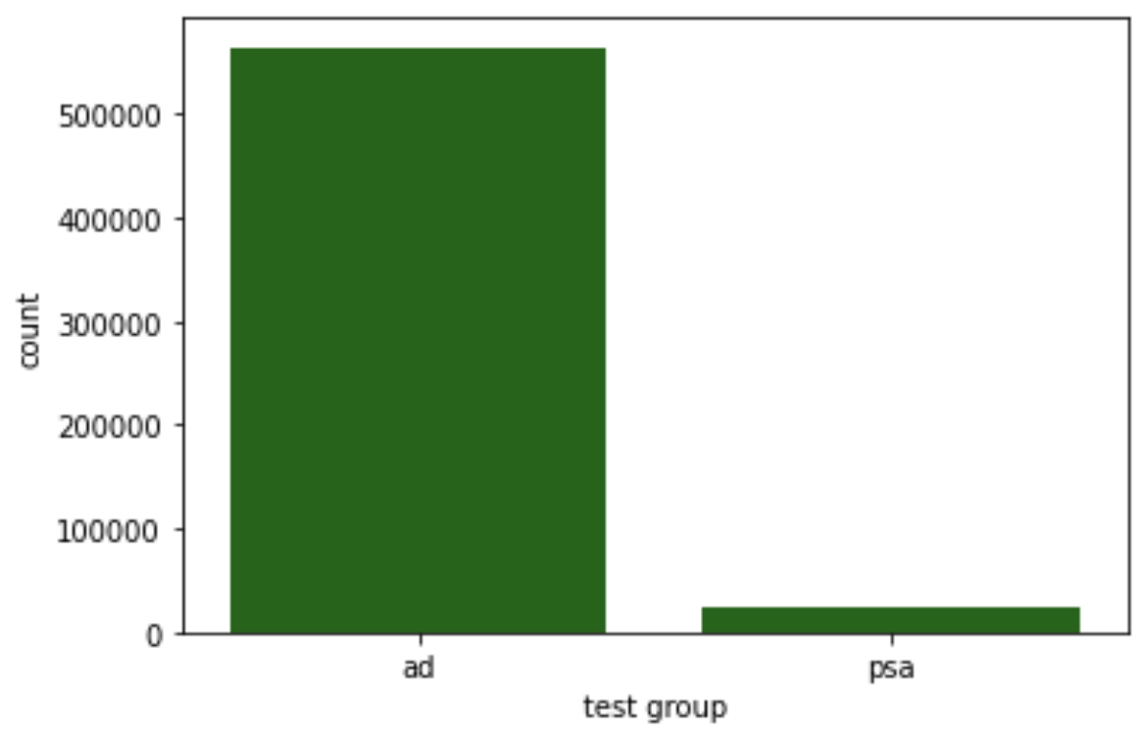
Experimental Design
Two groups: Ad group vs. PSA group
Group sizes were imbalanced (ad group was larger)
Random assignment used; stratification not applied (no user metadata)

Slide 4
Hypotheses & Significance
Defining the question and the statistical tools used to answer it
H₀: No difference in conversion rate between groups
H₁: Ad group has a higher conversion rate than PSA group
Significance level (α): 0.05
Test: Two-Proportion Z-Test
One-tailed (right-tailed) test: We’re testing for improvement, not just any difference
💡 Why we chose this test:
We’re comparing two groups, ad vs. PSA to see if one has a higher conversion rate. Because of the large sample size, the Two-Proportion Z-Test is appropriate and statistically reliable.

Slide 5
Results — Conversion Rates & Lift
📌 Statistical Result:
Two-Proportion Z-Test
p-value < 0.001, well below the significance level (α = 0.05)
✅ Null hypothesis rejected — ad group significantly outperformed PSA
📊 Highlights:
Ad group conversion rate: e.g., 2.55%
PSA group conversion rate: e.g., 1.78%
Absolute Lift: 0.77 percentage points
0.0255 - 0.0179 = 0.0077
Relative Lift: 43.09% improvement
(0.0077 / 0.0179) * 100 = 43.09%
➡️ Takeaway:
The ad group drove 43% more conversions than PSA — a meaningful lift that justifies continued investment in ad-based campaigns

Slide 6
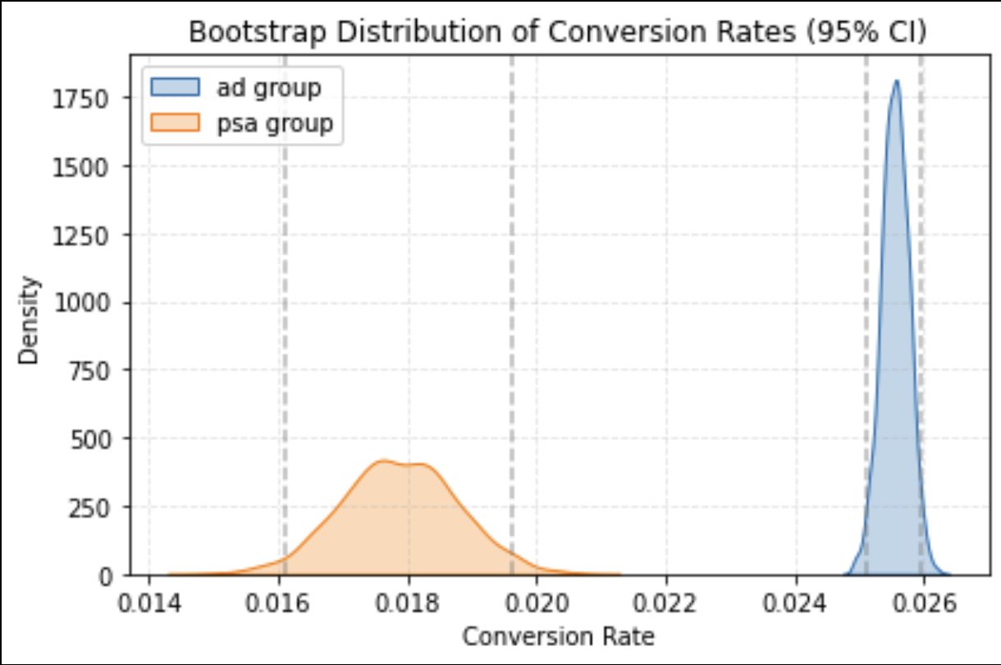
Confidence & Bootstrapping
The ad group outperformed PSA with high confidence
Bootstrapped 1,000 samples per group to visualize uncertainty
95% Confidence Intervals show no overlap
Ad group shows higher and more consistent performance
The visual clearly shows a clear separation between the two groups – there’s no ambiguity

Slide 7
Final Takeaways & Recommendation
✅ Ad strategy is a clear winner
Ad group achieved a 43% higher conversion rate than PSA
Lift is both statistically significant and business meaningful
📊 Backed by strong evidence
Two-Proportion Z-Test confirms significance
Bootstrapped confidence intervals show no overlap
💡 Actionable next steps
Move forward with ad-based campaigns
Test ad variations and targeted segmentation strategies

Slide 8
Appendix / Additional Notes
Group imbalance noted; PSA group still exceeded power threshold
No stratification applied due to lack of user-level metadata
Synthetic data used — reflects structure of real A/B test
Dataset: Synthetic data from Kaggle – Marketing A/B Test

