Slide 1

Olist E-Commerce Sales & Fulfillment Analysis
Driving Business Insight Through SQL, Python, and Visual Analytics
Presented by: Joe Lam

Slide 2
Project Overview
Goal: Analyze Olist's order data for key sales and fulfillment trends.
Tools Used: SQL, Python (Pandas, Seaborn, Matplotlib), MySQL, Jupyter Notebook
Focus Areas: Fulfillment, Seller & Customer Segments, Anomalies

Slide 3
Data Sources & Preparation
Source: Olist Brazilian E-Commerce Dataset (Kaggle)
SQL: Combined data across orders, sellers, customers, and reviews
Data Enrichments: Added order revenue, delivery timing, and seller tiering
Python: Cleaned data and created new fields for analysis

Slide 4
What the Data Reveals: Key Business Insights
📉 Fulfillment Lag During Growth: From Nov 2017 to Mar 2018, on-time delivery rates dropped as monthly revenue surged, suggesting capacity constraints.
🛠️ Operational Recovery: By Apr 2018, Olist recovered fulfillment performance while sustaining growth.
🏆 Seller Concentration: 17.9% of sellers generate 80% of revenue, roughly confirming the Pareto Principle.
🚩 High-Value Orders More Likely Delayed: Anomaly detection flagged that large orders were disproportionately affected by fulfillment delays.
📦 Late Deliveries Hurt Satisfaction: On-time orders averaged a 4.29 review score, while severely delayed ones dropped to 1.73 — quantifying the fulfillment–CX connection.

Slide 5
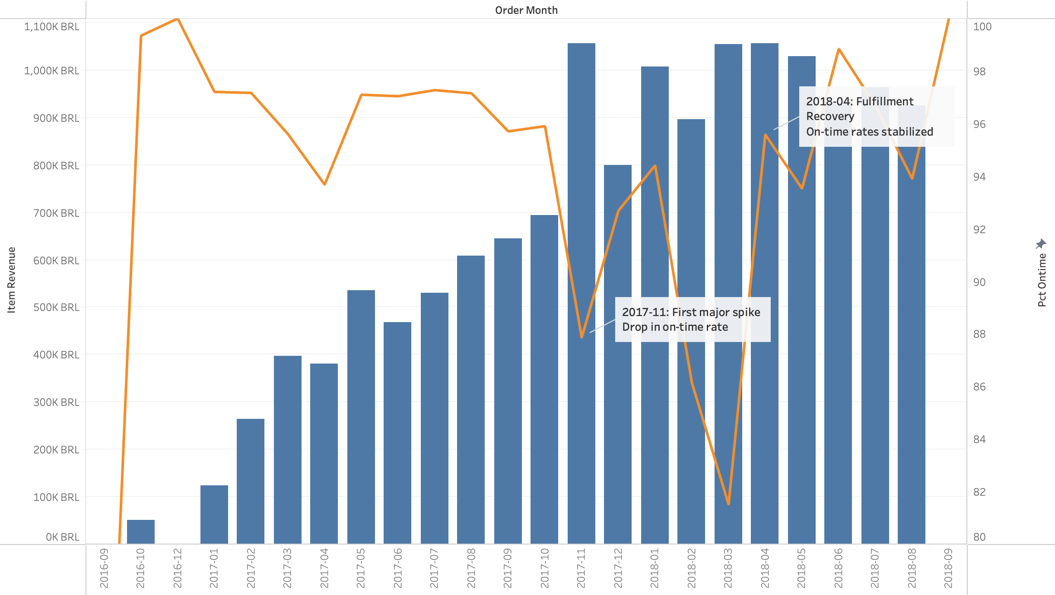
Operational Strain & Recovery Delivery Delays Amid Rapid Growth
Fulfillment lag during growth: From Nov 2017 to Mar 2018
Operational recovery by Apr 2018, likely reflects internal improvements, such as:
Scaling fulfillment operations
Optimizing delivery logistics
Expanding warehouse capacity or third-party delivery support

Slide 6
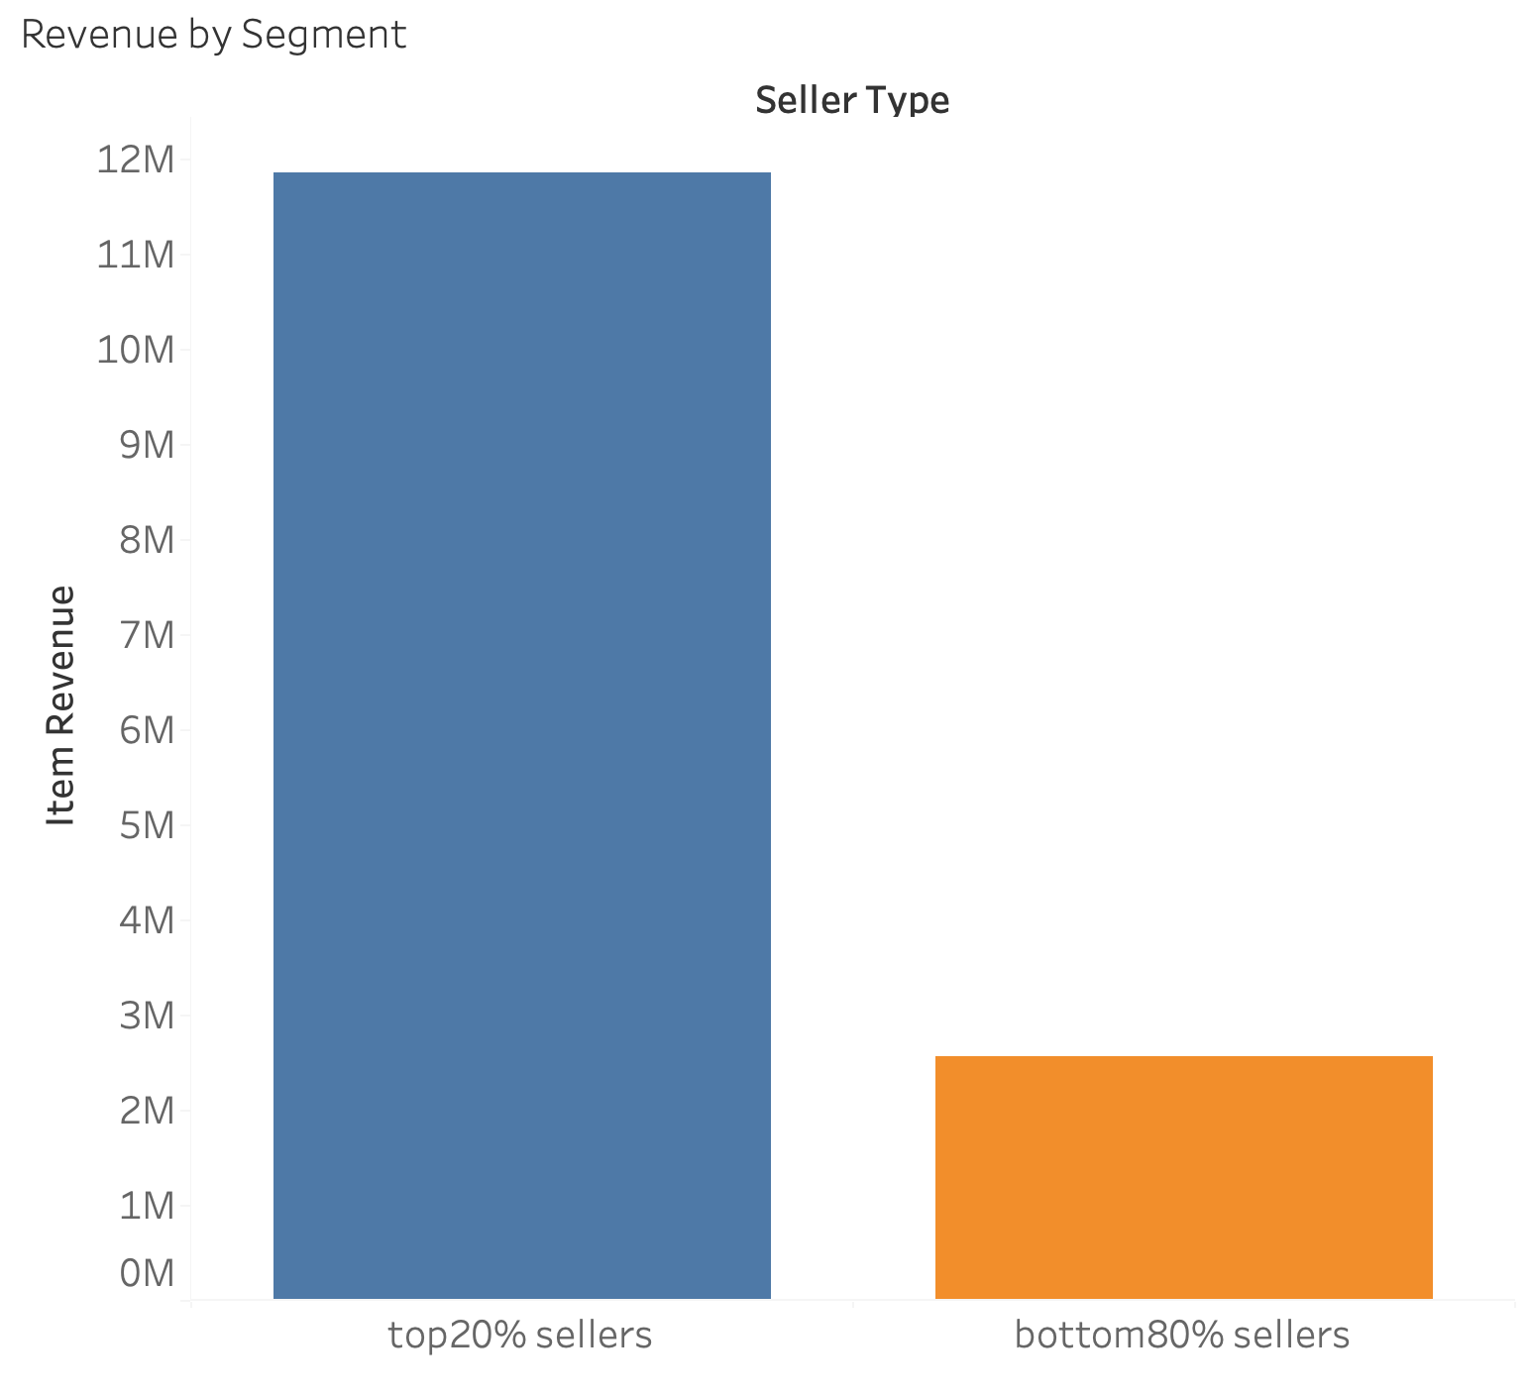
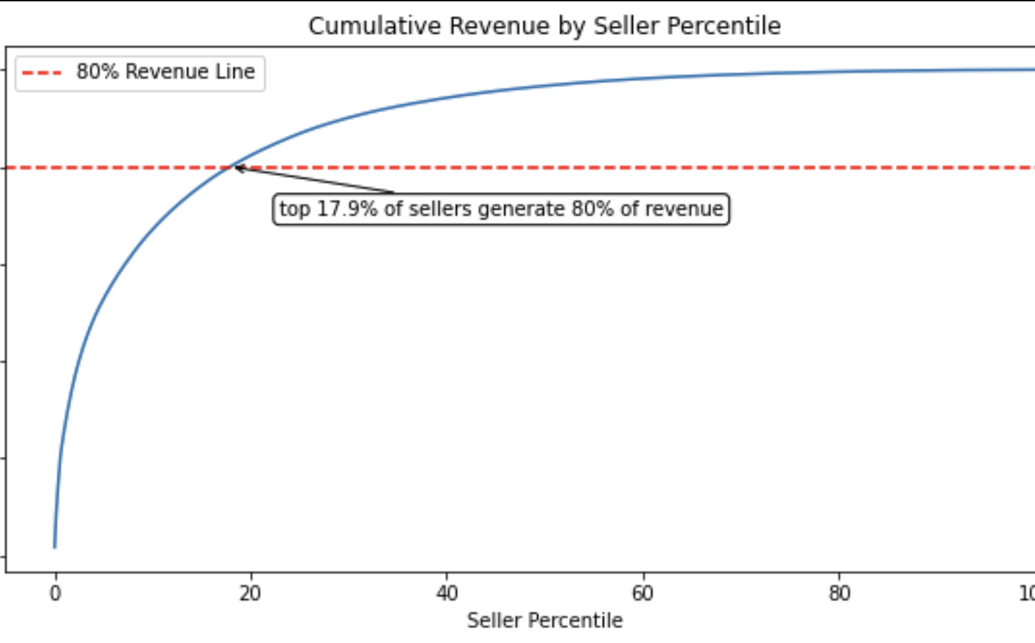
Seller Revenue Concentrated in Top Sellers
Top 17.9% of sellers drive 80% of revenue — consistent with the Pareto Principle
Prioritizing top sellers enables high-impact growth without scaling effort across all sellers

Slide 7
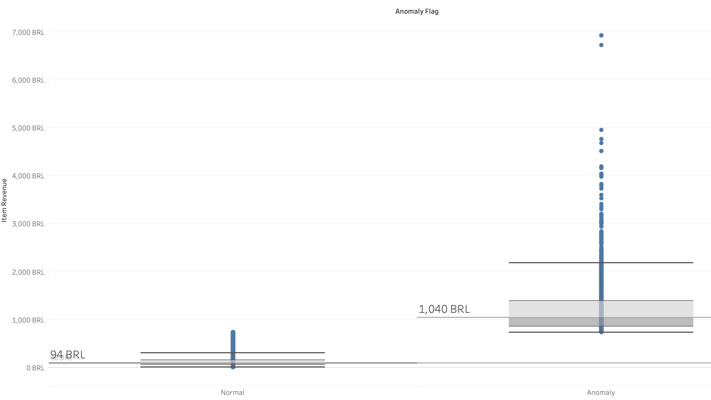
Order Revenue Distribution: Anomalies vs Normal Orders
Anomalies were classified as anything beyond three standard deviations delay
❌ High-value orders were disproportionately flagged as anomalies
📦 Indicates potential operational strain in fulfilling large orders
🧩 Delays may increase risks of cancellations, dissatisfaction, or revenue loss

Slide 8
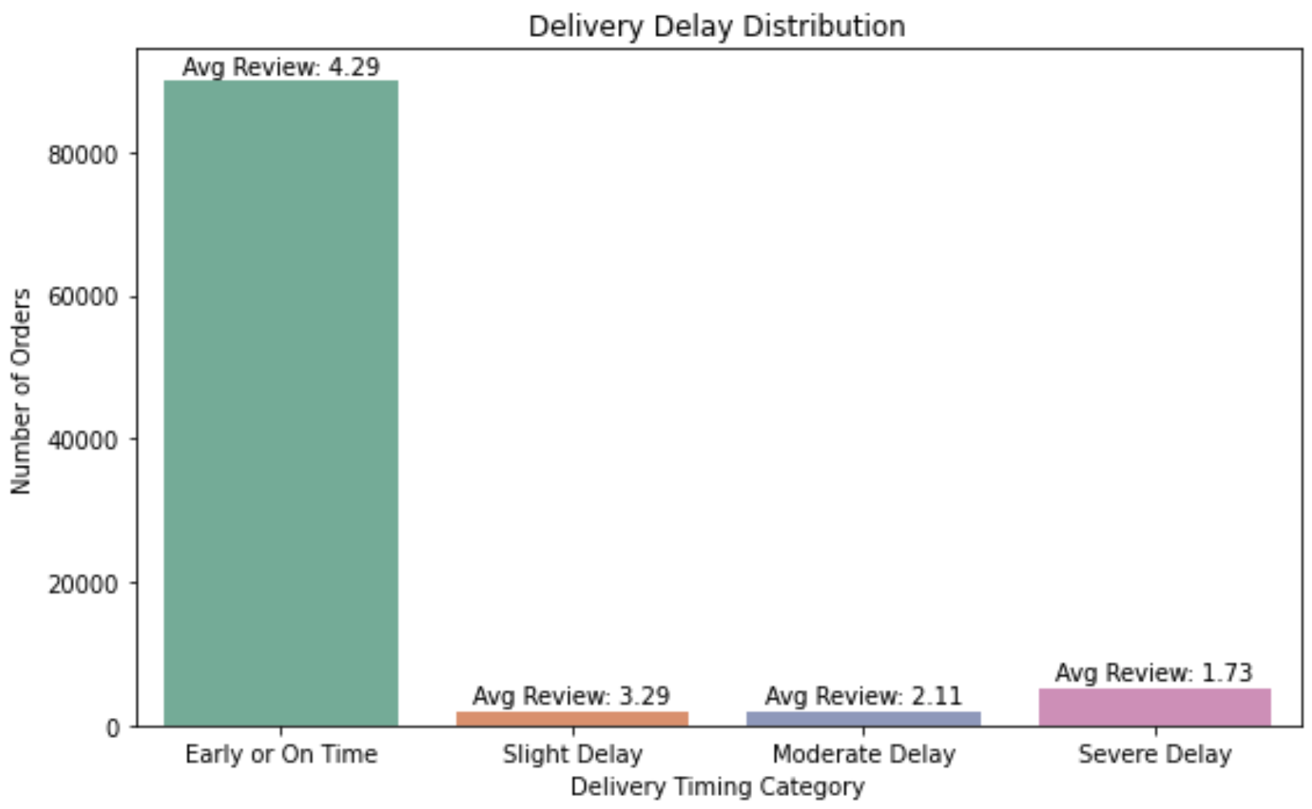
Delivery Delay & Review Impact
As expected, Early or On Time deliveries score much higher reviews than late deliveries
Review ratings drop sharply as delivery delays increase — from 4.29 (on-time) to 1.73 (severe delays), highlighting the direct link between fulfillment and customer satisfaction

Slide 9
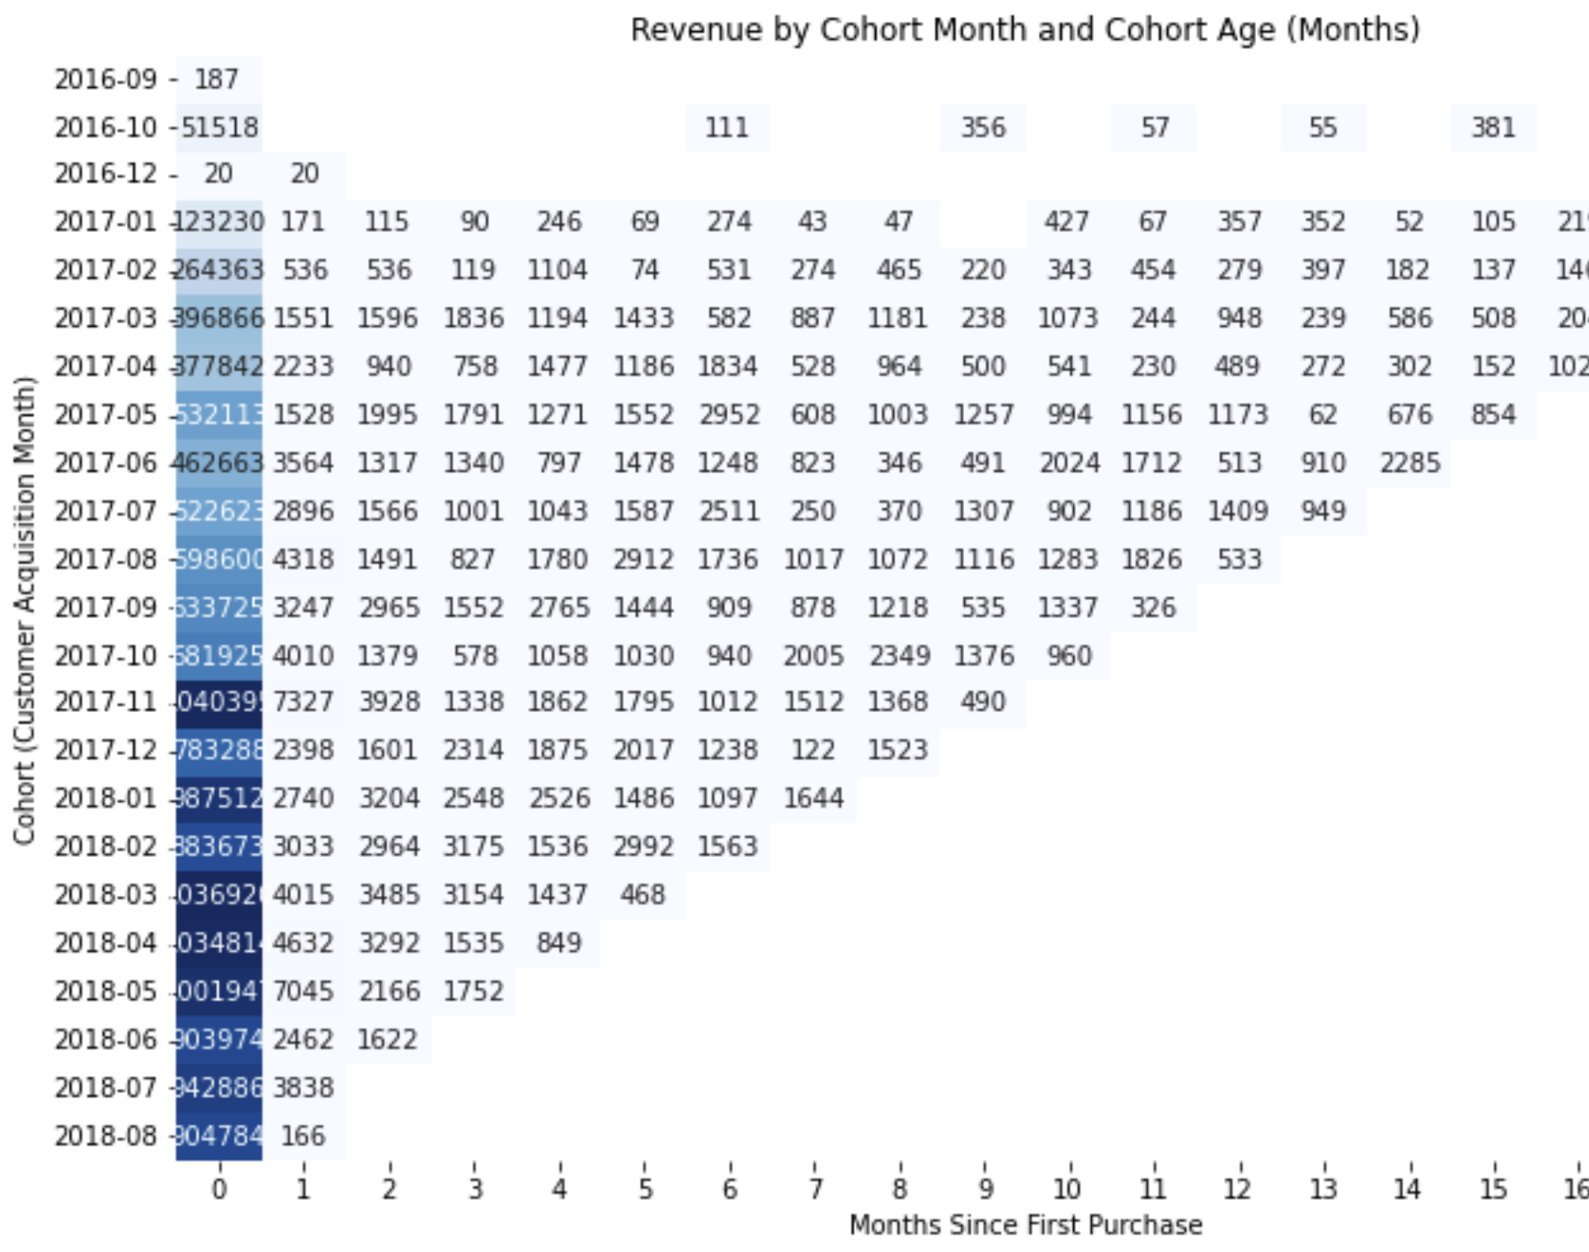
Cohort Analysis Reveals One-Time Buyers Dominant
Most cohorts show strong first-month revenue, but little activity in subsequent months — suggesting minimal repeat purchasing

Slide 10
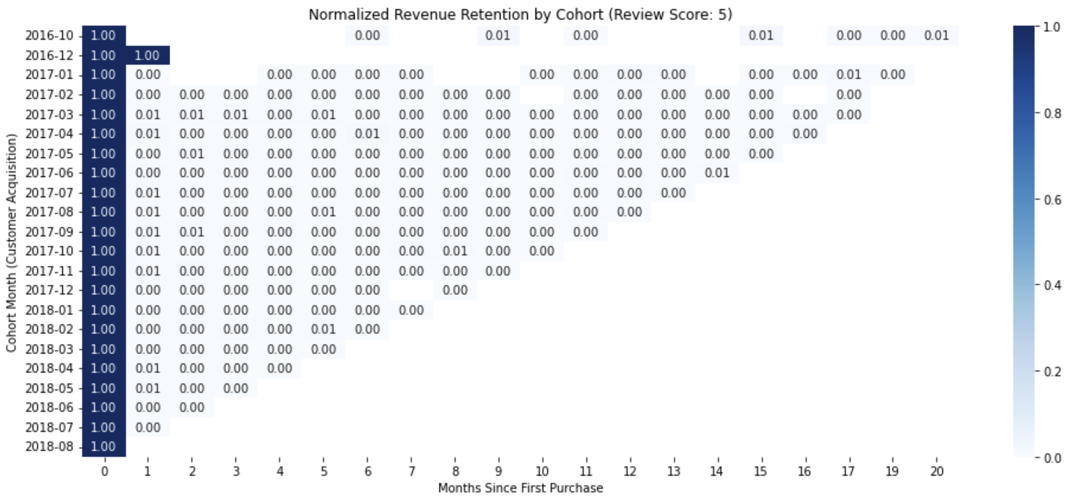
Cohort Analysis Review score 5
Review Score 5 ≠ Repeat Customer: Retention Data Inconsistencies
Likely ID reassignment obscures returning buyer behavior
This undermines metrics like churn and LTV, and limits customer lifetime analysis

Slide 11
Recommendations
On-time delivery impacts satisfaction
Improve peak period planning to prevent delays and protect CX
Top 20% sellers drive most revenue
Launch a top-seller success program to boost high-impact growth
Delayed large orders = Risk
Audit fulfillment pipeline for high-value order delays

Slide 12
Conclusion
This project simulates a real-world business scenario:
SQL is used to create clean, joinable datasets from disparate sources
EDA uncovers fulfillment bottlenecks during growth
Cohort analysis revealed unreliable tracking of repeat customers
Visualization connects operational issues with lost revenue
Key takeaway: Data science is not just algorithms — it's understanding the business, challenging assumptions, and knowing what the data can and cannot tell you

