Slide 1
Design patterns
for government services
@timpaul @cjforms
#gdsteam
Notes:
This is the name of this session.
We’re going to talk about:
How we approached design patterns and why
Specific design patterns we like
And we’re going to have a go later at crowdsourcing some new patterns using a wiki.
So, whilst we’re talking - have a think about any specific patterns you’re interested in, or design challenges you’re facing.

Slide 2

Caroline Jarrett Forms specialist
Government Digital Service
@cjforms

Slide 3
Tim Paul Lead designer
Government Digital Service
@timpaul
Notes:
I’m one of the lead designers at GDS.
I’ve been there 3 years - working mainly on transactions and services.

Slide 4
Ask: Who are you? What is your job title? What is your main role? Are you working on design of a government service, and if so which one?

Slide 5
Introduction
@timpaul @cjforms
#gdsteam

Slide 6
Government Digital Service
@timpaul @cjforms
#gdsteam
Notes:
GDS is part of the Cabinet Office.
We’re a department of about 450 people.
We work with government departments to help make their digital services and information simpler, clearer and faster.
We’re responsible for GOV.UK

Slide 7
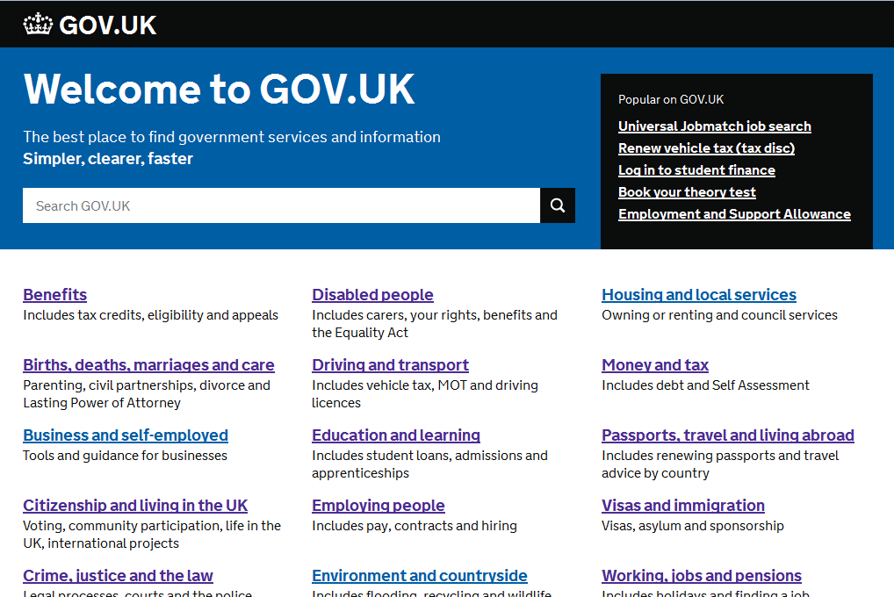
@timpaul @cjforms
#gdsteam
Notes:
GOV.UK A single website for people interacting with the UK Government

Slide 8
12 million visitors every week
Home to over 330 departments and organisations
Saving more than £62 million a year
@timpaul @cjforms
#gdsteam
Notes:
That saving is based on what it would have cost to maintain all the different websites that existed before.
GOV.UK is a mixture of information and services.
Information like…

Slide 9
Information on GOV.UK
@timpaul @cjforms
#gdsteam
Notes:
We’ve transferred information from over 300 old websites onto GOV.UK
Some of it’s quite niche…

Slide 10
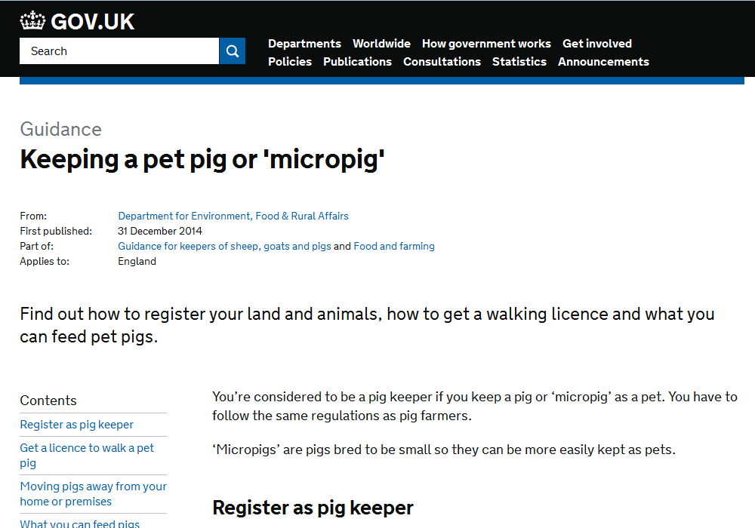
@timpaul @cjforms
#gdsteam
Notes:
A guide to keeping a pet pig or ‘micro pig’.
Did you know you needed a licence to walk your pet micro pig?

Slide 11
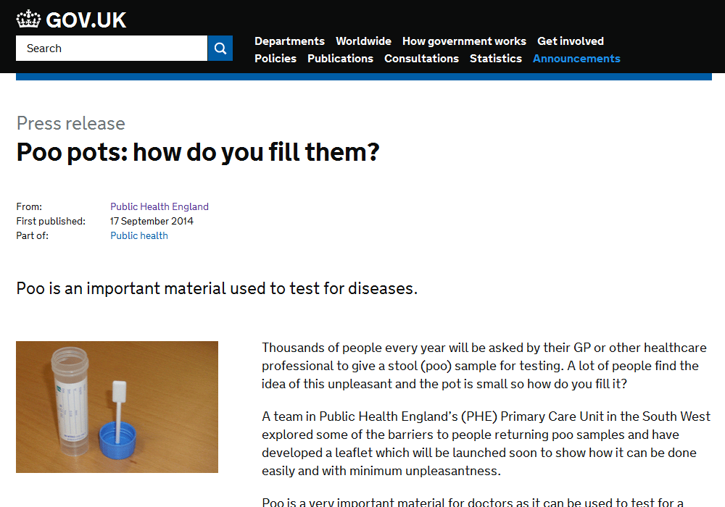
@timpaul @cjforms
#gdsteam
Notes:
Poo pots.
Not totally sure we needed to publish that one.

Slide 12
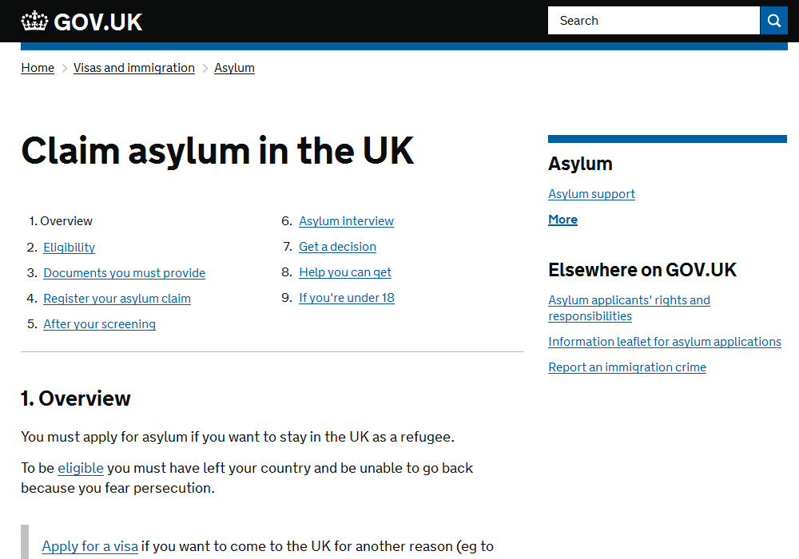
@timpaul @cjforms
#gdsteam
Notes:
How to claim asylum in the UK

Slide 13
Services on GOV.UK
@timpaul @cjforms
#gdsteam
Notes:
So, lots of information. But also, lots of services…

Slide 14
Ask: Which government service did you use most recently?
(in everyday life, not for work)

Slide 15
766 services
1.43 billion transactions
@timpaul @cjforms
#gdsteam

Slide 16
The top 28 services account for over 90% of transactions
@timpaul @cjforms
#gdsteam

Slide 17
Register to vote, renew a patent, apply for rural payments, book a prison visit, find an apprenticeship, apply for redundancy payment, create a lasting power of attorney, claim carer’s allowance, apply for a visa…
@timpaul @cjforms
#gdsteam
Notes:
2 years ago we asked departments to pick some of their highest volume transactions and created a list of 25 that we would help them to transform into modern digital services.
We gave ourselves 2 years to do it.

Slide 18


@timpaul @cjforms
#gdsteam
Notes:
This is how we did.
These are the 4 development phases we defined.
We’ve got all but one in to beta (half of which are public betas), and over a third are live.

Slide 19
Carer’s Allowance
@timpaul @cjforms
#gdsteam
Notes:
Over 138,000 Carer’s have used the service so far
Real social impact - Carer’s have very little time for anything else and the service is 24hr

Slide 20
Video about Carer’s allowance
https://www.youtube.com/watch?v=IYBLX3V8ek4
Most important change:
Removing 49% of the questions
Notes:
Transcript of video: GOV.UK Transformation
You can now apply for Carer's Allowance using a simple online service.
Pete Desmond, Service Manager, Carer's Allowance Digital Service:
"Carer's allowance is a benefit that's provided to people who are really deserving in society.
These are people who are looking after friends and family that are very ill, in some cases terminally ill, and it's providing them with an income to help support the cost of caring for that individual.
When having to deal with all these problems and all the other strife that's going on in their lives, being able to claim Carer's Allowance should be the least of their worries."
Kathryn Baxendale, Subject Matter Expert, Carer's Allowance Digital Service:
"The new service is to enable people to claim Carer's Allowance online which is a much quicker and easier process than using the paper form."
Pete Desmond:
"We've been able to remove 170 questions from the process; that's 49%, and we've done that because we've challenged the way that policy's been interpreted on the claim form."
Kathryn Baxendale:
"Make sure that the customer can understand and progess through the claim, giving us the right information to make a quick decision on their application."
Pete Desmond:
"We've simplified things and cut things back to just the bare information that customers need, and we've done that via our user testing and research.
The service would not be up and running without the user research, to make sure that the participants, the carers' voice is at the heart of everything that we do.
We've had people, less confident users, who by the time they get from the start of the claim through to the end, you can see them, they say this, 'That's so much better than I expected. I could go away and do that on my own now, it's been so good'."
Kathryn Baxendale:
"Carers are busy people and these are some of the most vulernable people in society, so if we're supporting them by providing a really easy method of claiming Carer's Allowance, then that to me has got to be a good thing because that's what we're here to do."
www.gov.uk/apply-carers-allowance

Slide 21
The challenge
@timpaul @cjforms
#gdsteam

Slide 22
How do you simultaneously design 25 services for the same website?
Notes:
So, back to our original challenge:
“How do you simultaneously design 25 services for the same website?”
But more to the point…

Slide 23
Well designed
Consistent
In 2 years
Notes:
Well designed: How do we make sure that all of those services are usable?
Consistent: Builds trust - very important for gov.
Makes it easier to learn - good for our less confident users
Makes it easier to integrate - global nav, links etc.
Quickly: We’d given ourselves 2 and a bit years
We can’t waste time designing the same things over and over again
Or making the same mistakes multiple time

Slide 24
How do you do design at scale?
Notes:
But what this all really boils down to is this.
How do you scale design? Design as an activity.
To explain the problem I need to go back to 2012…

Slide 25
GOV.UK Beta
@timpaul @cjforms
#gdsteam
Notes:
May 2012
GOV.UK was in Public Beta. No services - just information.
GDS was less than 100 people.
We had a small design team of around 10 people, all co-located in Holborn
We were a small enough team to all fit in a room.

Slide 26
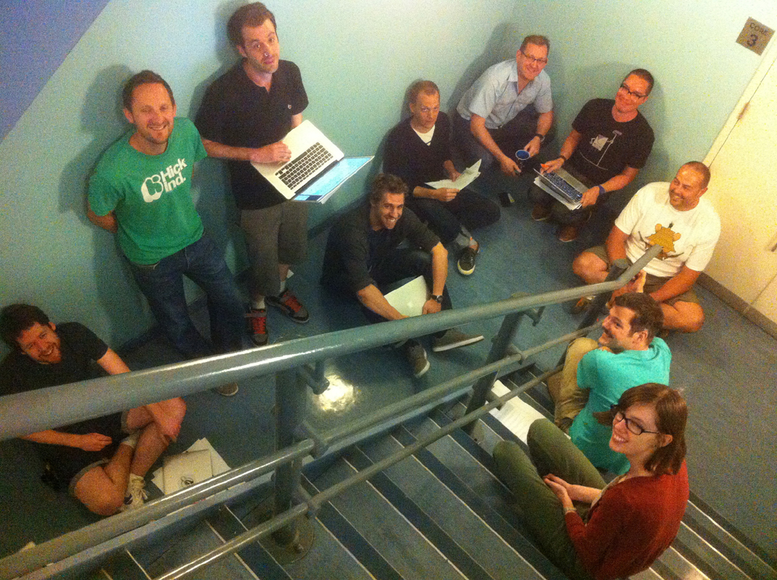
www.flickr.com/photos/benterrett/7309046368
#gdsteam
Notes:
And here we all are - in a stairwell.
The great thing about a team of this size was:
Easy to share and discuss ideas
- Quality and consistency emerged naturally

Slide 27
GOV.UK Live
@timpaul @cjforms
#gdsteam
Notes:
Now fast forward a few years
GOV.UK has been live for a while
GDS is 400+ people

Slide 28
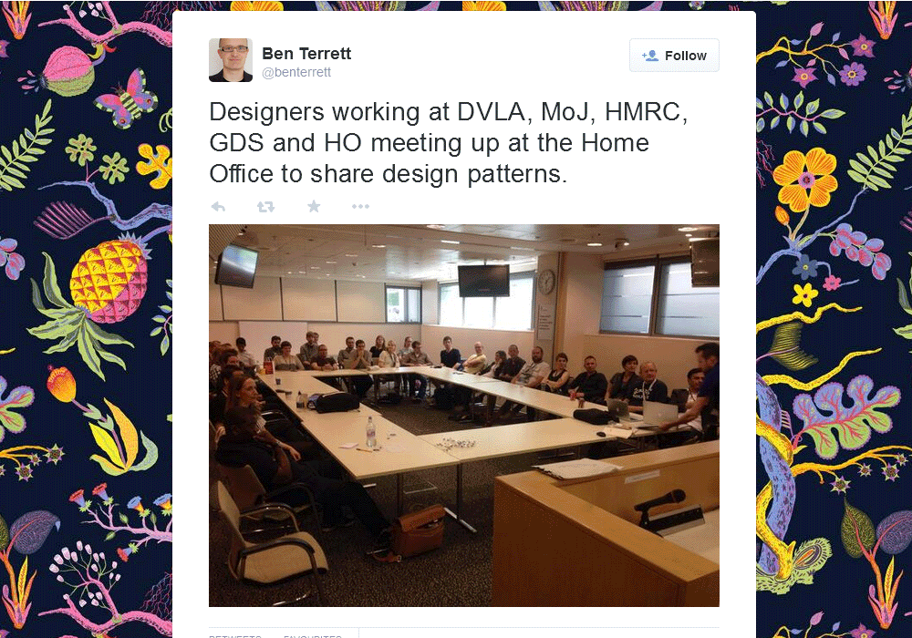
https://twitter.com/benterrett/status/474917315562455041
#gdsteam
Notes:
Twice as many GDS designers, but half of them are out working with the departments.
That’s a photo of one of our regular design meet-ups.
30 designers from 5 departments, and that’s just the ones who could make it to London.

Slide 29
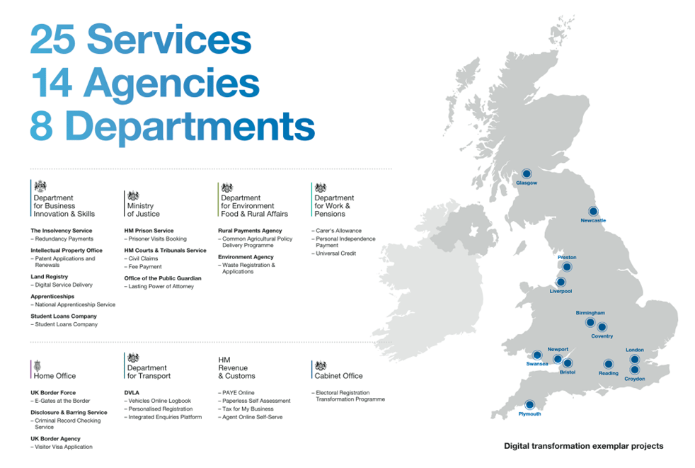
@timpaul @cjforms
#gdsteam
Notes:
Actually, services are being developed in 13 sites around the UK.
In fact - some of those services have teams in other countries as well.

Slide 30
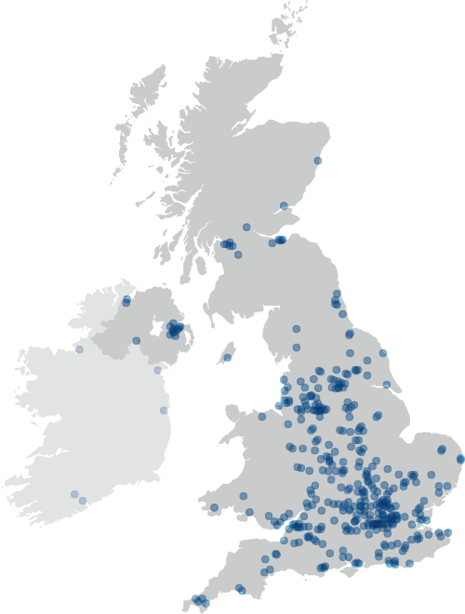
@timpaul @cjforms
#gdsteam
Notes:
And each service makes use of multiple suppliers from the private sector.
This is a map showing all the agencies and SMEs working on GOV.UK services.
So we’ve gone from stairwell - to this.

Slide 31
There are more people designing GOV.UK outside GDS than inside GDS
@timpaul @cjforms
#gdsteam

Slide 32
The solution
@timpaul @cjforms
#gdsteam

Slide 33
Resources
+
Community
@timpaul @cjforms
#gdsteam
Notes:
Resources: People need practical tools to do their job
Community: People need to be able to share and discuss their work
Recreate the ‘stairwell’ but at scale.
Let good consistent design emerge from the teams rather than imposed from GDS.

Slide 34
www.gov.uk/service-manual
@timpaul @cjforms
#gdsteam
Notes:
All of these tools are available via the GDS service manual,
which is the place for guidance for anyone making services for GOV.UK.

Slide 35
ASK
What do YOU need?
Notes:
Before I describe what we made and why - what kinds of things would you like?

Slide 36
1. Principles
@timpaul @cjforms
#gdsteam

Slide 37
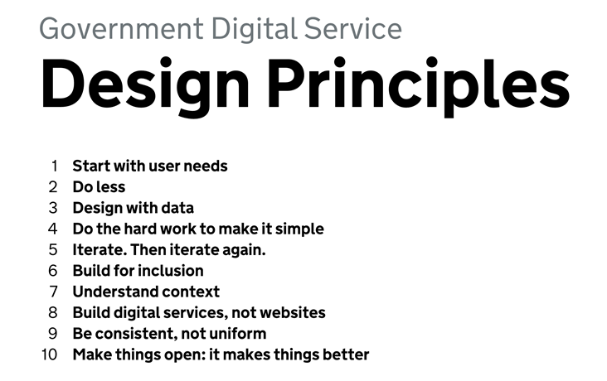
https://www.gov.uk/design-principles #gdsteam
Notes:
So first, we created a set of design principles.
1. Start with user needs
2. Do less
3. Design with data
4. Do the hard work ot make it simple.
5. Iterate. Then iterate again.
6. Build for inclusion
7. Understand context
8. Build digital services, not websites
9. Be consistent, not uniform
10. Make things open: it makes things better
This let everyone know how we like to approach design
and what we valued.
1, 4 and 9.
‘Be consistent, not uniform’
No cookie-cutter off-the-peg solutions.
No stone tablets handed on down.
Make the best thing for YOUR users.

Slide 38
2. Templates
@timpaul @cjforms
#gdsteam

Slide 39

@timpaul @cjforms
#gdsteam
Notes:
Then, we deliberately made the template as minimal as possible:
Header, footer, logo, New Johnston typeface
That way:
it could accommodate lots of different kinds of service
we wouldn’t have to keep updating it
minimising dependencies (bad experience at tfl.gov.uk)

Slide 40
3. Elements
@timpaul @cjforms
#gdsteam

Slide 41
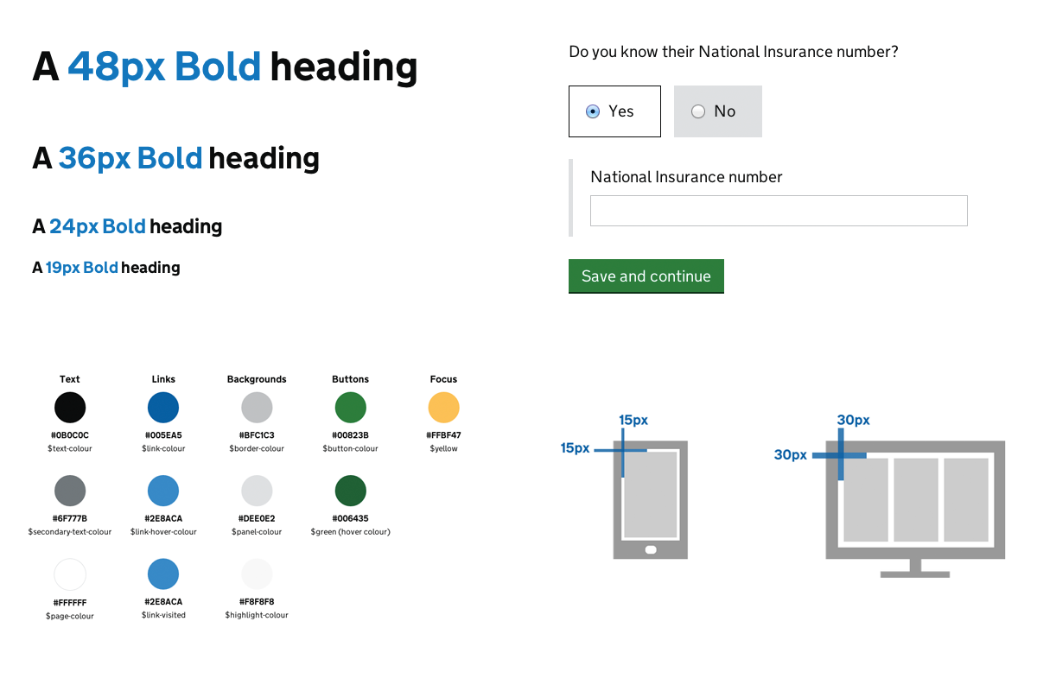
govuk-elements.herokuapp.com
#gdsteam
Notes:
Then we created a set of common design elements.
Building blocks.
Grids, typography, colours, basic form styles etc.
All credit to Gemma Leigh and George Sheldrake for their work on this.
Yes, there’s CSS - but it’s not Bootstrap.
Use it as a starting point - then extend it.

Slide 42
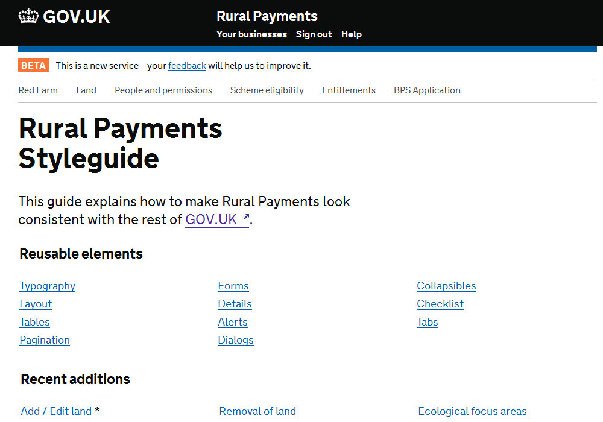
rural-payments-styleguide.herokuapp.com/
#gdsteam
Notes:
…Which is exactly what Trevor Saint has done
Trevor Saint is a front-end developer from Kainos.
He’s working on the rural payments service in Reading.

Slide 43
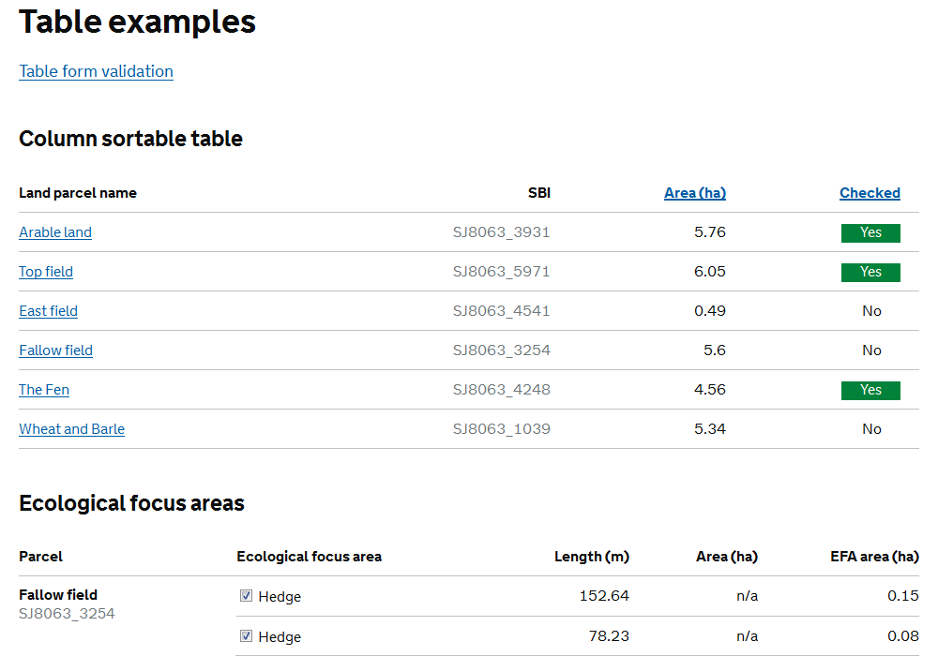
#gdsteam
Notes:
Rural payments involves a lot of tabular data, so his extended style guide has loads of examples of
nested tables
sortable tables
tables with form elements and validation
All of this is open and on GitHub - so now everyone can benefit from his work.
This is crucial - this is how we scale.

Slide 44
4. Screenshots
@timpaul @cjforms
#gdsteam

Slide 45
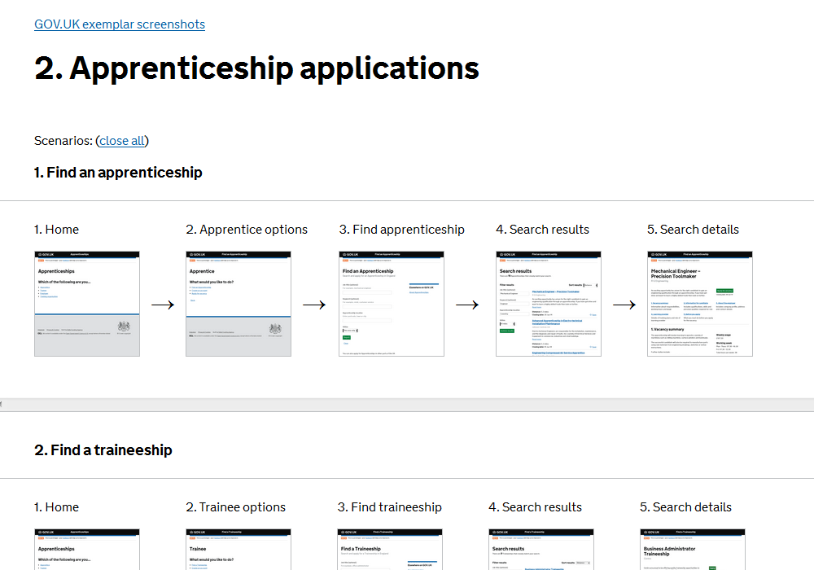
http://alphagov.github.io/exemplar-screens
#gdsteam
Notes:
We created a site where you could share screenshots of the service you were developing.
We did this because it’s often hard to share your work on transactional services.
Screens are hidden behind logins or payment systems or just hard to replicate.
It’s pretty low tech but it does the job.

Slide 46
5. Mailing list
@timpaul @cjforms
#gdsteam
Notes:
No image, because a picture of a mailing list is really dull.
But they’re crucial - they’re the glue that binds all the other stuff.
Often what starts out as a discussion on the list will end up as new content in one of the other resources.

Slide 47
The mailing list is (currently) by invitation from people who are already on it.

Slide 48
6. Patterns
@timpaul @cjforms
#gdsteam
Notes:
Finally - patterns.

Slide 49
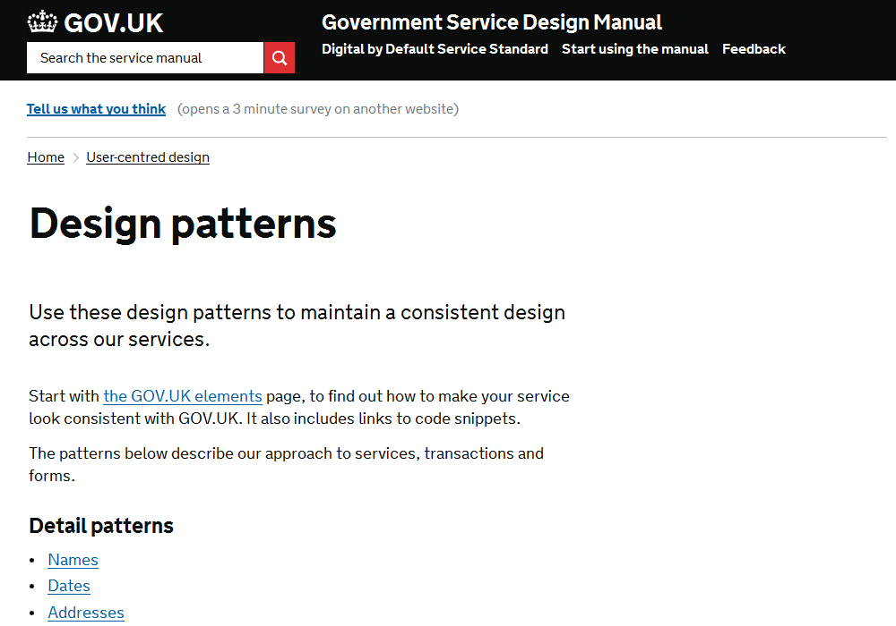
@timpaul @cjforms
#gdsteam
Notes:
On the service manual we’ve got a small set of the most commonly requested patterns.

Slide 50
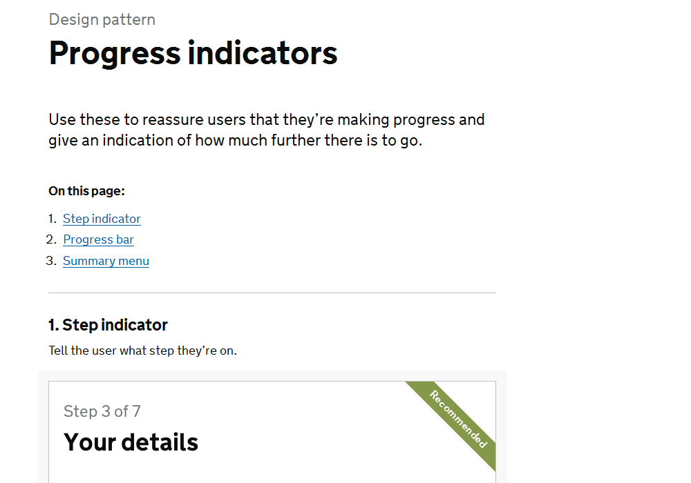
@timpaul @cjforms
#gdsteam
Notes:
For example - we noticed a lot of variation in how we were indicating progress through a transaction.
So one of the first patterns we made was for progress indicators.
Before a pattern gets written up here, we discuss it in our patterns wiki…

Slide 51
designpatterns.hackpad.com
@timpaul @cjforms
#gdsteam
Notes:
We use a free service called Hackpad.
It’s now owned by Dropbox.

Slide 52
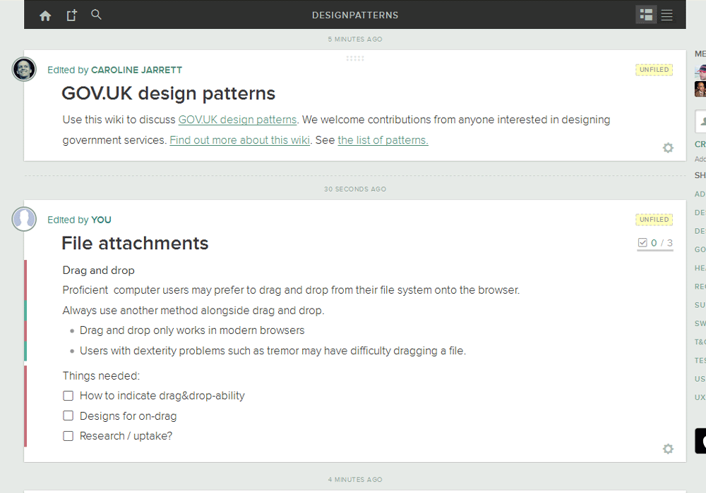
@timpaul @cjforms
#gdsteam
Notes:
I’m afraid Hackpad is really dull to look at.
But it’s perfect for collaborating on ideas.
It’s just a wiki, but it’s a good one:
real-time
you can ‘follow’ pages
you can ‘at’ people
you can paste images from the clipboard
it’s got an API

Slide 53
350+ members
100+ patterns
@timpaul @cjforms
#gdsteam
Notes:
It’s be around for just over a year and it’s still growing.
There’s some kind of activity most days.
About half the members are designers
About half the members are from GDS

Slide 54
1. | Elements | 105 edits
2. | Navigation buttons | 76 edits
3. | Date of birth | 56 edits
4. | Progress indicators | 55 edits
5. | Dates | 54 edits
6. | Help text | 41 edits
7. | Addresses | 41 edits
8. | Radios & checkboxes | 36 edits
@timpaul @cjforms
#gdsteam
Notes:
Lets have a look at the most edited patterns.
So - at number one are the basic elements themselves (grids, colours, typography etc.)
This makes sense, as this is what all the other patterns are made of.
But you can see below, the other things that people are most interested in talking about.

Slide 55
1. | Tim Paul | 383 edits
2. | Caroline Jarrett | 151 edits
3. | Ed Horsford | 148 edits
4. | Joe Lanman | 115 edits
5. | Gemma Leigh | 53 edits
6. | Sjors Timmer | 41 edits
7. | Henry Charge | 35 edits
8. | Tom Byers | 25 edits
@timpaul @cjforms
#gdsteam
Notes:
These are the people who’ve made the most edits.
This isn’t here just for the bragging rights - there are some points to make:
If you take on the editor role, expect to do twice as much as the biggest contributor
It’s not just GDS people:
Sjors is a designer with the Ministry Of Justice
Henry works with the agency Valtech

Slide 56
designpatterns.hackpad.com
@timpaul @cjforms
#gdsteam
Notes:
We use a free service called Hackpad.
It’s now owned by Dropbox.

Slide 57
Did it work?
@timpaul @cjforms
#gdsteam
Notes:
We think so.
The services look remarkably consistent.
Over half are now public and the rest are in Beta.
Quality is variable - but when it’s good it’s REALLY good.

Slide 58
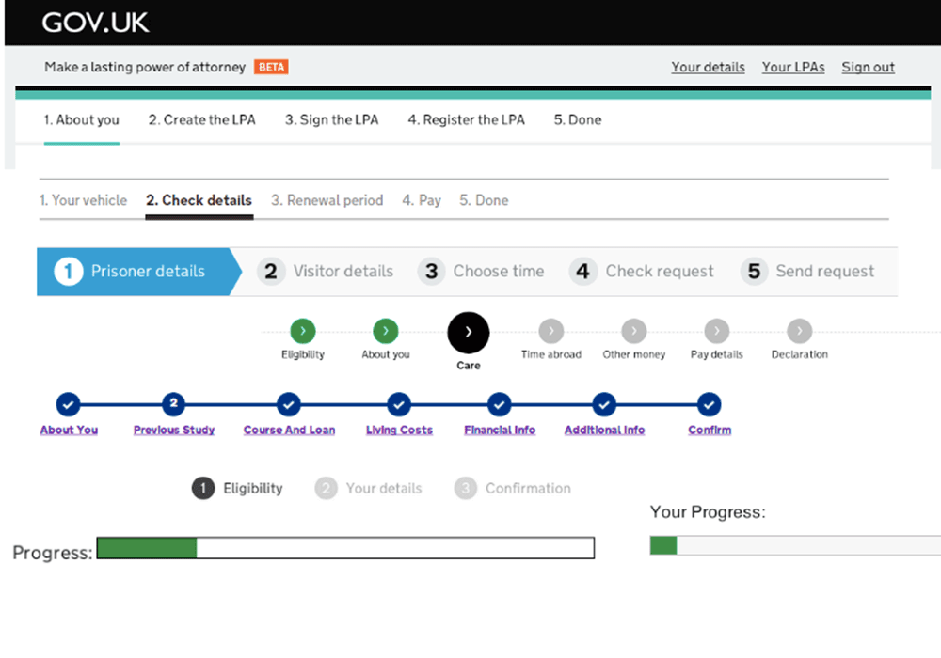
@timpaul @cjforms
#gdsteam
Notes:
Well, we don’t see this any more.
This is what I found a year and a half ago when I did an audit of progress indicators across the exemplars.
This was before the Hackpad and elements.
[Use the screenshots site to show how things are more consistent]

Slide 59
ASK
let's vote on the questions we most want to look at today

Slide 60
Make groups to work on a question you want to answer

Slide 61
Search for:
Service Manual Design Patterns

Slide 62
@timpaul @cjforms
#gdsteam
Notes:
On the service manual we’ve got a small set of the most commonly requested patterns.

Slide 63
Is your question answered?
If it is, join another team or try another question! If not, try the hackpad
Is your question answered on the hackpad? If it is, join another team or try another question!
If not, try editing it.

Slide 64
General discussion and feedback

Slide 65
Lessons learned
@timpaul @cjforms
#gdsteam

Slide 66
What design patterns can’t do
@timpaul @cjforms
#gdsteam
Notes:
Before I end - a quick sanity check.
A vibrant community centred around sharing and discussing different design patterns is a great thing.
Having those patterns available to all is also fantastic.
But they’re not a magic bullet.

Slide 67
Design patterns can’t be imposed on people
@timpaul @cjforms
#gdsteam
Notes:
Well, maybe they can a bit - but it’s time consuming and not much fun and everyone ends up hating you.
Much better to develop the patterns from the ground up - that way you get consensus, because the people who need the patterns got to create them.

Slide 68
Design patterns can’t replace designers
@timpaul @cjforms
#gdsteam
Notes:
I’ve heard people say “Well eventually the developers will just be able to go straight to the pattern library”.
You can use really good design patterns and still create a terrible service.
It's in the patterns you choose, how you combine them and how you customise them.
We especially see this with typographic design. GOV.UK services that use the templates, elements and patterns but just look wrong somehow. The spacing and rhythm is all out.

Slide 69
Design patterns can’t negotiate with the business
@timpaul @cjforms
#gdsteam
Notes:
Designing for government can be really frustrating.
Often you know exactly what needs to happen.
But making it happen is the tricky bit.
You need to be persistent, you need to be able to explain, influence and negotiate.
Design patterns don’t help much with that.
It can feel like a least half of the usability gains come from successfully negotiating with the business rather than coming up with some amazing innovative design.
Carer’s Allowance video: 170 questions removed. 49%

Slide 70
What design patterns can do
@timpaul @cjforms
#gdsteam

Slide 71
Design patterns save time because you don't have to keep answering the same question
@timpaul @cjforms
#gdsteam

Slide 72
Design patterns can help to provide consistency for users
@timpaul
#gdsteam

Slide 73
Design patterns help to provide known answers to common problems
@timpaul @cjforms
#gdsteam

Slide 74
Design patterns help to provide a focus for the community
@timpaul @cjforms
#gdsteam

Slide 75
What would we do differently if we started again?
Notes:
I’d do the Elements work sooner. There was a long period where people were having to make everything from scratch.
I’d secure the editorial role for the Hackpad. It doesn’t need to be one person but there needs to be someone always working on it.
I’d find a way to integrate research more closely.
We’ve done it where we can, but:
Not always possible to share research
Research on patterns is often anecdotal
When you’re researching a whole service, once a pattern is ‘good enough’ you typically move on to the next thing. GDS could help here.

Slide 76
If you're starting your own design patterns...
Notes:
Try this out!
Let us know how it goes
Share your work publicly

Slide 77
What's happening next?

Slide 78
Caroline is mostly working on creating candidate patterns to go into the Service Manual

Slide 79
There's a big Service Manual project that's just started

Slide 80
Thank you and please join in
@timpaul @cjforms
#gdsteam

Slide 81
URLs
https://www.gov.uk/service-manual/user-centred-design/resources/header-footer.html
https://www.gov.uk/service-manual/user-centred-design/resources/patterns/index.html
https://designpatterns.hackpad.com/
http://govuk-elements.herokuapp.com/
http://rural-payments-styleguide.herokuapp.com/
http://alphagov.github.io/exemplar-screens/
@timpaul @cjforms
#gdsteam

Slide 82
Tim Paul Lead Designer Government Digital Service @timpaul

