Slide 1
Let’s have a lovely chat
about forms
WWC October 2014 Caroline Jarrett @cjforms

Slide 2
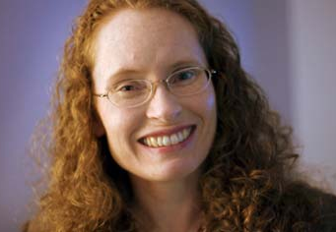
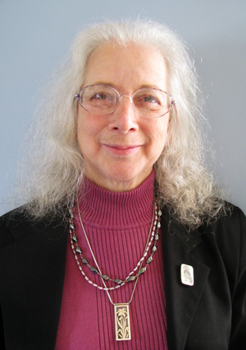
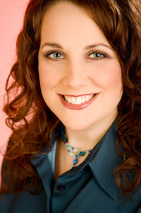

In honour of Ada Lovelace day: Four people with inspiring ideas about forms

Slide 3


Slide 4
It’s a form if it …
Looks like a form and works like a form
Asks questions and expects answers
“transaction”
Allows someone to achieve a
goal

Slide 5
Looks like a form and works like a form
Interaction Design
Asks questions and expects answers
Content
Strategy
and
Plain Language
Allows someone to achieve a
goal
Service
Design
and
Process Design

Slide 6
Looks like a form and works like a form
Where you
put the pixels
The questions you ask
Asks questions and expects answers
Allows someone to achieve a
goal
Users’ goals
(and business ones)
The answers you need

Slide 7
A great form works well across all three layers
Appearance
Lovely and legible. Simple interaction
Goals achieved
Conversation
Easy to understand and answer
Goals achieved
Relationship
Goals achieved
Schema from “Forms that work: Designing web forms for usability”, Jarrett and Gaffney (2008) www.formsthatwork.com

Slide 8
Four people with inspiring ideas about forms

Slide 9
Jessica Enders, forms and survey expert
Follow her @Formulate
Find her articles at: http://formulate.com.au/

Slide 10

Karen Schriver, information designer
Follow her @firstwren
“Information design is a process of orchestrating content visually and verbally, making the structure salient to people who engage with it.”

Slide 11

Kathryn Summers, low literacy expert
Follow her @SummersKathryn
Co-author, “Design to Read” in “Rhetorical AccessAbility” (2013) edited by Lisa Meloncon
Shorter version in User Experience magazine, linked from http://www.designtoread.com

Slide 12
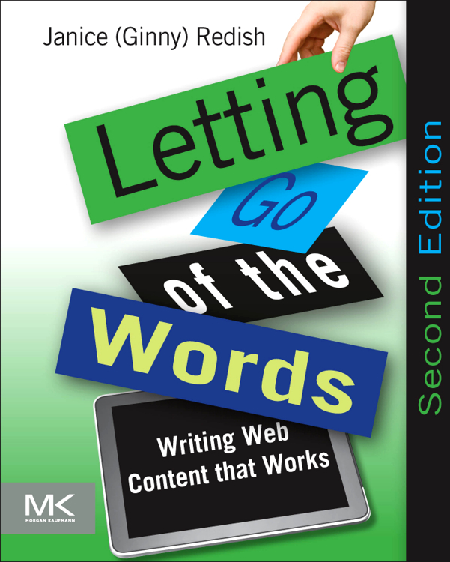
Ginny Redish, writing and usability expert
Follow her @GinnyRedish
Even if you already have the first edition of “Letting go of the words”, buy the 2nd edition

Slide 13
How to look at a form
Don’t look at it.
Choose a persona and write the story of why that persona is filling in this form.
Fill in the form as that persona, as honestly as you can.
Now look at it. How did it work across the three layers?
Appearance
Conversation
Relationship

Slide 14
Now you try it: ‘Get a quote’ on http://systango.com/
Don’t look at it.
Choose a persona and write the story of why that persona is filling in this form.
Fill in the form as that persona, as honestly as you can.
Now look at it. How did it work across the three layers?
Appearance
Conversation
Relationship

Slide 15
Some resources for forms design
“Forms that work”: http://www.formsthatwork.com
Columns on Uxmatters.com:
Don’t Put Hints Inside Text Boxes in Web Forms http://www.uxmatters.com/mt/archives/2010/03/dont-put-hints-inside-text-boxes-in-web-forms.php
Don’t Put Labels Inside Text Boxes (Unless You’re Luke W) http://www.uxmatters.com/mt/archives/2013/02/dont-put-labels-inside-text-boxes-unless-youre-luke-w.php
The Question Protocol: How to Make Sure Every Form Field Is Necessary http://www.uxmatters.com/mt/archives/2010/06/the-question-protocol-how-to-make-sure-every-form-field-is-necessary.php
Eye Tracking of Forms and Surveys http://www.uxmatters.com/mt/archives/2014/09/eye-tracking-in-user-experience-design.php

Slide 16
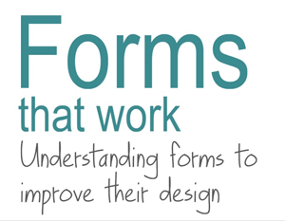
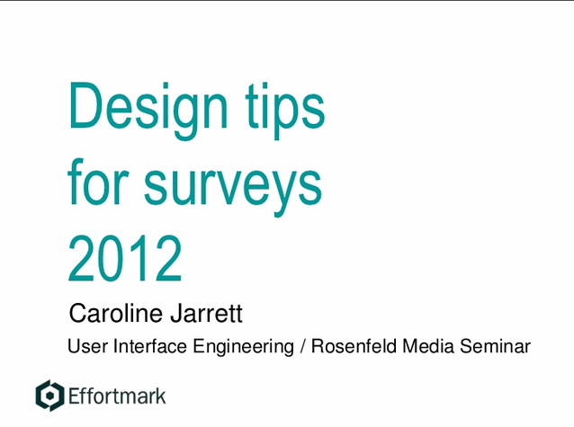
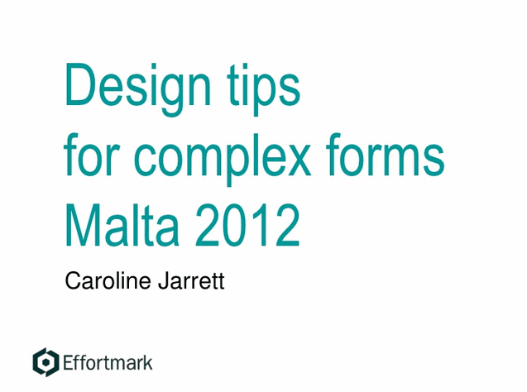
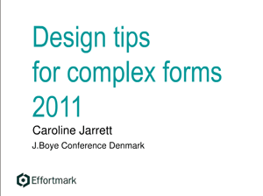
More tips http://www.slideshare.net/cjforms

Slide 17

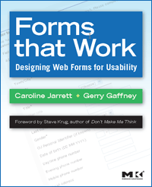

Caroline Jarrett
twitter @cjforms caroline.jarrett@effortmark.co.uk
www.effortmark.co.uk

