Slide 1

10 tips for a better survey
Caroline Jarrett @cjforms
UPA2012, Las Vegas

Slide 2


Story 1: My experience of surveys in UX (up to about 2010)
We need lots of data. Your samples are too small.
We’re going to do a survey.
But, but… er, er, …

Slide 3

Story 2: Interviews with UX experts, mostly in Australia, changed my views
Do you use surveys?
Sure. Alongside other user research, all the time.

Slide 4
Where do we stand on surveys?
Do you do surveys?
Who decides whether to do the survey?

Slide 5
Agenda
Tips about questions
Survey =
Questionnaire + Process

Slide 6
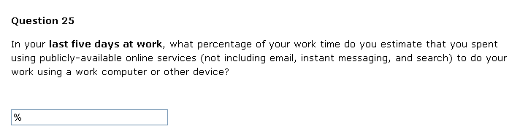
Any ideas?

Slide 7
Any ideas?
This is a badly-written question, and most of us could only guess wildly at an answer

Slide 8
The approximate curve of forgetting
High
Major life event
Quality of data
Low
Unremarkable, repetitive
Occasional, salient
Recent
Long ago
Time since event

Slide 9

Tip 1
Ask about recent vivid experience
Image credit: Fraser Smith

Slide 10
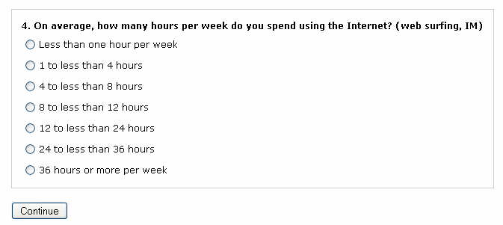
Looks like bands …

Slide 11
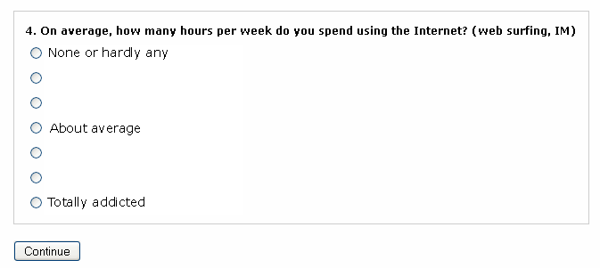
Looks like bands … works like rating scale
Howard Schuman and Stanley Presser (1996, reprinted in 1981) Questions and Answers in Attitude Surveys: Experiments on Question Form, Wording, and Context Summary at: http://www.rosenfeldmedia.com/books/survey-design/blog/which_is_better_an_open/

Slide 12

Tip 2
Be careful when offering banded answers
Image credit: Caroline Jarrett

Slide 13
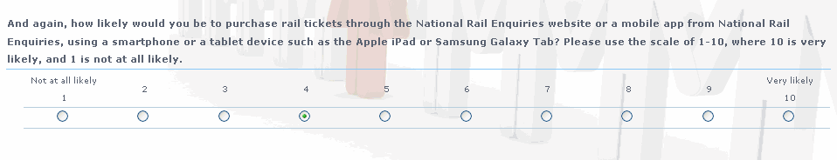
How many questions can you find here?
And again, how likely would you be to purchase rail tickets through the National Rail Enquiries website or a mobile app from National Rail Enquiries, using a smartphone or tablet device such as the Apple iPad or Samsung Galaxy Tab?

Slide 14

Tip 3
Ask one question at a time
Image credit: Shutterstock

Slide 15
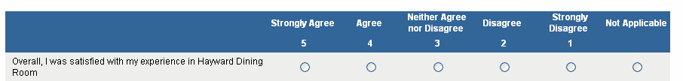

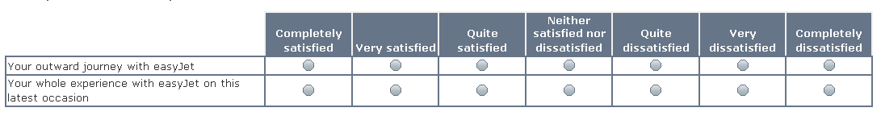

Most surveys I see have ratings from 1 to 5
Wouldn’t it be easier to have just two ?
7 points are more accurate!
What about 1 to 10?

Slide 16
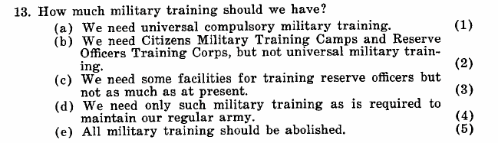
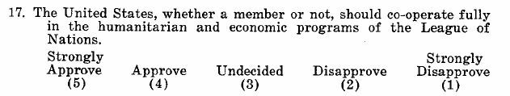
Likert had several different types of question in his scales
Likert, Rensis. (1932). A Technique for the Measurement of Attitudes. Archives of Psychology, 140, 1–55.

Slide 17
You can find an academic paper to support almost any number of points in a range
Krosnick and Presser refer to ~87 papers on ranges
Krosnick, J. A. and S. Presser (2009). Question and Questionnaire Design. Handbook of Survey Research (2nd Edition) J. D. Wright and P. V. Marsden, Elsevier
If you’d like to track down the research yourself: http://comm.stanford.edu/faculty/krosnick/docs/ 2010/2010%20Handbook%20of%20Survey%20Research.pdf or http://bit.ly/KNWlio

Slide 18

Users don’t care much about the number of points. They care more about the questions.
What’s the difference between those questions? This survey is too repetitive.

Slide 19
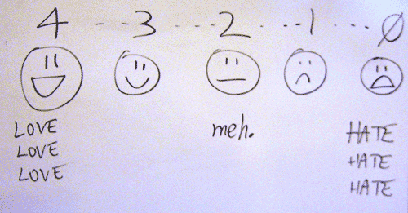
Tip 4
Don’t stress too much about the number of points in your rating scale
Picture credit: Flickr - Bill Soderman (BillsoPHOTO)

Slide 20
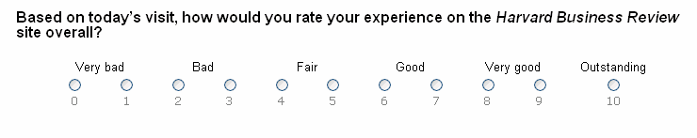
Well, OK, stress a bit.
This scale is downright peculiar. Avoid.

Slide 21
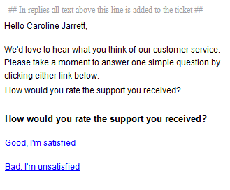
How would you improve this questionnaire?

Slide 22
How would you improve this questionnaire?
Lots of ways, e.g. the instructions are too long. But the biggest problem is: many people will want to choose ‘other’ but there isn’t an ‘other’ option

Slide 23
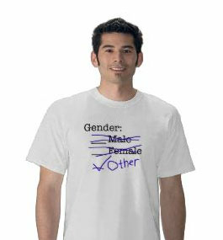
Tip 5
Stress a lot about ‘other’
Design by @RickyBuchanan; t-shirt from nopitycity.com or zazzle.co.uk

Slide 24
Agenda
Survey =
Questionnaire + Process
Tips about process

Slide 25
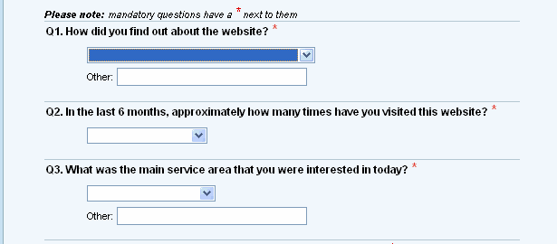
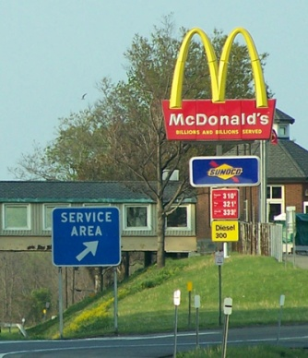
“Shared reference”: both sides interpret in the same way
Service area?
Photo credit: Flickr - chaptstickaddict

Slide 26
Tip 6
Interview users about the topics in your survey

Slide 27
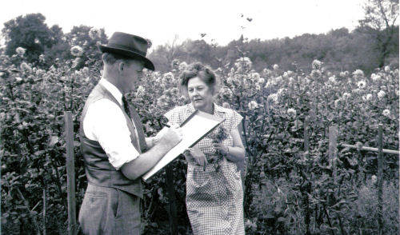
Collecting data used to be expensive. A survey was a rare event.
http://www.census.gov/history/www/genealogy/decennial_census_records/

Slide 28
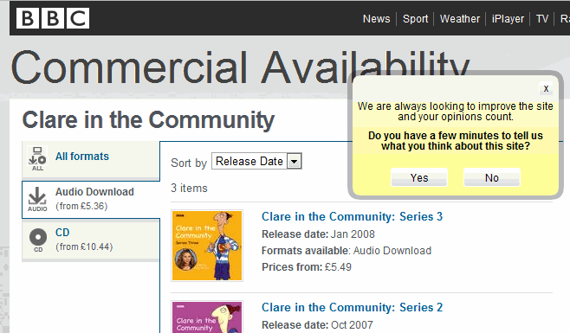
Today, we get surveyed constantly

Slide 29
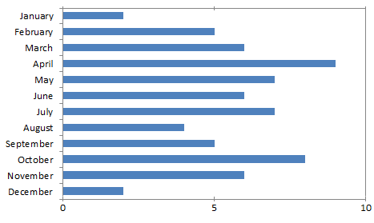
I respond to a lot of surveys
89 invitations
67 completed surveys
1387 questions

Slide 30
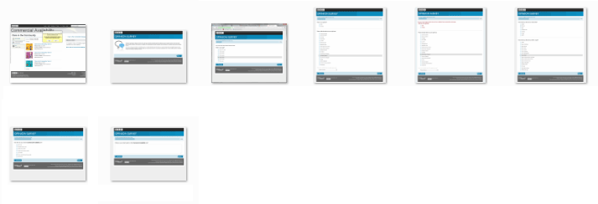
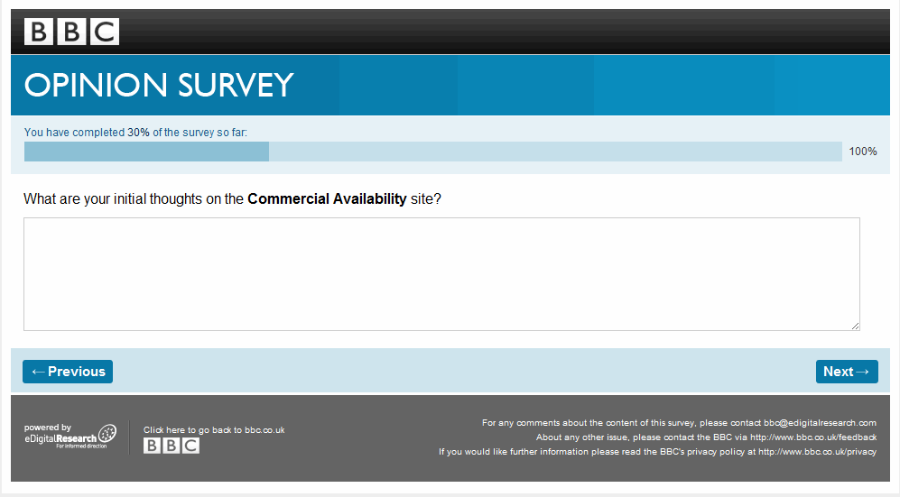
They wanted my opinions but it took 6 screens to get to the first opinion question

Slide 31
Could the BBC trim some of these?
Gender
Region you live in
Ethnic origin
Type of Internet connection
Rate how it looks
What do you like about it
What do you dislike about it
Your main reason for visiting the site today

Slide 32
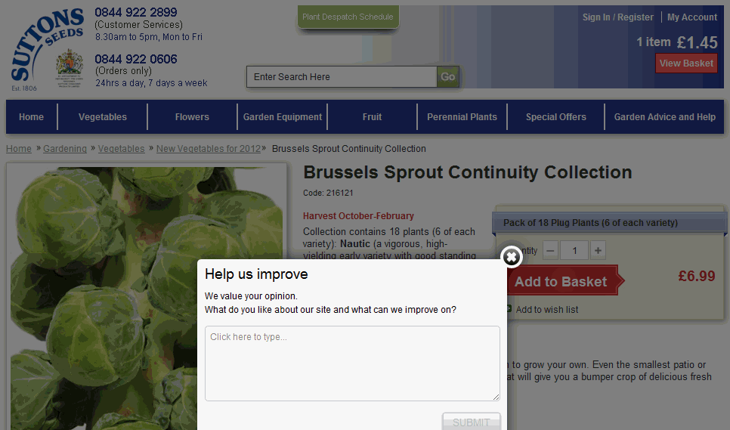
Why not ask one really simple question?

Slide 33
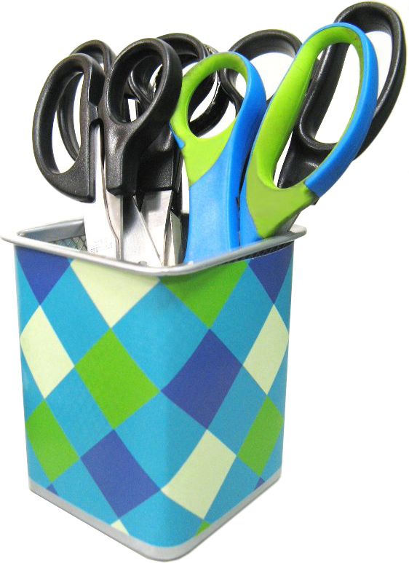
Tip 7
Remove the questions that you don’t need
Image credit: Flickr - Enokson

Slide 34
If you ask for answers, you have to read and think about them

Slide 35
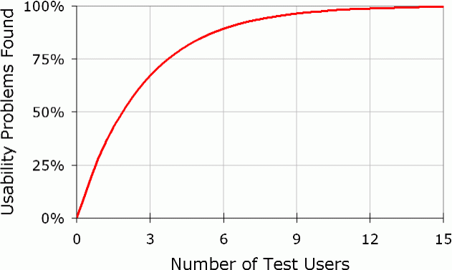
Tip 8
Decide how many responses you really need
http://www.useit.com/alertbox/20000319.html

Slide 36

We got so much great data that I put every detail in this report
!!!!

Slide 37
Tip 9
Create a draft presentation, early. Really early.

Slide 38
Presser et al 2004: pretesting focuses on a “broader concern for improving data quality so that measurements meet a survey’s objective”
Field testing focuses on the mechanics and procedures
Cognitive interviewing focuses on the questions
Usability testing focuses on interaction
http://www.slideshare.net/cjforms/introduction-to-usability-testing-for-survey-research

Slide 39
Try some cognitive interviewing
Pair up. One person gets to be the interviewer.
Think aloud as you try to answer this question:

Slide 40
Try some cognitive interviewing
Pair up. One person gets to be the interviewer.
Think aloud as you try to answer this question:
'how many windows are there in your house’
(Dillman et al, 2009)

Slide 41
OK, now swap and try this question
Please think about a computer system or web site that you used recently. Now think aloud as you answer this question:

Slide 42
OK, now swap and try this question
Please think about a computer system or web site that you used recently. Now think aloud as you answer this question:
‘I thought there was too much inconsistency in this system’
(from the System Usability Scale, Brooke 1986)

Slide 43
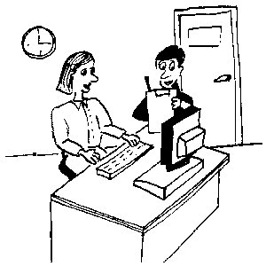
Tip 10
Test, test, test, test
Top tip
Image credit: infodesign.com.au

Slide 44

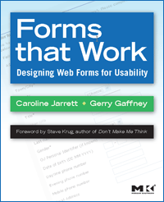

Caroline Jarrett twitter @cjforms caroline.jarrett@effortmark.co.uk
Slides: http://www.slideshare.net/cjforms
Blog posts and more resources: http://www.rosenfeldmedia.com/books/survey-design/

