Slide 1
Thoughts without sensory grounding: the argument from duplication
Joe Y. F. Lau
Dept of Philosophy University of Hong Kong
ASSC 2024

Slide 2
Does AI need sensory grounding for full understanding and reasoning?
Understanding and reasoning at the level of human intelligence.
LLMs lack full understanding.
Many of them rely on text without extra-linguistic inputs.
Sensory grounding: Multimodal sensory capacities are necessary for full understanding. (not sufficient)

Slide 3
Many different motivations for thinking that sensory grounding is necessary
Truth grounding: More diverse and contextually-relevant data might reduce hallucination.
More efficient self-supervised learning: Sensory capacities offer higher bandwidth; more data redundancy.
Semantic grounding: Understanding requires concepts with genuine representational content grounded in our senses.

Slide 4
My presentation
Discuss two arguments against necessity of sensory grounding. (Pavlick 2023, Chalmers 2023)
My argument (from duplication):
In principle, concepts and knowledge can be copied.
So it is possible for an AI to have full understanding and reasoning without any sensory capacity.

Slide 5

Ellie Pavlick (2023)
We can know a lot about things through text without direct perceptual and sensory access.
Congenitally blind children are still able to acquire substantial knowledge about language and the world.
So it is not a problem for LLMs to rely solely on text-based data.

Slide 6
However …
Yes we can (often) learn about X without perceptual access to X.
But our knowledge of text is still mediated through our senses.
Helen Keller relied on the sense of touch to learn signs.
Not examples of understanding without sensory capacities.
Yann LeCun: Humans can get “pretty smart without vision and audition”, but “not without touch” (high bandwidth channel).

Slide 7
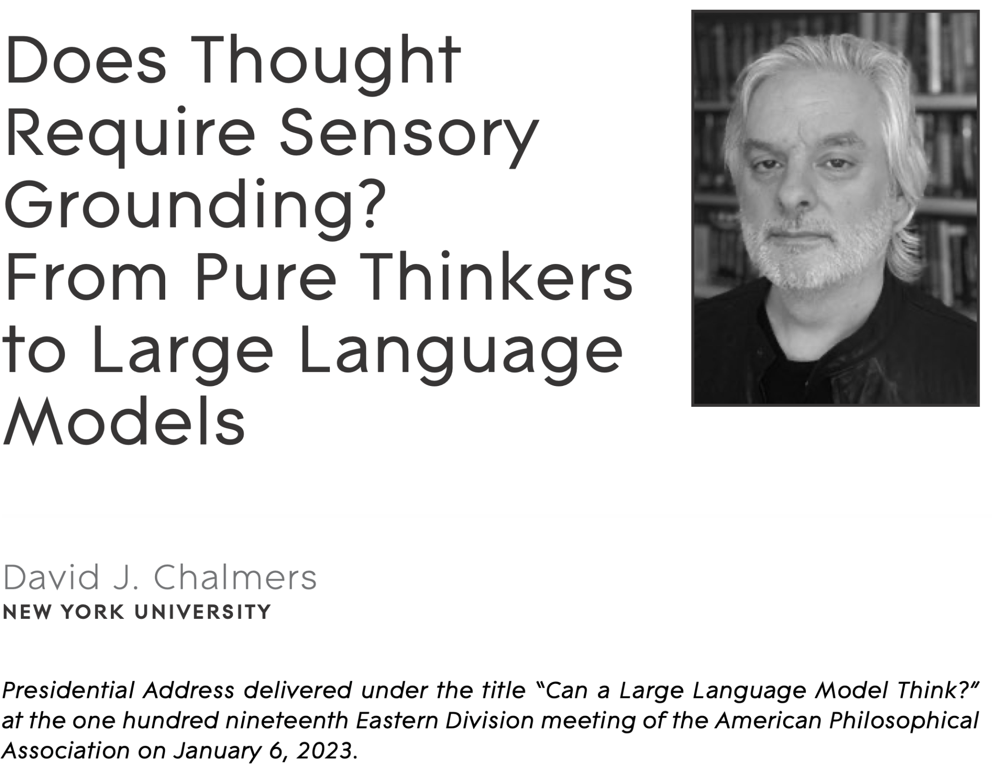
Chalmers (2023)
“Pure thinkers”: Hypothetical, possible beings
“never had the capacity to sense”
“lack even quasi-sensory capacities such as imagery”
They might still be able to use concepts to think.
Some mathematical and abstract concepts
Some mental, metaphysical, causal concepts
But no sensory, singular concepts.

Slide 8
Chalmers: Pure thinkers lack singular concepts
“It’s arguable that pure thinkers will lack singular concepts of entities in the external world more generally.”
Example: Having the concept Barack Obama “requires having a causal and cognitive connection to Obama himself, which a pure thinker will lack.”

Slide 9

My response
If singular concepts can be copied to a system without sensory capacities, then pure thinkers might still acquire singular concepts.
Does not assume internalism about mental content.
Appropriate duplication of representation preserves content.
Intentional reference borrowing is not necessary.
Comparison: Copying a photo image.

Slide 10
Objection #1
“With neural networks, it is not possible to copy individual concepts because they employ highly distributed representations and there is superposition of concepts.”
Depends on the cognitive architecture.
Some architectures might make copying easier. (a whole network of concepts rather than a single concept)

Slide 11
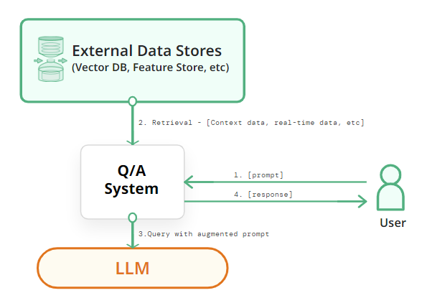

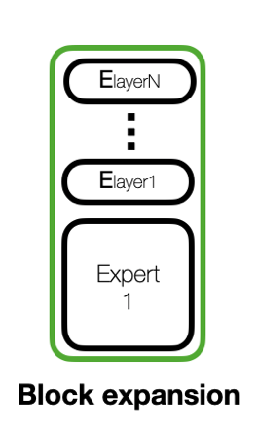
Knowledge expansion
Retrieval Augmented Generation Mixture of Experts
Disclaimer

Slide 12
Objection #2
“Copying only relocates the problem of sensory grounding. The original system that is the source of the concepts might still require sensory capacities to acquire those concepts in the first place.”
The point remains that the target system lacks sensory capacities.
Concepts depend on internal functional role + content.
We are in the early days of research on knowledge editing.
There might be different ways to construct the same concept.

