Slide 1


Chapter 1 Introduction
A note on the use of these Powerpoint slides:
We’re making these slides freely available to all (faculty, students, readers). They’re in PowerPoint form so you see the animations; and can add, modify, and delete slides (including this one) and slide content to suit your needs. They obviously represent a lot of work on our part. In return for use, we only ask the following:
Computer Networking: A Top Down Approach
If you use these slides (e.g., in a class) that you mention their source (after all, we’d like people to use our book!)
If you post any slides on a www site, that you note that they are adapted from (or perhaps identical to) our slides, and note our copyright of this material.
Thanks and enjoy! JFK/KWR
All material copyright 1996-2016
J.F Kurose and K.W. Ross, All Rights Reserved
7th edition Jim Kurose, Keith Ross Pearson/Addison Wesley April 2016
Introduction
1-‹#›

Slide 2
Chapter 1: introduction
our goal:
get “feel” and terminology
more depth, detail later in course
approach:
use Internet as example
overview:
what’s the Internet?
what’s a protocol?
network edge; hosts, access net, physical media
network core: packet/circuit switching, Internet structure
performance: loss, delay, throughput
security
protocol layers, service models
history
Introduction
1-‹#›
Notes:
‹#›

Slide 3
Chapter 1: roadmap
1.1 what is the Internet?
1.2 network edge
end systems, access networks, links
1.3 network core
packet switching, circuit switching, network structure
1.4 delay, loss, throughput in networks
1.5 protocol layers, service models
1.6 networks under attack: security
1.7 history
Introduction
1-‹#›

Slide 4




















What’s the Internet: “nuts and bolts” view
PC
billions of connected computing devices:
hosts = end systems
running network apps
mobile network
server
global ISP
wireless
laptop
smartphone
home
network
communication links
fiber, copper, radio, satellite
transmission rate: bandwidth
regional ISP
wireless
links
wired
links
packet switches: forward packets (chunks of data)
routers and switches
router
institutional
network
Introduction
1-‹#›
Notes:
‹#›

Slide 5


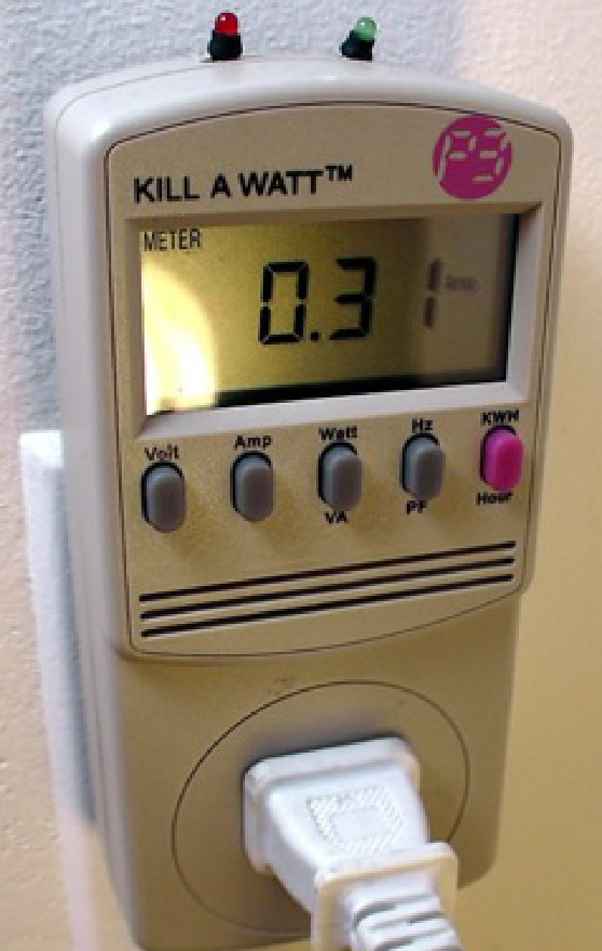




“Fun” Internet-connected devices
Web-enabled toaster +
weather forecaster
IP picture frame
http://www.ceiva.com/
Tweet-a-watt:
monitor energy use
Slingbox: watch,
control cable TV remotely
sensorized,
bed
mattress
Internet
refrigerator
Internet phones
Introduction
1-‹#›
Notes:
‹#›

Slide 6
What’s the Internet: “nuts and bolts” view
Internet: “network of networks”
Interconnected ISPs
protocols control sending, receiving of messages
e.g., TCP, IP, HTTP, Skype, 802.11
Internet standards
RFC: Request for comments
IETF: Internet Engineering Task Force
mobile network
global ISP
home
network
regional ISP
institutional
network
Introduction
1-‹#›
Notes:
‹#›

Slide 7
What’s the Internet: a service view
mobile network
infrastructure that provides services to applications:
Web, VoIP, email, games, e-commerce, social nets, …
provides programming interface to apps
hooks that allow sending and receiving app programs to “connect” to Internet
provides service options, analogous to postal service
global ISP
home
network
regional ISP
institutional
network
Introduction
1-‹#›
Notes:
‹#›

Slide 8
What’s a protocol?
human protocols:
“what’s the time?”
“I have a question”
introductions
… specific messages sent
… specific actions taken when messages received, or other events
network protocols:
machines rather than humans
all communication activity in Internet governed by protocols
protocols define format, order of messages sent and received among network entities, and actions taken on message transmission, receipt
Introduction
1-‹#›

Slide 9



What’s a protocol?
a human protocol and a computer network protocol:
Hi
TCP connection
request
Hi
TCP connection
response
Got the
time?
Get http://www.awl.com/kurose-ross
2:00
<file>
time
Q: other human protocols?
Introduction
1-‹#›

Slide 11
Chapter 1: roadmap
1.1 what is the Internet?
1.2 network edge
end systems, access networks, links
1.3 network core
packet switching, circuit switching, network structure
1.4 delay, loss, throughput in networks
1.5 protocol layers, service models
1.6 networks under attack: security
1.7 history
Introduction
1-‹#›

Slide 12
A closer look at network structure:
network edge:
hosts: clients and servers
servers often in data centers
mobile network
global ISP
access networks, physical media: wired, wireless communication links
home
network
regional ISP
network core:
interconnected routers
network of networks
institutional
network
Introduction
1-‹#›

Slide 13
Access networks and physical media
Q: How to connect end systems to edge router?
residential access nets
institutional access networks (school, per second) of access network?
shared or dedicated?
Introduction
1-‹#›
Notes:
‹#›

Slide 14

Access network: digital subscriber line (DSL)
central office
telephone
network
DSL
modem
splitter
DSLAM
ISP
voice, data transmitted
at different frequencies over
dedicated line to central office
DSL access
multiplexer
use existing telephone line to central office DSLAM
data over DSL phone line goes to Internet
voice over DSL phone line goes to telephone net
< 2.5 Mbps upstream transmission rate (typically < 1 Mbps)
< 24 Mbps downstream transmission rate (typically < 10 Mbps)
Introduction
1-‹#›

Slide 15
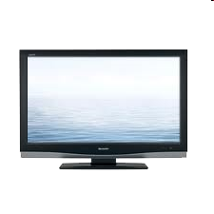


Access network: cable network
cable headend
…
cable
modem
splitter
C
O
N
T
R
O
L
V
I
D
E
O
V
I
D
E
O
V
I
D
E
O
V
I
D
E
O
V
I
D
E
O
V
I
D
E
O
D
A
T
A
D
A
T
A
1
2
3
4
5
6
7
8
9
Channels
frequency division multiplexing: different channels transmitted
in different frequency bands
Introduction
1-‹#›

Slide 16
Access network: cable network
cable headend
…
cable
modem
splitter
CMTS
cable modem
termination system
data, TV transmitted at different
frequencies over shared cable
distribution network
ISP
HFC: hybrid fiber coax
asymmetric: up to 30Mbps downstream transmission rate, 2 Mbps upstream transmission rate
network of cable, fiber attaches homes to ISP router
homes share access network to cable headend
unlike DSL, which has dedicated access to central office
Introduction
1-‹#›

Slide 17





Access network: home network
wireless
devices
to/from headend or central office
often combined
in single box
cable or DSL modem
wireless access
point (54 Mbps)
router, firewall, NAT
wired Ethernet (1 Gbps)
Introduction
1-‹#›

Slide 18









Enterprise access networks (Ethernet)
institutional link to
ISP (Internet)
institutional router
Ethernet
switch
institutional mail,
web servers
typically used in companies, universities, etc.
10 Mbps, 100Mbps, 1Gbps, 10Gbps transmission rates
today, end systems typically connect into Ethernet switch
Introduction
1-‹#›

Slide 19








Wireless access networks
shared wireless access network connects end system to router
via base station aka “access point”
wide-area wireless access
provided by telco (cellular) operator, 10’s km
between 1 and 10 Mbps
3G, 4G: LTE
wireless LANs:
within building (100 ft.)
802.11b/g/n (WiFi): 11, 54, 450 Mbps transmission rate
to Internet
to Internet
Introduction
1-‹#›

Slide 20


Host: sends packets of data
host sending function:
takes application message
breaks into smaller chunks, known as packets, of length L bits
transmits packet into access network at transmission rate R
link transmission rate, aka link capacity, aka link bandwidth
two packets,
L bits each
2
1
R: link transmission rate
host
packet
transmission
delay
time needed to
transmit L-bit
packet into link
L (bits)
R (bits/sec)
=
=
Introduction
1-‹#›

Slide 21
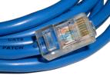
Physical media
bit: propagates between transmitter/receiver pairs
physical link: what lies between transmitter & receiver
guided media:
signals propagate in solid media: copper, fiber, coax
unguided media:
signals propagate freely, e.g., radio
twisted pair (TP)
two insulated copper wires
Category 5: 100 Mbps, 1 Gbps Ethernet
Category 6: 10Gbps
Introduction
1-‹#›

Slide 22


Physical media: coax, fiber
coaxial cable:
two concentric copper conductors
bidirectional
broadband:
multiple channels on cable
HFC
fiber optic cable:
glass fiber carrying light pulses, each pulse a bit
high-speed operation:
high-speed point-to-point transmission (e.g., 10’s-100’s Gbps transmission rate)
low error rate:
repeaters spaced far apart
immune to electromagnetic noise
Introduction
1-‹#›

Slide 23
Physical media: radio
signal carried in electromagnetic spectrum
no physical “wire”
bidirectional
propagation environment effects:
reflection
obstruction by objects
interference
radio link types:
terrestrial microwave
e.g. up to 45 Mbps channels
LAN (e.g., WiFi)
54 Mbps
wide-area (e.g., cellular)
4G cellular: ~ 10 Mbps
satellite
Kbps to 45Mbps channel (or multiple smaller channels)
270 msec end-end delay
geosynchronous versus low altitude
Introduction
1-‹#›
Notes:
‹#›

Slide 24
Add a Knowledge Check question Here

Slide 25
Chapter 1: roadmap
1.1 what is the Internet?
1.2 network edge
end systems, access networks, links
1.3 network core
packet switching, circuit switching, network structure
1.4 delay, loss, throughput in networks
1.5 protocol layers, service models
1.6 networks under attack: security
1.7 history
Introduction
1-‹#›
Notes:
‹#›

Slide 26









The network core
mesh of interconnected routers
packet-switching: hosts break application-layer messages into packets
forward packets from one router to the next, across links on path from source to destination
each packet transmitted at full link capacity
Introduction
1-‹#›

Slide 27





Packet-switching: store-and-forward
L bits
per packet
source
3
2
1
R bps
R bps
destination
takes L/R seconds to transmit (push out) L-bit packet into link at R bps
store and forward: entire packet must arrive at router before it can be transmitted on next link
one-hop numerical example:
L = 7.5 Mbits
R = 1.5 Mbps
one-hop transmission delay = 5 sec
end-end delay = 2L/R (assuming zero propagation delay)
more on delay shortly …
Introduction
1-‹#›

Slide 28
Packet Switching: queueing delay, loss
R = 100 Mb/s
C
A
D
R = 1.5 Mb/s
B
E
queue of packets
waiting for output link
queuing and loss:
if arrival rate (in bits) to link exceeds transmission rate of link for a period of time:
packets will queue, wait to be transmitted on link
packets can be dropped (lost) if memory (buffer) fills up
Introduction
1-‹#›

Slide 29
Two key network-core functions
routing: determines source-destination route taken by packets
routing algorithms
forwarding: move packets from router’s input to appropriate router output
routing algorithm
local forwarding table
header value
output link
0100
0101
0111
1001
3
2
2
1
1
3
2
0111
destination address in arriving
packet’s header
Introduction
1-‹#›

Slide 30
Alternative core: circuit switching
end-end resources allocated to, reserved for “call” between source & dest:
in diagram, each link has four circuits.
call gets 2nd circuit in top link and 1st circuit in right link.
dedicated resources: no sharing
circuit-like (guaranteed) performance
circuit segment idle if not used by call (no sharing)
commonly used in traditional telephone networks
Introduction
1-‹#›

Slide 31
Circuit switching: FDM versus TDM
Example:
FDM
4 users
frequency
time
TDM
frequency
time
Introduction
1-‹#›

Slide 32
Packet switching versus circuit switching
packet switching allows more users to use network!
example:
1 Mb/s link
each user:
100 kb/s when “active”
active 10% of time
circuit-switching:
10 users
packet switching:
with 35 users, probability > 10 active at same time is less than .0004 *
N
users
…..
1 Mbps link
Q: how did we get value 0.0004?
Q: what happens if > 35 users ?
* Check out the online interactive exercises for more examples: http://gaia.cs.umass.edu/kurose_ross/interactive/
Introduction
1-‹#›

Slide 33
Packet switching versus circuit switching
is packet switching a “slam dunk winner?”
great for bursty data
resource sharing
simpler, no call setup
excessive congestion possible: packet delay and loss
protocols needed for reliable data transfer, congestion control
Q: How to provide circuit-like behavior?
bandwidth guarantees needed for audio/video apps
still an unsolved problem (chapter 7)
Q: human analogies of reserved resources (circuit switching) versus on-demand allocation (packet-switching)?
Introduction
1-‹#›

Slide 34
Internet structure: network of networks
End systems connect to Internet via access ISPs (Internet Service Providers)
residential, company and university ISPs
Access ISPs in turn must be interconnected.
so that any two hosts can send packets to each other
Resulting network of networks is very complex
evolution was driven by economics and national policies
Let’s take a stepwise approach to describe current Internet structure
Introduction
1-‹#›

Slide 35
Internet structure: network of networks
Question: given millions of access ISPs, how to connect them together?
…
…
access
net
access
net
access
net
access
net
access
net
access
net
access
net
…
…
access
net
access
net
access
net
access
net
access
net
access
net
…
access
net
access
net
…
access
net
Introduction
1-‹#›

Slide 36
Internet structure: network of networks
Option: connect each access ISP to every other access ISP?
…
…
access
net
access
net
access
net
access
net
access
net
…
…
access
net
access
net
…
connecting each access ISP to each other directly doesn’t scale: O(N²) connections.
…
…
access
net
access
net
…
access
net
access
net
access
net
…
access
net
…
access
net
access
net
…
access
net
Introduction
1-‹#›

Slide 37
Internet structure: network of networks
Option: connect each access ISP to one global transit ISP?
Customer and provider ISPs have economic agreement.
…
…
access
net
access
net
access
net
access
net
access
net
access
net
access
net
…
…
global ISP
access
net
access
net
access
net
access
net
access
net
access
net
…
access
net
access
net
…
access
net
Introduction
1-‹#›

Slide 38
Internet structure: network of networks
But if one global ISP is viable business, there will be competitors ….
…
…
access
net
access
net
access
net
access
net
access
net
access
net
ISP A
access
net
…
…
access
net
ISP B
access
net
ISP C
access
net
access
net
access
net
access
net
…
access
net
access
net
…
access
net
Introduction
1-‹#›

Slide 39
Internet structure: network of networks
But if one global ISP is viable business, there will be competitors …. which must be interconnected
Internet exchange point
…
…
access
net
access
net
access
net
access
net
access
net
IXP
access
net
access
net
ISP A
…
…
access
net
IXP
ISP B
access
net
ISP C
access
net
access
net
peering link
access
net
access
net
…
access
net
access
net
…
access
net
Introduction
1-‹#›
Notes:
‹#›

Slide 40
Internet structure: network of networks
… and regional networks may arise to connect access nets to ISPs
…
…
access
net
access
net
access
net
access
net
access
net
IXP
access
net
access
net
ISP A
…
…
access
net
IXP
ISP B
access
net
ISP C
access
net
access
net
access
net
regional net
access
net
…
access
net
access
net
…
access
net
Introduction
1-‹#›
Notes:
‹#›

Slide 41
Internet structure: network of networks
… and content provider networks (e.g., Google, Microsoft, Akamai) may run their own network, to bring services, content close to end users
…
…
access
net
access
net
access
net
access
net
access
net
IXP
access
net
access
net
ISP A
…
…
Content provider network
access
net
IXP
ISP B
access
net
ISP C
access
net
access
net
access
net
regional net
access
net
…
access
net
access
net
…
access
net
Introduction
1-‹#›

Slide 42
Internet structure: network of networks
Tier 1 ISP
Tier 1 ISP
Google
IXP
IXP
IXP
Regional ISP
Regional ISP
access
ISP
access
ISP
access
ISP
access
ISP
access
ISP
access
ISP
access
ISP
access
ISP
at center: small # of well-connected large networks
“tier-1” commercial ISPs (e.g., Level 3, Sprint, AT&T, NTT), national & international coverage
content provider network (e.g., Google): private network that connects it data centers to Internet, often bypassing tier-1, regional ISPs
Introduction
1-‹#›

Slide 43
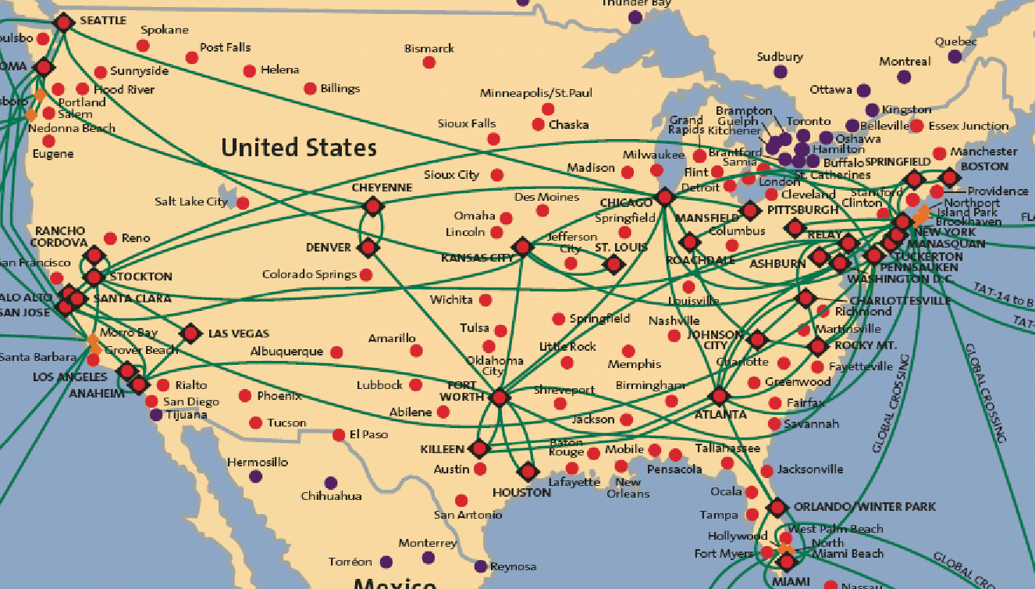
Tier-1 ISP: e.g., Sprint
POP: point-of-presence
to/from backbone
peering
…
…
…
…
…
to/from customers
Introduction
1-‹#›

Slide 44
Add a Knowledge Check question Here

Slide 45
Chapter 1: roadmap
1.1 what is the Internet?
1.2 network edge
end systems, access networks, links
1.3 network core
packet switching, circuit switching, network structure
1.4 delay, loss, throughput in networks
1.5 protocol layers, service models
1.6 networks under attack: security
1.7 history
Introduction
1-‹#›

Slide 46
How do loss and delay occur?
packets queue in router buffers
packet arrival rate to link (temporarily) exceeds output link capacity
packets queue, wait for turn
packet being transmitted (delay)
A
B
packets queueing (delay)
free (available) buffers: arriving packets
dropped (loss) if no free buffers
Introduction
1-‹#›

Slide 47
Four sources of packet delay
transmission
A
propagation
B
nodal
processing
queueing
d_{nodal} = d_{proc} + d_{queue} + d_{trans} + d_{prop}
d_{proc}: nodal processing
check bit errors
determine output link
typically < msec
d_{queue}: queueing delay
time waiting at output link for transmission
depends on congestion level of router
Introduction
1-‹#›

Slide 48
Four sources of packet delay
transmission
A
propagation
B
nodal
processing
queueing
d_{nodal} = d_{proc} + d_{queue} + d_{trans} + d_{prop}
d_{trans}: transmission delay:
L: packet length (bits)
R: link bandwidth (bps)
d_{trans} = L/R
d_{prop}: propagation delay:
d: length of physical link
s: propagation speed (~2x10⁸ m/sec)
d_{prop} = d/s
d_{trans} and d_{prop}
very different
* Check out the online interactive exercises for more examples: http://gaia.cs.umass.edu/kurose_ross/interactive/
* Check out the Java applet for an interactive animation on trans vs. prop delay
Introduction
1-‹#›

Slide 49
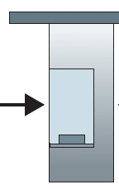

Caravan analogy
100 km
100 km
ten-car
caravan
toll
booth
toll
booth
cars “propagate” at 100 km/hr
toll booth takes 12 sec to service car (bit transmission time)
car ~ bit; caravan ~ packet
Q: How long until caravan is lined up before 2nd toll booth?
time to “push” entire caravan through toll booth onto highway = 12*10 = 120 sec
time for last car to propagate from 1st to 2nd toll both: 100km/(100km/hr)= 1 hr
A: 62 minutes
Introduction
1-‹#›

Slide 50
Caravan analogy (more)
100 km
100 km
ten-car
caravan
toll
booth
toll
booth
suppose cars now “propagate” at 1000 km/hr
and suppose toll booth now takes one min to service a car
Q: Will cars arrive to 2nd booth before all cars serviced at first booth?
A: Yes! after 7 min, first car arrives at second booth; three cars still at first booth
Introduction
1-‹#›

Slide 51
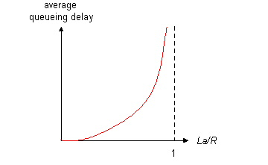

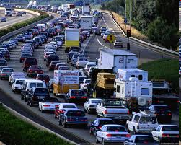
Queueing delay (revisited)
R: link bandwidth (bps)
L: packet length (bits)
a: average packet arrival rate
average queueing delay
traffic intensity
= La/R
La/R ~ 0: avg. queueing delay small
La/R -> 1: avg. queueing delay large
La/R > 1: more “work” arriving
than can be serviced, average delay infinite!
La/R ~ 0
La/R -> 1
* Check online interactive animation on queuing and loss
Introduction
1-‹#›

Slide 52
“Real” Internet delays and routes
what do “real” Internet delay & loss look like?
traceroute program: provides delay measurement from source to router along end-end Internet path towards destination. For all i:
sends three packets that will reach router i on path towards destination
router i will return packets to sender
sender times interval between transmission and reply.
3 probes
3 probes
3 probes
Introduction
1-‹#›

Slide 53
“Real” Internet delays, routes
traceroute: gaia.cs.umass.edu to www.eurecom.fr
3 delay measurements from
gaia.cs.umass.edu to cs-gw.cs.umass.edu
1 cs-gw (128.119.240.254) 1 ms 1 ms 2 ms
2 border1-rt-fa5-1-0.gw.umass.edu (128.119.3.145) 1 ms 1 ms 2 ms
3 cht-vbns.gw.umass.edu (128.119.3.130) 6 ms 5 ms 5 ms
4 jn1-at1-0-0-19.wor.vbns.net (204.147.132.129) 16 ms 11 ms 13 ms
5 jn1-so7-0-0-0.wae.vbns.net (204.147.136.136) 21 ms 18 ms 18 ms
6 abilene-vbns.abilene.ucaid.edu (198.32.11.9) 22 ms 18 ms 22 ms
7 nycm-wash.abilene.ucaid.edu (198.32.8.46) 22 ms 22 ms 22 ms
8 62.40.103.253 (62.40.103.253) 104 ms 109 ms 106 ms
9 de2-1.de1.de.geant.net (62.40.96.129) 109 ms 102 ms 104 ms
10 de.fr1.fr.geant.net (62.40.96.50) 113 ms 121 ms 114 ms
11 renater-gw.fr1.fr.geant.net (62.40.103.54) 112 ms 114 ms 112 ms
12 nio-n2.cssi.renater.fr (193.51.206.13) 111 ms 114 ms 116 ms
13 nice.cssi.renater.fr (195.220.98.102) 123 ms 125 ms 124 ms
14 r3t2-nice.cssi.renater.fr (195.220.98.110) 126 ms 126 ms 124 ms
15 eurecom-valbonne.r3t2.ft.net (193.48.50.54) 135 ms 128 ms 133 ms
16 194.214.211.25 (194.214.211.25) 126 ms 128 ms 126 ms
17 * * *
18 * * *
19 fantasia.eurecom.fr (193.55.113.142) 132 ms 128 ms 136 ms
trans-oceanic
link
* means no response (probe lost, router not replying)
* Do some traceroutes from exotic countries at www.traceroute.org
Introduction
1-‹#›

Slide 54
Packet loss
queue (aka buffer) preceding link in buffer has finite capacity
packet arriving to full queue dropped (aka lost)
lost packet may be retransmitted by previous node, by source end system, or not at all
buffer
(waiting area)
A
packet being transmitted
B
packet arriving to
full buffer is lost
* Check out the Java applet for an interactive animation on queuing and loss
Introduction
1-‹#›

Slide 55
Throughput
throughput: rate (bits/time unit) at which bits transferred between sender/receiver
instantaneous: rate at given point in time
average: rate over longer period of time
server, with
file of F bits
to send to client
link capacity
R_{s} bits/sec
link capacity
R_{c} bits/sec
server sends bits
(fluid) into pipe
pipe that can carry
fluid at rate
R_{s} bits/sec)
pipe that can carry
fluid at rate
R_{c} bits/sec)
Introduction
1-‹#›

Slide 56
Throughput (more)
R_{s} < R_{c} What is average end-end throughput?
R_{s} bits/sec
R_{c} bits/sec
R_{s} > R_{c} What is average end-end throughput?
R_{s} bits/sec
R_{c} bits/sec
bottleneck link
link on end-end path that constrains end-end throughput
Introduction
1-‹#›

Slide 57
Throughput: Internet scenario
per-connection end-end throughput: min(R_{c},R_{s},R/10)
in practice: R_{c} or R_{s} is often bottleneck
R_{s}
R_{s}
R_{s}
R
R_{c}
R_{c}
R_{c}
10 connections (fairly) share backbone bottleneck link R bits/sec
* Check out the online interactive exercises for more examples: http://gaia.cs.umass.edu/kurose_ross/interactive/
Introduction
1-‹#›

Slide 58
Add a Knowledge Check question Here

Slide 59
Chapter 1: roadmap
1.1 what is the Internet?
1.2 network edge
end systems, access networks, links
1.3 network core
packet switching, circuit switching, network structure
1.4 delay, loss, throughput in networks
1.5 protocol layers, service models
1.6 networks under attack: security
1.7 history
Introduction
1-‹#›

Slide 60
Protocol “layers”
Networks are complex,
with many “pieces”:
hosts
routers
links of various media
applications
protocols
hardware, software
Question:
is there any hope of organizing structure of network?
…. or at least our discussion of networks?
Introduction
1-‹#›

Slide 61
Organization of air travel
ticket (purchase)
baggage (check)
gates (load)
runway takeoff
airplane routing
ticket (complain)
baggage (claim)
gates (unload)
runway landing
airplane routing
airplane routing
a series of steps
Introduction
1-‹#›

Slide 62

Layering of airline functionality
ticket (purchase)
baggage (check)
gates (load)
runway (takeoff)
airplane routing
ticket (complain)
baggage (claim
gates (unload)
runway (land)
airplane routing
ticket
baggage
gate
takeoff/landing
airplane routing
airplane routing
airplane routing
departure
airport
intermediate air-traffic
control centers
arrival
airport
layers: each layer implements a service
via its own internal-layer actions
relying on services provided by layer below
Introduction
1-‹#›

Slide 63
Why layering?
dealing with complex systems:
explicit structure allows identification, relationship of complex system’s pieces
layered reference model for discussion
modularization eases maintenance, updating of system
change of implementation of layer’s service transparent to rest of system
e.g., change in gate procedure doesn’t affect rest of system
layering considered harmful?
Introduction
1-‹#›

Slide 64
Internet protocol stack
application: supporting network applications
FTP, SMTP, HTTP
transport: process-process data transfer
TCP, UDP
network: routing of datagrams from source to destination
IP, routing protocols
link: data transfer between neighboring network elements
Ethernet, 802.111 (WiFi), PPP
physical: bits “on the wire”
application
transport
network
link
physical
Introduction
1-‹#›

Slide 65
ISO/OSI reference model
presentation: allow applications to interpret meaning of data, e.g., encryption, compression, machine-specific conventions
session: synchronization, checkpointing, recovery of data exchange
Internet stack “missing” these layers!
these services, if needed, must be implemented in application
needed?
application
presentation
session
transport
network
link
physical
Introduction
1-‹#›
Notes:
‹#›
Two simple multiple access control techniques.
Each mobile’s share of the bandwidth is divided into portions for the uplink and the downlink. Also, possibly, out of band signaling.
As we will see, used in AMPS, GSM, IS-54/136

Slide 66
Encapsulation
source
message
M
application
transport
network
link
physical
segment
H_{t}
M
H_{t}
datagram
H_{n}
H_{n}
H_{t}
M
frame
H_{l}
H_{n}
H_{t}
M
link
physical
switch
destination
H_{n}
H_{t}
M
network
link
physical
M
application
transport
network
link
physical
H_{l}
H_{n}
H_{t}
M
H_{n}
H_{t}
M
H_{t}
M
H_{n}
H_{t}
M
H_{l}
H_{n}
H_{t}
M
router
Introduction
1-‹#›

Slide 67
Add a Knowledge Check question Here

Slide 68
Chapter 1: roadmap
1.1 what is the Internet?
1.2 network edge
end systems, access networks, links
1.3 network core
packet switching, circuit switching, network structure
1.4 delay, loss, throughput in networks
1.5 protocol layers, service models
1.6 networks under attack: security
1.7 history
Introduction
1-‹#›

Slide 69
Network security
field of network security:
how bad guys can attack computer networks
how we can defend networks against attacks
how to design architectures that are immune to attacks
Internet not originally designed with (much) security in mind
original vision: “a group of mutually trusting users attached to a transparent network” ☺
Internet protocol designers playing “catch-up”
security considerations in all layers!
Introduction
1-‹#›

Slide 70
Bad guys: put malware into hosts via Internet
malware can get in host from:
virus: self-replicating infection by receiving/executing object (e.g., e-mail attachment)
worm: self-replicating infection by passively receiving object that gets itself executed
spyware malware can record keystrokes, web sites visited, upload info to collection site
infected host can be enrolled in botnet, used for spam. DDoS attacks
Introduction
1-‹#›

Slide 71

Bad guys: attack server, network infrastructure
Denial of Service (DoS): attackers make resources (server, bandwidth) unavailable to legitimate traffic by overwhelming resource with bogus traffic
1. select target
2. break into hosts around the network (see botnet)
3. send packets to target from compromised hosts
target
Introduction
1-‹#›

Slide 72
Bad guys can sniff packets
packet “sniffing”:
broadcast media (shared Ethernet, wireless)
promiscuous network interface reads/records all packets (e.g., including passwords!) passing by
A
C
src:B dest:A payload
B
wireshark software used for end-of-chapter labs is a (free) packet-sniffer
Introduction
1-‹#›

Slide 73
Bad guys can use fake addresses
IP spoofing: send packet with false source address
A
C
src:B dest:A payload
B
… lots more on security (throughout, Chapter 8)
Introduction
1-‹#›

Slide 74
Add a Knowledge Check question Here

Slide 75
Chapter 1: roadmap
1.1 what is the Internet?
1.2 network edge
end systems, access networks, links
1.3 network core
packet switching, circuit switching, network structure
1.4 delay, loss, throughput in networks
1.5 protocol layers, service models
1.6 networks under attack: security
1.7 history
Introduction
1-‹#›
Notes:
‹#›

Slide 76
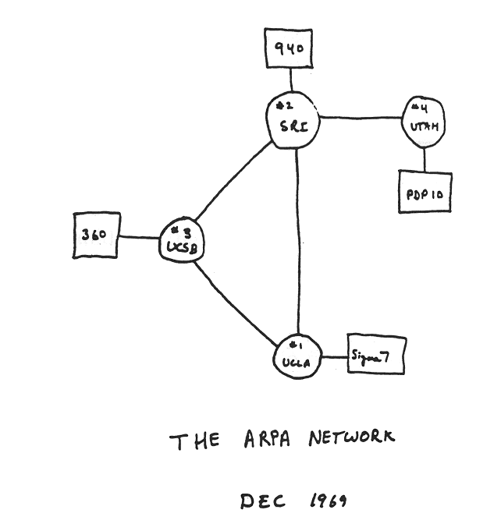
Internet history
1961-1972: Early packet-switching principles
1961: Kleinrock - queueing theory shows effectiveness of packet-switching
1964: Baran - packet-switching in military nets
1967: ARPAnet conceived by Advanced Research Projects Agency
1969: first ARPAnet node operational
1972:
ARPAnet public demo
NCP (Network Control Protocol) first host-host protocol
first e-mail program
ARPAnet has 15 nodes
Introduction
1-‹#›

Slide 77
Internet history
1972-1980: Internetworking, new and proprietary nets
1970: ALOHAnet satellite network in Hawaii
1974: Cerf and Kahn - architecture for interconnecting networks
1976: Ethernet at Xerox PARC
late70’s: proprietary architectures: DECnet, SNA, XNA
late 70’s: switching fixed length packets (ATM precursor)
1979: ARPAnet has 200 nodes
Cerf and Kahn’s internetworking principles:
minimalism, autonomy - no internal changes required to interconnect networks
best effort service model
stateless routers
decentralized control
define today’s Internet architecture
Introduction
1-‹#›
Notes:
‹#›

Slide 78
Internet history
1980-1990: new protocols, a proliferation of networks
1983: deployment of TCP/IP
1982: smtp e-mail protocol defined
1983: DNS defined for name-to-IP-address translation
1985: ftp protocol defined
1988: TCP congestion control
new national networks: CSnet, BITnet, NSFnet, Minitel
100,000 hosts connected to confederation of networks
Introduction
1-‹#›

Slide 79
Internet history
1990, 2000’s: commercialization, the Web, new apps
early 1990’s: ARPAnet decommissioned
1991: NSF lifts restrictions on commercial use of NSFnet (decommissioned, 1995)
early 1990s: Web
hypertext [Bush 1945, Nelson 1960’s]
HTML, HTTP: Berners-Lee
1994: Mosaic, later Netscape
late 1990’s: commercialization of the Web
late 1990’s – 2000’s:
more killer apps: instant messaging, P2P file sharing
network security to forefront
est. 50 million host, 100 million+ users
backbone links running at Gbps
Introduction
1-‹#›

Slide 80
Internet history
2005-present
~5B devices attached to Internet (2016)
smartphones and tablets
aggressive deployment of broadband access
increasing ubiquity of high-speed wireless access
emergence of online social networks:
Facebook: ~ one billion users
service providers (Google, Microsoft) create their own networks
bypass Internet, providing “instantaneous” access to search, video content, email, etc.
e-commerce, universities, enterprises running their services in “cloud” (e.g., Amazon EC2)
Introduction
1-‹#›

Slide 81
Add a Knowledge Check question Here

Slide 82
Introduction: summary
covered a “ton” of material!
Internet overview
what’s a protocol?
network edge, core, access network
packet-switching versus circuit-switching
Internet structure
performance: loss, delay, throughput
layering, service models
security
history
you now have:
context, overview, “feel” of networking
more depth, detail to follow!
Introduction
1-‹#›

Slide 83
Chapter 1 Additional Slides
Introduction
1-‹#›

Slide 84

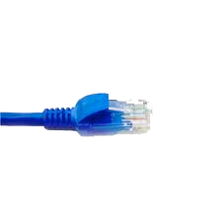
application
(www browser,
email client)
packet
analyzer
application
OS
packet
capture
(pcap)
Transport (TCP/UDP)
Network (IP)
Link (Ethernet)
Physical
copy of all Ethernet frames sent/received

