Slide 1
Welcome to Switzerland
Information for new residents arriving from abroad

Slide 2
Content
5
A country with many faces
Cultural diversity within a small area
7
Living together
Equal opportunities and respect
9
Citizens have the final say
Federalism and direct democracy
13
The bridge to success
High priority for education and work
2
17
Taking responsibility together
Social security and health

Slide 3
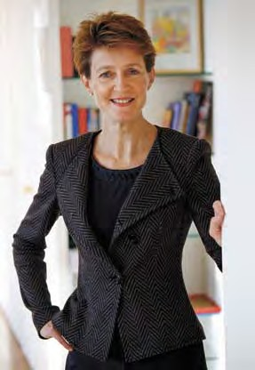

Welcome to Switzerland
You have decided to live in Switzer- land. This involves lots of changes. You will have the impression that many things are unfamiliar com- pared to your native country. Work, school, healthcare, traffic and many other areas are organised differ- ently.
Regardless of how long you will ultimately stay: Make the most of your time here and seize the op- portunities offered to you. It is absolutely worth getting to know Switzerland. Many people who only planned to stay for a short time, end up spending their entire life here.
This brochure is intended to help you integrate more easily into day- to-day life in Switzerland. Informa- tion and social contacts are the most important requirements for people wanting to live together suc- cessfully. You must be familiar with the language to be able to get along in everyday life. To get off to a good start, you also require knowledge of the most important aspects of law, society and political system in Swit- zerland.
Perhaps not everything will work out as you imagined from the start. As immigrants, you are not the only
ones to face challenges; the Swiss and everyone who has been living here for some time also have to cope with them. Their lives also change if new faces appear at work or at school and they come into contact with people who are not familiar with the local circumstances.
It takes time for people to get on with each other. A great deal of patience is required as well as the “willingness of the immigrant and the openness of the local people”. This is stated in our Aliens Act.
This information should give you a first impression of Switzerland and open the door to get you off to a good start.
3
Simonetta Sommaruga Federal Councillor
Welcome

Slide 4
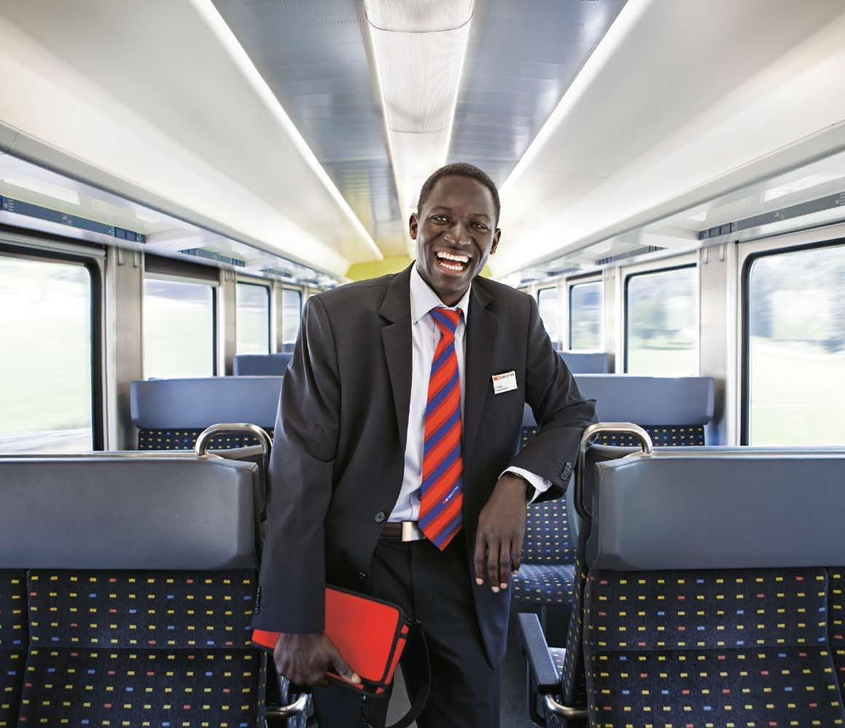
Samba Kebbeh (34) Train Conductor Turbenthal
4
“I had a big culture shock when I came to Switzerland at the age of twenty-one for the love of my life, who is now my wife. The Swiss were very polite, correct and reliable –
but they lacked a certain amount of openness. Then, after applying for jobs and receiving numerous
rejections, I realised that Switzerland is not a fairytale country and that I have to fight for my happiness. I then went to school for a whole year to learn German intensively. This greatly improved my options and above all my self-confidence.
It is largely thanks to my employer that, after initial problems, I have become an absolutely satisfied Gam- bian Swiss. It was he who believed
in my abilities and who made me the first African train conductor in Switzerland.
Nowadays, I am very happy living in Switzerland and even consider it a great asset to be a mixture of two cultures and to be able to take the best of both worlds.”

Slide 5
A country with many faces
Cultural diversity within a small area
Immigrants have always con- tributed greatly to Switzerland’s prosperity. For example, the Gotthard Tunnel, one of the most important transport routes in Switzerland, was built primarily by Italian workers. In addition, immigrants have founded many of today’s large and successful enterprises. Even nowadays, the Swiss economy is dependent on foreign workers.
People from around 140 countries live in Switzerland. One in five per- sons does not have a Swiss passport. And every third marriage is bina- tional. Switzerland’s entire resident population is nearly 7.8 million.
language and come across different ways of living. This linguistic and cultural diversity has a long tradi- tion and is fundamental for Swit- zerland.
Such a small area requires respect and consideration Travellers never fail to be aston- ished by the short distances within Switzerland. One needs no more than five hours from one end to the other. A third of the population in Switzerland live in the five large cit- ies Zurich, Geneva, Basel, Berne and Lausanne and their agglomerations. More than half of the country is made up of mountains. Just about ten percent of the population live there. We live together, therefore, on a very small area and this calls for a certain amount of considera- tion from everyone.
Language is the key to success- ful integration
The majority of the population lives in the German-speaking part of Switzerland. About 70 percent of the population speaks Swiss-Ger- man. About 20 percent French, 7 percent Italian. Rhaeto-Romanic is only spoken in specific districts in the Canton of Graubünden. High German is used as the official lan- guage in the German-speaking part of Switzerland, particularly in writ- ten communication. In conversation however, a number of dialects are spoken. The everyday language in Basel is therefore different from that in the Canton of Zurich. The peo- ple in Berne speak differently from those in Fribourg. You don’t have to learn to speak the dialects perfectly, but it will be considerably easier in daily life if you understand the dia- lect. Language skills are a prereq- uisite for settling into everyday life and work.
5
Information about Switzerland Everything you would like to know about Switzerland
www.swissworld.org
The Swiss Portal
Switzerland and its authorities www.ch.ch
Each region maintains its cultural idiosyncrasies
Four official languages are spoken in Switzerland: German, French, Italian and Rhaeto-Romanic. De- pending on the area in which you are, you will encounter a different

Slide 6
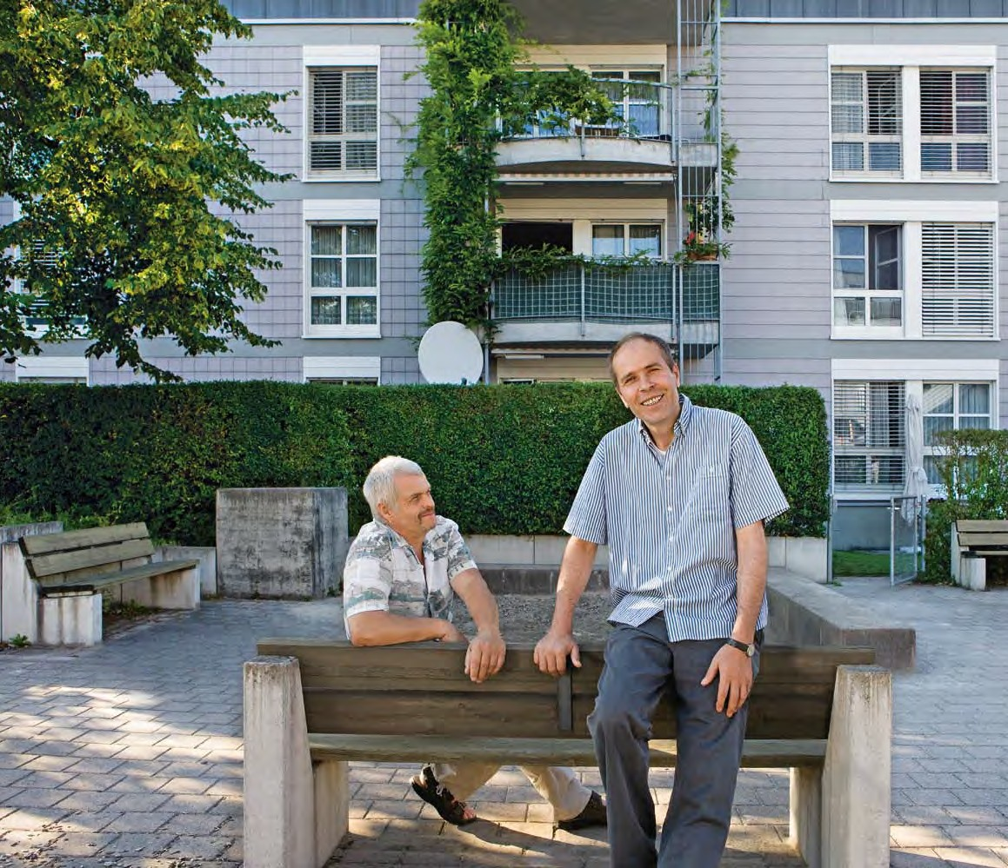
Sabri Aliu (46)
Co-founder of the Fathers’ Group Zurich
6
“My neighbour is a Swiss. He intro- duced us to life in the neighbourhood and made sure that our Kosovar cus- toms were enhanced by Swiss ones. He did it very simply, from one person to another, and without prejudices.
I will never forget that - above all because of my five children. I wanted to get them off to a good start in Switzerland.
Our neighbourhood means more to me than just having a roof over our heads. This certainly has something to do with the fact that the people who live here gradually realised that living happily together requires ef- fort from all of us. It doesn’t matter whether one is Swiss or a foreigner, old or young. One has to start talking
to one another. This is the only way to change things together.
With this in mind, we set up our Fathers’ Group, where we fathers meet up once a month to learn from each other and to deal with problems together. This has really simplified our daily life. And the best part of it all
is: Our neighbours have become our friends.”

Slide 7
Living together
Equal opportunities and respect
Having contact with your new neighbours or taking part in an organisation or a club in your municipality is a personal en- richment. At the same time, you will also get information which will help you and your family at school and at work or when con- tacting the relevant authorities.
Immigrants contribute to the eco- nomic and also cultural wealth of Switzerland. To ensure that living together also works out, all resi- dents in our country are expected to be able to communicate with each other and to strive for finan- cial independence. Living together peacefully also includes having re- spect for and complying with the Swiss legal system as well as the basic values of the constitution. Every individual should also have the same opportunity to play their role in society.
In turn, however, everyone also has to grant the same right to their fel- low human beings. Everyone can defend themselves against possible discrimination. In the case of con- flicts, there are information centres which will help you find a solution.
Alongside written laws there are also unwritten rules
It is often the little things in eve- ryday life which are important for people living together. Getting to know these day-to-day rules is of- ten difficult. For example: perhaps there is a certain plan in your house which specifies when which family can wash their clothes. You have to comply with it. Or the neighbours react if you continue to discuss loudly on the balcony late in the evening or the children play on the stairs. You are expected to com- ply with such written or unwrit- ten rules for living together. Get informed. For example, ask for the house rules or contact your neigh- bour. Mutual respect and open dis- cussions are the first step to a good neighbourhood.
7
Living in Switzerland
Information
www.bwo.admin.ch
Dokumentation > Publikationen
Infoblatt Wohnen > Infoblatt
Important fundamental rights in Switzerland
In Switzerland, fundamental rights guarantee that you may not be discriminated against due to your origin, your race, your gender, your religion or your sexual orientation. Women and men have the same rights and are free for example to choose their occupation or profes- sion and to decide who they want to marry. Everyone also has the right to choose their own religion and have their own philosophy.
Discrimination and racism
Contacts
www.edi.admin.ch/ara
Anlauf- und Beratungsstellen

Slide 8
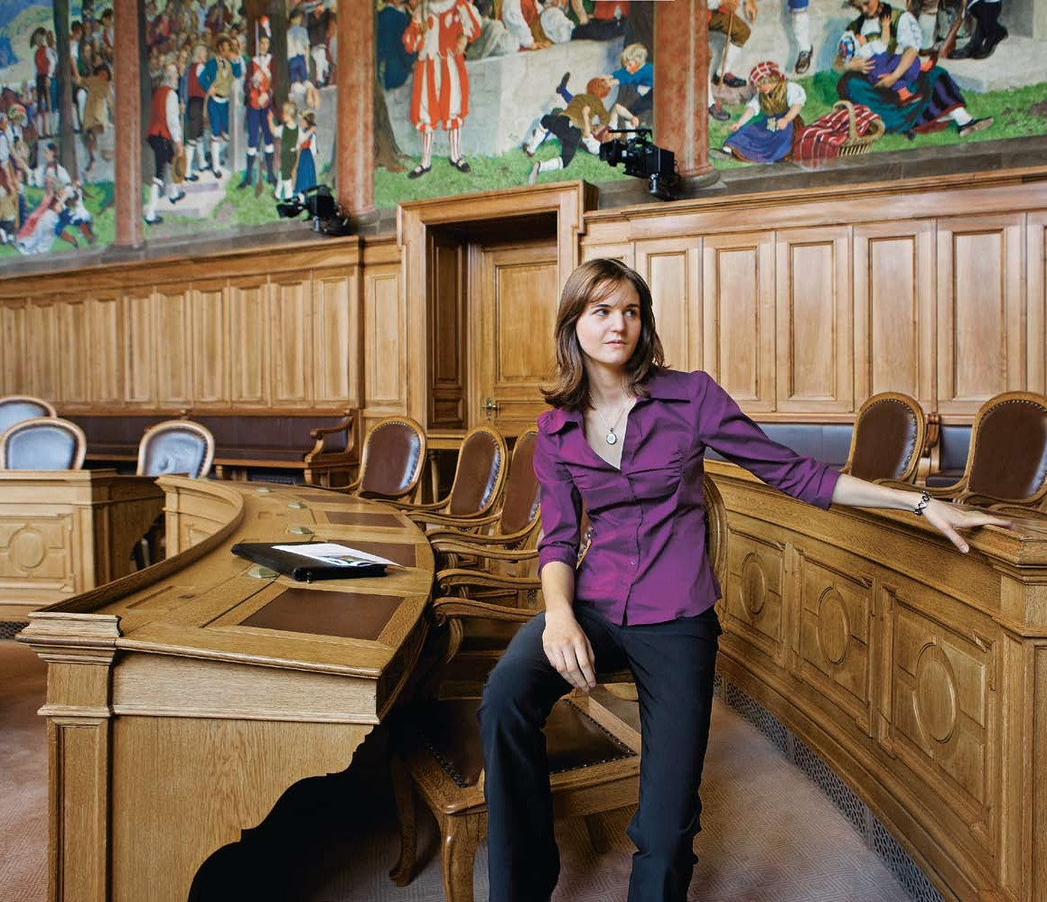
Anna Gruber (20)
Student, Member of the Youth Council Fribourg
8
“To consciously set yourself goals, not to lose sight of them and at the same time remain true to yourself. That ap- plies to me just as it did to Eva, who came to Switzerland from Macedonia when we were at primary school. But it was much more difficult for her as an eight-year-old foreigner. However, Eva learned fast. And we learned with her. In particular she practiced speak- ing German and we practiced being considerate and patient. We learned with each other and from each other. And we grew as persons.
In the Youth Parliament, we also dis- cuss integration topics. What bothers me slightly is that the word integra- tion is often reduced to learning the language or to whether one wears
a headscarf or not. But integration means a lot more: It needs people who have the will to become involved with a new country and a foreign cul- ture. And on the other hand it needs a society which allows this. Mutual understanding and tolerance just can- not be stipulated by laws.”

Slide 9
Citizens have the final say
Federalism and direct democracy
In Switzerland, it is important that you become familiar with the life in your canton and in your municipality as quickly as possible. There you will get ini- tial information on all important aspects of life such as residence, work and school. In particular, you will find out who to contact and where, in order to get an an- swer to your questions.
You need basic information about the state and the law to be able to know how Switzerland is organised locally, from schools to taxes to in- dividual rights and duties.
to another with your family, your child might learn different things at school; or you do not have to pay the same amount of taxes even if your wages have remained the same. Or health insurance does not cost the same anymore even though you are able to use the same services.
Switzerland is made up
of 26 independent cantons Switzerland consists of 26 member states, the so-called cantons. The cantons used to be completely in- dependent. One after the other, they then joined together to be- come what is now Switzerland and gave up some of their responsibili- ties to the Federal Government. In many areas, the cantons are to a large extent still independent. E.g. they have their own constitutions and laws, which however must not contradict federal law. They also have their own parliaments, gov- ernments and courts.
The Confederation, cantons and municipalities share the state functions
Switzerland is divided into three levels of government: the Confed- eration, cantons and municipalities. The Confederation, as the supe- rior level, assumes only those tasks which are explicitly transferred to it by the federal constitution. This includes national defence or regu- lating road traffic. The cantons look after e.g. the school system, police, healthcare and levy taxes to be able to deal with these tasks. The approx. 2700 municipalities in Switzerland also have a great deal of independence. For example, they are responsible for the registration of local residents or they assume specific tasks for schools.
9
The federal authorities
The federal bodies in Switzerland www.admin.ch
Points of contact for integration Information on everyday life and on courses offered in your canton
www.bfm.admin.ch
Themen > Integration > Weiter- führende Adressen > Kompetenzzen- tren Integration
Many things differ from one canton to the next
The independence of the cantons is an important peculiarity of Switzer- land. You will be confronted by it again and again in your daily life.
E.g. if you move from one canton

Slide 10

Bruno Moll (62)
Freelance writer and filmmaker Berne
10
“Broadly speaking my documentaries deal with politics. Being political in my opinion does not mean attracting attention by shouting slogans, but paying close attention to what goes on around you. Responding to preju- dices and opening doors, not closing them – this is my aim.
Not only as a Swiss person, but from one person to another, I would give the following advice to new residents arriving from abroad: They should ap- proach our country inquisitively and not shut themselves away with peo- ple in the same situation. Of course,
I would advise them to learn our language and explore our mentality. I would prefer them to see what we have in common, instead of the dif-
ferences. They should ask questions and try to discuss with their fellow citizens. They should definitely climb our mountains and join the strollers on Sundays. They should go shop- ping at the weekly markets and read, watch and listen to our media. To put it simply: They should try to become a part of things. Of course, I also wish this for ourselves, the natives.”

Slide 11
Citizens have the final say
Federalism and direct democracy
The people enjoy an extensive right of co-determination
The form of government is direct democracy. Persons entitled to vote can not only elect the repre- sentatives into parliament regularly at federal level, at the level of the respective canton and in the mu- nicipality. They can also vote on a variety of issues, such as the amount of taxes and charges, the layout of roads or the postal serv- ices, and also on Switzerland be- coming a member of international organisations or agreements with other states. Swiss citizens from the age of 18 can elect and vote on matters which affect all of Swit- zerland.
period in Switzerland, such as for example voting and election rights. Get more information from your municipality.
All important political forces are represented in the government The government in Switzerland con- sists of seven members and is called Federal Council. The Federal Coun- cil is elected by the parliament and is made up of representatives of the large political parties. Each member of the Federal Council is appointed by the parliament to be the Presi- dent for one year. The parliament is made up of two chambers: the Na- tional Council, which represents the people, and the Council of States, which represents the cantons. To- gether they form the United Federal Assembly.
11
Participation is important and welcomed
In Switzerland there are many ways of getting involved. For example, you can become a member of the parents’ association or take part in local clubs. In addition, all per- sons of sound mind can file ap- plications, address their questions, suggestions and complaints to the authorities; this can for example be in the form of a petition (collection of signatures). In a few cantons and municipalities, you also have politi- cal rights if you have spent a longer
Political system
General information www.ch.ch
Same rights and duties for all Switzerland is a constitutional state. This means that not only the resi- dents of our country have to ob- serve the laws, but also the state itself is bound by the existing law. The courts are independent of the government and parliament. The Swiss Federal Constitution specifies the fundamental rights and duties which apply here, and how Switzer- land is organised.
Insight into Switzerland’s
political institutions
Brochure “The Confederation in brief” www.bk.admin.ch
Dokumentation > Der Bund kurz erklärt

Slide 12
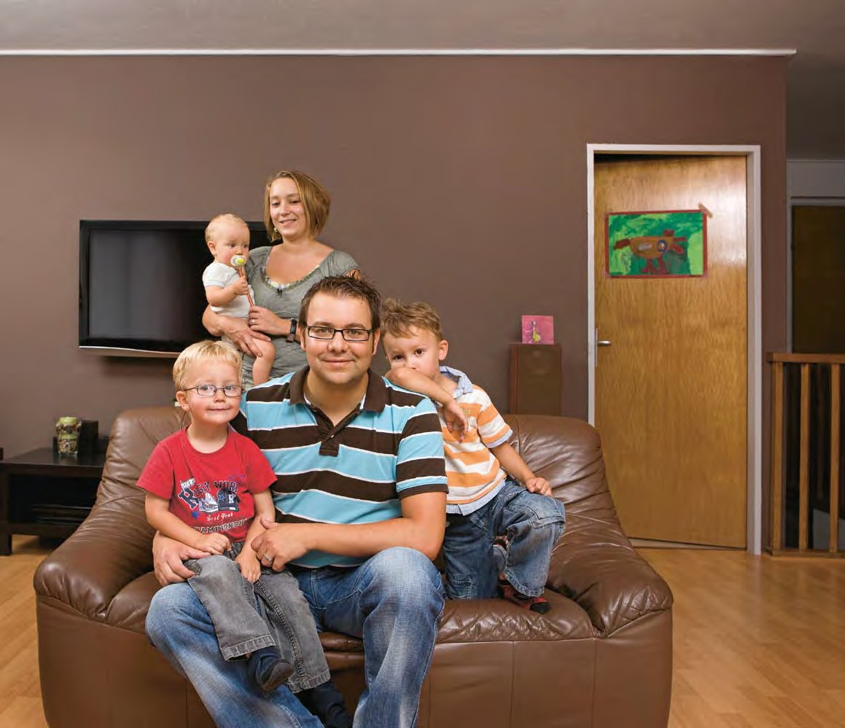
Vasco Belo (31)
Swiss-Portuguese family La Chaux-de-Fonds
12
“I find the way vocational training is offered in Switzerland exemplary. It helps youths with their transi- tion from education into a working
environment. In my country of origin, Portugal, education is provided only by the schools, which means that those who do not go to a secondary school do not have any really good options.
For us it is important that we can offer our children a good future. This means taking part in their schooling and training, and supporting each child in his/her abilities. Those who don’t have any qualifications will quickly find themselves without work
– it doesn’t matter where one comes from.
In our family we only speak French
– which I find is rather a pity. As my wife is Swiss and does not speak Por- tuguese and I grew up in the French- speaking part of Switzerland, it just sort of happened. But we still have our Portuguese festivities within the family and our holidays in Portugal where the children have the possibil- ity to get to know my mother tongue in a playful manner.”

Slide 13
The bridge to success
High priority for education and work
Qualified education/training after completing compulsory schooling is normal in Switzer- land. Around ninety percent of all youths gain a vocational qualification or academic de- gree. This increases the opportu- nities in the labour market and the flexibility for their future working life.
Education and work have a high pri- ority in Switzerland. All children and youths as well as adults should be supported and encouraged accord- ing to their abilities.
Kindergarten prepares children for school
Depending on the canton, the
kindergarten takes children from the age of three to five. Attend- ing a public kindergarten is free of charge. Two years of kindergarten are offered in most cases. In some places, the kindergarten is com- pulsory; but even if it is voluntary, almost all children attend. This is im- portant preparation for compulsory schooling. Take advantage of this offer. The contact with other chil- dren will help your child to improve his/her language and social skills. It is also important for your child’s language skills that you continue to speak your mother tongue with him/her at home.
Support from birth
Linguistic development is of great significance for children. Support from an early age contributes signif- icantly to equal opportunities. There are many possibilities for your child to learn the local language before starting school: for example “day nurseries” (children of pre-school age are supervised from morning to evening) and “playgroups” (chil- dren of pre-school age are looked after on an hourly basis and are encouraged to play). These public or private facilities look after your child for certain periods before he/ she starts compulsory schooling and also afterwards, in addition to the lessons at school (e.g. school lunch- es, homework supervision). Such facilities are worth visiting. In most cases, fees are charged which have to be paid by the parents, whereby the fees are often graded according to the parents’ income.
13
Information and addresses concern- ing the school system in Switzerland
www.edk.ch
Political bodies > To the list of EDK members
www.educa.ch
Bildungsszene > Bildungssystem der Schweiz
How does school work?
As soon as your child has reached the school entrance age, the munic- ipality will assign him/her to a school near to your home and will inform the parents in writing of the place and date of the first day of school. In Switzerland, all children at- tend the compulsory school. State schools provide free basic education
Help in choosing a career
Career service
www.berufsberatung.ch
Vocational training
Information on basic vocational training www.berufsbildungplus.ch

Slide 14
The bridge to success
High priority for education and work
of a very good quality for nine aca- demic years.
The compulsory school is divided into a primary level and a second- ary level I: the primary level normal- ly lasts six years. This is followed by three years secondary level I, where pupils are streamed into groups for lessons.
In Switzerland, the cantons are pri- marily responsible for education. The organisation is not the same everywhere. Get information at an early stage from your municipality.
language well enough, ask for inter- cultural translations.
of higher education or, if a supple- mentary examination is taken, also to the universities.
After the compulsory school
In Switzerland, getting qualifica- tions from secondary level II is very important for the professional and social future of your child. There are different ways to get them. The two main ones are: vocational train- ing in a particular occupation, the so-called “basic vocational train- ing” in a firm where apprentices are trained, or attending a second- ary school (e.g. Fachmittelschule, Gymnasium). The pupils, together with their parents and teachers, already take decisions about their education towards the end of sec- ondary level I (from Class 8) based on their professional interests and their capabilities. Careers offices and information centres will help you and your child to choose.
An apprenticeship after compulsory schooling
You have to look for an appren- ticeship in time, i.e. at the latest one year before finishing the com- pulsory school. However, not all youths find a suitable apprentice- ship. In this case, you can attend a bridging programme. Ask your school or the career service for suitable offers.
Additional educational support Schoolchildren with special educa- tional needs get free support as part of compulsory schooling. Special support programmes are also of- fered to children with inadequate knowledge of the school language. Native-language lessons are also of- fered outside school. Ask, for exam- ple, your school or the organisations within your language community for lessons offered in “Native language and culture”.
Vocational training and further education at tertiary level
Higher education institutions in Switzerland are divided into uni- versities and colleges (e.g. teacher training colleges or universities of applied sciences or social studies). Depending on the type of institution and field of study, the secondary or vocational school-leaving certificate is generally a prerequisite for the course of studies.
14
Vocational training plays an important role in Switzerland
In Switzerland, around two thirds of youths complete their basic vo- cational training after the compul- sory school. Such an apprenticeship combines on-the-job training in a company with school education. Most apprenticeships last between two and four years. In addition, high-capability youths can take the vocational school-leaving certifi- cate. It opens the way to colleges
It is not possible without the parents
There are regular information eve- nings for parents in the kindergar- ten and at the school. Parents are expected to take the opportunity to talk to the teachers about their child and his/her education options. If you do not understand the local
The significance of work
In Switzerland, hard work and fi- nancial independence are tradi- tionally considered important for integration into society. Alongside being able to finance their daily life, many people need to have work for a good self-esteem and for their so- cial standing.

Slide 15
Further education is also im- portant for adults. There are different options available for vocational training and fur- ther education. These qualifica- tions have become increasingly important. Further education courses are offered above all by private institutions, but also by state institutions.
There are liberal labour laws in Switzerland
The rights and duties of employ- ers and employees are specified in a written employment contract. It regulates the most important points such as working hours, probationary period, wages, periods of notice and holiday. For some employment sec- tors, there are generally applicable rules (collective labour agreements). In Switzerland, people work an av- erage of 42 hours per week. How- ever, up to 50 hours (maximum legal working week) are possible depend- ing on the sector. The wage agreed with your employer is a gross wage. The compulsory social security con- tributions are deducted from this. There is no statutory minimum wage in Switzerland. In many industries, however, there are minimum wages which have been agreed upon in the collective labour agreements between employers’ associations and trade unions.
Illegal employment harms everybody
People who work but do not pay any social security contributions and taxes are working illegally. Il- legal employment is liable to pros- ecution both for the employer and also for the employee and is not worth the risk. Illegal employment endangers both your own insur- ance protection as well as the ben- efits for others.
What type of permits do you need for work and residence?
If you have entered Switzerland as a citizen of a European Union (EU) state or the European Free Trade Area (EFTA), then the free move- ment of persons agreement applies to you. If, on the other hand, you have come from another state or live here as a provisionally admitted foreign national or as a recognised refugee, the provisions in the For- eign Nationals Act or Asylum Act apply. The Federal Office for Mi- gration FOM will inform you about the general provisions which apply to access the Swiss employment market, for residence or for family reunification. The cantons are re- sponsible for issuing the permits. Please contact the relevant cantonal authority, normally the Immigration Office, for matters regarding the exact formalities for the different types of permits.
15
Lessons in your native language
www.edk.ch
Bildungssystem CH > Kantonsumfra- gen > HSK-Unterricht
Foreign degrees
Information and addresses for recogni- tion of foreign qualifications
www.opet.admin.ch
Topics > Recognition of foreign qualifications
Recognition of qualifications
In Switzerland, employers attach great importance to qualifications which are officially recognized, i.e. degrees and job references. Vari- ous points of contact are respon- sible for assessing the equivalence of qualifications or experience you have gained elsewhere. They will inform you about the possible steps to take.
Work, residence and family
Federal Office for Migration FOM www.fom.admin.ch
Topics
Cantonal authorities www.fom.admin.ch
The FOM > Contact address
Cantonal authorities

Slide 16
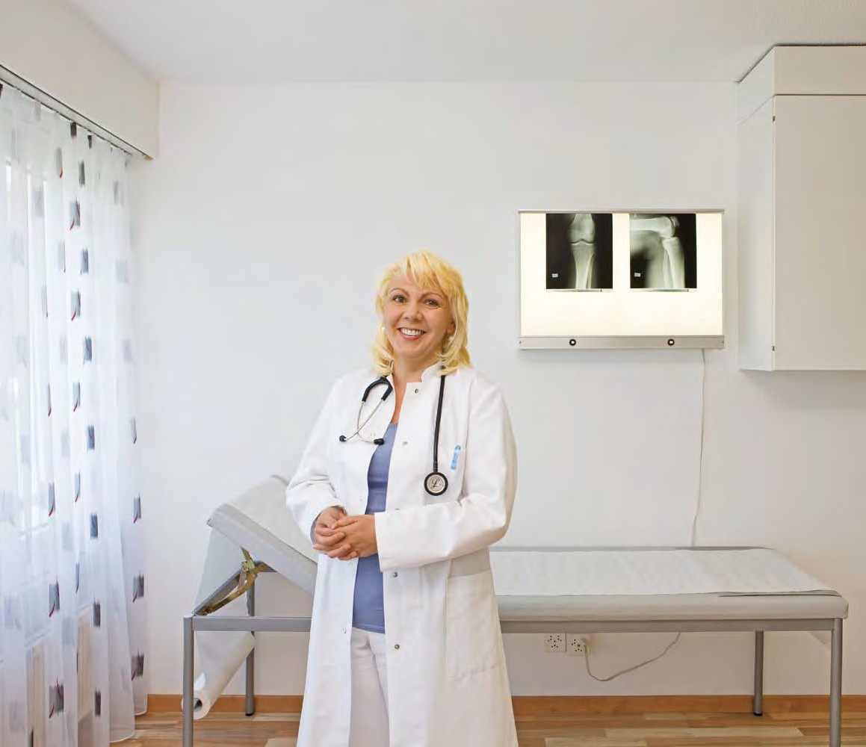
Yasar Turgut (44) General practitioner Lucerne
16
“I have cared for my patients for a number of years. This enables me to assess the described medical
conditions better than in the case of a person who I have only seen once and whose medical history I do not know. The fact of the matter is that not only the body but the person as a whole suffers from an illness. A per- sonal conversation or a relationship between doctor and patient based on trust can make a big difference.
Especially in the case of foreigners who come to me in the surgery, cul- tural differences must not be under- estimated and have to be interpreted. My Turkish roots help me not only to understand their problems but also to relate to them. It is not easy for
many of them to adjust to the Swiss healthcare system. It is therefore my duty to negotiate between specialists, hospitals and patients and to accom- pany them individually.”

Slide 17
Taking responsibility together
Social security and health
Everyone can be affected by hardship. The social security network is based on solidarity. This is the reason why everyone makes their contribution: the healthy for the sick, the young for the old, the rich for the poor or singles for families.
Switzerland has a well-developed social system. It ensures that peo- ple in difficult situations do not have to suffer material hardship in the long term.
est after three months of residence in Switzerland, you must have reg- istered yourself and your family with a health insurance company. The basic insurance cover, which is compulsory for all adults and children in Switzerland, covers the costs for treatment by doctors and in specific hospitals as well as for most prescribed medication. Every month, you pay the health insur- ance company a premium for this. The level of this premium depends on where you live, whether you want to pay part of the costs your- self and whether you have insur- ance for additional benefits. Dental treatment is an example of such an additional benefit which is not cov- ered by the basic insurance and has to be paid for separately.
Solidarity on the one hand and personal responsibility on the other
Every person is responsible for themselves and contributes to the best of their ability to dealing with tasks in state and society. This is stipulated by the Federal Constitu- tion of Switzerland. In situations where this does not work, the Con- federation, cantons and munici- palities provide the required pro- tection, e.g. against the economic consequences of age, invalidity or sickness, accident and unemploy- ment. To be able to provide such services, it is important that every- one pays their insurance contribu- tions as well as taxes and does their best to earn their own living.
17
Social security
in Switzerland
www.bsv.admin.ch
Themen
Sickness
Information on health insurance www.foph.admin.ch
Topics > Health Insurance
At your place of work, you are also insured against accidents Those who work for eight hours a week or more are insured by the employer against accidents. This insurance covers the costs and loss of income in the event of accidents. Persons employed for less than eight hours or the self-employed
Unemployment
What to do?
www.jobarea.ch
Violence
Violence prevention service www.ebg.admin.ch
Themen > Gleichstellung in der Fami- lie > Fachstellen gegen Gewalt
Health insurance is compulsory in Switzerland
Everybody living in Switzerland has to have health insurance. At the lat-

Slide 18
Taking responsibility together
Social security and health
have to take care of their own ac- cident insurance.
64 and to men from the age of 65. After the death of a close relative, it also pays pensions to surviving de- pendants and orphans. The aim of the IV is to support persons with a disability. It also helps affected per- sons to keep their job or to find a new one. If neither is possible, the IV also pays pensions. The pensions of the AHV and IV are high enough to cover the costs for absolutely es- sential expenses. If this is not the case, additional supplementary ben- efits can be requested.
Additional requirements, which go beyond the subsistence level, are covered by the pensions of the pension funds. Insurance through a pension fund is compulsory for em- ployees from a certain income (ap- prox. 20000 Swiss francs per year). Self-employed persons can become voluntary members of a pension fund and pay contributions. Those who wish to save additionally for a comfortable life in old age can in- vest money in the so-called “third pillar” through an insurance com- pany or a bank and will be reward- ed with tax relief.
gional employment agency (RAV) in your canton. They will advise you when searching for a new job. You will get unemployment benefit if you have worked for at least 12 months in the last two years (as of 2010) or can provide a reason for exemption from paying the compulsory contri- butions. All dependent employees in Switzerland are compulsorily in- sured against unemployment.
Are you looking for a general practitioner whom you trust?
In Switzerland, most people have a general practitioner to whom they go regularly in the event of sick- ness or an accident. Depending on the sickness or accident, he/she will refer them to a specialist or to the hospital. You should only go di- rectly to the hospital in case of an emergency.
Additional support for families Every employed woman is entitled to a 14-week maternity leave as well as to a maternity allowance during this period amounting to 80% of her last wage or income. In principle, employees with children are entitled to family allowances regardless of their income. These allowances are also granted to per- sons with a modest income who are not working.
Every individual has a right to physical and mental integrity
In Switzerland, every form of vio- lence is forbidden and liable to pros- ecution. This includes domestic vio- lence, female genital mutilation or forced marriage. If you find yourself in an emergency situation, seek help from the responsible agency.
18
Support in old age, for surviving dependants and in the event of invalidity
In Switzerland, it is compulsory for adults from the age of 18 to be in- sured under the old-age and survi- vors’ insurance (AHV) as well as the invalidity insurance (IV) schemes and to pay contributions. The AHV pays a pension to women from the age of
The aim is to provide everyone with a decent existence
In cases where the income is not enough to live on and also none of the social security benefits can help any more, social welfare fills the gap. Social welfare is the responsibility of the cantons and is normally paid by the municipality of residence. It is fi- nanced by taxes.
What to do in the event of un- employment?
If you are looking for work or have lost your job, please contact the re-

Slide 19
Dear Readers
We hope that we have been able to give you a first impression of life in Switzerland with this brochure and have supported you in getting a good start in your new environment. If you have more questions and personal problems, you will find links to additional information below. Please do not hesitate to request additional information. We will be happy to pro- vide you with further assistance. We wish you the best of luck and lots of motivation!
Integration
Additional topics
Competence centres within the cantons and additional addresses regarding integration
www.bfm.admin.ch
Themen > Integration > Weiter- führende Adressen
Work
State Secretariat for Economic Affairs (seco)
www.seco.admin.ch Illegal employment
www.keine-schwarzarbeit.ch
Federal Commission on Migration Issues (EKM)
www.ekm.admin.ch
Education
Swiss Conference of Cantonal Ministers of Education (EDK)
www.edk.ch
State Secretariat for Education and Research
www.sbf.admin.ch
Federal Office for Professional Education and Technology (OPET)
www.bbt.admin.ch
Integration Forum for Migrants (FIMM) www.fimm.ch
Information on all areas of life in different languages
www.migraweb.ch
Intercultural translations www.inter-pret.ch
Discrimination/Racism/Violence Federal Service for Combating Racism (SCRA)
www.edi.admin.ch/ara
Federal services for combating violence www.ebg.admin.ch
Topics > Equality in the Family
Violence Prevention Service
Impressum
Migration
Publisher
Bundesamt für Migration BFM (Federal Office for Migration FOM) Quellenweg 6, 3003 Berne-Wabern
Telephone 031 325 11 11 www.bfm.admin.ch
Federal Office for Migration
19
Work/Residence/Family reunification www.fom.admin.ch
Topics
Cantonal addresses
www.fom.admin.ch
The FOM > Contact address > Can- tonal authorities
Health
Federal Office of Public Health FOPH www.bag.admin.ch
Information on questions regarding health in different languages
www.migesplus.ch
Concept and editorial Abteilung Integration BFM
Design, editing and realisation medialink, Zürich
www.medialink.net
Naturalisation
www.bfm.admin.ch
Themen > Schweizer Bürgerrecht/ Einbürgerungen
Cantonal addresses
www.fom.admin.ch
The FOM > Contact address
Cantonal authorities
Social security system
Federal Social Insurance Office FSIO www.bsv.admin.ch
Information on AHV/IV and EL www.ahv.ch
Photography
Patrik Fuchs, Zürich
www.patrikfuchs.com
Social welfare
www.skos.ch
Translation
proverb, Biel/Bienne www.proverb.ch
FOM publications
www.fom.admin.ch
Documentation > Publications
Housing
Federal Housing Office FHO www.bwo.admin.ch
Source
Vertrieb Bundespublikationen BBL CH-3003 Bern
www.bundespublikationen.admin.ch Order number 420.002.eng
Civil status
www.bj.admin.ch
Themen > Gesellschaft > Zivilstand
Merkblätter
© BFM / EJPD 2011

Slide 20
