Slide 1
Crash Course in GitHub
For Data Scientists
Joel Byford
November 2022

Slide 2
Agenda
3 things – what and why?
Application Concepts
Version control
Git
GitHub

Slide 3
https://github.com/joelbyford/gitCrashCourse
Repo of this Whole Crash Course

Slide 4
Application Concepts

Slide 5


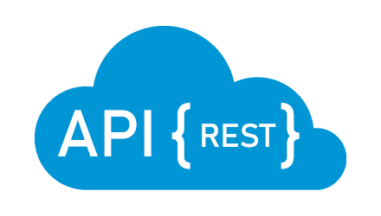
Git in DevOps
GitHub
Local Machine
git clone/pull
Source Code
Source Code
git push
CI/CD Pipeline
Build
Edit
Test
Build
?
Test
Package Binaries
Web Service/API
REST Calls
Deploy Binaries
Deploy
Web Access
Container
Container

Slide 6


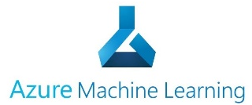
Git in Data Science
GitHub
Server Cluster
Local Machine
git clone/pull
R or Python Code
R or Python Code
git push
Train/Test
CI/CD Pipeline
Train
Model
Results
Test
Full Data Set
Train
?
Test
Package Model
Web Service/API
REST Calls
Partial Data Set
Deploy Model
Deploy
Score/Classify
Container
Container

Slide 7
Lifecycle of a Repo
Peer Replicas
Remote Repo
git clone
Local Repo
git checkout -b
git pull
File History
File History
git add
git push
Branch History
Branch History
git commit
Hooks (Automation)
Hooks (Automation)
git pull
git merge or rebase
Generally NO Binaries
Generally NO Binaries
git push

Slide 8
Version control

Slide 9
In software engineering, version control is any kind of practice that tracks and provides control over changes to source code.
— Wikipedia

Slide 10
In software engineering, version control is any kind of practice that tracks and provides control over changes to source code.
— Wikipedia

Slide 11
Why might we want to track changes to source code?

Slide 12
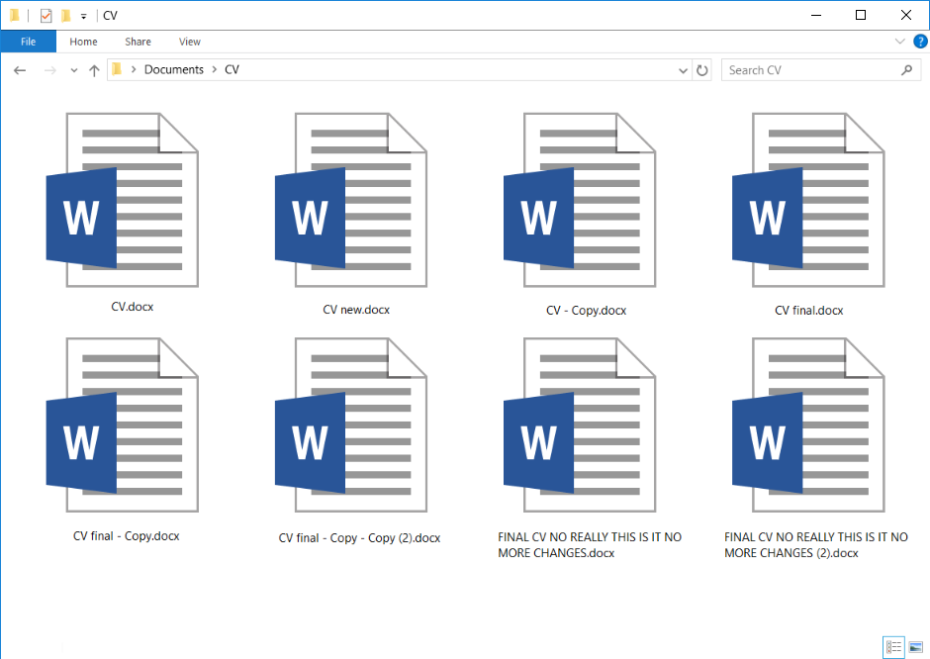
Why version control?

Slide 13








Git basics - commits

Slide 14
What version control do we use?

Slide 15
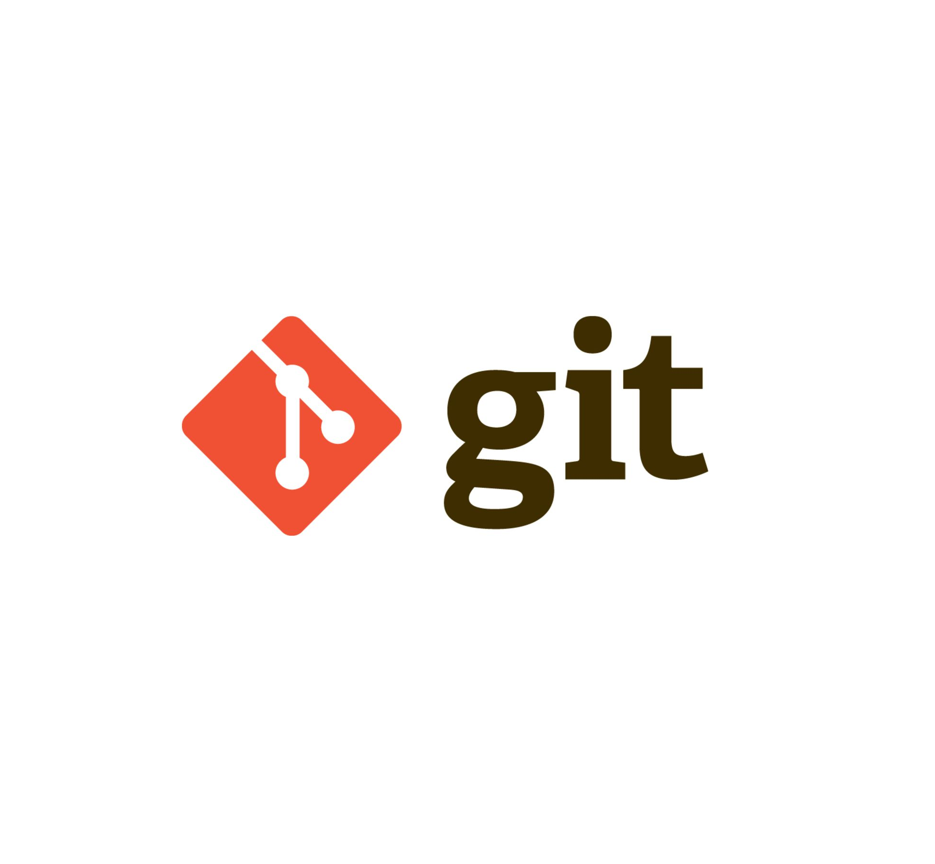
Git
Extremely popular distributed version control system
Control versions of files and directories
Use it locally as you work
Share changes with everyone else via a server

Slide 16
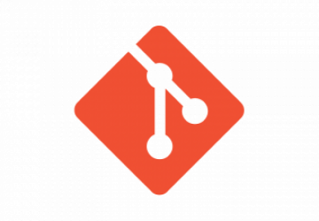
Git basics - commits
Same file; different versions managed by Git
v1
v2
v3
v4
v5
v6
v7
v8

Slide 17
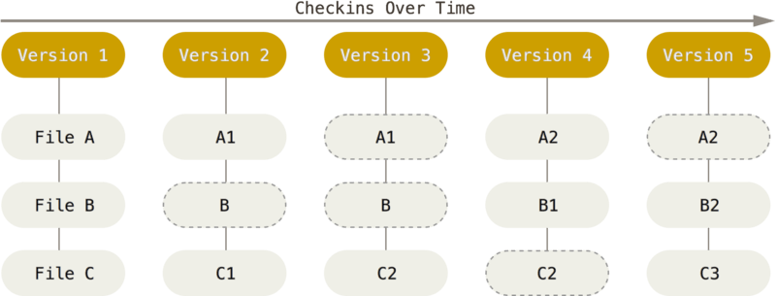
Git basics - commits
Commits are snapshots of the repository at a particular time
Make a commit to ‘save your work’ regularly
Git history (log) is a list of the commits
Go back to any point in the history at any time!
Checkins over time

Slide 18
Git basics - workflow
Working copy
Staging area
Local repository
Remote (GitHub)

Slide 19
Git basics - workflow
Working copy
Staging area
Local repository
Remote (GitHub)
clone
add
commit

Slide 20
Git basics - workflow
Working copy
Staging area
Local repository
Remote (GitHub)
pull

Slide 21
Git basics - workflow
Working copy
Staging area
Local repository
Remote (GitHub)
clone
add
commit
push

Slide 22
Demo

Slide 23
Exercise 1
15 mins
TO DO – PROVIDE SOME INSTRUCTIONS ON:
- Installing Git on a Local Machine
- Init a repo, Add a file, Commit a repo

Slide 24
Branches & Pull Requests
Quick summary

Slide 25
Branching & Versioning Applied
Researcher A
Model, Train, Test
Model v1 Branch
Main/Deployed Model(s)
Model v2 Branch
Researcher B
Model, Train, Test

Slide 26
Branch basics
Short-Lived Feature Branch
Researcher A
Model,Train, Test
Model v1 Branch
Main/Deployed Model(s)
Clone & Push to v2 Branch
Model v2 Branch
Long-Lived Main Branch
Researcher B
Model Train, Test
Self-Run & Code
Pull
Server-Run Automated Pipelines

Slide 27
GitHub

Slide 28
Demo

Slide 29








Continuous integration - pipelines
your_branch
main
A series of jobs that run on your code – to verify, build and deliver it

Slide 30
GitHub Pull Request
Overall merge status
View diffs of the changes
Code review

Slide 31
GitHub Actions
Overall pipeline status
Click on jobs to see their logs
Download job ‘artifacts’ (build output)

Slide 32
Exercise 2
10 mins

Slide 33
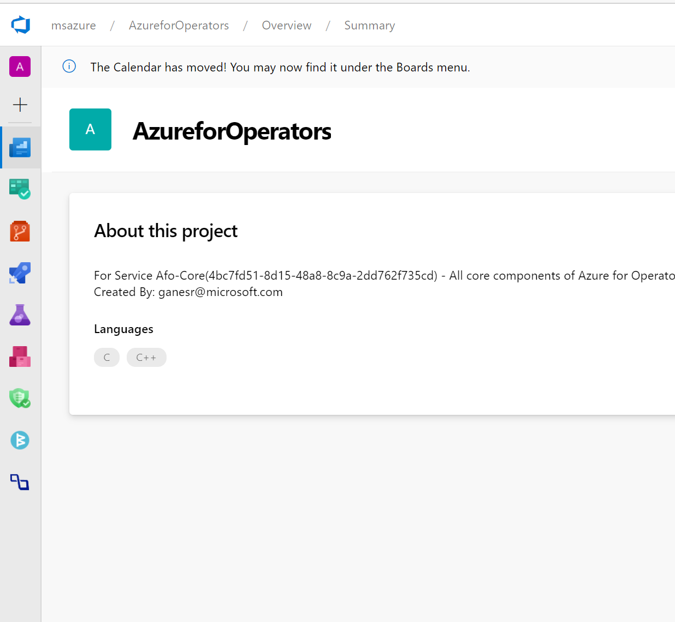
Additional Tooling
(Azure DevOps, GitLabs, etc.)
Very similar to GitHub in the way it manages codebases
Also has actions or pipelines though they’re configured a bit differently
Minor feature differences
Project management
Compliance – security checks etc.

Slide 34
Summary

Slide 35
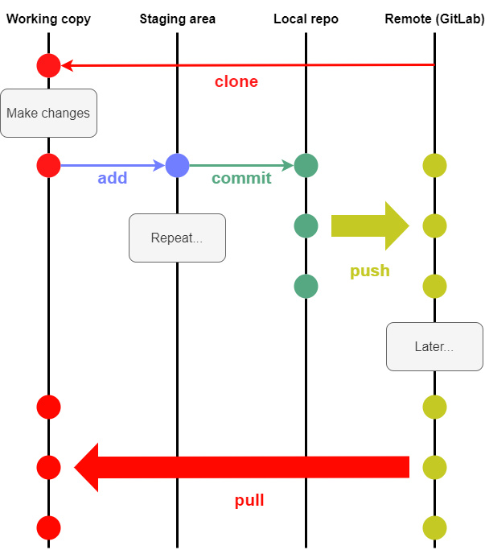


Summary
Commits are snapshots of the codebase at a point in time
Make changes locally and store them in version control
Push to remote (GitHub) whenever you want
Pull other people’s changes regularly
Git provides version control
GitHub provides cetnralized Git repos for team working (+ a few more things)

