Slide 1

Git Remotes
GitHub
Azure Repos
GitLab
Example Developer PC

Slide 2
Peer Replicas
Remote Repo
git clone
Local Repo
git checkout -b
git pull
File History
File History
git add
git push
Branch History
Branch History
git commit
Hooks (Automation)
Hooks (Automation)
git pull
git merge or rebase
Generally NO Binaries
Generally NO Binaries
git push

Slide 3
Fork
Fork
Pull Request
“Upstream” or Origin

Slide 4
Branch
Main (Release)
Version Branch
Pull Request
Pull Request
Feature Branches

Slide 5

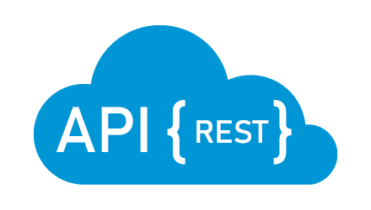
GitHub
Local Machine
git clone/pull
Source Code
Source Code
git push
CI/CD Pipeline
Build
Edit
Test
Build
?
Test
Package Binaries
Web Service/API
REST Calls
Deploy Binaries
Deploy
Web Access
Container
Container

Slide 6




GitHub
Server Cluster
Local Machine
git clone/pull
R or Python Code
R or Python Code
git push
Train/Test
CI/CD Pipeline
Train
Model
Results
Test
Full Data Set
Train
?
Test
Package Model
Web Service/API
REST Calls
Partial Data Set
Deploy Model
Deploy
Score/Classify
Container
Container

