Slide 1
Intro to Git
Engineering Technical Training

Slide 2
Agenda
3 things – what and why?
Version control
Git
GitHub

Slide 3
Version control

Slide 4
In software engineering, version control is any kind of practice that tracks and provides control over changes to source code.
— Wikipedia

Slide 5
In software engineering, version control is any kind of practice that tracks and provides control over changes to source code.
— Wikipedia

Slide 6
Why might we want to track changes to source code?

Slide 7
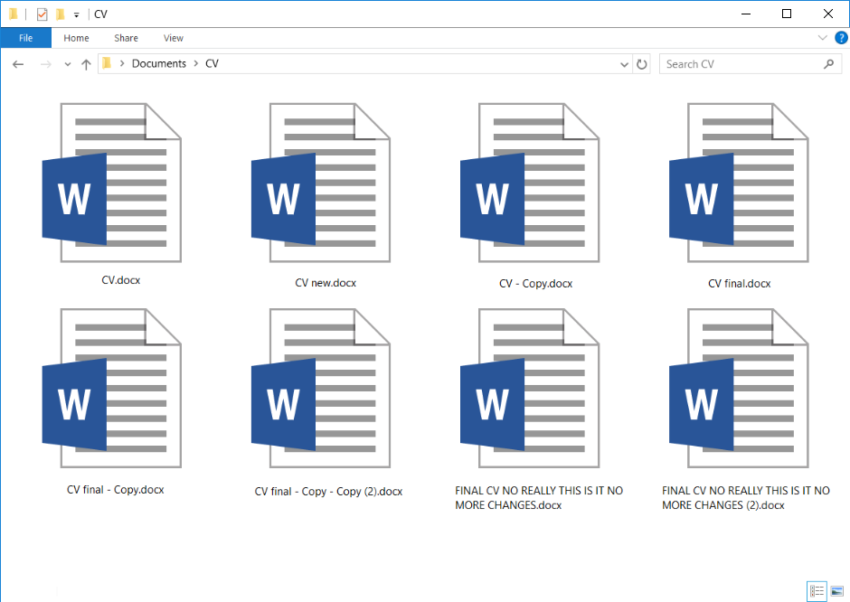
Why version control?

Slide 8








Git basics - commits

Slide 9
What version control do we use?

Slide 10

Git
Extremely popular distributed version control system
Control versions of files and directories
Use it locally as you work
Share changes with everyone else via a server

Slide 11
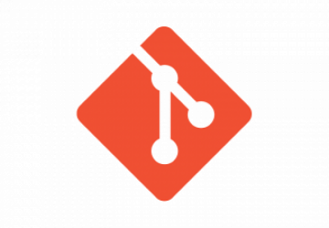
Git basics - commits
Same file; different versions managed by Git
v1
v2
v3
v4
v5
v6
v7
v8

Slide 12
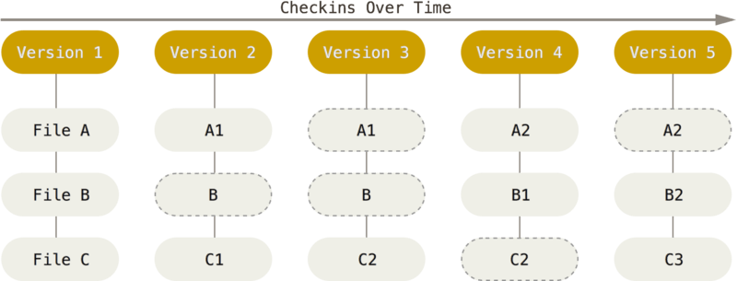
Git basics - commits
Commits are snapshots of the repository at a particular time
Make a commit to ‘save your work’ regularly
Git history (log) is a list of the commits
Go back to any point in the history at any time!
Checkins over time

Slide 13
Git basics - workflow
Working copy
Staging area
Local repository
Remote (GitHub)

Slide 14
Git basics - workflow
Working copy
Staging area
Local repository
Remote (GitHub)
clone
add
commit

Slide 15
Git basics - workflow
Working copy
Staging area
Local repository
Remote (GitHub)
pull

Slide 16
Git basics - workflow
Working copy
Staging area
Local repository
Remote (GitHub)
clone
add
commit
push

Slide 17
Demo

Slide 18
Exercise 1
15 mins
TO DO – PROVIDE SOME INSTRUCTIONS ON:
- Installing Git on a Local Machine
- Init a repo, Add a file, Commit a repo

Slide 19
Branches & Pull Requests
Quick summary

Slide 20
Branching & Versioning Applied
Researcher A
Model, Train, Test
Model v1 Branch
Main/Deployed Model(s)
Model v2 Branch
Researcher B
Model, Train, Test

Slide 21
Branch basics
Short-Lived Feature Branch
Researcher A
Model,Train, Test
Model v1 Branch
Main/Deployed Model(s)
Clone & Push to v2 Branch
Model v2 Branch
Long-Lived Main Branch
Researcher B
Model Train, Test
Self-Run & Code
Pull
Server-Run Automated Pipelines

Slide 22
GitHub

Slide 23
Demo

Slide 24








Continuous integration - pipelines
your_branch
main
A series of jobs that run on your code – to verify, build and deliver it

Slide 25
GitHub Pull Request
Overall merge status
View diffs of the changes
Code review

Slide 26
GitHub Actions
Overall pipeline status
Click on jobs to see their logs
Download job ‘artifacts’ (build output)

Slide 27
Exercise 2
10 mins

Slide 28
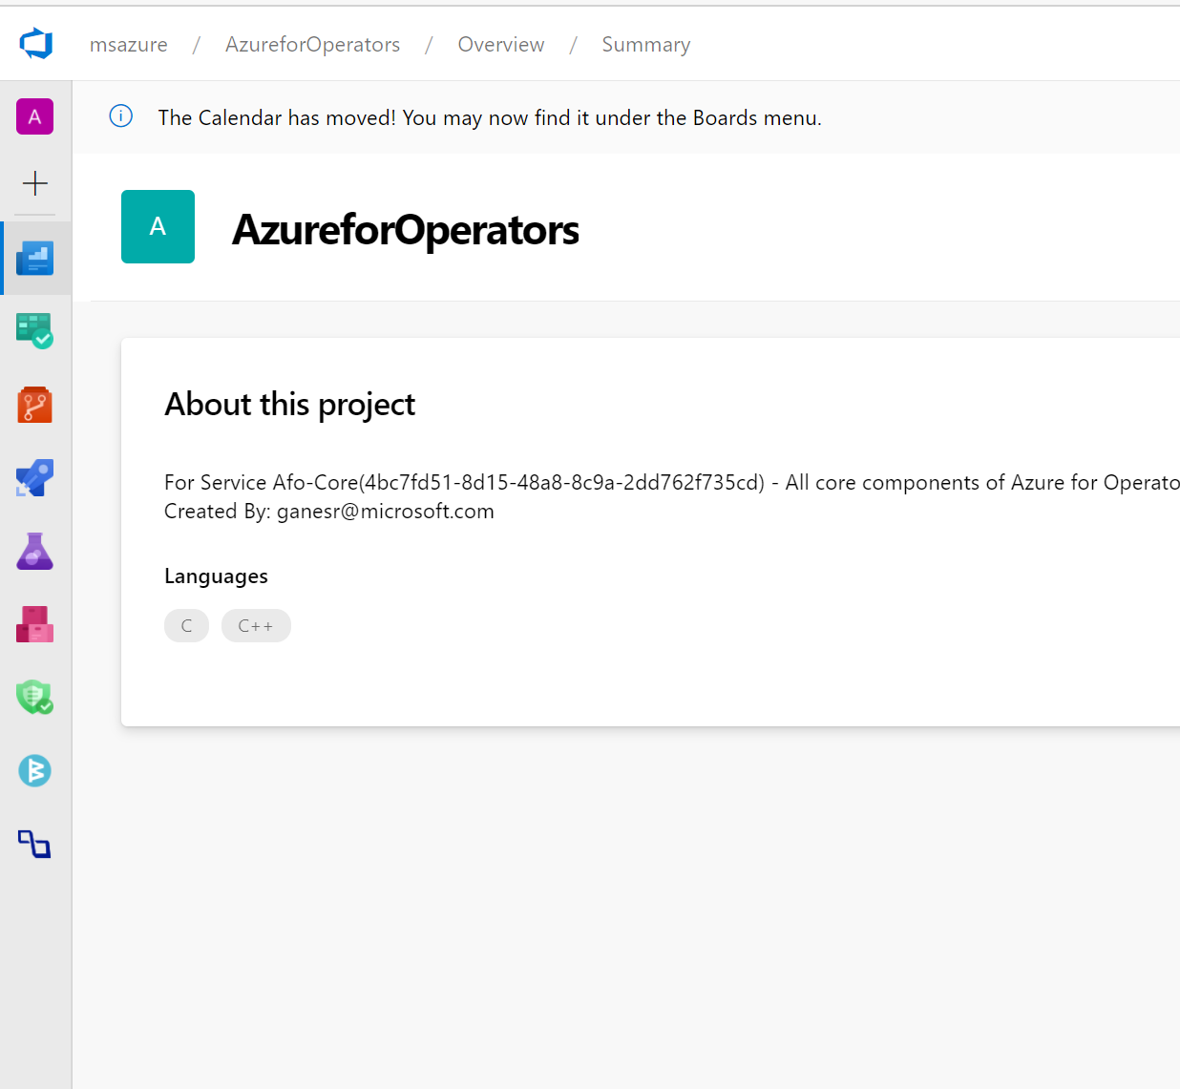
Additional Tooling
(Azure DevOps, GitLabs, etc.)
Very similar to GitHub in the way it manages codebases
Also has actions or pipelines though they’re configured a bit differently
Minor feature differences
Project management
Compliance – security checks etc.

Slide 29
Summary

Slide 30
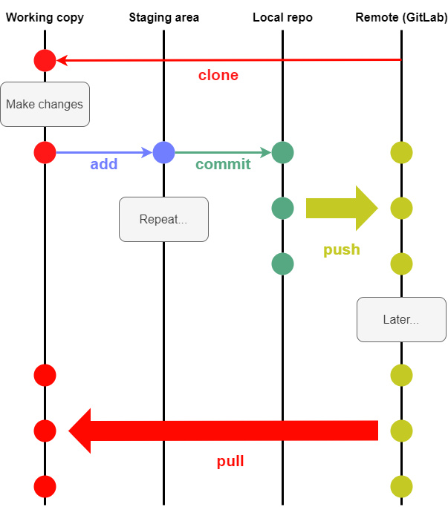


Summary
Commits are snapshots of the codebase at a point in time
Make changes locally and store them in version control
Push to remote (GitHub) whenever you want
Pull other people’s changes regularly
Git provides version control
GitHub provides cetnralized Git repos for team working (+ a few more things)

