Slide 1
Modeling electrons bounded by potentials
Joel Corser

Slide 2
Introduction
Problem: How does one find the probability distribution of a bounded electron? How does this distribution change? Where do electron orbitals come from?
Motivation: Electron orbitals in chemistry that were derived from the schrodinger equation and the connection between initial conditions and eigenstates
I’m going to discuss how to calculate an electron’s probability distribution in one dimension via the schrodinger equation with finite differences in one dimension and how visualize and show the data.

Slide 3
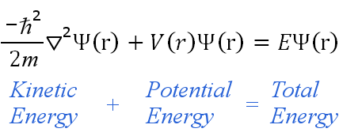

Background
Quantum mechanics
The branch of physics that deals with modeling particles that focuses on systems on a very small scale
The Schrodinger equation is used to find probability distributions occurring in quantum mechanics.
The one dimensional schrodinger equation:
Results 𝜳(x,y,z,t) show probability amplitude at t=a and location x,y,z
1/A*abs(𝜳*𝜳) where * is the complex conjugate gives the probability density and A is the normalizing constant
Integrating the density gives the total probability
V(r) is the potential and is the main property that concerns this problem

Slide 4
The problem
The electron is in one dimension
It is bounded by a potential function V(r) from a p+
And has an initial wave function 𝜳(x,0)=f(x)
What is its probability distribution based on time?
How does its probability distribution change?
How can its probability distribution be found for any conditions f(x) and V(r) above?

Slide 5
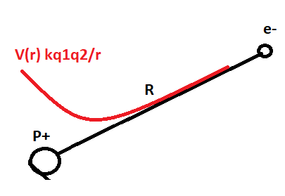
Mathematical Model
e- is somewhere on R
The schrodinger equation will be used
Conditions:
V(r)=kq₁q₂/r
𝜳(r,0)=f(r)
As r→ a v(a)<𝟄 or converges
The left point will not be at r=0 but r=0+𝟄
“Unbounded”
The solution: abs(𝜳*𝜳)(r,t) will give a plot of the probability distribution

Slide 6
Numerics
How do I find the results using the schrodinger equation?
The analytical solution is not readily available for an arbitrary f(x) and 𝜳(x,0)
Separation of variables doesn’t yield an obvious solution
Finite differences approximation
Discretize 𝜳 as a i*j matrix where i is the i’th entry and j is the jth entry
𝜳(x,t)=𝜳_{i}^{j}=𝜳(i,j)
Approximate 𝜳_{t} as 𝜳_{t}=(𝜳_{i}^{j+1}-𝜳_{i}^{j})/dt
Approximate 𝜳_{xx} as 𝜳_{xx}=(𝜳^{j}_{i+1}-2𝜳_{i}^{j}+𝜳^{j}_{i-1})/dx²
Substitute 𝜳_{t} and 𝜳_{xx} into schrodinger equation and get the finite difference form

Slide 7
How to evaluate the finite difference equation?
Rearrange finite difference equation
i*h(𝜳_{i}^{j+1}-𝜳_{i}^{j})/dt=-h²/2m*(𝜳_{i}^{j+1}-2𝜳_{i}^{j}+𝜳_{i}^{j})/dx²
𝜳_{i}^{j+1}=-h*dt/(dx²*i)*(𝜳^{j}_{i+1}-2𝜳_{i}^{j}+𝜳^{j}_{i-1})/dx²+𝜳_{i}^{j}
For the explicit scheme calculate 𝜳_{i}⁰ with the IC 𝜳(x,0)=f(x) and use the form above!
This has stability constraints and will not yield physical values for certain nt,nx
For the implicit scheme(calculate all values at once)
construct make j+1 =j and j=j+1
Giving 𝜳_{i}^{j}=-h*dt/(dx²*i)*(𝜳^{j}_{i+1}-2𝜳_{i}^{j}+𝜳^{j}_{i-1})/dx²+𝜳_{i}^{j+1}
Construct a matrix system A*𝜳_{i}^{j}=𝜳_{i}^{j+1}
𝜳_{i}^{j+1}=A⁻¹𝜳_{i}^{j} Ax=b Solve for every time step(j)

Slide 8
Normalizing and showing data
To find abs(𝜳*𝜳) substitute with discrete form abs(𝜳_{i}^{j}*𝜳_{i}^{j}) the conjugate * can be found with conj()
To find A to normalize abs(𝜳_{i}^{j}*𝜳_{i}^{j}) use riemann sum for time at j
Produce graphs on y,x axis where y is the probability density and x is the location
As time passes the y,x axis will change
The programming for the code has considerable round off error, so changing the constants to 1 across the equation will be done
This will show how the distributions change
The results will not show true distances for the electron’s wave function

Slide 9
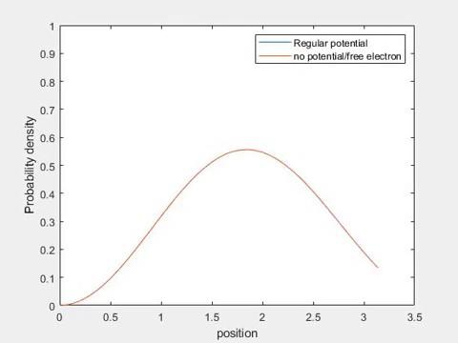
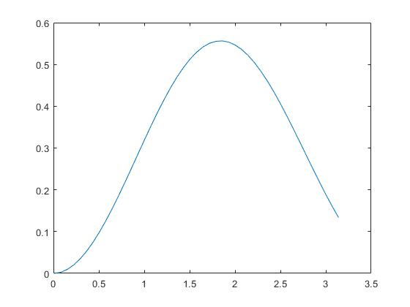
Results: No potential?
For f(x)=j₁(x) and V(r) coulomb potential
And f(x)=j₁(x) and V(r) no potential

Slide 10
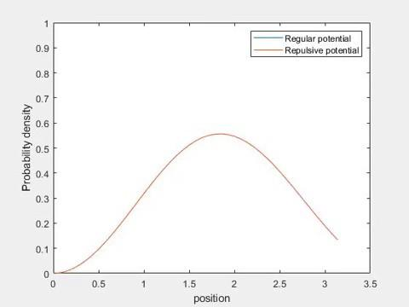
Results: Repulsive potential?
For f(x)=j₁ and V(r)=coulomb potential
For f(x)=j₁ and V(r)=-V(r) [repulsive]

Slide 11

Results Helium potential?
For f(x)=j₁ and V(r)=coulomb potential
For f(x)=j₁ and V(r)=2*V(r) [Helium atom potential]

Slide 12
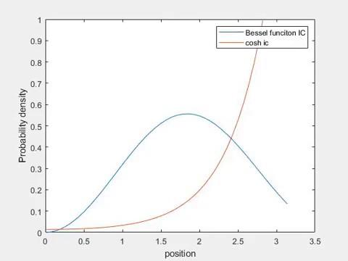
Results: COSH initial condition?
For f(x)=j₁(x) and V(r)=coulomb potential
For f(x)=cosh(x) and V(r)=V(r)

Slide 13
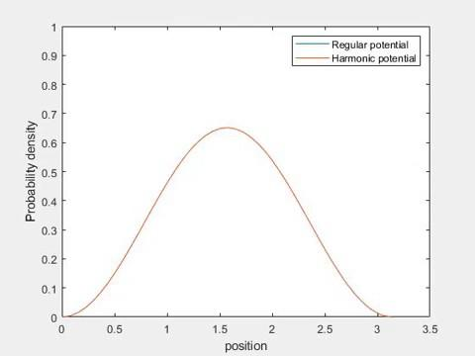
Results: Harmonic oscillator potential?
For f(x)=j₁ and V(r)=coulomb
For f(x)=j₁ and V(r)=x^2

Slide 14
Extra comments
If V(r) is V(r,t) instead it can be easily implemented
Code has issues with round off error
The schrodinger equation can be solved in 3 dimensional cases:
𝜳(x,y,z,t)=𝜳 When discretized is a four dimensional matrix

Slide 15
Conclusion
Can model a bounded electron with schrodinger equation
Can numerically evaluate schrodinger equation with finite differences
Discrete functions can be difficult to show and animations can be useful
Results
Increasing potential: closer distribution to nucleus
No potential: probability distribution oscillates slightly and stops changing
Repulsive potential: Pushes distribution away and makes it behave similar to no potential later in time

