Slide 1
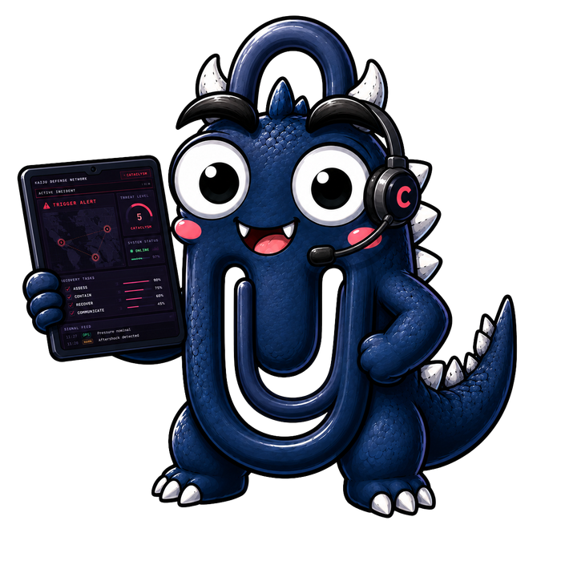
CAPGEMINI FDE · HVE TRAINING
The Kaiju Lab
One hour. Three labs. One monster. Take a slice of a vibe-coded command centre toward production with the HVE method and hve-core on Claude Code.
Project Titan Watch · github.com/joelcapgemini/titan-watch-lab
Notes:
Pitch in three minutes. Giant monsters in Puget Sound. Somebody vibe-coded a command centre. Looks fantastic, does nothing. Your job: one slice, toward production, the way we would for a client.

Slide 2



What we are doing
1
3
1
4
hour
labs
role
scenarios
A demo that looks done
The Titan Watch command centre renders a map, a roster, a dispatch panel. None of it does anything.
Discovery before code
An AI coach interviews you as the commander, then writes the requirements and the architecture.
Then security, ethics, a plan
Three more agents threat-model it, assess the one AI decision in the app, and plan one feature.
Notes:
Why monsters: nobody has domain experience, so nobody skips discovery. The method transfers, the kaiju do not.

Slide 3
The Titan Watch command centre
Looks done. Does nothing.
LEVIATHAN ROSTER
Gorathos
Vespyra
Terrakon
Nyxmora
Skarnyx
Molvorak
COMMAND MAP
Puget Sound, six tracks
SIGNAL FEED
12:04 sonar ping
12:04 sensor 7
12:05 report
12:05 public
12:06 ping
LAST STAND
coin flip
Jets you scramble do not fly anywhere
Mechs are a counter with no behaviour
Click a kaiju and the map zooms instead of targeting
Last Stand picks a city to save with a coin flip
DISPATCH · Scramble Jets · Deploy Mechs · Raise Barrier · Evac Sector · Citywide Alert
Vite and React, no backend, mocked feeds. MIT licensed.
amiedd.github.io/Apex-Dynamics-Response-Systems
Notes:
Open the hosted demo live here if the network allows. Click a kaiju. Click Scramble Jets. Point at the Last Stand inset: that coin flip is Lab 2's Responsible AI seed.

Slide 4




Pick one scenario
Sixty-eight thousand at Lumen Field
The bridge is floating
Gorathos · 11 min to the seawall
Terrakon · 26 min to the anchor line
Empty a sold-out stadium into streets that face the kaiju, or hold 68,000 people in a building never built to take a hit.
Clear the I-90 span and strand Mercer Island, or keep it open and gamble 4,000 vehicles on a cable.
Forty aircraft on approach
The locks
Vespyra · 19 min to the outer marker
Skarnyx · no clock, that is the problem
Land everything onto runways in its path, or divert forty aircraft with fuel some do not have.
Raise a three-city alert on a sonar log alone, or wait for something to surface and lose the lakes.
Notes:
Two minutes. Pick by interest, not by difficulty. Each pack is four pages: scenario, your card, run sheet. Read page one and your card, nothing else.

Slide 5





You are the incident commander
Full authority
Airport, police, WSDOT, Titan Watch: they all answer to you. Order anything. Nobody argues.
No screen of your own
You see only what the specialists report, when they report it. Nine of them have already been interviewed.
Three phrases
"I do not know." "Assume and label it." "Ask the specialist, then tell me."
Graded on
Lives first, then property. And whether every decision was a decision, recorded, with a name on it.
Notes:
Not realistic on purpose. Easy to follow. The commander decides, the specialists act. The coach will quiz you on what the specialists said.

Slide 6

Lab 1 · Discovery
/clear then /hve-core:dt-coach
Done when
25 min
1
Pick your scenario from the coach's list
PRD, diagram and Azure overlay exist in your scenario folder under .copilot-tracking/dt/.
Say: I am the incident commander. Start the interview.
2
Answer five questions as the commander
From what the specialists reported. "I do not know" and "assume and label it" are good answers.
Rules
3
Paste run sheet step 3
Approve every prompt by hand. Never auto-approve. Decline the canonical deck. No commits, no pushes.
The coach restates the outcome, synthesises, writes a PRD, a diagram and an Azure overlay. 10 to 15 minutes, hands off.
4
Write down one question you did not expect
That is your show-and-tell item.
Notes:
Checkpoints: 5 min everyone is being interviewed; 12 min synthesis running; 25 min PRD exists. Behind? Pair with a neighbour who is ahead.

Slide 7
Lab 2 · Security and Responsible AI
/hve-core:security-planner
/hve-core:rai-planner-agent
Done when
20 min
1
Write three findings you predict. Paper.
Severity summary from the security planner compared with your paper. Go or no-go from the RAI planner.
Before anyone types.
2
Two Claude Code windows, side by side
Security in one, RAI in the other. Run sheet steps 5 and 6. They never read each other.
Watch for
3
Security planner runs six phases
Prompts arrive from both windows. Approve the right one. One screen? Run security first, then RAI.
10 to 20 minutes. Approve prompts. Never "assume I confirm everything".
4
RAI planner assesses the Last Stand coin flip
Read its two opening observations before you reply. Do not argue the risk down.
Notes:
Coffee goes while the planner runs. Over the break: which security standards has a client of yours actually named?

Slide 8
Lab 3 · Research, Plan, Implement
/clear then /hve-core:rpi-agent
Done when
25 min
1
Pick one requirement from your PRD
Research and plan exist. The plan carries your amendment. The critique has run.
One screen, one rule, one feed. Not the whole PRD.
2
Ask: what do you need to create an RPI plan?
It lists six things. Paste run sheet step 9 with your six answers.
Homework
3
Research stops. Read it, fix the file, then /hve-core:rpi-plan
/hve-core:rpi-implement then /hve-core:rpi-review. Bring the verdict. Complete is not accepted; the review says what is missing.
Correct the artifact, not the chat.
4
Plan stops with a critique. Amend one item in the file
A status, a requirement, a test case. Then: plan amended in the file.
Notes:
At the plan checkpoint ask who amended rather than approved. Celebrate the amendments: that is the human gate working.

Slide 9


Show-and-tell
Three minutes per scenario, one presenter. Four items, one sentence each.
One coach question you did not expect
One Critical threat you did not predict
One plan amendment, and why
Where the loop stopped
Gaps, not compliments.
Notes:
Closing questions: which finding would your team have missed? The review found zero defects and still refused acceptance; would you have shipped? What broke today, and would it break on a client machine?

