Slide 1

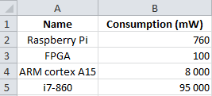





Pimca
Excel
Hypothetical system A
Hypothetical system B
Hypothetical system C
Hypothetical system D
FPGA
Raspberry Pi
FPGA
Raspberry Pi
Bus
Bus
Bus
Bus
I7
I7
ARM
ARM
Ethernet
Ethernet
Ethernet
Ethernet
1 : Creation of role model
1
1
Role4All
2 : Consolidating models and
code generation
for the evaluation tool
2
4: Update the role model
according the selected
hypotheses
Morphose
4
3: Highlighted of the unselected
hypotheses
3
Hypothetical system A
Hypothetical system B
Hypothetical system C
Hypothetical system D
FPGA
Raspberry Pi
FPGA
Raspberry Pi
Bus
Bus
Bus
Bus
I7
I7
ARM
ARM
Ethernet
Ethernet
Ethernet
Ethernet

