Slide 1



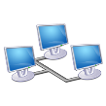
Hypothetical system
Platform
Bus
Processor
Ethernet

