Slide 1



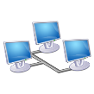
Hypothetical system
FPGA
Bus
ARM or I7
Ethernet

