Slide 1
Pimca
Excel
PimcaMachinery
ExcelCell
Class
RoleFPGA
Role-Type relation
Role4All

Slide 2
PimcaMachinery
Player
0..1 player
ExcelCell
DynamicAdapterFPGA_Pimca
* roles
adapter
0..1
PlayRelation
DynamicAdapter
0..1 playRelation
DynamicAdapterFPGA_Pimca
Class
0..1 role
Generalization
Role
RoleFPGA
Association
Binary Association

Slide 3
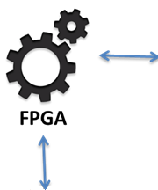
Pimca
Excel
RoleFPGA
Class
Role4All
Instance
Play relation

Slide 4
Pimca
Excel
roleFPGA1
roleFPGA2
roleFPGA1
0..1 player
0..1 player
* roles
* roles
roleContained1
roleContained2
* containedRoles
* containedRoles
containerRoles *
* containerRoles
RoleFPGA

