Slide 1
elementOfTool1
elementOfTool2
0..1 player
0..1 player
* roles
* roles
roleContained1
roleContained2
* containedRoles
* containedRoles
containerRoles *
* containerRoles
roleContainer

Slide 2
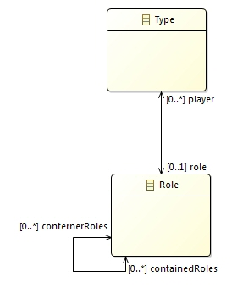
elementOfTool1
elementOfTool2
roleContained1
roleContained2
roleContainer
: intanced

Slide 3
Type
elementOfTool1
elementOfTool2
0..1 player
roleElement1
roleElement2
* roles
containerRoles
Role
*
* containedRoles
roleElement
: Instance of
: Class
: Instance

Slide 4
Classes
Instances
Type
elementOfTool1
elementOfTool2
0..1 player
roleElement1
roleElement2
* roles
containerRoles
Role
*
* containedRoles
roleElement
: Instance of

