Slide 1



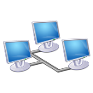
Hypothetical system
FPGA or Raspberry Pi
Bus
ARM or I7
Ethernet

