Slide 1
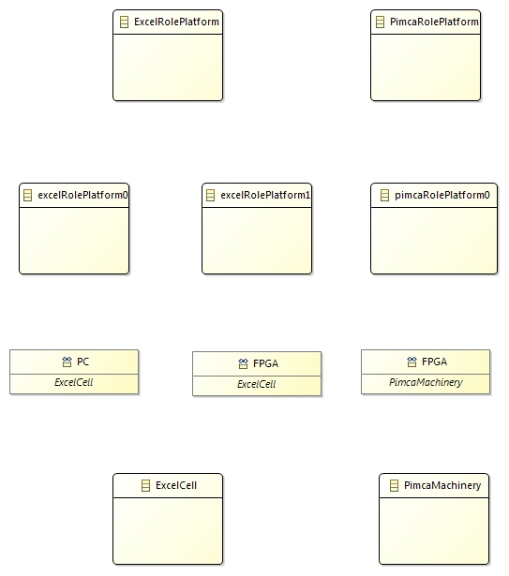
: Instance of
: “play” relation

