Slide 1



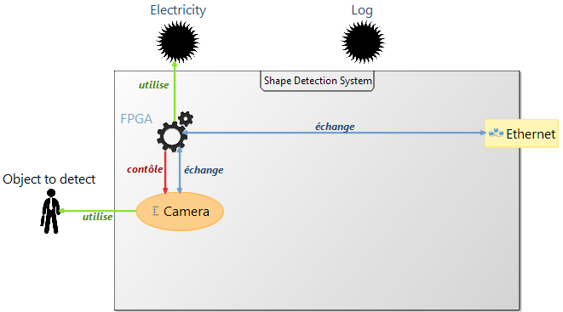
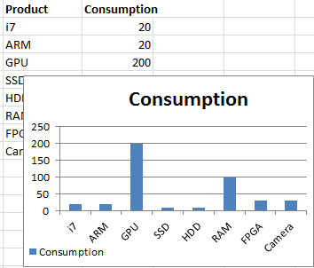
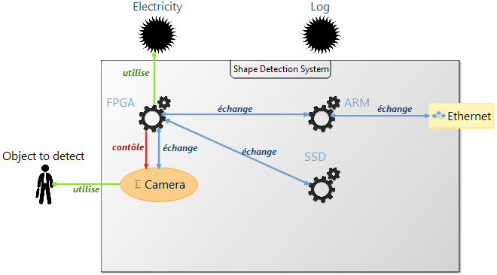
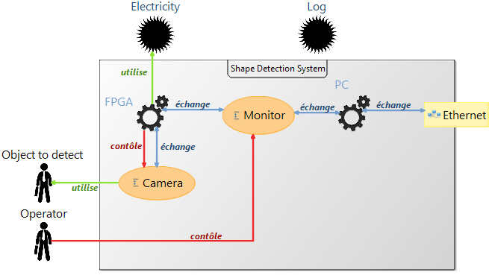


Toolkit Dedicated to System Discovery
Bastien DROUOT, Vincent LEILDE , Jean-Philippe SCHNEIDER, Jean-Christophe LE LANN, Joël CHAMPEAU
Lab-STICC UMR CNRS 6285 ENSTA Bretagne contact: joel.champeau@ensta-bretagne.fr
Partially observable real system
Various sources of information about the real system
Working hypothesis hardly modeled and simulated
Issues
Benefits
Recreate the real system (Morphose)
Creation of hypothetic system based on model federation (Role4All)
System modeling (Pimca) and discovery (Morphose) through iterative validation of assumptions
System Modeling
System modeling with Pimca DSL
Various tool with heterogeneous data (Datasheet, Nmap, log files…)
?
Incomplet model
Not modeled information
Relation between model elements and data
Iterative federation of model elements according to observations
Create hypothetic models
Role4All
Model consolidation
Hypothetic model 1
Hypothetic model 2
System simulations
Morphose
Simulate the hypothetic models
Compare real data and simulated data
Select the hypothetical models consistent with the real data
Hypothetic model validated
Hypothetic model reject

