Slide 1
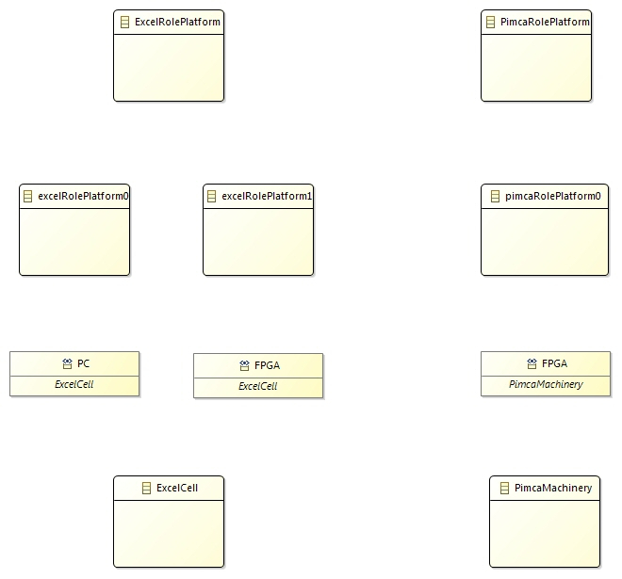
: Instance of
[0..*] containedRoles
[0..*] containedRoles
[0..*]roles
[0..*]roles
[0..*]roles

