Slide 1
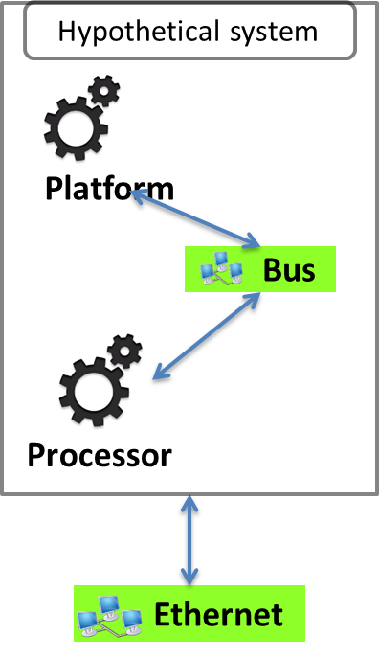
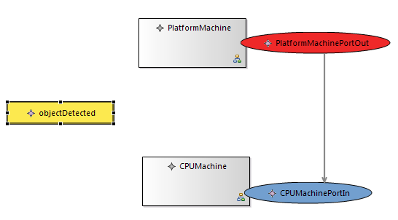
PimCa model
Graffiti model system layer
: Analigie between PimCa Machinery and Graffiti Actor

