Slide 1
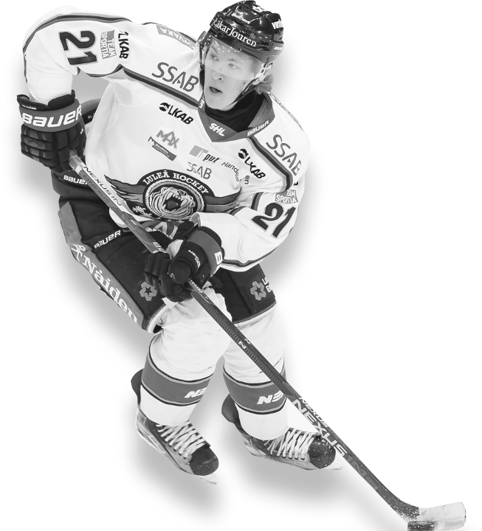
Sports Analytics NHL-3.0
Presenter Names:
Ravina Kolsawala
Gosaye White
Ghislain Nyirumuheto
Joel Demontigny
Date: September 28, 2023
© Copyright Showeet.com
Notes:
© Copyright Showeet.com – Free PowerPoint Templates

Slide 2
Agenda:
- Introduction, Challenge, Future Iteration
- Visualizations
- Machine Learning Models Overview
© Copyright Showeet.com
Notes:
© Copyright Showeet.com – Free PowerPoint Templates

Slide 3

Introduction to our project:
For this project version, we are focused on creating an effective Machine Learning Model to predict a team’s odds of winning the Stanley cup! The model will leverage team Key Performance Indicators (KPI) over the last 31 seasons. This includes but not limited to ‘Goals For’, ‘Goals Against’, ‘Wins’, ‘Losses’, ‘Shots Taken’, ‘Shots Allowed’, etc.
Challenge: Imbalanced Data. The dataset is heavily skewed towards losing teams (823) vs winning teams (31)
Future iterations: Leverage additional KPIs such as player statistics, geographic location, etc. to enhance the user experience and additional value points.
(The NHL and the NHL Shield are registered trademarks of the National Hockey League. NHL and NHL team marks are the property of the NHL and its teams. © NHL 2023. All Rights Reserved.)
Notes:
© Copyright Showeet.com – Free PowerPoint Templates

Slide 4
Team Stats –Tableau Visualization
© Copyright Showeet.com
Notes:
© Copyright Showeet.com – Free PowerPoint Templates

Slide 5
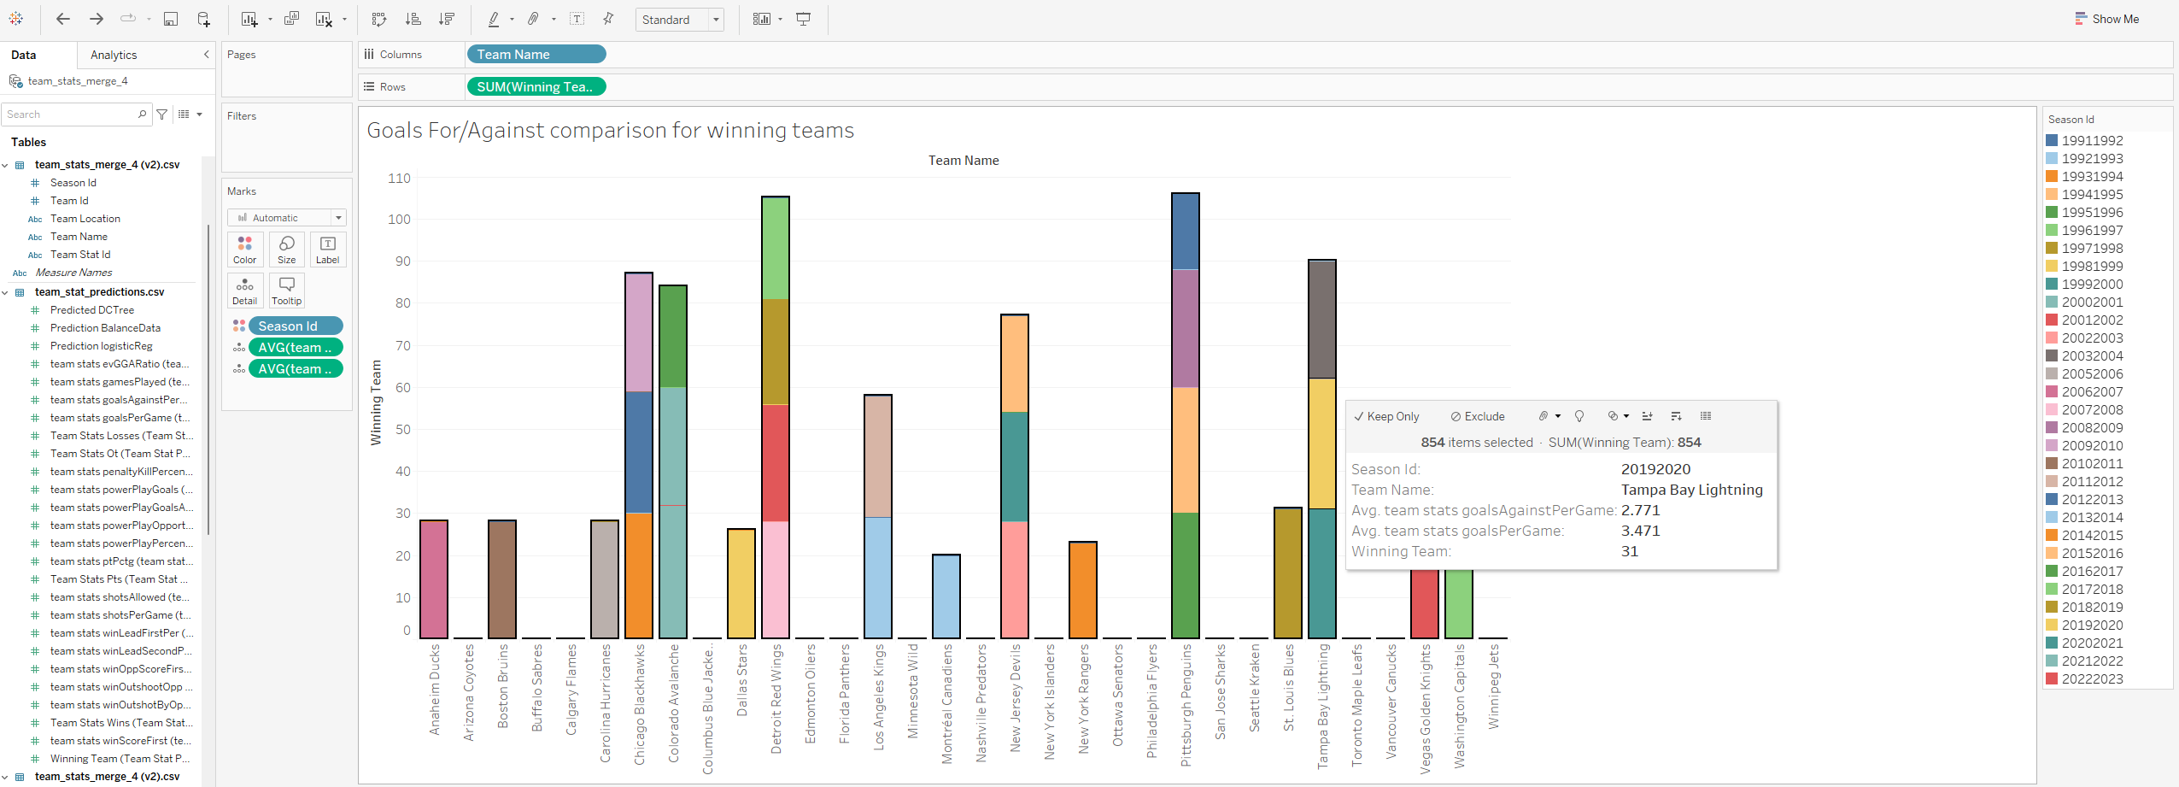

Slide 6
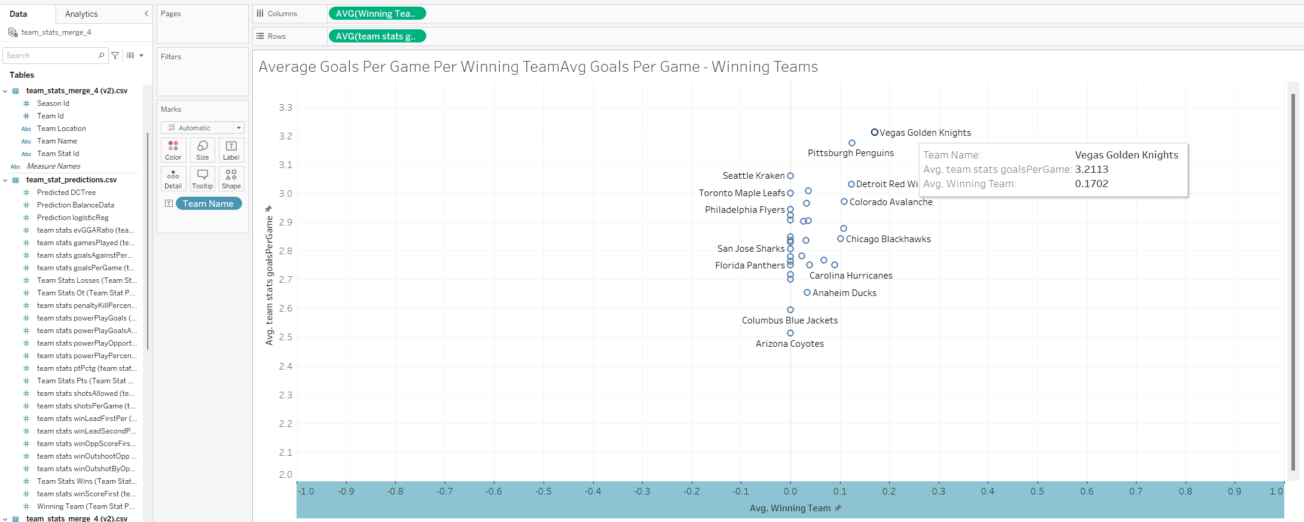

Slide 7
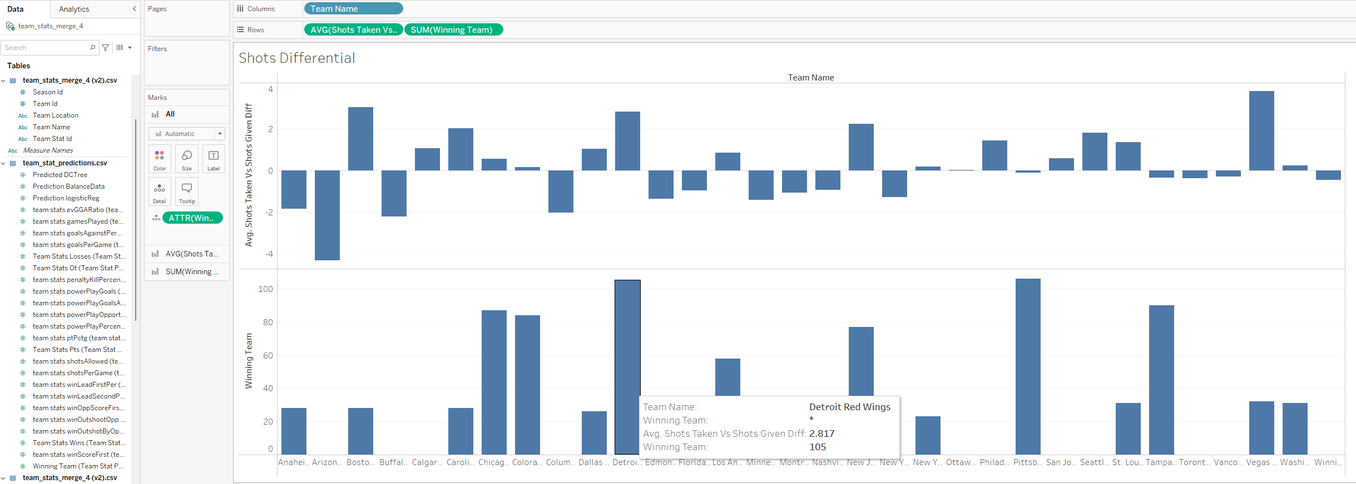

Slide 8
Machine Learning Models Overview
© Copyright Showeet.com
Notes:
© Copyright Showeet.com – Free PowerPoint Templates

Slide 9

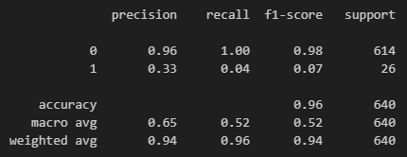
Logistic Regression – Supervised – Original imbalanced data
Confusion matrix with test data:
Report:
Notes:
© Copyright Showeet.com – Free PowerPoint Templates

Slide 10

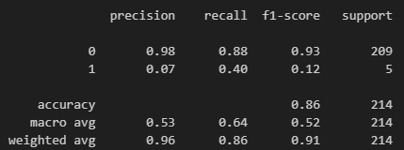
Logistic Regression – Supervised – Random Over Sampler to balance the data
Confusion matrix with test data:
Report:
Notes:
© Copyright Showeet.com – Free PowerPoint Templates

Slide 11

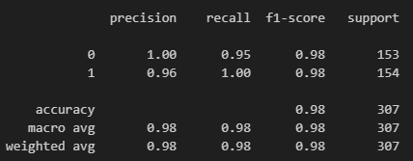
Decision Tree Classifier – Supervised – Random Over Sampler to balance data
Confusion matrix with test data:
Report:
Notes:
© Copyright Showeet.com – Free PowerPoint Templates

Slide 12

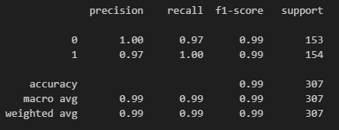
Decision Tree Classifier – Supervised – Random Over Sampler balance data with class weight
This is our optimized model
Confusion matrix with test data:
Report:
Notes:
© Copyright Showeet.com – Free PowerPoint Templates

Slide 13

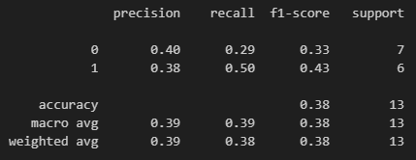
Decision Tree Classifier – Supervised – Under sampling with class weight
Confusion matrix with test data:
Report:
Notes:
© Copyright Showeet.com – Free PowerPoint Templates

Slide 14

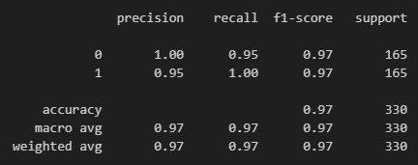
Decision Tree Classifier – Supervised – Over sampling with class weight
Confusion matrix with test data:
Report:
Notes:
© Copyright Showeet.com – Free PowerPoint Templates

Slide 15

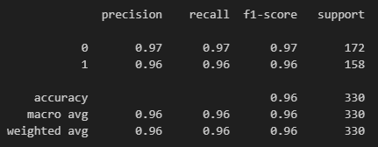
Decision Tree Classifier – Supervised – Synthetic Minority Over-Sampling Technique (SMOTE) with class weight
Confusion matrix with test data:
Report:
Notes:
© Copyright Showeet.com – Free PowerPoint Templates

Slide 16
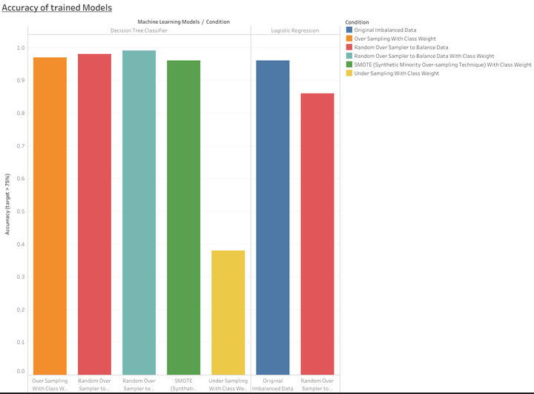
Model accuracy via Tableau:

Slide 17
