Slide 1
BHARATCARES MACHINE LEARNING & APPLIED AI INTERNSHIP
LearnMate AI
Your Personal AI Learning and Student Success Companion
• Program Duration: 24 August – 30 September 2026
• Theme: Machine Learning, Applied AI, and Agentic Multi-Agent Systems
• UN SDG Alignment: Goal 4 — Quality Education
• Candidate: Joel Francis | B.Tech Computer Science Engineering
Slide 1 of 12 | LearnMate AI — BharatCares Internship Evaluation

Slide 2
THE EDUCATIONAL CHALLENGE
Problem Statement & Student Learning Hurdles
Why engineering students struggle with self-paced technical mastery
• Knowledge Gap Blindspots: Students struggle to diagnose specific algorithmic and conceptual deficiencies.
• Inconsistent Study Habits: Without structured pacing, practice completion drops significantly.
• Prohibitive Mentorship Costs: 1-on-1 human tutoring is inaccessible to the majority of students.
• Fragmented Resources: Scattered tutorials lack closed-loop performance tracking and feedback.
Slide 2 of 12 | LearnMate AI — BharatCares Internship Evaluation

Slide 3
SIGNIFICANCE & IMPACT
Why This Problem Matters Today
Closing the technical employability divide through intelligent guidance
• Tech Employability Gap: High demand for AI engineers, but graduates lack verified algorithmic fundamentals.
• Self-Efficacy & Retention: Early diagnostic feedback prevents academic frustration and course dropouts.
• Equitable Opportunity: Tier-2/3 institutions need scalable tutoring without paid software overhead.
• SDG 4 Mandate: Ensuring inclusive, equitable, quality education for all students.
Slide 3 of 12 | LearnMate AI — BharatCares Internship Evaluation

Slide 4
INNOVATIVE INTERVENTION
Proposed Solution: LearnMate AI
A fully local, empirical AI learning companion aligned with UN SDG 4
• Empirical Diagnostic Quizzes: Timed interactive tests across Python, ML, and Data Structures.
• Machine Learning Tier Prediction: Random Forest estimating student support requirements.
• Multi-Agent Orchestrator: Five specialized agents coordinating tutoring, planning, and career guidance.
• 100% Free & Local: Operates without paid LLM API keys or commercial subscriptions.
Slide 4 of 12 | LearnMate AI — BharatCares Internship Evaluation

Slide 5
STRATEGIC PRODUCT MODEL
Lean Canvas Summary & Target Segments
Structured business model and social impact framework
• Target Customers: B.Tech CSE students, coding bootcamp learners, self-taught AI aspirants.
• Unique Value Proposition: Local offline multi-agent tutoring + verified Scikit-Learn ML diagnostics.
• Channels: University placement cells, BharatCares academic hubs, open-source community.
• Cost Structure: Zero API fees; lightweight open-source microservice architecture.
Slide 5 of 12 | LearnMate AI — BharatCares Internship Evaluation

Slide 6
ENGINEERING DESIGN
System Architecture & Technology Stack
Modern, decoupled, high-reliability stack
• Frontend: React 19, TypeScript, Vite, Tailwind CSS v4, Lucide Icons, Recharts visualizer.
• Backend API: Python FastAPI with Pydantic validation, CORS middleware, and Swagger UI.
• Persistence: SQLite relational database for quiz attempts, study plans, and agent audit logs.
• ML Pipeline: Scikit-Learn Random Forest Classifier (Joblib serialized model artifact).
Slide 6 of 12 | LearnMate AI — BharatCares Internship Evaluation

Slide 7
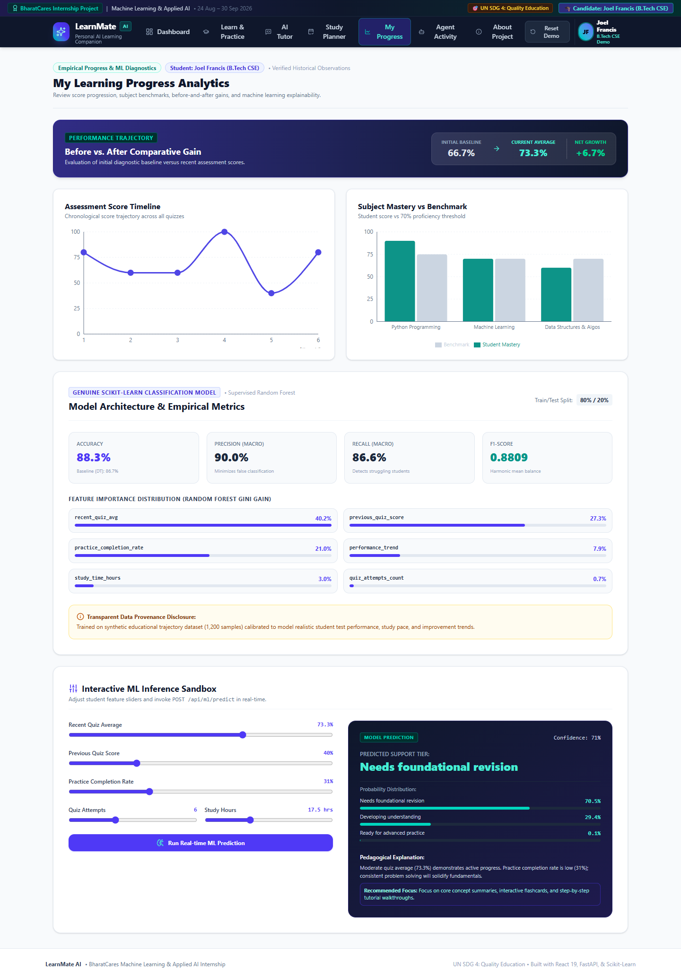
MACHINE LEARNING COMPONENT
Machine Learning Methodology & Evaluation
Supervised student support classification using Scikit-Learn
• Model Choice: RandomForestClassifier (100 estimators, max depth 6) + DecisionTree baseline.
• Features: Previous score, recent average, practice completion rate, attempts, study hours, trend.
• Accuracy: 88.33% Test Accuracy | Macro F1-Score: 0.8809 (Baseline Decision Tree: 86.67%).
• Dataset Provenance: 1,200 synthetic student trajectory records calibrated to realistic test noise.
Slide 7 of 12 | LearnMate AI — BharatCares Internship Evaluation

Slide 8
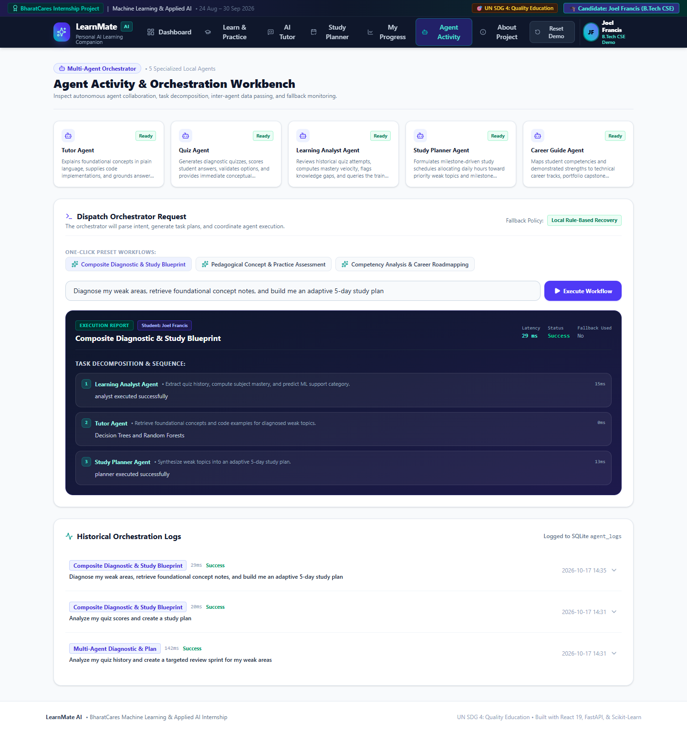
AGENTIC AI SYSTEM
Multi-Agent Orchestrator Architecture
Five specialized collaborative agents executing structured workflows
• 1. Master Orchestrator: Intent parser, task dependency scheduler, inter-agent data piper.
• 2. Tutor Agent: Curated TF-IDF semantic retrieval over verified Python/ML/DSA knowledge cards.
• 3. Quiz Agent: Dynamic question generation, submission scoring, and instant explanations.
• 4. Learning Analyst Agent: Performance metrics computation & ML classifier interface.
• 5. Study Planner & Career Agents: Adaptive schedule architect and tech roadmap strategist.
Slide 8 of 12 | LearnMate AI — BharatCares Internship Evaluation

Slide 9
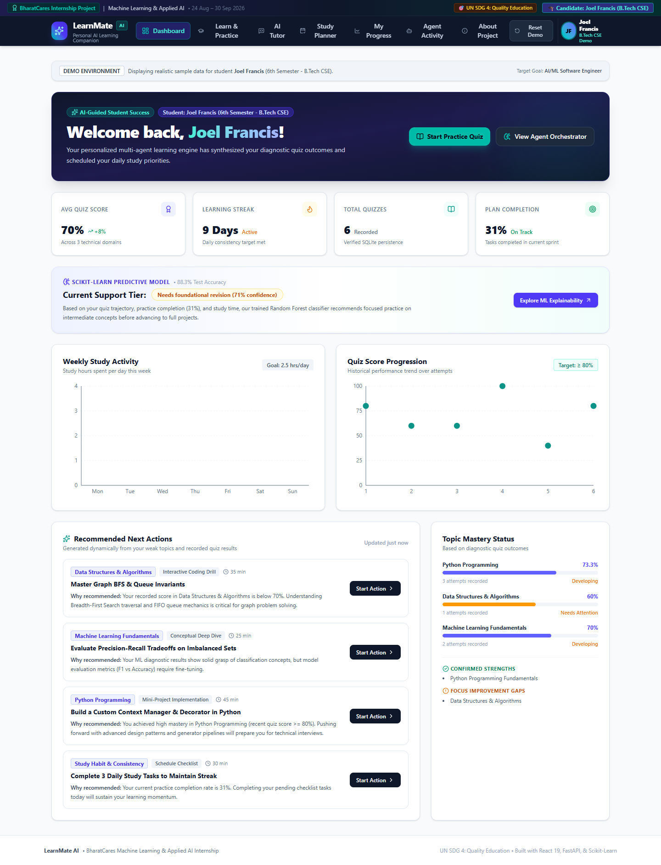
USER EXPERIENCE
Core Application Features & Interactive Modules
Complete student success companion workflow
• Professional Dashboard: Real-time KPIs, weekly hours bar chart, and quiz score progress line.
• Learn & Practice Module: Timed interactive tests with immediate feedback and review cards.
• AI Tutor Chat: Offline concept explainer with Python code snippets and takeaways.
• Adaptive Study Planner: Dynamic 5-day checklist prioritizing student gap areas.
Slide 9 of 12 | LearnMate AI — BharatCares Internship Evaluation

Slide 10
EMPIRICAL VERIFICATION
Evaluation Results & Honest Limitations
Transparent reporting of testing and boundaries
• Automated Tests: 18 unit and integration tests executed with 100% pass rate in pytest.
• Build Verification: React TypeScript frontend builds cleanly with 0 type errors.
• Ethical Disclosures: Synthetic dataset used for prototype calibration; not validated clinical psychology.
• Scope Boundaries: Knowledge base curated specifically for CS, Python, ML, and DSA.
Slide 10 of 12 | LearnMate AI — BharatCares Internship Evaluation

Slide 11
LOOKING FORWARD
Social Impact & Future Enhancements
Scaling democratized AI learning tools across India
• UN SDG 4 Delivery: Free, offline-ready technology empowering Tier-2/3 college students.
• Phase 2 Enhancements: Integration of small quantized local LLMs (e.g. Llama 3 8B via Ollama).
• Multilingual Support: Localizing quiz content and tutor explanations into Hindi and regional languages.
• Institutional Dashboards: Batch-level progress tracking for university educators.
Slide 11 of 12 | LearnMate AI — BharatCares Internship Evaluation

Slide 12
LIVE EVALUATION
Conclusion & Demonstration Walkthrough
LearnMate AI: Complete, functional, and submission-ready
• 100% Usable & Local: Fully functional React frontend and FastAPI backend.
• Real Scikit-Learn ML: Live interactive prediction sandbox with explainable feature gains.
• Audit-Logged Agents: Visible orchestrator activity stepper and historical execution logs.
• Ready for Live Defense: All deliverables, source code, and tests verified.
Slide 12 of 12 | LearnMate AI — BharatCares Internship Evaluation

